Slide 1
Network Services
Group 2

Slide 2
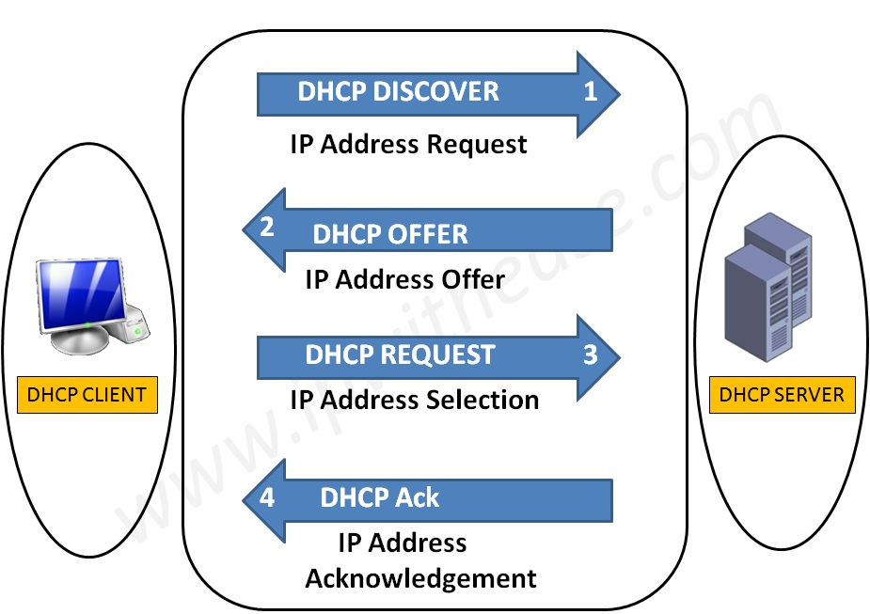
What is DHCP?
Logical Address
Used to dynamically assign an IP address to any node
DHCP Allocation Mechanism:
Manual allocation
Automatic allocation
Dynamic allocation
ARP
Physical Address
Logical Address
RARP
Physical Address

Slide 3
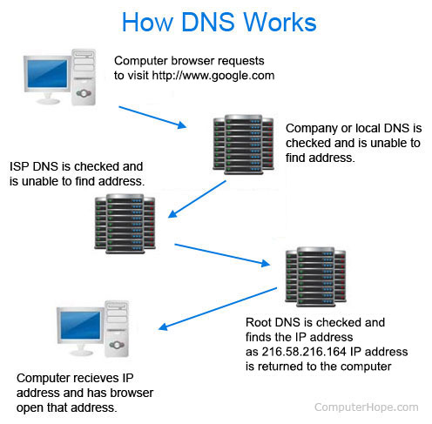
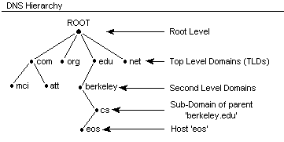

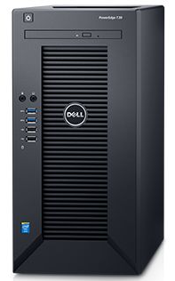

DNS
It converts a computer's host name into an IP address on the Internet.
What is ip of xyz.com
Here is 156.x.x.x
DNS CACHE
OS cache

Slide 4
LDAP (Lightweight Directory Access Protocol)

Slide 5





Mail Services
Mail Delivery Agent (MTA)
SMTP
SMTP
SMTP
Internet/Intranet
Mail Transfer Agent (MTA)
Mail Transfer Agent (MTA)
Pop / IMAP
Master User Agent (MUA)
Master User Agent (MUA)

Slide 6
Proxy Server
Acts as an intermediary between the user's computer and the Internet

Slide 7
What is Web Service?

