Slide 1
APPLICATION
Group 2

Slide 2
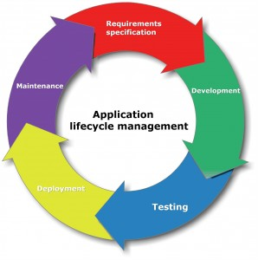
Introduction
Application is a program designed to perform a group of coordinated functions, tasks, or activities for the benefit of the user
Components of Application
Life Cycle of Application
Presentation Layer
Presentation Logic
Business Processing Layer
Business Logic
Data Storage and Access
Data Persistence

Slide 3
Application
Application Types
API :
An application program interface (API) is code that allows two software programs to communicate with each other.
Compiled
Interpreted
REQUEST
Types of attacks:
SQL Injection
Cross site scripting
Denial of Service
Buffer Overflows
Session Hijacking
LARGE CORPORATE SITE/SYSTEM
SMARTPHONE APP OR WEBSITE
API
RESPONSE

Slide 4
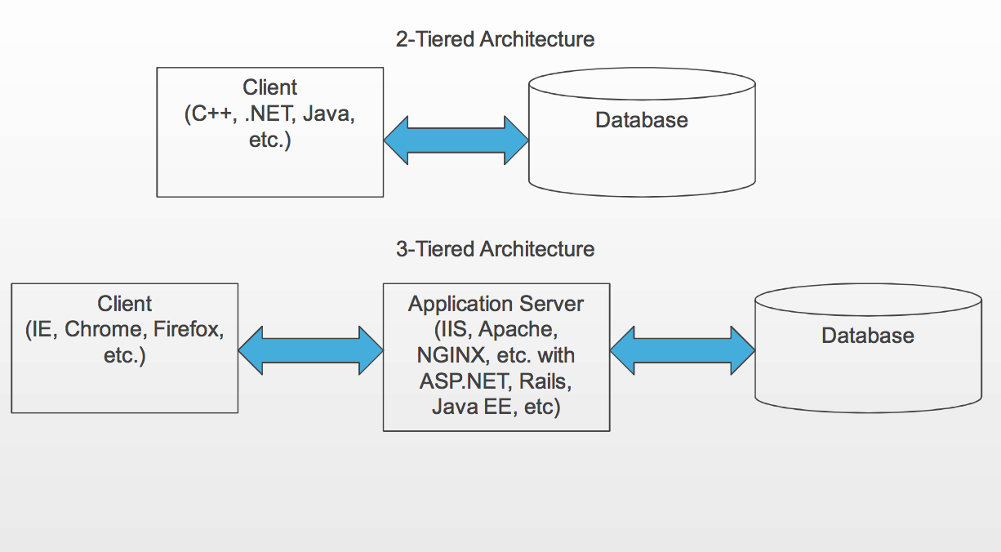
Application
Architecture Types
Thick Client Architecture
Thin Client Architecture
Rich Internet Architecture

