Slide 1

By (Team 8) - Gauravi Chaudhari
Ajinkya Kunjir
Priyal Shrotriya

Slide 2
Introduction
World’s largest home improvement retailer in the United States
The Home Depot is ranked #21 on FORTUNE’s MOST ADMIRED list
Typical products that customers see on the shelves are tools, equipment, and supplies for decorating, small building jobs, plumbing and gardening

Slide 3
Goal
To suggest promotional offers and campaigns for a new product by analyzing the trends and insights of the existing promotions of the retail store.

Slide 4
Platform - AWS
Amazon S3 bucket - To store csv files
Amazon Redshift database - Target database for integrating data to display on BI tool
Tableau- To create dashboards for displaying the trends and insights of the data

Slide 5
Dataset
Entity : Contains the four major entity types of various products
Product Category : Contains the various categories of products
Product SubCategory : Contains the sub categories
Product: Contains the various products of our retail store
Customer: Has the existing customers information
SalesOrderDetails : Contains the products sold with its associated costs
SalesOrderHeader : Contains the shipping and billing information of the products sold
Promotions : Contains the discount,type and promotions offered by the retail store company
Marketing_ways : Contains digital marketing types and their timeframe

Slide 6
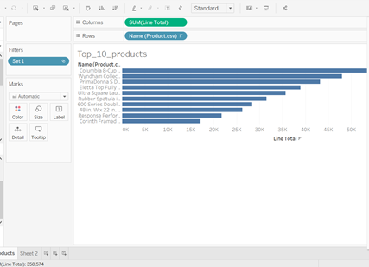
Part I
Analysis - Bar Chart

Slide 7
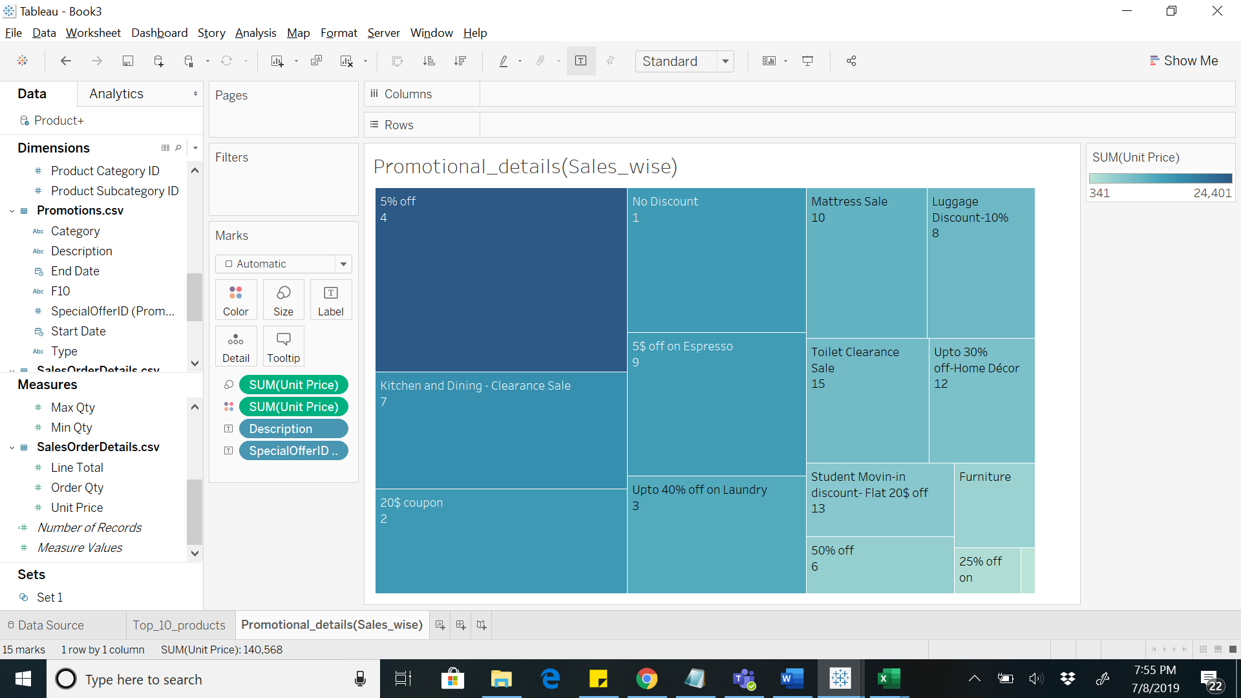
Analysis - HeatMap

Slide 8
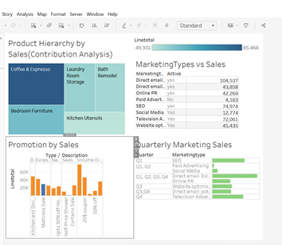
Marketing Analysis
Based on the effective marketing ways in the respective quarters gives us the analysis of which marketing ways we can move forward for our new product.

Slide 9
Part - II
Spotify Dataset
Analyzed the Spotify(Team9) data based on profit and leads associated with various campaigns lead by Spotify as follows:
Profit made by various types of subscriptions.
Profit made by each campaign in a state.
Leads by campaign type.
Profit gained by each subscription.

Slide 10
Instructions
If you want to access our dataset, we share the following things you to access our data:
1. Host Name: info7374clusterassignment1.cf3cwiqaf3ud.us-east-1.redshift.amazonaws.com
2. Port Number:5439
3. Database Name: info7374dbassignment1
4. Table Names: Entity,ProductCategory,ProductSubCategory,Product,Promotions,Customers,SalesOrderDetails,SalesOrderHeader
5. UserName: pramod
6. Password: Pramod@123

