Slide 1
PROJECT ANSHUMAN
AI-Based Noise Signal for Hidden Undetectable Military Audio/Message Networks
GAN-Based LPI Waveform Generation with OTA SDR Validation
Maj Ambuj Sharma (Roll No: 2502193004)
M.Tech AI-ML (CFDST)
MCTE Guide: Asst Prof (Dr.) Gaurav Sharma
IIT Guide: Asst Prof (Dr.) Sumit Gautam

Slide 2
INDEX
Literature Survey
Research gaps, prior work & ANSHUMAN novelty statement
Problem Definition
EW threat landscape, aim & scope of work
Milestones & Deliverables
Miscillaneous
Academic & military outputs with key parameters
Military Applications, Limitations & Future Work
Proposed Timeline
Conclusion
Completed phases + future roadmap
Current Status
Completed phases + future roadmap, Core Tradeoff
Paper Publication Details

Slide 3
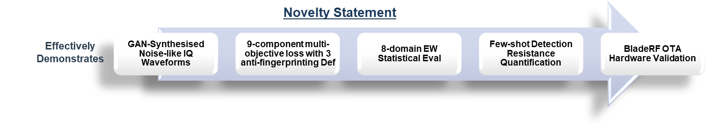
LITERATURE SURVEY — RESEARCH GAPS & PRIOR WORK
Existing LPI Techniques & Gaps
🔍 Identified Research Gap
DSSS / FHSS
Detectable via Cyclostationary analysis — spreading codes are periodic & predictable
UWB
Ultra-wide bandwidth required; timing pulse structures still expose statistical fingerprints
Autoencoder AE [Dorner'18]
SDR-validated but does NOT target noise-indistinguishability — Optimizes BER only
AE+Interference Filter [Erpek]
36 dB jamming resistance; simulation only; no stealth metric defined
GAN covert [Li'25]
Theoretical power Optimization; NO OTA hardware validation
NRPCS [Wang'25]
Phase Randomization; simulation-only; no adversarial CNN training
NO PRIOR WORK SIMULTANEOUSLY DEMONSTRATES:
Gan-based Noise-level Waveform Synthesis
Multi-domain EW Statistical Resistance
SDR Hardware Over-the-air Validation
Few-shot Adversarial Detection Analysis
Three Pillars Of Prior Work That ANSHUMAN Builds Upon And Extends
End-to-End Deep Learning
Conditional GAN (C-GAN)
Covert AWGN Limits (√n Law)
O'Shea & Hoydis, 2017
Mirza & Osindero, 2014
Bash et al., 2013
Proved that a neural network can jointly optimise transmitter and receiver (autoencoder). This gave ANSHUMAN its E2E framework — GAN generator as TX, neural decoder as RX.
C-GAN conditions the generator on a class label. ANSHUMAN uses message bits as conditioning input — each generated waveform encodes a specific, encrypted bit pattern.
Information theory proves covert capacity scales as √n of channel uses. This provides the theoretical upper ceiling that ANSHUMAN's statistical stealth must operate below.
Framework
Core Architecture
Theoretical Bound

Slide 4
PROBLEM DEFINITION — THE EW THREAT LANDSCAPE
Encryption Alone Is Insufficient For Covert Military Communication
1
Signal
Detection
2
Direction
Finding (DF)
3
Traffic
Analysis
4
AI-Based
Classification
5
Jam /
Intercept
▶
▶
▶
▶
RF energy above noise floor
Triangulate source location
Pattern + timing exploitation
CNN identifies waveform type
Targeted denial or interception
⚠ Even AES-encrypted signals are DETECTABLE — the ciphertext pattern is still statistically non-Gaussian. Encryption secures CONTENT, not EXISTENCE.
Carries AES-encrypted Information
Is Statistically Indistinguishable From AWGN
Resists Ml-based RF Detectors
Achieves Zero BER Under Realistic RF Impairments
Validates On Real SDR Hardware
RESEARCH PROBLEM:
Design a communication waveform that simultaneously:
Proj Anshuman Findings
100%
58.2%
-5 dB
8
BPSK detected
with 10 samples
ANSHUMAN
detection (target < 60%)
Operating SNR
(below noise floor)
EW Detection
Domains evaluated
PROJECT ANSHUMAN | Maj Ambuj Sharma (2502193004) | M.Tech AI-ML, CFDST

Slide 5
PROBLEM DEFINITION — AIM & SCOPE OF WORK
AIM
Develop A Deployable AI-driven LPI Waveform Generation System Enabling Encrypted Audio/Message Transmission Over SDRs — Indistinguishable From Noise — For Covert Operations
SCOPE
Noise Modelling
Train GAN models to replicate AWGN / Coloured noise statistically
Encrypted Embedding
AES-128-CTR + Reed-Solomon ECC for secure, error-resilient payload
Detection Avoidance
Adversarial training with 9-component loss; < 60% CNN detection
SDR Export & Framing
Complex64 IQ files compatible with BladeRF + GNU Radio Companion
E2E Comms Pipeline
Full TX → Channel → RX loopback with OTA hardware validation
Robust Communication
Zero BER from –10 to +10 dB SNR under 5 simultaneous RF impairments
Adversarial Testing
8-domain EW evaluation + few-shot resistance across n = 10 to 2000
Project Objective
Statistically similar to noise.
Conflicting Requirements
Reliable payload transmission
Minimal detectability
Designing signals that carry information while remaining
Key Challenge
Generate noise-like communication waveforms using deep learning.
Preserve encrypted payload recoverability.
Reduce detectability against statistical and ML-based detectors
ANSHUMAN = Noise Modelling + Adversarial Training + Statistical Verification + Hardware Validation — Four pillars, one deployable system

Slide 6
MILESTONES & DELIVERABLES — MILITARY & ACADEMIC
MILITARY DELIVERABLES
ACADEMIC DELIVERABLES
IETE Journal Paper
Working Python Codebase
Evaluation Reports
GNU Radio Flowgraph
LPI Waveform Engine
Secure Payload Transmission
RF-Robust Framework
ML-Resistant Signal
EW Evaluation Framework
SDR Hardware Validation
Anti-Fingerprinting Defences
Prototype Covert Comn Sys
GAN-generated noise-like IQ waveform
AES-128-CTR + Reed-Solomon ECC
18-char message → 336-bit frame
5 simultaneous channel impairments
CNN detection: 58.2% ≈ random guessing
Adversarial D1 accuracy: 49–50%
8-domain detection test suite
BladeRF Micro 2.0 · 915 MHz · 2 MSPS
3 active Defences:
Dither · Diversity · D2

Slide 7
ACHIEVED/PROPOSED TIMELINE — IMPLEMENTATION PHASES
Core system validated on BladeRF hardware · Enhancements in progress through Jun 2026 · Further scope identified
Phase 1
Phase 2
Phase 3
Phase 4
Phase 5
Phase 6
Months 1–2
▶
Months 3–4
▶
Months 5–6
▶
Months 7–8
▶
Months 9–12
▶
Months 13–18 (→ Jun)
COMPLETE
COMPLETE
COMPLETE
COMPLETE
IN PROGRESS
PLANNED
Foundation & Literature
Training & Optimisation
EW Evaluation
SDR Validation
Detection Hardening
Payload & Voice
✓ Literature survey & gap analysis
✓ C-GAN training — 500 epochs
✓ 8-domain EW statistical tests
✓ GNU Radio Companion GRC
» Reduce CNN accuracy → 50–55%
○ Extended multi-frame payload
✓ C-GAN architecture design
✓ 9-component loss function
✓ Independent CNN detector (n=3200)
✓ BladeRF OTA — 26,007 frames
» Expand adversarial ensemble (5+)
○ Voice codec (µ-law) integration
✓ AES-CTR + Reed-Solomon pipeline
✓ Anti-fingerprinting (3 defences)
✓ Few-shot analysis (n=10→2000)
✓ BER = 0.0000 hardware proven
» Adaptive real-time loss weighting
○ Temporal anti-fingerprint layer
✓ Python env (Google Colab)
✓ BER converged to zero
✓ 6-family waveform benchmarking
✓ IETE paper v6 submitted
» 3rd-order HOS suppression layer
▶
Phases 1–4 Validated ✓
Phases 5–6 · Work in Progress → Jun 2026
Fixed Frame Arch
336-bit frame is structurally coupled to GAN input dimensions.
GAN Retraining Cycles
Anti-fingerprinting improvements need multiple full retraining cycles with different loss configs;
Voice Codec Integ
µ-law framing, multi-frame reassembly, and sequence-order across GAN frames requires a new Frame Protocol layer;
OTA Re-Validation
Any architectural change requires a fresh BladeRF over-the-air test cycle to confirm BER=0
Adversarial Ensemble Complexity
Adding 5+ discriminators increases GPU memory non-linearly.
Extending payload requires redesigning the C-GAN conditioning layer and full retraining
Each requires independent statistical validation.
Real-time throughput at 2 MSPS must be validated end-to-end.
Hyperparameter sensitivity grows with each discriminator; - Independent eval reqd

Slide 8
CURRENT STATUS — SYSTEM ARCHITECTURE & PIPELINE
T
X
1
Plaintext Message
1
R
X
ASCII text input
Received IQ Samples
▼
From BladeRF OTA or simulation
2
AES-128-CTR Encrypt
2
▼
NSA Suite B · fresh 128-bit nonce per session
Neural Decoder (CNN)
3
▼
Recovers bit posteriors from IQ
Reed-Solomon ECC
▼
8 parity symbols · 336-bit frame
3
Bit Recovery
▼
RF
Channel
Tanh → {0,1} via threshold
4
Bipolar Conversion
Bits {0,1} → {-1,+1}
4
▼
AWGN
Multipath
Phase/Freq
AGC
Reed-Solomon Decode
5
▼
Error correction applied
C-GAN Generator G
z~N(0,I64) + msg embed [96-D] → IQ [2×512]
5
▼
▼
AES-128-CTR Decrypt
6
LPI IQ Waveform
Authenticated decryption
2×512 complex samples · statistically Gaussian
6
▼
7
▼
Recovered Plaintext
SDR Export (complex64)
Exact message match verified
BladeRF · 915 MHz · 2 MSPS
Proof of Concept:
Conditional GAN waveform generation
Adversarial training against CNN signal detectors
Successful message embedding within noise-like signals
This confirms that AI can synthesize covert communication waveforms.
Lab Validation:
Adversarial detector testing
Waveforms eval using Eight EW detection tests, confirming noise-like statistical behavior.
Realistic RF channel modelling & Statistical stealth evaluation
PROJECT ANSHUMAN | Maj Ambuj Sharma (2502193004) | M.Tech AI-ML, CFDST

Slide 9
CURRENT STATUS — TRG & WAVEFORM GEN
Teaching The Generator To Make Waveforms That Are Statistically Indistinguishable From Noise
A Generator (G) creates IQ waveforms. A Discriminator (D) tries to distinguish them from real noise. G is trained to fool D — when D reaches ~50% accuracy (random guessing), the waveform is truly noise-like.
30% Gaussian noise added at training & inference, then renormalized. Prevents 'clean' fingerprinting.
Forces G to produce different waveforms for different inputs — prevents mode collapse to one recognisable 'safe' output subspace.
A second discriminator D2 is re-initialised every 25 epochs — forces G to generalise against detectors it has never seen before.
The Core Idea
Defence 1: Stochastic Dither
Defence 2: Diversity Regularisation
Defence 3: Refreshed Adversary (D2)
Loss Component | λ Weight | EW Domain | What It Enforces
Adversarial (D1) | 1.0 | ML Classification | Fools primary CNN detector — drives its accuracy to ~50% (random guess)
Adversarial D2 (Refreshed) | 0.5 | ML Classification | Fools a fresh re-initialised discriminator every 25 epochs — forces generalisation against unseen detectors
Mean Regularisation | 0.5 | Statistical / KS test | Keeps output zero-mean — matches real AWGN first-order statistics
Variance Regularisation | 0.5 | Statistical / Kurtosis | Keeps unit variance — matches AWGN second-order statistics
Power Constraint | 3.0 | Energy Detection | Enforces Signal Power ≤ 1.01× Noise Power — stays below energy detector threshold
Spectral Flatness | 3.0 | Spectral Entropy | Penalises any non-flat PSD — no frequency peaks or signatures visible on spectrum analyser
Cyclostationary Suppression | 2.5 | Cyclostationary SCF | Drives autocorrelation Rxx(τ) → 0 for all lags — eliminates periodic structure detectable by SCF analysis
Power Normalisation | 6.0 ★ | Energy / PAPR | HIGHEST WEIGHT — log² penalty: any deviation from P_signal = P_noise is severely punished. Most critical stealth constraint.
Diversity Regularisation | 3.0 | HOS / Fingerprinting | Maximises output variation across latent inputs — prevents mode collapse and output fingerprinting
RF Channel Modelling
▶ Additive White Gaussian Noise (AWGN)
▶ Carrier Frequency Offset (CFO)
▶ Phase Noise
▶ DC Offset
▶ IQ Imbalance

Slide 10
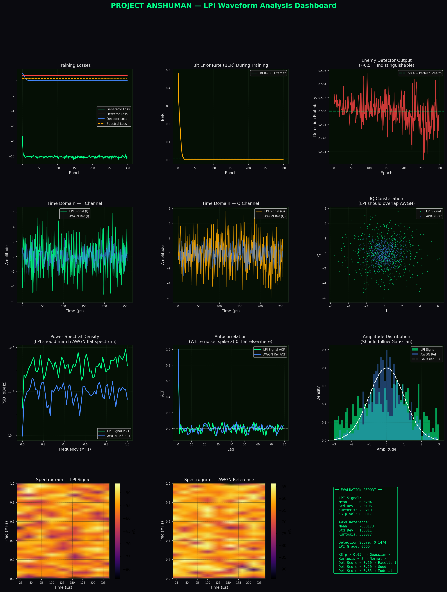
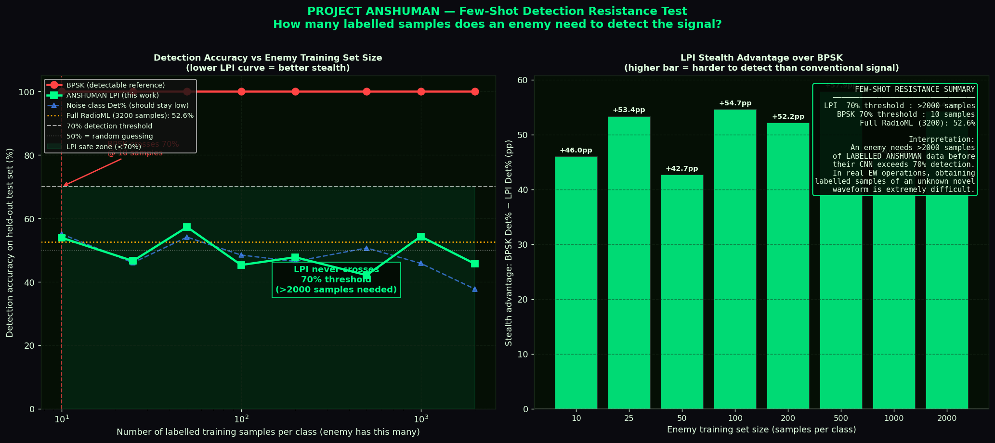
CURRENT STATUS — TRG & WAVEFORM GEN
Statistical dashboards confirming LPI properties and detection stealth
LPI Waveform Analysis Dashboard (v14)
Few-Shot Detection Resistance
KEY FINDINGS
✅ Detection Score 0.147 — GOOD grade
✅ Enemy CNN: 49.3–50.5% (random guess)
✅ Independent CNN: 58.2% (< 60% threshold)
✅ BPSK needs only 10 samples to detect
✅ ANSHUMAN needs > 2000 samples — still < 70%

Slide 11
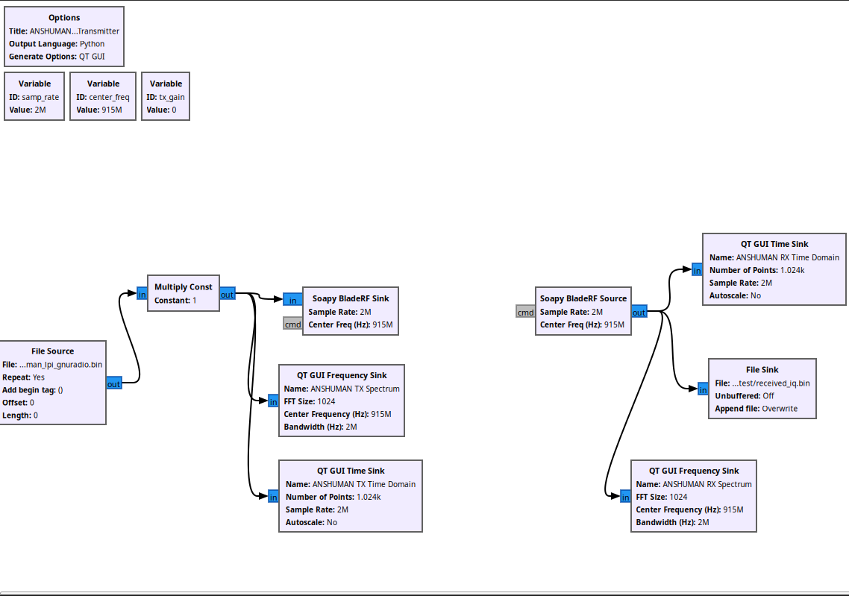
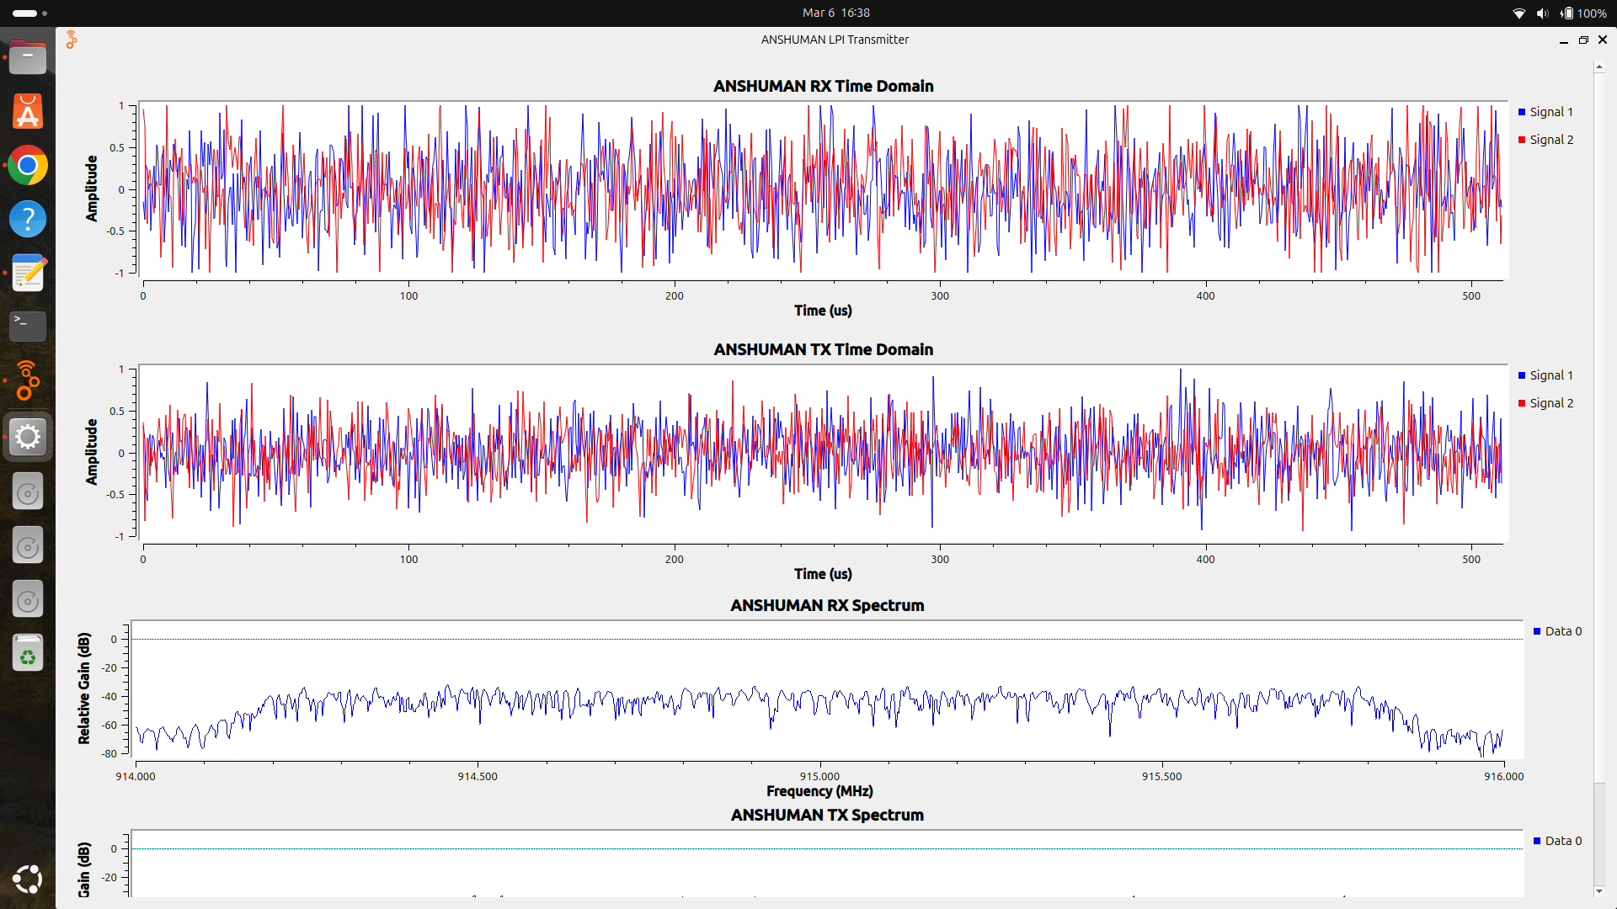
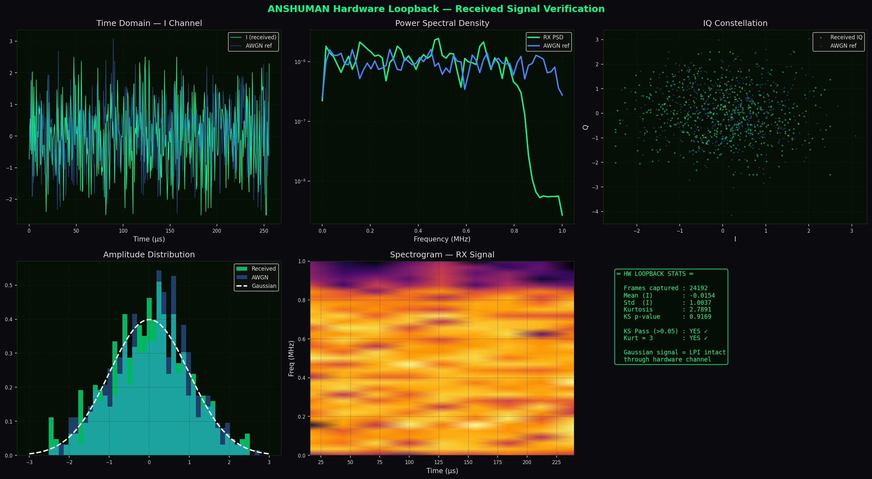
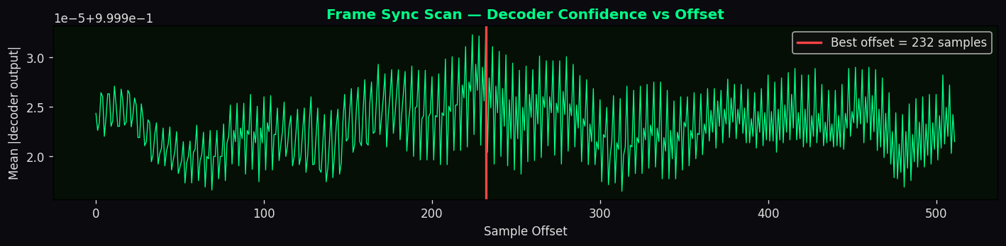
CURRENT STATUS — OTA TXN
GNU Radio Companion Flowgraph
Live GNU Radio Display — OTA Transmission
Frame Sync Scan
OTA Test Stats
Frames Captured:
24,192
Mean (I):
-0.0154
Std Dev (I):
1.0037
Kurtosis:
2.7891
KS p-value:
0.9169
KS Pass (>0.05):
YES ✓
Kurt ≈ 3:
YES ✓
Decode Result:
SUCCESS

Slide 12
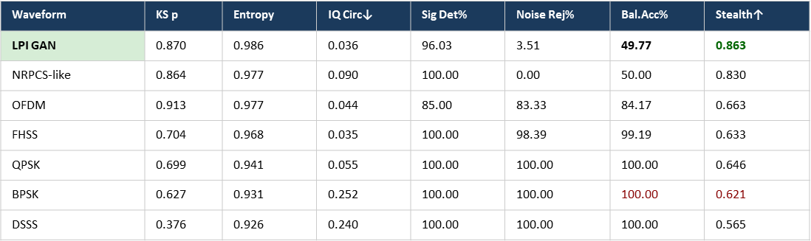
Stealth vs Reliability — The Core Tradeoff
STEALTH METRICS
RELIABILITY METRICS
LAYER 1 — General adversary (Binary Classifier- Signal or Noise) "A general binary (CNN) signal detector, benchmarked across 7 waveform families, achieves only 49.77% Balanced Accuracy on ANSHUMAN — equivalent to random guessing."
↓ But what if they specifically target us?
LAYER 2 — Specialist adversary (Detector B, 58.2%) "CNN trained exclusively on 3,200 captured ANSHUMAN frames achieves only 58.2% accuracy."
↓ But what if they collect even more samples?
LAYER 3 — Persistent adversary (Few-shot, n=2000) "At n=2000 samples ANSHUMAN detection reaches only 61%, still below the 70% threshold."
CNN Detection Accuracy
58.2%
Bit Error Rate (BER)
0.0000
vs 100% for BPSK — target < 60% ✓
Zero bit errors at ALL SNR test points
Internal Discriminator (D1)
49.7%
SNR Range Tested
−10→+10 dB
Random guessing throughout training ✓
21 test points, zero failures
Few-Shot (n=10)
58.0%
RF Impairments Applied
5 types
Enemy needs huge dataset to classify
AWGN + multipath + phase noise + freq offset + AGC
Stealth Advantage vs BPSK
+39–55 pp
OTA Frames Decoded
26,007
Waveform Stealth Score Comparison
Percentage-point gap in detection rate
BladeRF 915 MHz / 2 MSPS — exact match
LPI GAN
0.863
Operating SNR
−5 dB
Independent Test Runs
3
NRPCS-like
0.830
OFDM
0.663
Signal sits BELOW the noise floor
Reproducible across different training seeds
FHSS
0.633
KS p-value (OTA)
0.560
QPSK
0.646
BPSK
0.621
Gaussian shape preserved after hardware channel
DSSS
0.565
The Two Things the Detector Can Be Right About
Thing 1 — Catching a real transmission.
When ANSHUMAN is actually transmitting, does the detector notice? This is Signal Detection% — the percentage of transmissions the detector correctly catches.
Thing 2 — Correctly dismissing noise.
When there is only background noise (no transmission), does the detector correctly say "nothing here"? This is Noise Rejection% — the percentage of noise samples the detector correctly identifies as just noise.

Slide 13
Paper Publication Details
One Paper Accepted for GCON 2026 (IIT Guwahati) based on old Runs; Recent Findings to be incorporated into Journal (Elsevier)
"RF Robust Payload Invarient Noise Masked LPI Waveform Synthesis with Authenticated Encryption for SDR Links"
Status: Accepted for GCON 2026 (IIT Guwahati) | Domain: RF Comn / AI in Comn / Jun 03 - 05
"GAN-Based Noise-Masking for Low Probability of Intercept Waveform Generation with Over-the-Air SDR Validation"
Status: To be Submitted for Elsevier Journal (as per IIT Guide) | Domain: IoT / PhyCom / Vehicular Comn
Key Technical Contributions in Paper
① Multi-objective GAN (9 loss components) for adversarial stealth, spectral flatness, cyclostationary suppression & message fidelity
② Three anti-fingerprinting defences reducing CNN detection from 100% (v9) → 58.2% (v14)
③ Eight-domain EW evaluation: KS test, kurtosis, spectral entropy, IQ circularity, PAPR, energy detection, SCF, HOS
④ Few-shot detection resistance: LPI stays < 70% even at n = 2000 samples (BPSK hits 100% at n = 10)
⑤ OTA validation: BladeRF Micro 2.0 at 915 MHz / 2 MSPS — 26,007 frames decoded, zero BER

Slide 14
Miscellaneous — Military Applications
Covert communication, UAS coordination, and Counter-UAS integration
📡 Covert Communications
🚁 UAS / Drone Operations
🛡️ Counter-UAS (C-UAS)
▸ Noise-masked waveform for patrol & section-level comms in EM-contested zones
▸ LPI datalink for UAV swarm coordination — prevents RF-based geolocation of UAV operator
▸ Can be repurposed as an RF deception emitter — lure adversary drones with false C2 signals
▸ Minimal detectable footprint during radio silence
▸ Covert telemetry & video backhaul masked as background RF noise
▸ LPI waveform acts as a covert kill-chain coordination channel between C-UAS radar, EW jammer & effector
▸ Encrypted C2 links resistant to enemy direction-finding (DF)
▸ Anti-intercept control channel for ISR (Intelligence, Surveillance, Reconnaissance) drones
▸ Noise-like signals prevent hostile drones from detecting the C-UAS ground station via passive RF sensing
▸ Covert coordination in High-Altitude / Border surveillance ops
▸ Low-power noise-like beacon allows rendez-vous without detectable broadcast
▸ Few-shot stealth (> 2000 samples to detect) ensures C-UAS control links are not learned by adversary AI
▸ Survivable comms during active jamming — signal below noise floor at –5 dB SNR
▸ GAN waveform adaptable to UAV operating frequencies (915 MHz / 2.4 GHz / 5.8 GHz bands)
▸ SDR-based deployment allows rapid frequency agility aligned with hostile drone datalink frequencies
▸ SDR portability: deployable on BladeRF / USRP field kits
▸ Resilient against CNN-based drone-signal classifiers used by adversaries
▸ Covert inter-unit coordination during counter-swarm operations without revealing positions

Slide 15
Miscellaneous — Limitations & Future Work
⚠ CURRENT LIMITATIONS
📦 Fixed Frame Size
🔧 Simplified RS Decoder
📶 No Multipath Modelling
📻 Single Carrier
🌐 Simulation-Only Channel
336-bit payload only. Streaming voice/data requires multi-frame segmentation & reassembly protocol — not yet implemented.
Simplified parity-only RS encoding. Production deployment needs full Berlekamp-Massey decoder for burst-error correction.
OTA tested bench-top (short range). Free-space multipath & frequency-selective fading not yet evaluated; BER under these conditions unknown.
Fixed 915 MHz carrier. No cognitive-radio frequency selection — vulnerable to narrowband EW targeting a known frequency.
RF channel model has 5 impairments but no real-world urban/jungle/high-altitude propagation datasets. Generalisation to diverse environments unvalidated.
🔭 FUTURE WORK ROADMAP
🎙️ Streaming Voice
Near
📡 Field Trials
Near
🧠 Adaptive Waveform
Mid
📡 MIMO Extension
Mid
Far
Multi-frame µ-law codec protocol for real-time compressed voice transmission across GAN frames.
Free-space OTA at ranges > 100 m. Urban / jungle / mountain terrain propagation testing with BER characterisation.
Detect EW activity and autonomously reconfigure GAN parameters. Cognitive radio frequency selection layer.
Multi-antenna spatial diversity for improved SNR and beamforming stealth. Covert MIMO-LPI link design.

Slide 16
CONCLUSION
🎯
GAN-generated LPI waveform is statistically indistinguishable from AWGN across all 8 EW detection
🔐
Zero BER from –10 to +10 dB SNR under 5 simultaneous RF impairments with AES-128-CTR encryption and Reed-Solomon ECC
🛡️
Independent CNN detector achieves only 58.2% accuracy — equivalent to near-random guessing; stealth advantage of 39–55.5 pp over BPSK
📡
Over-the-air validated on BladeRF Micro 2.0 at 915 MHz / 2 MSPS — 26,007 frames decoded with exact message match
📰
Paper submission to IETE/IEEE Journal of Research under prog— first work combining C-GAN synthesis, multi-domain EW testing, and SDR OTA validation

