Slide 1

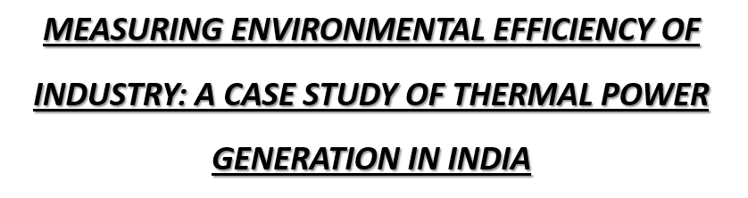


Slide 2
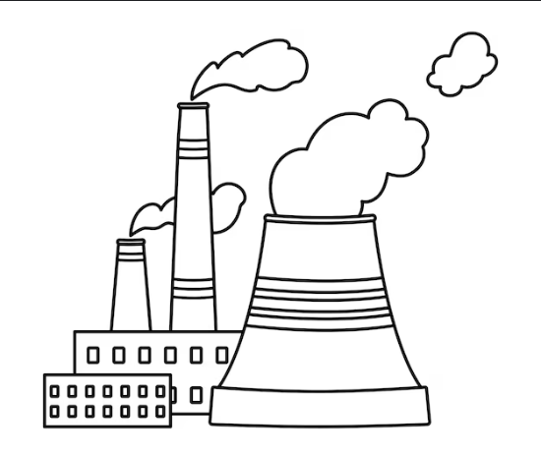
Objective of the Study
Methodology
The paper aims to evaluate the technical and environmental efficiency of coal-fired thermal power plants in Andhra Pradesh, India, using a model that jointly considers the production of good outputs (electricity) and bad outputs (pollutants like SPM, SO₂, and NOₓ).
Data collected from 5 coal-fired thermal power plants under APGENCO, Andhra Pradesh
Timeframe: 1996–97 to 2003–04 (8 years)
Observations: 480 monthly data points
Estimated shadow prices of pollutants and Morishima elasticity of substitution.
Model Used: Directional Output Distance Function (DODF)
A distance function measures how far a firm is from being fully efficient.

Slide 3
Measuring Environmental and Technical Efficiency
The paper aims to evaluate how efficiently coal-based thermal power plants in India produce electricity while also managing pollution.
Modeling Production with Pollution
It introduces the Directional Output Distance Function (DODF) to assess how plants can simultaneously increase electricity (good output) and reduce emissions (bad outputs).
Core Focus of the Paper
Estimating Shadow Prices of Pollutants
It calculates the shadow prices (i.e., marginal abatement costs) of pollutants like SPM, SO₂, and NOₓ to show what it would cost plants to reduce each pollutant by one unit.
The paper assesses how efficiently power plants can balance electricity generation and pollution control, and suggests economic tools to support cleaner energy production.
Policy Recommendation
Based on the findings, the paper advocates for market-based environmental regulations like pollution taxes or permits as more cost-effective than traditional methods.

Slide 4
RESULTS OF QUANTITATIVE ANALYSES
The average firm-specific inefficiency was 0.06, implying that firms can increase electricity output by 6% and simultaneously reduce emissions by 6% without additional resources.
Shadow Prices
SPM: ₹4777
SO₂: ₹1883
NOₓ: ₹6725
Shadow prices vary across firms and over time, indicating heterogeneous abatement costs.
Most efficient plant: NTS = 0.033 (inefficiency)
Least efficient plant: KTPS = 0.115 (inefficiency)
Morishima Elasticity of Substitution (MES):
Electricity–SPM: –0.243
Electricity–SO₂: –0.73
Electricity–NOₓ: –0.135
It’s difficult and expensive for power plants to increase electricity while reducing pollution at the same time.

Slide 5


Policy Suggestions from Murty et al. (2007):
Use of Marginal Abatement Costs (MACs): Helps design pollution taxes based on cost-effective reduction.
Plant-Specific Emission Targets: Recommends avoiding uniform standards; target inefficient plants instead.
Link Production & Environmental Efficiency: Policies should encourage both cleaner and more efficient operations.
Support Market-Based Tools: Suggests pollution permits or incentives for adopting cleaner technologies.

Slide 6
Why This Study Stands Out
Objective
Focused on both technical and environmental efficiency, making it highly relevant for policy and sustainability discussions.
Model & Data
Applied an advanced econometric model (DODF) to capture real-world trade-offs between outputs and emissions.
Used reliable secondary data from actual power plant operations (not simulated), enhancing practical relevance.
Results & Calculations
Accurately estimated plant-level inefficiencies and shadow prices of pollutants.
Results are quantitative and actionable—helpful for cost-based pollution control.
Structural Strengths of Murty et al. (2007)
✅ Clear Objective: Well-defined aim linking efficiency with environmental policy
✅ Strong Methodology: Uses advanced DODF + SFA model for realistic analysis
✅ Empirical Rigor: Based on real plant-level data (480 observations)
✅ Logical Flow: Smooth progression from theory → model → results → policy
✅ Actionable Insights: Ends with clear, policy-relevant recommendations

Slide 7
Where the Paper Falls Short.
1. Narrow Data Scope
Study is limited to 5 thermal plants in one state (Andhra Pradesh)
Not representative of India’s diverse power sector
2. No Consideration of CO₂
Focuses only on SPM, SO₂, and NOₓ
Omits CO₂, a key global pollutant in climate policy
3. No Real Policy Compliance Analysis
Does not assess actual environmental regulation enforcement or compliance costs
Unlike other studies, lacks a regulatory performance angle
4. Static Analysis
Doesn't explore dynamic changes or trends in efficiency over time in depth
Lacks forward-looking or predictive insights
What’s Missing in the Study ?
CO₂ Emissions: The study excludes carbon dioxide, a key greenhouse gas in global climate policy.
National Coverage: Only 5 plants in Andhra Pradesh are studied – not representative of India's entire power sector.
Regulatory Assessment: Lacks evaluation of actual policy enforcement or compliance behavior.
Dynamic Trends: The study looks at only one time period (2000–2001) rather than tracking changes over multiple years.

Slide 8
Aspect | Murty et al. (2007) | Sahoo et al. (2021)
Main Focus | Measuring environmental & technical efficiency and shadow prices of pollutants | Evaluating the normalization process in India’s PAT scheme for thermal power plants
Methodology | Directional Output Distance Function (DODF) with Stochastic Frontier Analysis | 4-stage DEA + Tobit Regression to study effect of uncontrollable factors
Data Scope | 5 APGENCO power plants, monthly data (1996–2004) | 69 plants across India, PAT Cycle 1 data
Outputs Considered | Electricity (good), and SPM, SO₂, NOₓ (bad) | Only electricity; focuses on energy efficiency targets, not direct pollutant emissions
Key Variables | Inputs: Coal, Capital, Wages; Outputs: Electricity & Pollutants | Inputs: Coal use, capacity, fuel quality; External factors: outages, GCV, maintenance
Pollution Treatment | Explicit modeling of pollution and marginal abatement cost | Pollution only indirectly addressed via energy efficiency and normalization criteria
Aspect | Murty et al. (2007) | Kumar & Rao (2003)
Main Focus | Measuring environmental & technical efficiency + estimating shadow prices of pollutants | Impact of environmental regulation on production efficiency of thermal power plants
Methodology | Directional Output Distance Function (DODF) + Stochastic Frontier Analysis (SFA) | Stochastic Output Distance Function using Translog functional form + inefficiency modeling
Pollution Consideration | Directly includes pollutants (SPM, SO₂, NOₓ) as bad outputs | No pollutant quantities; uses a compliance dummy (ENVS) to capture regulation
Data Scope | 5 APGENCO thermal plants (Andhra Pradesh), monthly data from 1996–2004 | 33 plants across India (CEA data, 1991–92), national coverage

Slide 9
What Murty et al. (2007) Can Improve
1. Broader Data Coverage
Current: Only 5 plants (APGENCO, Andhra Pradesh)
Compared To: Sahoo covers 69 plants PAN India; Kumar & Rao include 33 plants
Improvement: Expand plant sample for national-level generalizability
2. Inclusion of CO₂ Emissions
Current: Only models SPM, SO₂, NOₓ
Compared To: Sahoo addresses India’s climate policy context
Improvement: Add CO₂ for climate relevance and international policy alignment
3. Policy Implementation Analysis
Current: Suggests market tools but doesn’t assess real-world compliance
Compared To: Sahoo deeply critiques PAT scheme implementation
Improvement: Analyze policy effectiveness, plant-level compliance costs, or incentives
4. Dynamic Trend Modeling
Current: Static analysis of one time period
Compared To: Kumar & Rao use panel data (1996–2000)
Improvement: Use multi-year or panel data to study performance over time
5. Address Model Sensitivity
Current: Model 3 (NOₓ) fails key theoretical properties
Compared To: Other studies maintain consistency
Improvement: Strengthen model robustness to avoid result variation based on pollutant choice

Slide 10
REFERENCES
1. Environmental and Resource Economics, 38(1), 31–50. Sahoo, N. R., Mohapatra, P. K. J., & Mahanty, B. (2021). Examining the Process of Normalising the Energy-Efficiency Targets for Coal-Based Thermal Power Sector in India. Energy Policy, 156, 112386.
2.Kumar, S., & Rao, D. N. (2003). Environmental Regulation and Production Efficiency: A Case Study of the Thermal Power Sector in India. The Journal of Energy and Development, 29(1), 81–94.

Slide 11

PRIYAL KESWANI MSC-ECONOMICS
TERI SCHOOL OF ADVANCED STUDIES

