Slide 1
Basel III Market Risk Modelling Using Monte Carlo VaR
A Probabilistic Approach to Value-at-Risk Estimation
S1_G4_FIN
CSE 400: Fundamentals of Probability in Computing
Instructor Prepared by
Prof. (Dr.) Dhaval Patel Priyam Modi
Dhruv Jodhani
Guided by: Prapti Patel Masoom Choksi
Jinay Shah
Gitika Agarwal

Slide 2
Motivation Behind the Project
To bridge the gap between theoretical concepts and real-world applications
Financial markets are uncertain and unpredictable, making risk estimation difficult
Deterministic models fail to capture extreme market events
Need for more realistic and robust risk estimation methods
Understand how randomness and probabilistic modeling improve decision-making
Course Perspective
To play with the random variables and handle their behavior
Understanding Probability Distributions (PDF & CDF) to model financial returns
Applying Gaussian (Normal) Distribution for continuous random variables
Building closed-form probabilistic models for risk estimation
Learning how to handle tail behavior and extreme events in distributions
Applying deterministic and randomized algorithms to solve the same problem

Slide 3
Real-World Perspective
Financial markets are highly uncertain and volatile
Institutions must estimate VaR for better decision making and regulatory compliance Basel III
Incorrect risk estimation can lead to huge financial losses or crises
Real markets exhibit extreme events that simple models fail to capture
Models like Monte Carlo simulation are widely used in industry for risk management
Why This Problem is Important
Risk estimation is critical for financial stability and investment decisions
Helps institutions prevent making losses as they can’t afford to lose money
Enables better portfolio management and capital allocation
Demonstrates how computing and probability solve real-world problems

Slide 4
Short Summary Of Your Base Research Paper
Proposes Monte Carlo-based framework for VaR estimation under Basel III
Compares return-based and factor-based simulation models
Demonstrates using technology stock portfolio and historical market data
Evaluates both models using backtesting and rolling backtesting
Shows that rolling recalibration improves model performance
Main Idea And Contribution Of The Paper
Shows that simulation-based risk estimation is more flexible than relying only on fixed formulas
Provides a simple and reproducible framework for practical VaR analysis using real market data
Shows factor sensitivity and regression diagnostics improve model reliability
Tells how factor-based model produces more accurate VaR estimates closer to actual values
It demonstrates that rolling backtesting improves model performance by adapting to changing market conditions

Slide 5
Problem Formulation
Objective: Estimate Value-at-Risk (VaR) for a financial portfolio under the Basel III regulatory framework
What is VaR?
VaR represents the maximum expected loss over a specified time horizon at a given confidence level. For Example:
For 95% confidence interval: 1-day VaR=2.43% means there is 95% probability that the portfolio will not lose more than 2.43% in one day
Why This Matters
Financial institutions must report VaR for regulatory capital requirements
VaR is used for internal risk management and model validation
Accurate VaR estimation prevents under-capitalization during market stress

Slide 6
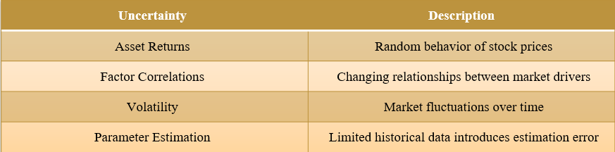
Problem Formulation
Key Uncertainties

Slide 7
Problem Formulation
Portfolio Weights Table:
Asset | Ticker | Weight
Apple | AAPL | 30%
Microsoft | MSFT | 25%
NVIDIA | NVDA | 20%
Alphabet | GOOG | 15%
AMD | AMD | 10%
Risk Factors Used:
Factor | Description | Proxy Used
XLK | Technology Sector | Dow Jones Returns
MTUM | Momentum Factor | NASDAQ Returns
VLUE | Value Factor | S&P 500 Returns

Slide 8
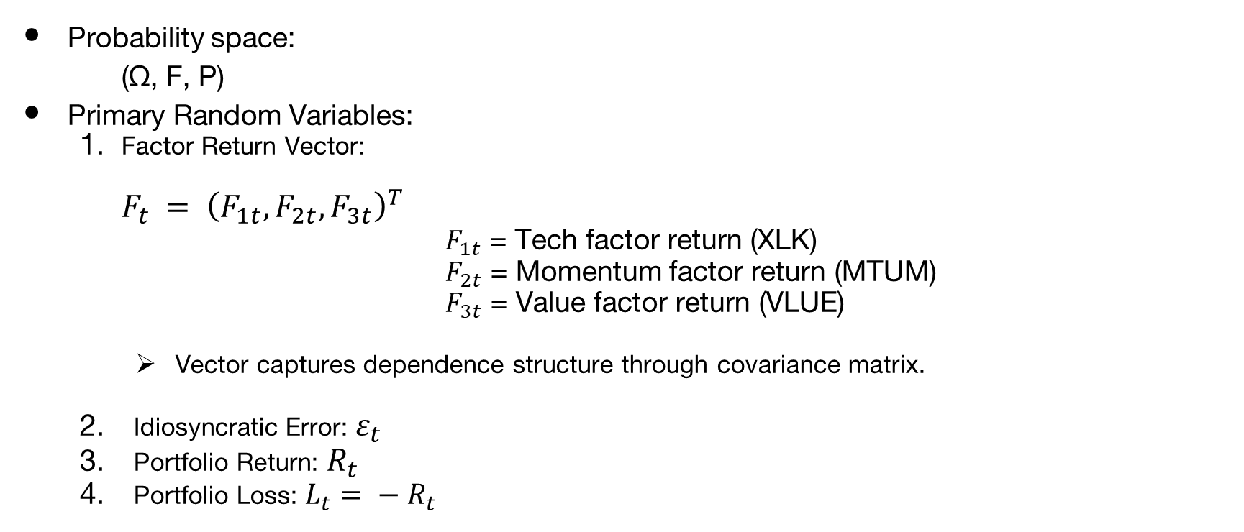
Mathematical Model- Random Variables

Slide 9
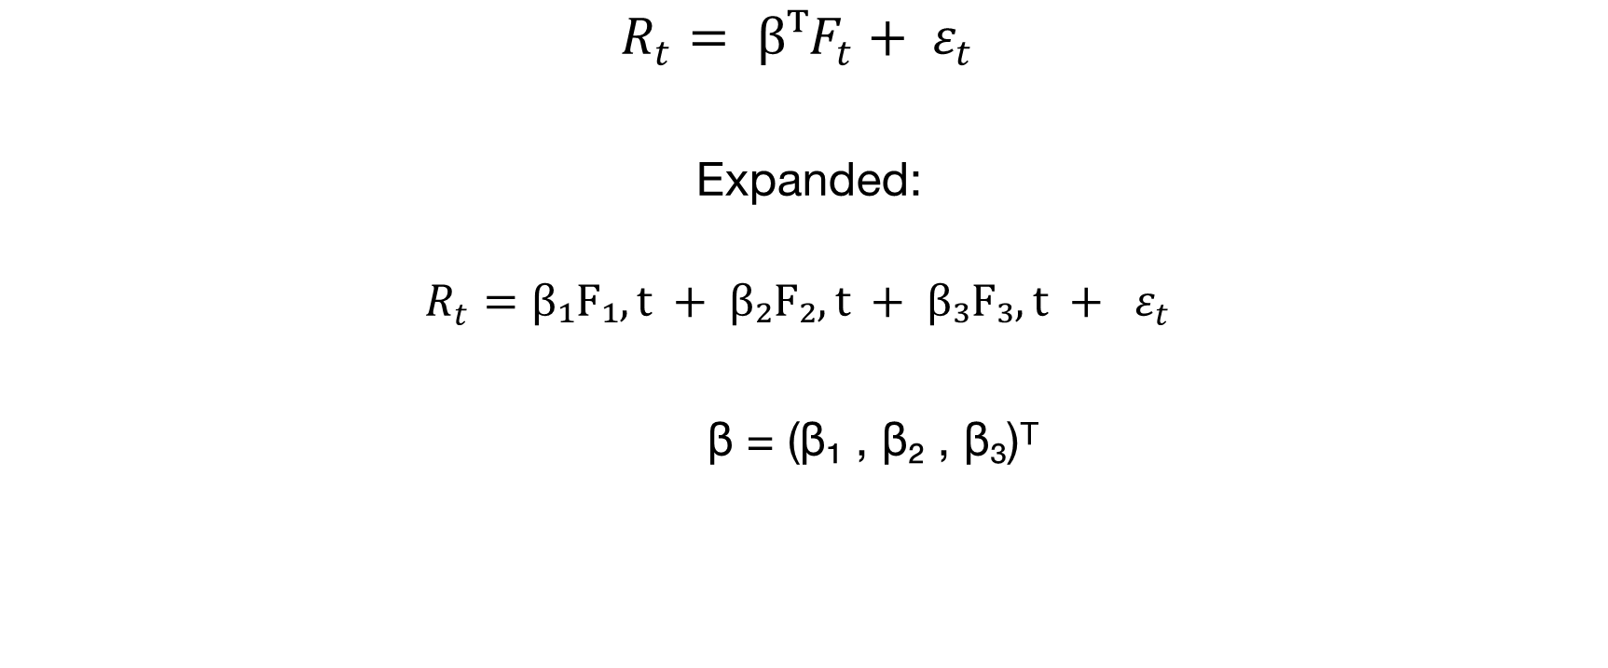


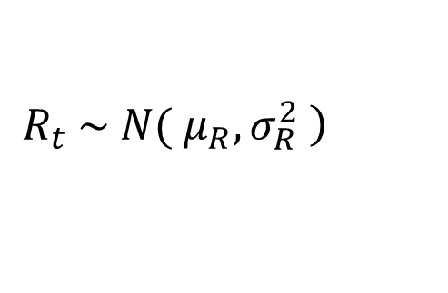


Mathematical Model-Distribution Derivation
Linear Factor Model
Distribution of Portfolio Return
Where:

Slide 10




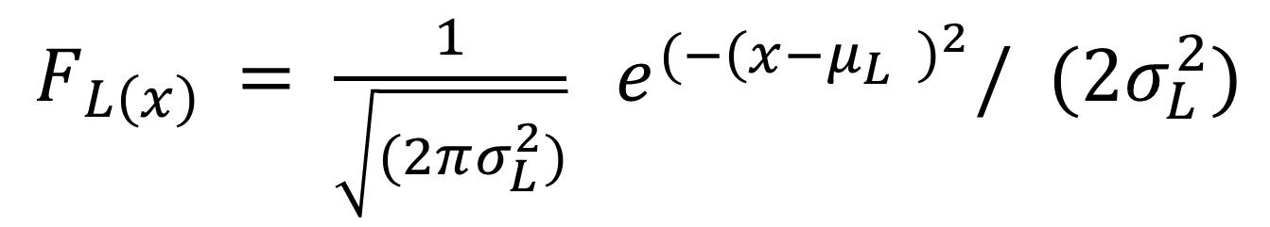
Mathematical Model-Distribution Derivation
Loss Distribution
Probability Density Function of Loss
Where:

Slide 11

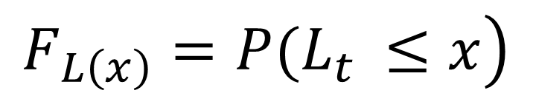



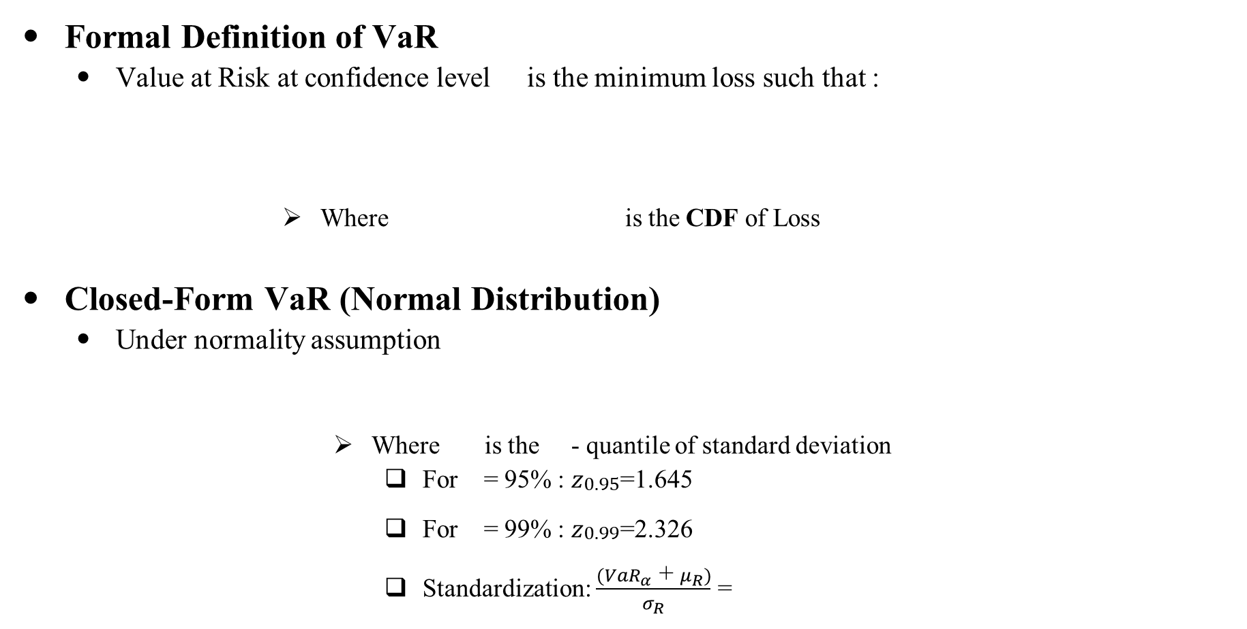
Mathematical Model-VaR Definition
Formal Definition of VaR
Value at Risk at confidence level is the minimum loss such that :
Where is the CDF of Loss
Closed-Form VaR (Normal Distribution)
Under normality assumption
Where is the - quantile of standard deviation
For = 95% : $z_{\begin{aligned}0.95 \\ \end{aligned}}$=1.645
For = 99% : $z_{\begin{aligned}0.99 \\ \end{aligned}}$=2.326
Standardization: $\frac{{(VaR}_{α}\text{ + }μ_{R})}{σ_{R}}$ =
$$z_{α}$$
$$z_{α}$$

Slide 12


Probability Bounds Used in VaR Estimation​
Why These Bounds Matter:​
They provide as with the mathematical guarantees on loss proabilities without assuming normal distribution and explains why Monte Carlo works better than deterministic.​
Have used 4 Bounds that we studied
Markov's Inequality
2. Chebyshev’s Inequality
Aspect | Detail
Statment
Used in VaR | Upper bound on loss probability using only expected loss
Limitation | Very loose, Works for only non-negative loss
Aspect | Detail
Statment
Used in VaR | Bounds deviation probability using mean and variance only
Limitation | No distribution assumption, but still conservative

Slide 13


Probability Bounds Used in VaR Estimation ​
3. Chernoff Bound
4. Jensen’s Inequality
Aspect | Detail
Statment
Used in VaR | Exponential tail bound – much tighter than Markov/Chebyshev
Limitation | Requires knowledge of moment generating function; harder to compute
Aspect | Detail
Statment | For Convex:
Used in VaR | Proves deterministic VaR underestimates true risk
Limitation | Only provides conceptual direction, not numerical bound

Slide 14
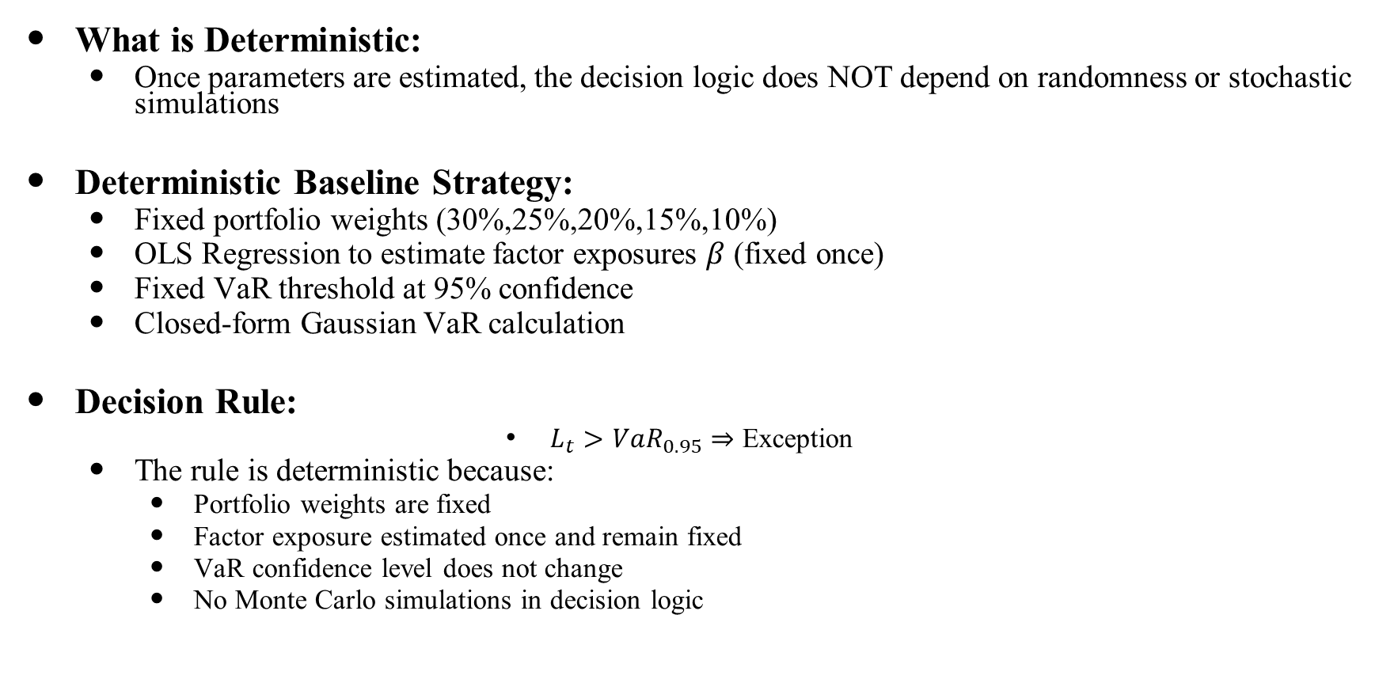
Deterministic Approach - Overview
What is Deterministic:
Once parameters are estimated, the decision logic does NOT depend on randomness or stochastic simulations
Deterministic Baseline Strategy:
Fixed portfolio weights (30%,25%,20%,15%,10%)
OLS Regression to estimate factor exposures $β$ (fixed once)
Fixed VaR threshold at 95% confidence
Closed-form Gaussian VaR calculation
Decision Rule:
$L_{t}>{VaR}_{0.95}⇒$ Exception
The rule is deterministic because:
Portfolio weights are fixed
Factor exposure estimated once and remain fixed
VaR confidence level does not change
No Monte Carlo simulations in decision logic

Slide 15
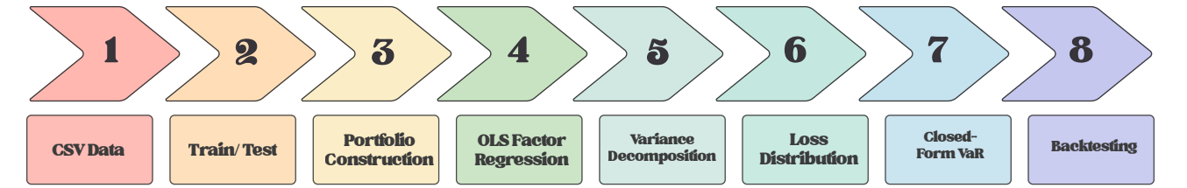
Deterministic Approach -Pipeline
This pipeline transforms historical portfolio and factor data into a closed-form VaR estimate, providing a fixed and interpretable baseline for risk measurement.

Slide 16
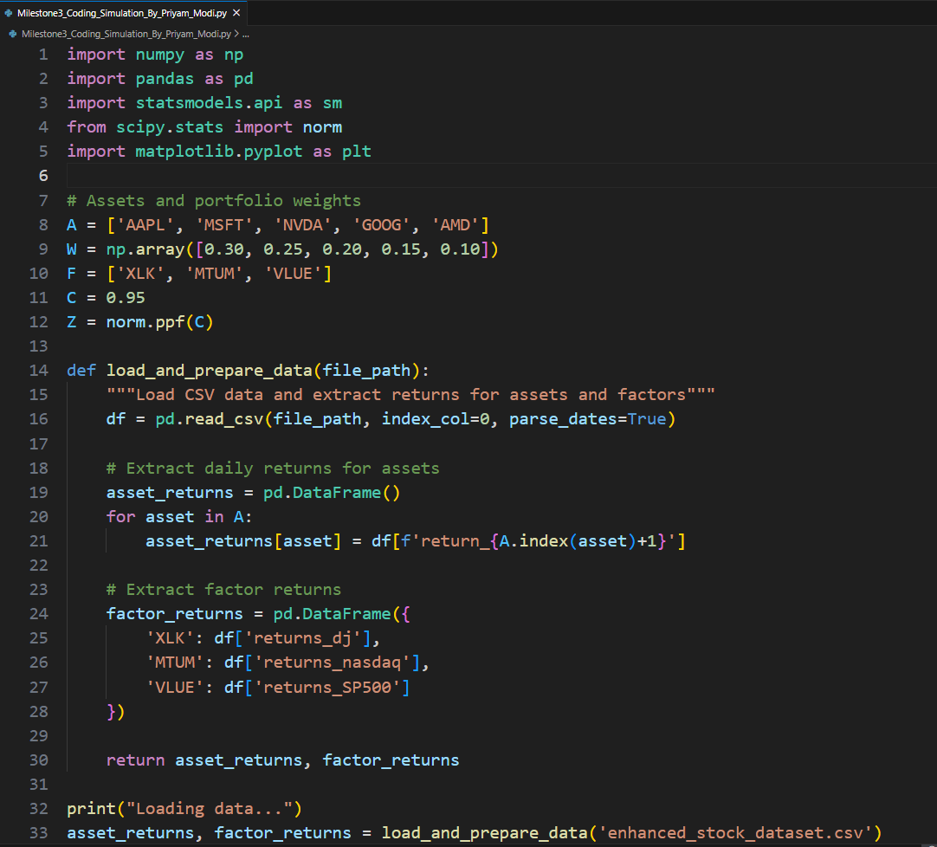
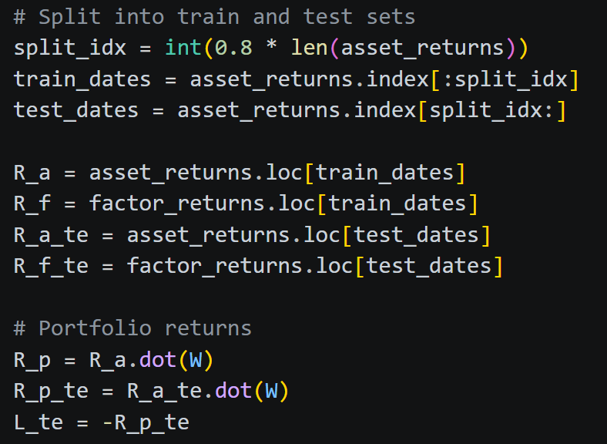
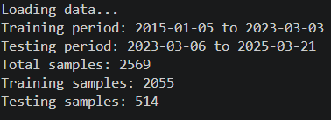
Deterministic Approach- Implementation
Data Loading and Portfolio Construction
Data Splitting
So here train and test dates are

Slide 17
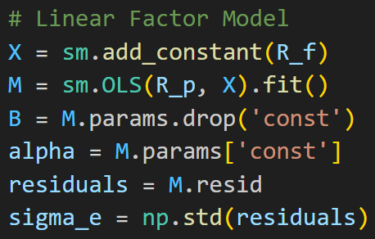
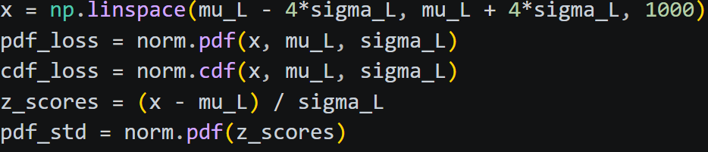
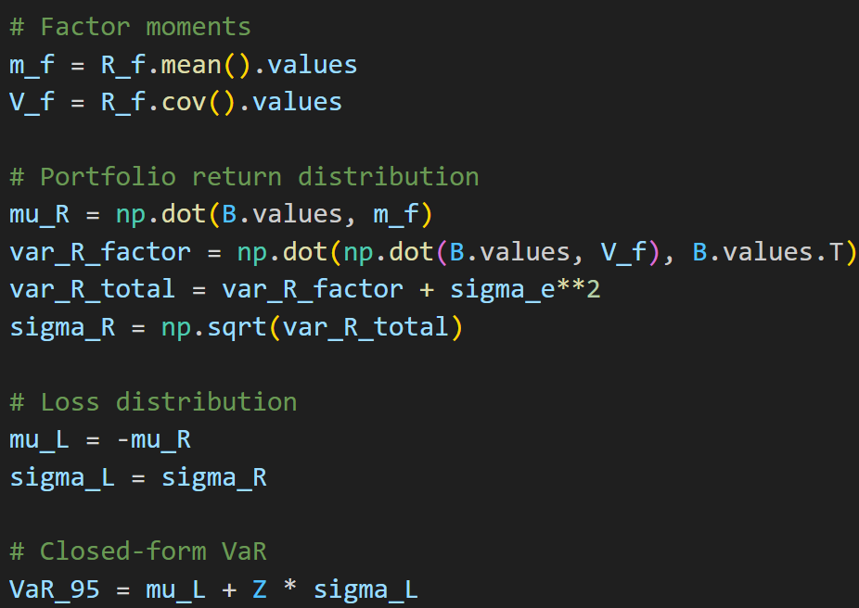
Deterministic Approach- Implementation
OLS Factor Regression and VaR Calculation
Loss Distribution Visualization

Slide 18
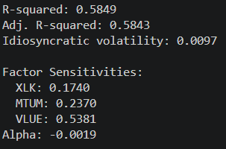
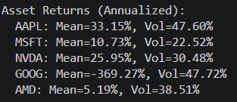
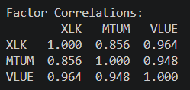
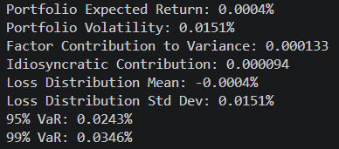
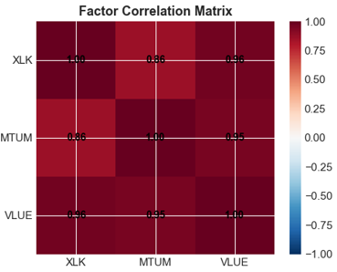
Deterministic Approach- Results
Model Fit Statistics
Gaussian Model Statistics
Summary Statistics

Slide 19
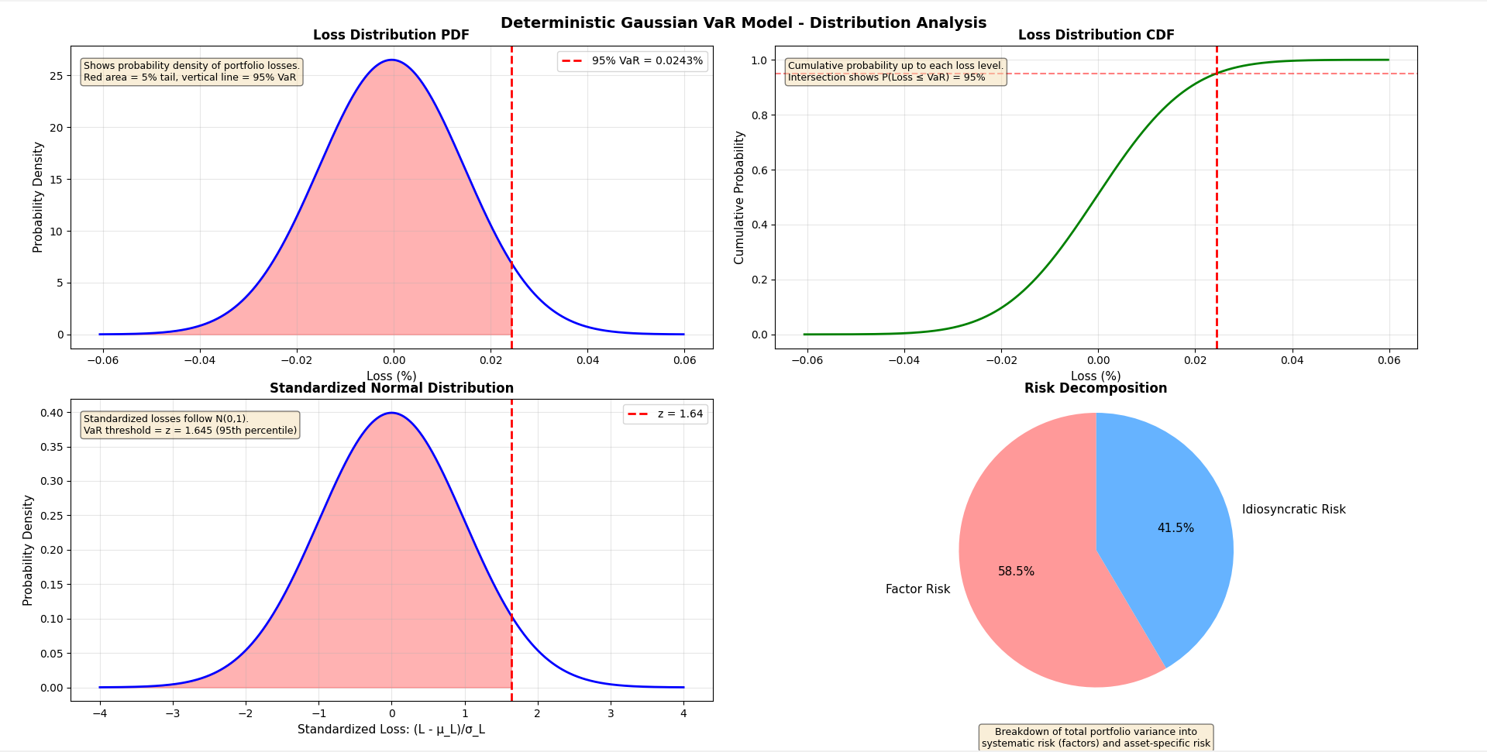
Deterministic Approach- Results
Deterministic Model Graphs (PDF, CDF, Risk Decomposition)

Slide 20
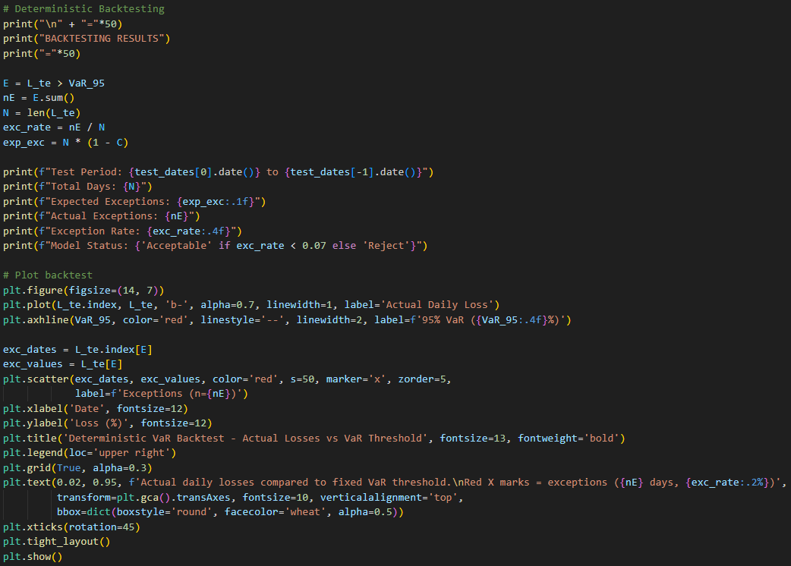
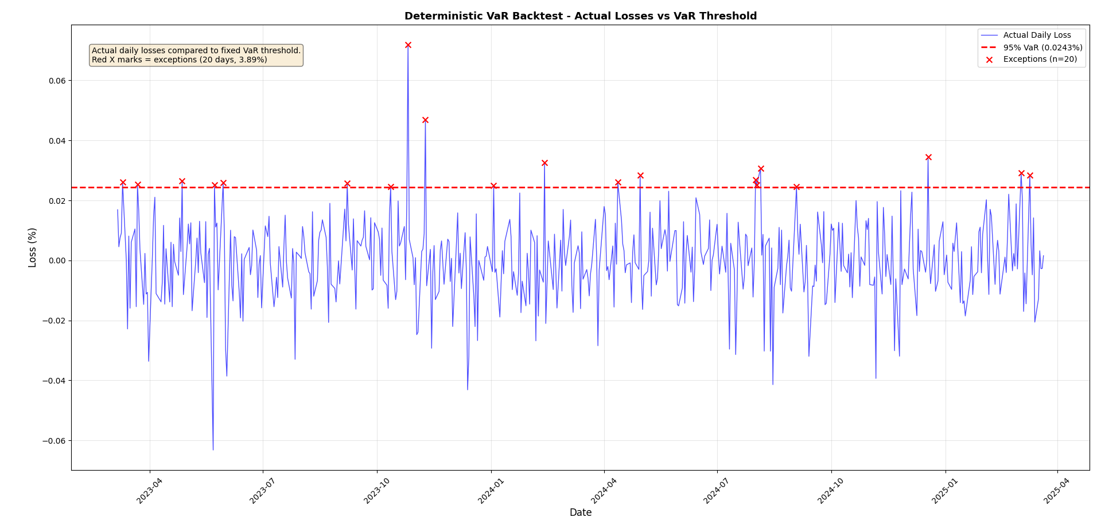
Deterministic Approach- Backtesting Results
Backtesting Code Snippet | Output

Slide 21
Randomized Approach - Motivation
Why Deterministic Approach has Limitations
Problem | Explanation
Normality Assumption | Markets don't follow perfect bell curves; real markets have "fat tails" (extreme crashes happen more often than predicted)
Parameter Uncertainty | Model parameters are estimated from limited historical data; actual future parameters are unknown
Static Parameters | Factor exposures and volatility are estimated once and never updated
No Scenario Exploration | Cannot simulate "what-if" scenarios or stress events

Slide 22
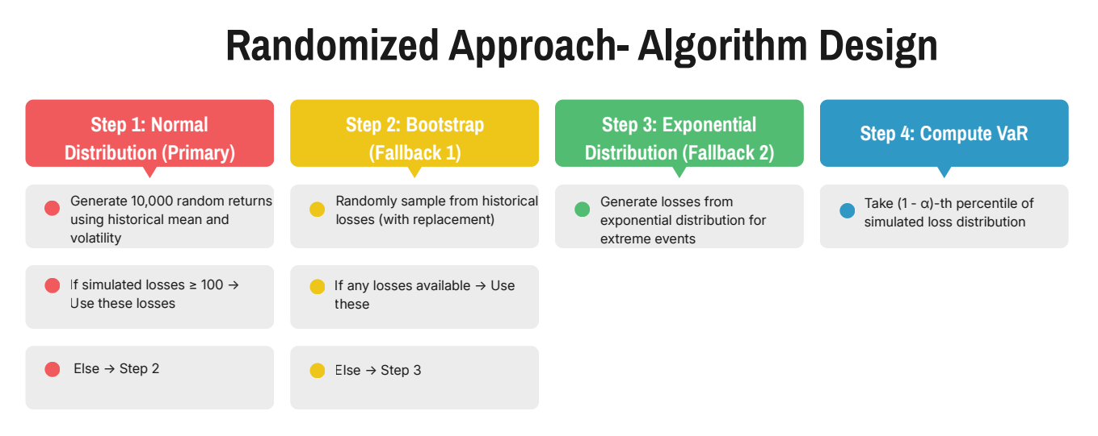
Randomized Approach- Algorithm Design

Slide 23
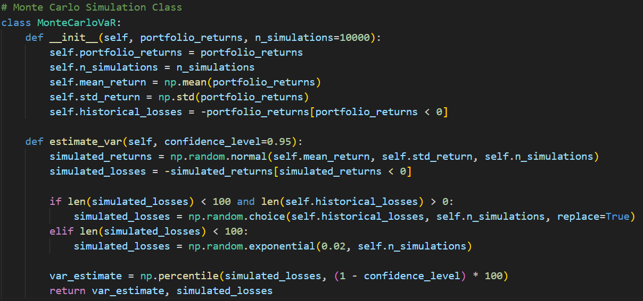
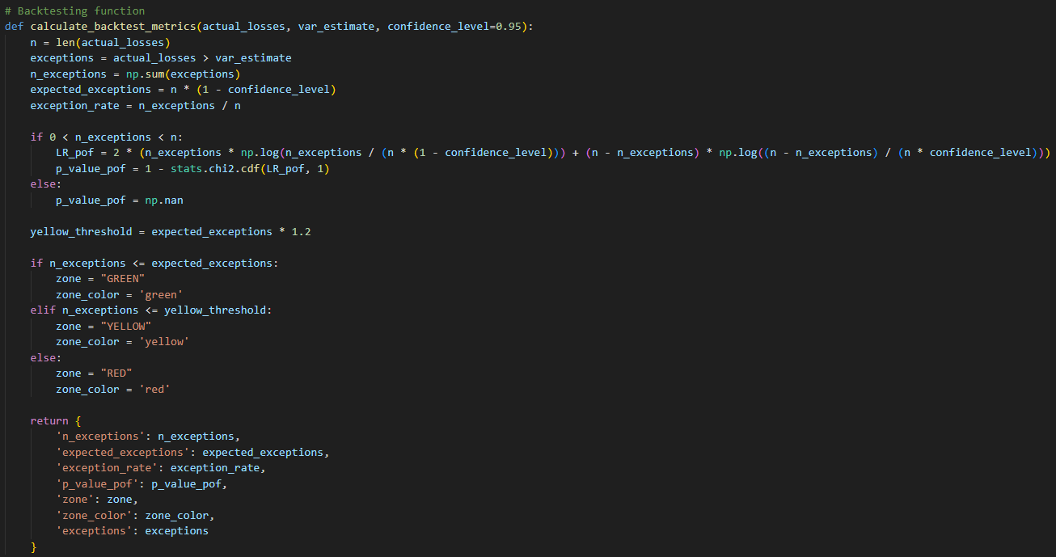
Randomized Approach- Algorithm Design
Monte Carlo Simulations
Back testing

Slide 24
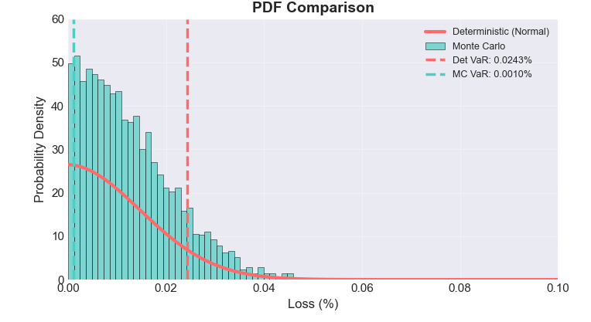
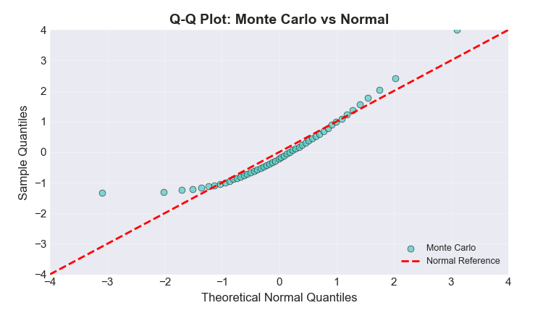
Results – Distribution Comparison
PDF Comparison
Deterministic distribution is Normal
Monte Carlo distribution shows wider spread
Monte Carlo VaR(0.0010%) is lower than Deterministic VaR(0.0244%)
Monte Carlo Captures tail losses that Normal Distribution ignores
Q-Q Plot
If the blue dots exactly fall on the red line- Monte Carlo Matches Normal Distribution
Dots deviate from the red line in tails- Monte Carlo losses are NOT Normal
Deviation indicate heavy tail. This confirms the need for a randomized approach

Slide 25
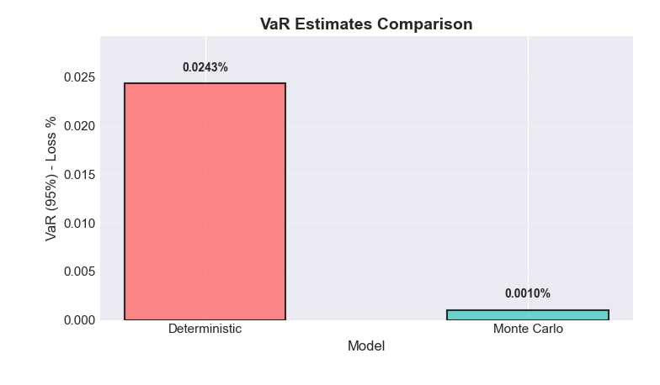
VaR Estimates Comparison
The Monte Carlo VaR being lower does not mean it is “better”- it means it is more sensitive to tail risk and captures different aspects of risk

Slide 26
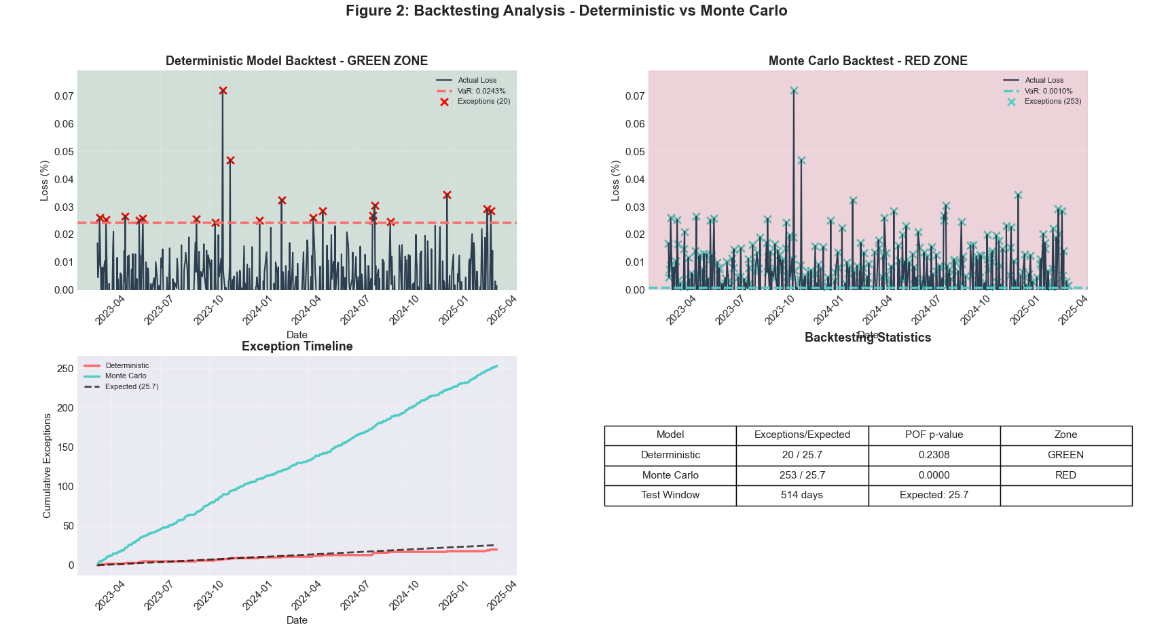
Backtesting Analysis

Slide 27
Backtesting (Deterministic and Monte Carlo) Interpretation
Backtesting Zones( Basel III)
GREEN: Good Model, exceptions within expected range
YELLOW: Caution, moderate exceptions
RED: Poor Model, too many exceptions
Cumulative Exceptions Over Time
Deterministic model stays below expected exceptions (GREEN zone)
Monte Carlo model quicky exceeds expected exceptions (RED zone)
Monte Carlo is more sensitive to market movements

Slide 28
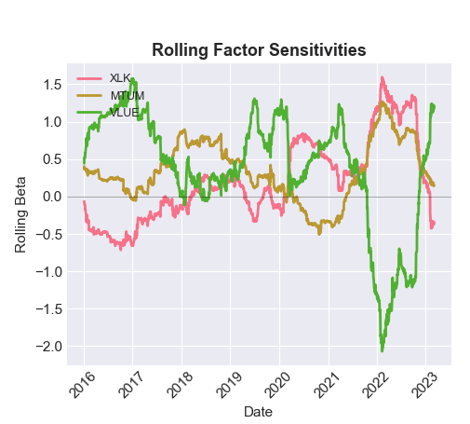
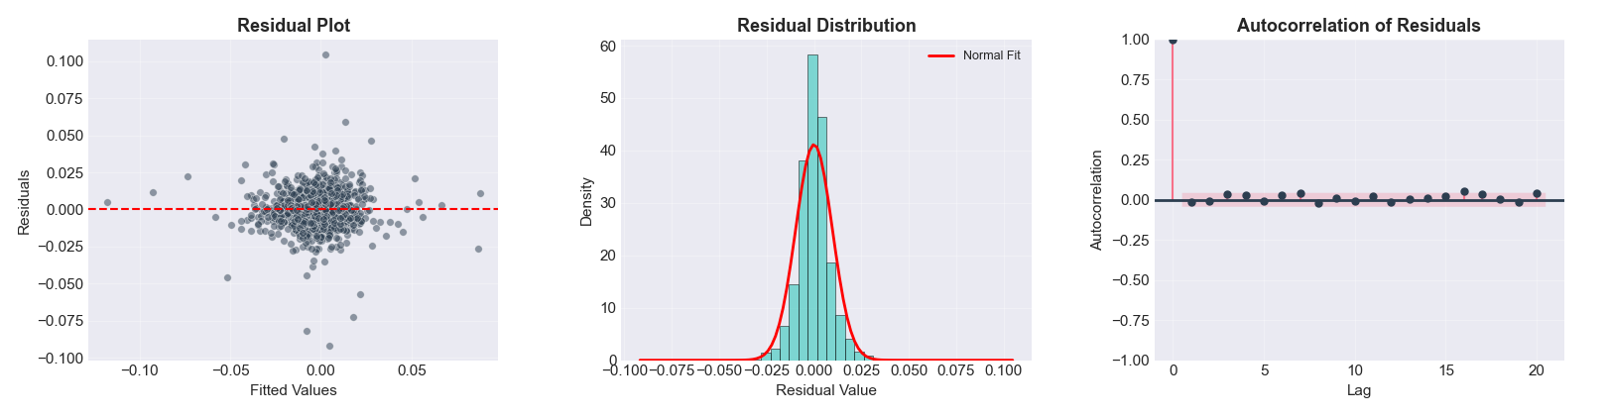
Model Diagnostics Results
Factor exposures change over time. A model that assumes fixed betas will be wrong. You need to update the model regularly.
Graph | One-Line Key Message
Residual Plot | No pattern → linear model fits well.
Residual Distribution | Approximately normal → normality assumption holds.
Autocorrelation | No correlation → residuals are independent.

Slide 29
Inference – Domain Perspective
Finding | Implication
Monte Carlo captures tail risk better | Better for stress scenarios and extreme market conditions
Deterministic model is more stable | Suitable for normal market conditions and regulatory reporting
Both models produce different VaR estimates | Model selection matters; use multiple models for robust risk assessment
Rolling recalibration improves performance | Risk models must adapt to changing market conditions

Slide 30
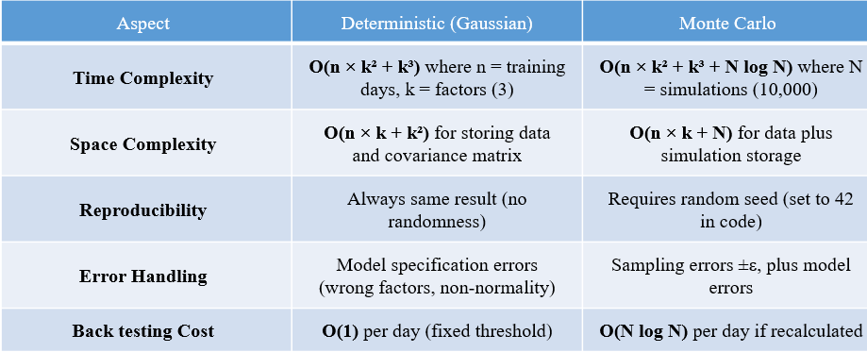
Inference – Computer Science Perspective

Slide 31
Summary & Conclusion
What We Accomplished
What We Accomplished
Deterministic model: Stable, conservative, GREEN zone
Monte Carlo: Sensitive, captures tail risk, RED zone
Both models serve different purposes in risk management
Combine both approaches: Deterministic for daily monitoring + Monte Carlo for stress testing
Milestone | Achievement
M1 | Understood research paper and probabilistic framework
M2 | Formal mathematical model with random variables
M3 | Implemented deterministic Gaussian VaR
M4 | Implemented Monte Carlo VaR with three-tier sampling

Slide 32
References
Cheng, Y. (2025). Monte Carlo Simulation of VaR and Regulatory Backtesting under Basel III. SSRN Working Paper.
GitHub Link: https://github.com/Chengyueminga/MarketRisk_VaR
Enhanced Stock Market Dataset. Kaggle.
Link: https://www.kaggle.com/datasets/muhammadahmad246/enhanced-stock-market-dataset
Investopedia. (n.d.). Monte Carlo simulation. Retrieved March 25, 2026, from https://www.investopedia.com/terms/m/montecarlosimulation.asp

Slide 33
THANK YOU

