Slide 1
Modeling Value at Risk (VaR): A Probabilistic Factor-Based Framework
Milestone – 2
Section 1
Group – 4
CSE 400 : Fundamentals of Probability in Computing
Prepared By : Priyam Modi (AU2440030)
Dhruv Jodhani (AU2440160)

Slide 2
Modeling Value at Risk (VaR) Using a Factor-Based Probabilistic Approach
Milestone 2 Focus:
Formal probabilistic modelling
Explicit random variable definition
Distributional assumptions
Analytical derivation of return distribution
Monte Carlo simulation (PDF & CDF intuition)
Tools Used:
Linear Regression
Multivariate Normal Modelling
Covariance Estimation
Monte Carlo Simulation

Slide 3
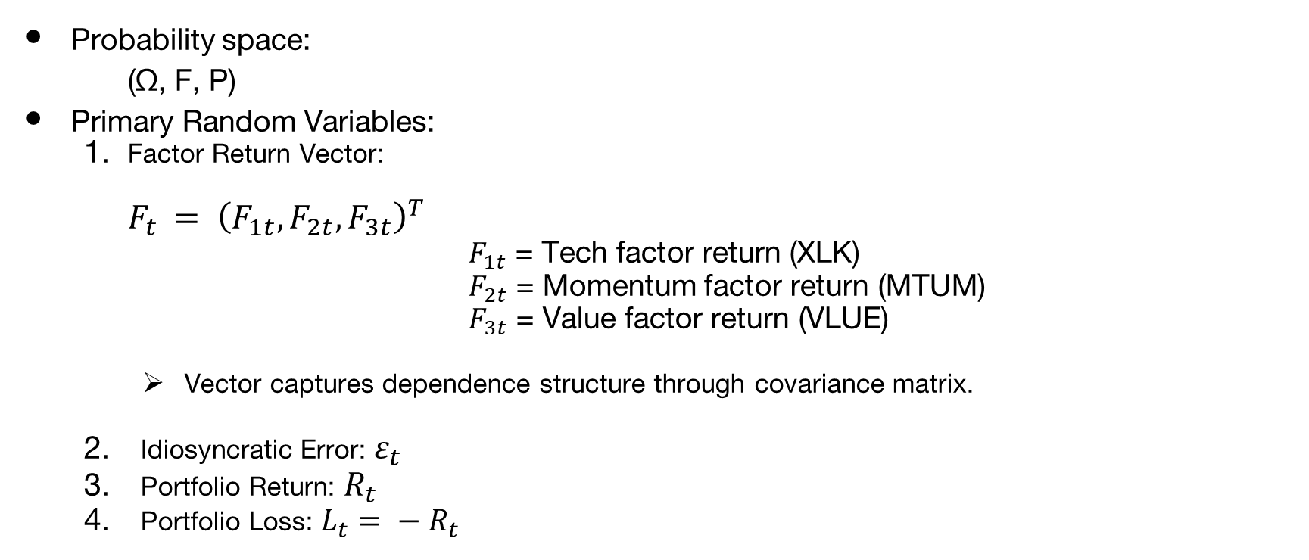
Definition of Random Variables

Slide 4
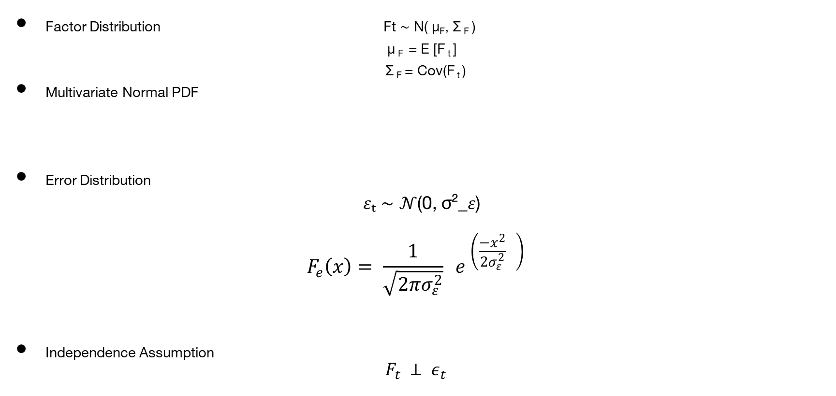
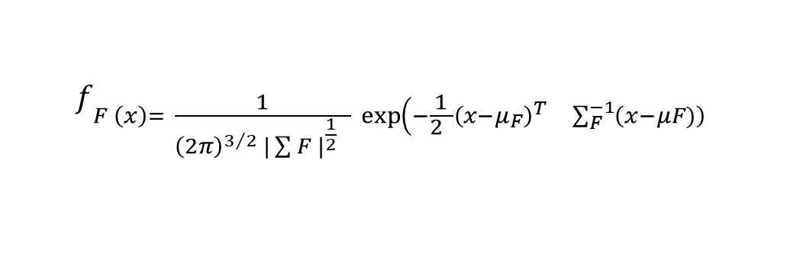
Distributional Assumptions

Slide 5
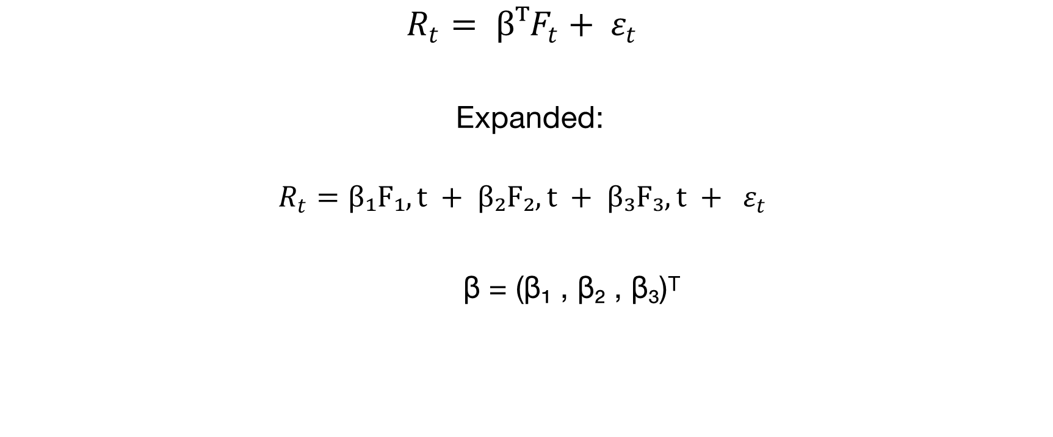
Linear Factor Model

Slide 6


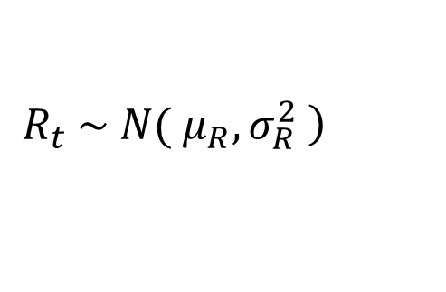


Distribution of Portfolio Return
Where:

Slide 7




Loss Distribution
Where:

Slide 8



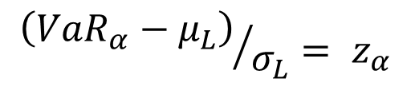
Formal Definition of VaR
Standardizing:

Slide 9

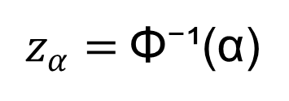
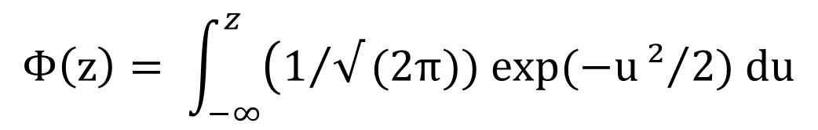
Closed-Form VaR
Where:
Standard Normal CDF:

Slide 10
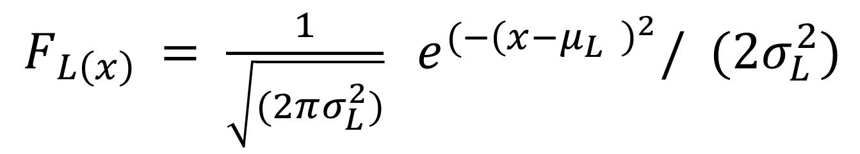
Probability Density Function of Loss

Slide 11
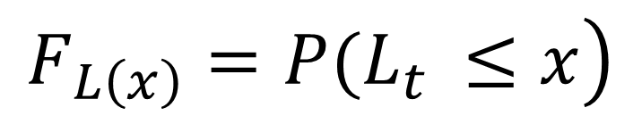
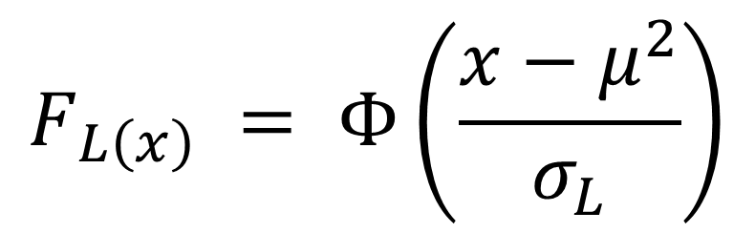
Cumulative Distribution Function

Slide 12
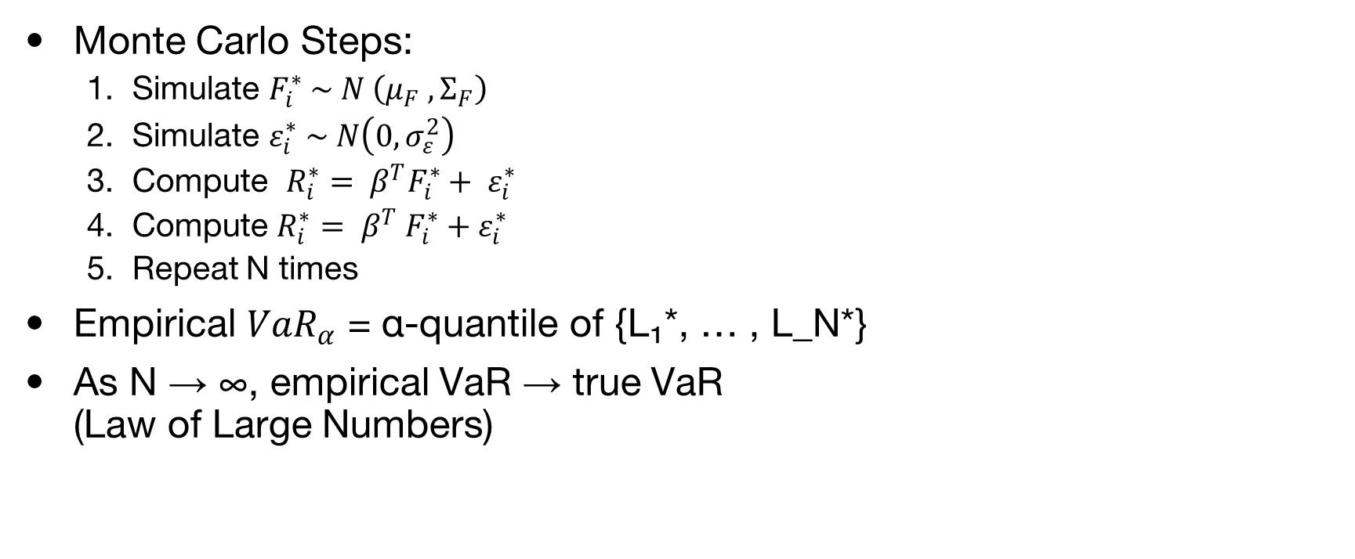
Monte Carlo VaR and Final Interpretation

Slide 13
Group Understanding
Portfolio risk viewed as a probabilistic concept
Returns and losses modeled as random variables
Distributional assumptions enable analytical derivation
VaR understood as the α-quantile of the loss distribution
Closed-form VaR → Analytical and efficient
Monte Carlo VaR → Flexible and simulation-based
Trade-off between simplicity and realism

