Slide 1

Sentiment Analysis Using NLP
Major Project - I
AD- 706
Problem Statement: Design and Development Sentiment Analysis Using NLP
Project Group Number: 13
Group Member Details:
Team Member 1 Name: Disha Vishawakarma
Branch : B-tech Stream: AI&DS Year: IV
Team Member 2 Name: Priyam Sahu
Branch: B-tech Stream : AI&DS Year : IV
Team Member 3 Name: Yuvika
Branch: B-tech Stream : AI&DS Year : IV
Guide Details: Prof. Ruchi Jain
Notes:
Team mentor

Slide 2



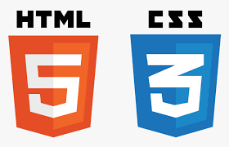

Idea/Approach Details
Abstract:
This project involves developing a deep learning-based sentiment analysis model to classify user’s comments into Positive, Negative, Neutral, or Irrelevant categories.
The data was cleaned and preprocessed, then used to train an ML Model. To address class imbalance, class weights were applied. The model achieved 85% accuracy, offering valuable insights into user sentiment.
Describe your idea Solution/Prototype here:
The Sentiment Analysis Using NLP solution aims to provide a robust system that can automatically classify customer reviews into predefined sentiment categories. By leveraging Natural Language Processing (NLP) and machine learning techniques, the system can process and understand textual data to evaluate customer feedback efficiently.
Key Features:
Sentiment Classification: Predicts sentiments (Positive, Negative, Neutral) from Twitter comments.
Naïve Bias & Logistic Regression Model: Uses machine learning to capture sequential patterns in text.
Text Preprocessing: Cleans, tokenizes, and pads text data for better analysis.
Class Imbalance Handling: Applies class weights to address uneven sentiment distribution.
Describe your Technology stack here:

Slide 3
Project Requirements
Hardware Requirements
Software Requirements
Processor (CPU): Quad-core processor (e.g., Intel i5 or AMD Ryzen 5)
Graphics Processing Unit (GPU):NVIDIA GPU with CUDA support for faster deep learning training.
RAM (Memory):16 GB or more (especially for handling larger datasets and faster performance).
Storage:512 GB SSD or more, depending on dataset size.
Internet Connection: For downloading datasets, pre-trained models, or dependencies.
Power Supply: Ensure a stable power source, especially during long training sessions.
Operating System: Windows 10/11, Programming Language:
Python 3.7+
Libraries:
Natural Language Toolkit (NLTK) and spacy
Machine Learning Libraries
Scikit-learn (for preprocessing and evaluation)
Pandas, NumPy (for data handling)
Matplotlib/Seaborn (optional, for visualization)
Text Processing: Keras Tokenizer and pad_sequences (for tokenizing and padding text)
IDE: Google Colab, VSCode
Frontend Technologies :HTML/CSS: For basic structure and styling of the web pages. JavaScript For interactivity
Flask: The core framework for your web application.

Slide 4
Project Requirements
Non-Functional Requirements
Functional Requirements
Scalability: The system should handle an increasing volume of data and users without a noticeable drop in performance.
Reliability: It must be highly reliable, ensuring minimal downtime for data collection and dashboard access.
Usability: The website should be user-friendly, with an intuitive interface for easy navigation.
Performance: The application should respond to user inputs within 5-10 seconds.
Compatibility: It should work seamlessly on various browsers and devices.
Security: Implement data protection measures, including input validation and secure data transmission.
Scalable Architecture: Use a scalable architecture that allows for future expansions and updates without major rework.
User Interface: Simple input form for text submission and clear result display.
Input Processing: Accept and process various text formats.
Sentiment Analysis: Classify text into categories (Positive, Negative, Neutral).
Display Results: Show predicted sentiment..
Documentation: Instructions for using the application.
Performance Metrics: Display model accuracy if requested.

Slide 5
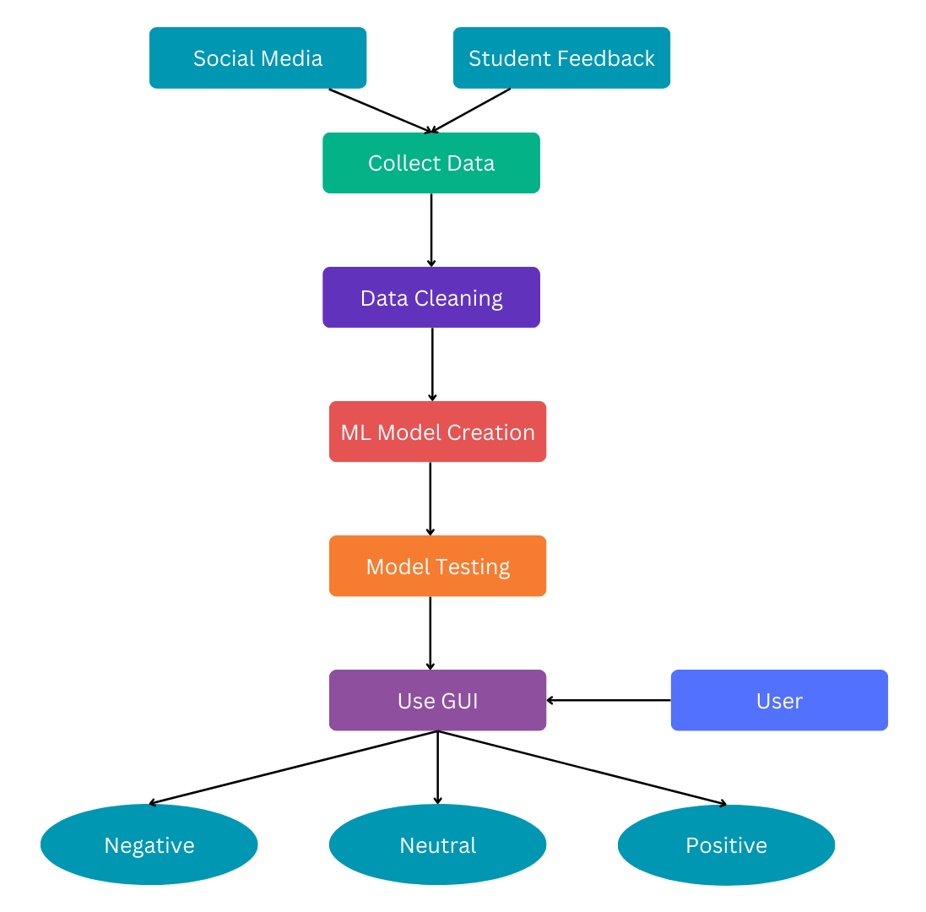
Design
Data flow diagram

Slide 6
Design
Describe your Dependencies
Data Quality:
Poorly labeled or biased data can affect model accuracy.
Model Complexity:
Advanced models may require significant computational
resources.
Computational Resources:
Limited hardware can hinder training efficiency.
Overfitting:
Complex models may overfit, impacting generalization

Slide 7
Deployment Details
Describe Deployment Details here
Model Training:
Data Preparation: Text data is cleaned, tokenized, and converted into numerical feature vectors using TF-IDF or Bag of Words, ensuring it is structured for model training.
Model Training: Naive Bayes and Logistic Regression models are trained on labeled sentiment data to classify tweets as positive, negative, or neutral based on learned patterns..
Deployment Environment:
Platform: VsCode or Google Colab
Frameworks: Python, Keras/spacy for building, Flask.
Model Refresh:
Data Pipeline: Set up automatic data ingestion pipelines to update the model with new review data from sources like Amazon or social media.
Model Retraining: Schedule periodic retraining of the model to adapt to new patterns in language and sentiment trends, ensuring up-to-date predictions.

Slide 8
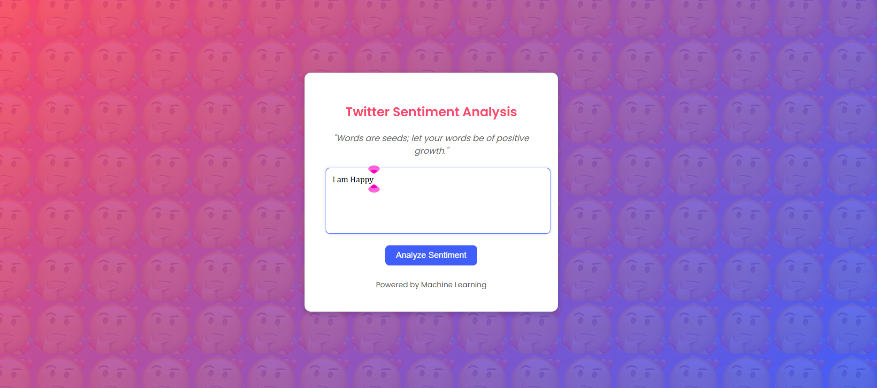
Project Screen shorts

Slide 9
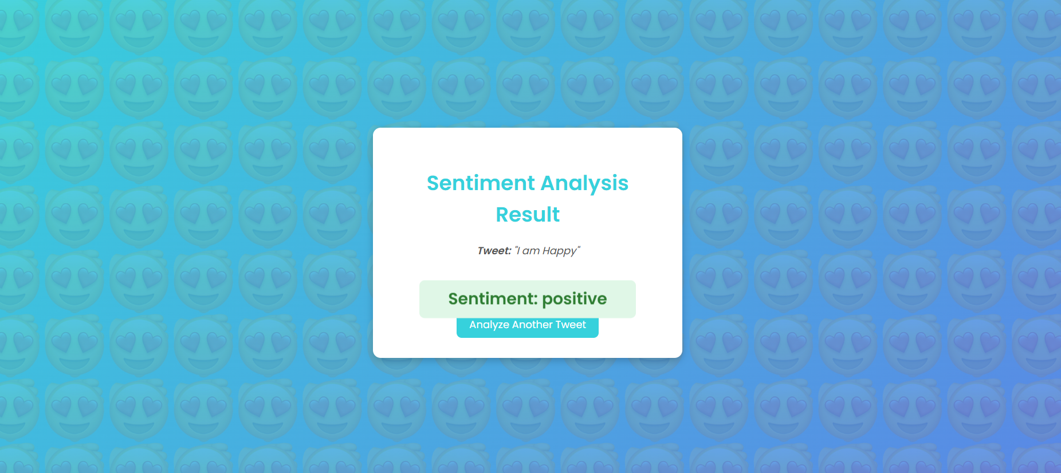
Project Screen shorts

Slide 10


