Slide 1



Student Result Management System
(SRMS)
MASTERS IN COMPUTER APPLICATION
Submitted By: Submitted To:
Name-Priyam Yadav Mrs. Palwinder Kaur Mangat
UID- 24MCA20377
Branch- MCA
Section- 6-A
(Assistant Professor)

Slide 2
Student Result Management System
A Comprehensive Solution for Academic Record Management

Slide 3
INDEX
S No. | Title | Page No.
1 | Introduction | 4
2 | Objective | 5
3 | Technology Used | 6
4 | System Requirements | 7
5 | System Architecture | 8
6 | GUI Design | 9--13
7 | Output | 14
8 | Database Design | 15
9 | Modules | 16
10 | Key Features and Functionalities | 17
11 | Advantages and Disadvantages
12 | Testing and Evaluation
13 | Future Enhancements
14 | Conclusion

Slide 4
Introduction
Managing student results is critical for academic institutions.
Manual record-keeping is outdated, and digital systems are essential.
Key Technologies: Python, Tkinter, SQLite

Slide 5
Objective
Primary Goal: Develop a user-friendly, efficient, and secure system.
Features:
- Add, update, delete course information.
- Manage student records.
- View student results.
- Create an intuitive GUI.

Slide 6
System Requirements
Software Requirements:
- Python: Logic implementation
- Tkinter: GUI development
- SQLite: Data storage
- PIL: Image handling
Hardware Requirements:
- 4GB RAM, 50MB Disk Space

Slide 7
System Architecture
Architecture Layers:
- Presentation: Tkinter-based GUI
- Business Logic: Python core operations
- Database: SQLite for data storage

Slide 8
GUI Design
Features:
- Title Bar: Application name
- Menu Bar: Course, Student, Result, etc.
- Dashboard: Background images, statistics
- Footer: Contact information

Slide 9
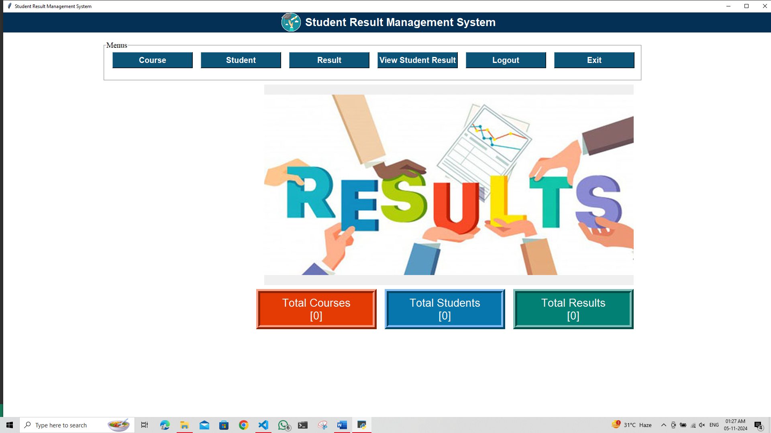
Output
1. Dashboard Page

Slide 10
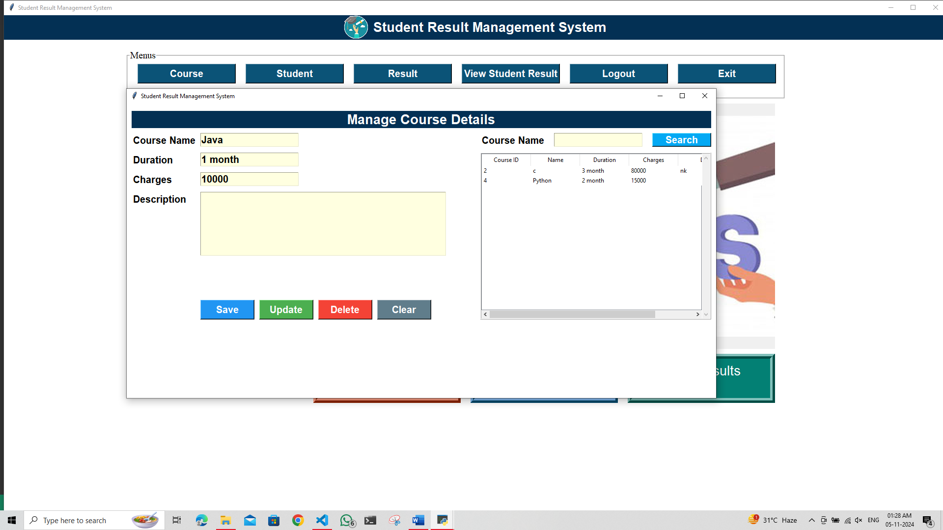
2. Course Page

Slide 11
Database Design
Tables:
- Course: Stores course details
- Student: Stores student information
- Result: Stores exam results
Example:
CREATE TABLE course (...)

Slide 12
Modules
1. Course Management: Add, update, delete course details
2. Student Management: Handle student records
3. Result Management: Add and display student results

Slide 13
Key Features and Functionalities
- User Authentication: Secure login
- Data Validation: Ensure accuracy
- Image Handling: PIL for image display
- Responsive Layout: Adapts to screen sizes

Slide 14
Advantages
- User-Friendly Interface
- Lightweight Database
- Cross-Platform Compatibility
- Scalable Design

Slide 15
Disadvantages
- Database Limitations: Not for large datasets
- Performance: Tkinter may lag
- Security Concerns: Requires robust measures

Slide 16
Testing and Evaluation
- Functional Testing: Verified features
- Usability Testing: Improved based on feedback
- Performance Testing: Measured response under load

Slide 17
Future Enhancements
- Cloud Storage: For data redundancy
- Multi-User Access: Enhanced security
- Advanced Security: Encryption and secure login

Slide 18
Conclusion
A reliable, efficient system for academic data management.
Potential improvements with new features like cloud storage.

