Slide 1

SMART INDIA HACKATHON 2026
TITLE PAGE
Problem Statement ID – 26133
Problem Statement Title – Accessibility and quality of public healthcare services, particularly in rural and underserved areas
Theme – MedTech / BioTech / HealthTech
PS Category – Software
Team ID – [TEAM ID]
Team Name – UNFILTEREDENGINEERS
Working prototype, live now: ruralai-psi.vercel.app
Government of Maharashtra · Maharashtra State Innovation Society
Notes:
[0:00-0:20] 20 seconds.
"Problem Statement 26133, for the Government of Maharashtra. Accessibility and quality of public healthcare in rural and underserved areas. We are team UNFILTERED ENGINEERS."
Then, immediately and without pausing:
"Before I describe anything, this is not a concept. It is deployed and you can open it right now at ruralai-psi.vercel.app."
Do not read the rest of the title slide aloud. Move on.

Slide 2
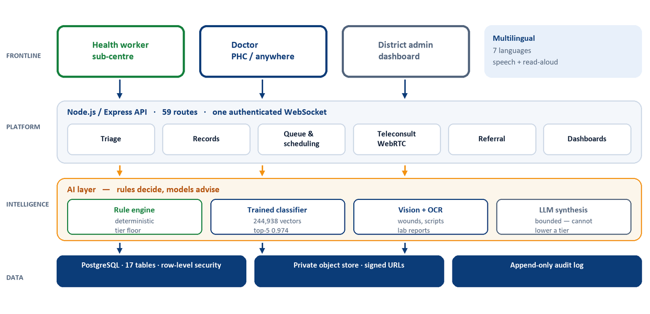
IDEA TITLE
UNFILTERED ENGINEERS
RuralAI Care access without the journey
DEPLOYED AND RUNNING TODAY
ruralai-psi.vercel.app
Proposed Solution
Already built — verifiable at the link
One platform, six services: assisted teleconsultation, appointment and queue management, digital triage, longitudinal records, emergency referral and facility dashboards.
59
API routes
17
DB tables
135
tests passing
7
languages
The health worker is the operator: the patient never touches it; a registered doctor makes every clinical decision.
Runs on what a sub-centre already has: a browser and a phone camera. No new hardware.
How it addresses the problem
Travel and waiting: the case travels, not the patient — video or same-day batch review.
Fragmented records: one record keyed to Aadhaar; paper scripts and lab reports digitised by camera.
Language and literacy: symptoms spoken in 7 Indian languages; findings read back aloud.
Delayed referral: red-flag rules escalate to the nearest district hospital automatically.
Innovation and uniqueness
Rules decide, models advise: a deterministic engine sets the triage floor; the model may raise a tier and can never lower one.
Bounded, not prompted: a classifier trained on 244,938 labelled symptom vectors constrains what the LLM may say.
Medication never model-authored: only from a practitioner-signed formulary. Enforced in code, covered by tests.
Architecture — every layer in this diagram is deployed.
Notes:
[0:20-1:20] 60 seconds. This is the slide that wins or loses the room.
Open with the live badge, top right: "Everything I am about to describe is running at that URL."
Proposed Solution - one line only: "One platform doing the six things the problem statement asks for: teleconsultation, queue management, triage, longitudinal records, referral and dashboards."
How it addresses the problem - pick TWO, not four: "The case travels instead of the patient. And the record is keyed to Aadhaar, so history does not restart at every facility."
Innovation - this is the differentiator, say it slowly:
"Most teams wire a language model to a prompt. We did not. A deterministic rules engine sets the triage floor. A classifier trained on 244,938 labelled symptom vectors bounds what the model is allowed to say. The model can raise a risk tier. It can never lower one. And it can never name a medicine - that comes from a practitioner-signed formulary, enforced in code and covered by tests."
Point at the four numbers: "59 routes, 17 tables, 135 tests passing, 7 languages. All verifiable at the link."
If asked to cut for time: drop 'How it addresses the problem' entirely. Keep Innovation.

Slide 3
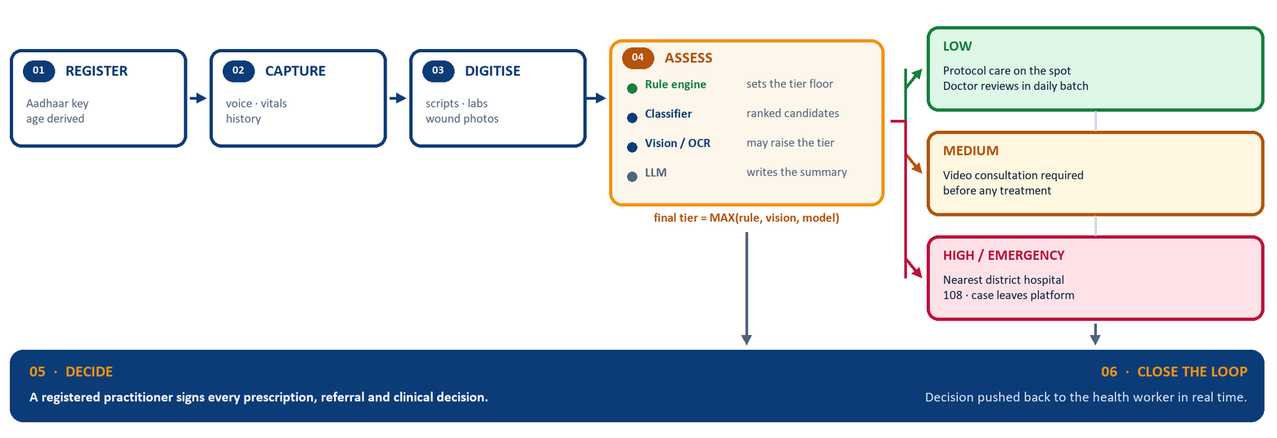
TECHNICAL APPROACH
UNFILTERED ENGINEERS
Methodology and process for implementation
Six steps from a patient arriving at a sub-centre to a signed clinical decision. The tier decides what happens next — each tier has a different, defined output.
Technologies to be used
Notes:
[1:20-2:10] 50 seconds. Do not read this slide. Trace it with your hand.
"Register, capture, digitise." - sweep left to right across the first three boxes.
Stop on ASSESS: "Four things run here. The rule engine sets the floor. The classifier proposes ranked candidates. Vision and OCR can raise the tier. The language model writes the summary last, and only within those bounds."
Then the formula: "Final tier is the maximum of rules, vision and model. That is the whole safety argument in one line."
Fan your hand across the three tiers: "Low gets a complete plan on the spot. Medium requires a video consultation before any treatment. High leaves the platform entirely and goes to the nearest district hospital."
Land on the navy bar: "A registered practitioner signs every decision, and it goes straight back to the health worker."
Tech stack: one sentence. "Standard open stacks. Nothing exotic - which is why it is already deployed."
Do not explain individual technologies unless asked.

Slide 4
FEASIBILITY AND VIABILITY
UNFILTERED ENGINEERS
Analysis of the feasibility of the idea
Potential challenges and risks · Strategies for overcoming these
Technical Built and deployed on proven open stacks — Node, PostgreSQL, React, scikit-learn. 135 automated tests. Model artifact is 3.6 MB and runs on CPU.
CLINICAL Risk: Triage thresholds and the formulary are drawn from published guidance but are not yet practitioner-signed.
Mitigation: Medication is withheld from the health worker at every tier and suppressed by default in production. The system states this on its own pages. Sign-off is a named launch gate, not a code task.
Operational The operator is the health worker who already staffs the sub-centre. No new cadre, no new hardware — a browser and a phone camera.
CONNECTIVITY Risk: Assessment currently needs a network round trip.
Mitigation: Rule engine, referral routing and read-aloud already run with no network. A 4-bit on-premise model at the PHC is the roadmap item that closes the rest.
Economic Video is peer-to-peer, referral routing is a local data file, read-aloud is on-device. Only the model calls cost money per assessment.
Institutional Six roles scoped by district, append-only audit log, row-level security — the shape a state health department can actually run.
INTEROPERABILITY Risk: ABDM/FHIR exchange is not built — the ABHA field is captured by card OCR only.
Mitigation: Records are already structured to the shapes ABDM consumes. Registering as a Health Information Provider is an adapter, not a data migration.
Viability
Deployment unit the sub-centre — already the tenancy key in the schema.
CONTINUITY Risk: Referral completion and high-risk follow-up are not yet tracked.
Mitigation: Both are scheduled work on an existing schema — the referral and review rows already exist; what is missing is the due-list and the closure loop.
Policy fit strengthens eSanjeevani and ABDM rather than competing with them.
Sustainability per-facility licensing under NHM budgets; teleconsultation is already reimbursable under the Ayushman Bharat framework.
LOAD Risk: Rate limiting and socket fan-out are per-process today.
Mitigation: A shared Redis store makes both horizontal. Identified, scoped, not yet needed at pilot scale.
Deployment path
NOW
NEXT
THEN
Deployed. One district grid, seeded and demonstrable.
Practitioner sign-off on the formulary and thresholds.
ABDM adapter, referral closure, follow-up due-list.
Notes:
[2:10-3:00] 50 seconds.
Feasibility - do not read all four. Say: "Technically it is already built and tested. Operationally, the operator is the health worker who is already there - no new cadre, no new hardware."
Economic, say this one deliberately: "Video is peer-to-peer, referral routing is a local file, read-aloud runs on the device. The expensive parts of a telemedicine platform are structurally free here."
Then turn to the risk column and OWN it - this is where you earn credibility:
"I want to be direct about what is not finished."
Clinical: "Our triage thresholds and formulary come from published guidance and have not been signed by a registered practitioner for this deployment. So medication is withheld from the health worker at every tier, and the system says so on its own front page. That is a launch gate, not a code task."
Then: "Referral completion tracking, high-risk follow-up and ABDM exchange are scheduled, not built. The schema already holds the rows they need."
Judges trust the team that names its own gaps before they do.

Slide 5
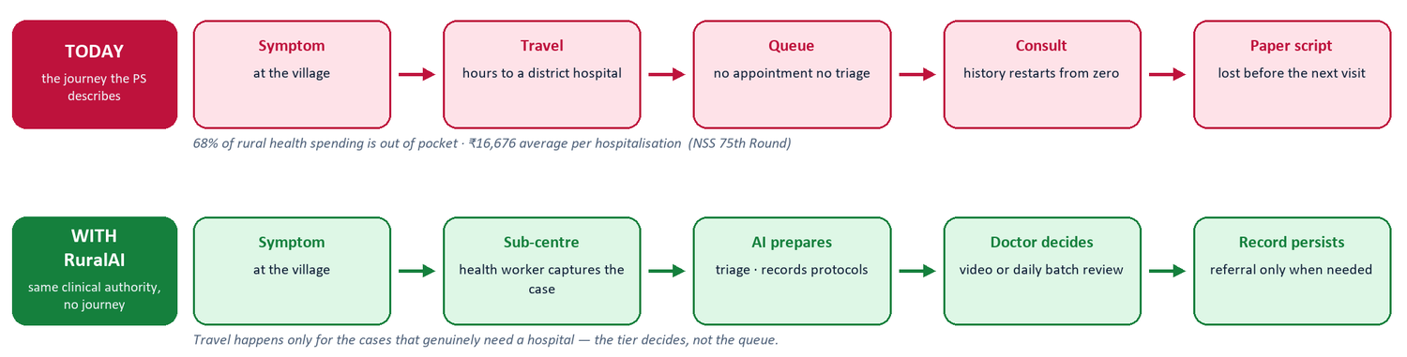
IMPACT AND BENEFITS
UNFILTERED ENGINEERS
Potential impact on the target audience
79.9% specialist shortfall at rural CHCs
54.2% of Maharashtra women 15-49 are anaemic
~34% of referred patients never complete referral
43 cr eSanjeevani consultations — we plug into it
MoHFW, Health Dynamics of India 2022-23
NFHS-5 Maharashtra fact sheet
Chennai referral cohort study
National Health Authority, 2025
Benefits of the solution
Social
Economic
Governance
Specialist reach a 79.9% shortfall becomes a scheduling problem, not a travel one.
Household cost 68% of rural health spending is out of pocket.
Quality monitoring live visits and risk mix, aggregate only — no identifiers.
Equity within the state 41.2% in Sindhudurg to 68.2% in Gadchiroli — one protocol.
System cost no per-minute video fee, no mapping API, no per-call TTS.
Accountability an append-only audit log that no role can edit or delete.
Notes:
[3:00-3:50] 50 seconds.
Top half, trace the two rows: "Today: symptom, hours of travel, a queue with no triage, a consult where history restarts, and a paper prescription that is lost before the next visit."
"With RuralAI: the same clinical authority, no journey. Travel happens only for the cases that genuinely need a hospital - and the tier decides that, not the queue."
Then the four numbers, and cite each source out loud - this is where you separate yourself:
"79.9 percent specialist shortfall at rural community health centres - Ministry of Health, 2022-23."
"54.2 percent of Maharashtra women aged 15 to 49 are anaemic - NFHS-5."
"Around a third of referred patients never complete the referral."
"And eSanjeevani has done 43 crore consultations - we plug into that, we do not compete with it."
Benefits: name the three buckets, do not read the contents. "Social, economic, governance."
If short on time, cut the benefits row entirely and stay on the numbers.

Slide 6
RESEARCH AND REFERENCES
UNFILTERED ENGINEERS
Details / Links of the reference and research work
Project resources
MoHFW Health Dynamics of India (Infrastructure & Human Resources) 2022-23 — 79.9% specialist shortfall at rural CHCs; 1,69,615 sub-centres, 31,882 PHCs, 6,359 CHCs.
pib.gov.in/PressReleasePage.aspx?PRID=2053070
Live prototype ruralai-psi.vercel.app
Source code github.com/PriyamMishra853/RURALAI-
NSS 75th Round Health in India — 68% of rural health expenditure out of pocket; ₹16,676 average rural spend per hospitalisation; ~86% without insurance.
mospi.gov.in — Report 586
Architecture document PROJECT_DOCUMENTATION/ — 20 sections
Demo video [DEMO VIDEO LINK]
NFHS-5 Maharashtra State fact sheet (DHS FR374) — anaemia 54.2% in women 15-49 and 68.9% in children 6-59 months; district range 41.2%-68.2%.
dhsprogram.com/pubs/pdf/FR374/FR374_Maharashtra.pdf
Strengthens the public system — does not replace it
National Health Authority eSanjeevani 43 crore teleconsultations, 1,31,793 spokes; ABDM 100 crore health records linked to ABHA.
abdm.gov.in · esanjeevani.mohfw.gov.in
eSanjeevani carries the consultation. We prepare the case before it and record the decision after it.
WHO / IMNCI · PALS Integrated Management of Neonatal and Childhood Illness — paediatric respiratory bands and dehydration plans B and C encoded in the triage engine.
who.int/publications — IMNCI
ABDM / ABHA the record is structured for it; ABHA is captured at registration by card OCR.
MoHFW / IPHS protocols retrieval is filtered to approved protocols only, cited with title, source and version.
NMC Telemedicine Practice Guidelines 2020 — the prescribing boundary the platform enforces in code.
nmc.org.in
Where existing tools stop
Teleconsultation platforms connect a doctor. They do not triage, read a paper prescription, or hold a record between visits.
Symptom checkers speak to the patient. This speaks to a trained health worker and refuses to name a medicine.
Hospital information systems begin at the hospital door — after the journey this platform exists to avoid.
Notes:
[3:50-4:30] 40 seconds, then stop and invite questions.
"Every number on the previous slide is sourced, and the sources are here - Ministry of Health, the 75th round of the National Sample Survey, the NFHS-5 Maharashtra fact sheet, the National Health Authority, WHO IMNCI, and the NMC telemedicine guidelines."
Then the positioning box - say this clearly, it directly answers the problem statement's own wording:
"The problem statement says strengthen, not replace. eSanjeevani carries the consultation. We prepare the case before it and record the decision after it. ABDM holds the record - ours is structured for it."
Then, if they have not already asked, pre-empt the obvious question:
"You may be wondering why this is not just a symptom checker. Symptom checkers speak to patients. This speaks to a trained health worker, and it refuses to name a medicine."
Close on the resources box: "Live prototype, source code, a twenty-section architecture document, and the demo video. All linked here."
Then stop talking. Do not fill silence.

