Slide 1
Public transport optimization
Phase 5: project documention & submission

Slide 2
Introduction :
The improvement of public transport service quality by elimination of the most onerous factors affecting the choice of mass transit modes is continuously a crucial problem concerning both passengers and transit operators.
The progress that has taken place in the field of hardware (low cost higly powered microcomputers, modem AVML systems and new generations of public transport vehicle detectors) creates high opportunity for deve-lopment of a new very efficient scheduling and control tools.
The weak points of nowadays existing approaches were widely discussed and analysed in detail in [5] and it was argued that the most promising approach should contain as its main points

Slide 3
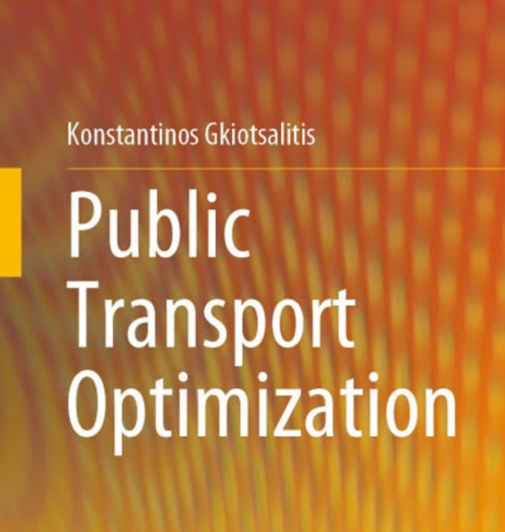
Public transport optimization:
To optimize public transport routes, we use specialized transport models that reflect current or projected transport demand.
Existing passenger flows are primarily used for model calibration, not as the main data source for optimization.

Slide 4

Used:
Transportation optimization helps shippers, 3PLs, and transportation consultants analyze shipments, rates, and constraints to produce realistic load plans that reduce overall freight spend.
“Companies are being asked to deliver more frequently and in smaller batches.

Slide 5
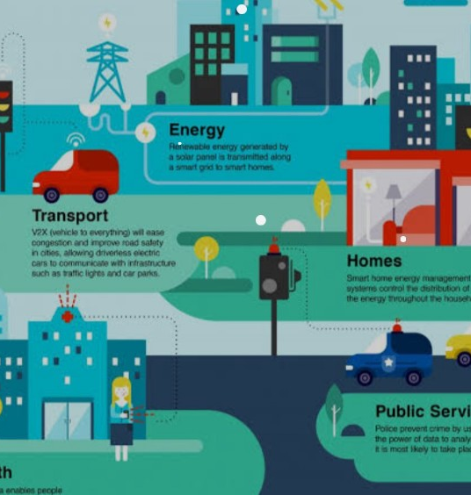
Efficient mode of public transport:
Rail remains the quickest and most cost-effective transportation mode for moving large numbers of people.
At average occupancy, a single heavy-rail commuter train can transport nine times as many people in one hour as one traffic lane of cars.

Slide 6
Advantages:
Improves Community Health
Economic Benefits to the Community
Improves Fuel Efficiency
Public Transportation Reduces Air Pollution
Improves Road Congestion
Improves Community Mobility
Provides an Equitable Transportation System

Slide 7

Disadvantages:
Vulnerable to Season and Weather Impacts: Road transport infrastructure and travel is vulnerable to weather changes and seasons
Accidents and Breakdowns
Not the Best Option for Long Distance and Heavy Cargo
Slow Speed
Lack of Organisation and Structure

Slide 8
Conclusion:
In conclusion, Mathematical Optimization can help public transportation systems, especially in large cities, overcome their existing challenges and unlock next-level business growth.

Slide 9
Thank you

