Slide 1

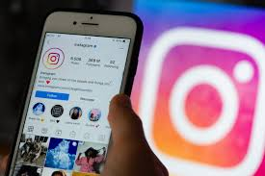
INSTAGRAM USER ANALYTICS

Slide 2
OVERVIEW
The goal of this project is to analyze Instagram user data using SQL to generate insights that can help drive marketing strategies, improve user engagement, and inform business decisions.
The objective is to extract valuable information from user interactions, such as user activity, photo engagement, hashtag popularity, and user demographics. These insights will be used by various teams within the business to enhance product features, optimize marketing efforts, and ensure the platform’s continued success.
The project focuses on two main areas:
Marketing Analysis: Tasks aimed at improving user engagement, identifying loyal users, assessing contest results, and determining the best strategies for ad campaigns.
Investor Metrics: Tasks to assess the overall activity on the platform, including average user engagement, detection of fake accounts, and performance metrics for investors.

Slide 3

TECH-STACK
Tech-Stack Used MySQL Workbench:
I used MySQL Workbench as my primary tool for this project. It provided an intuitive interface for running SQL queries, visualizing the data, and handling database management. I chose MySQL Workbench because of its powerful SQL execution features, ease of use, and compatibility with large datasets.

Slide 4
Marketing Analysis
Loyal User Reward: The marketing team wants to reward the most loyal users, i.e., those who have been using the platform for the longest time.
Your Task: Identify the five oldest users on Instagram from the provided database.
SELECT * FROM USERS ORDER BY CREATED_AT LIMIT 5;

Slide 5
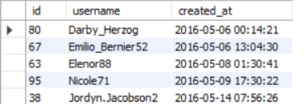

Loyal Users: The analysis revealed the oldest users on the platform, allowing the marketing team to target them for loyalty programs or special offers.
The analysis revealed that the oldest users created their account in 2016.

Slide 6
Inactive User Engagement: The team wants to encourage inactive users to start posting by sending them promotional emails.
Your Task: Identify users who have never posted a single photo on Instagram.
select users.id,users.username,users.created_at
from users
left join photos on users.id = photos.user_id
where photos.user_id is null;

Slide 7

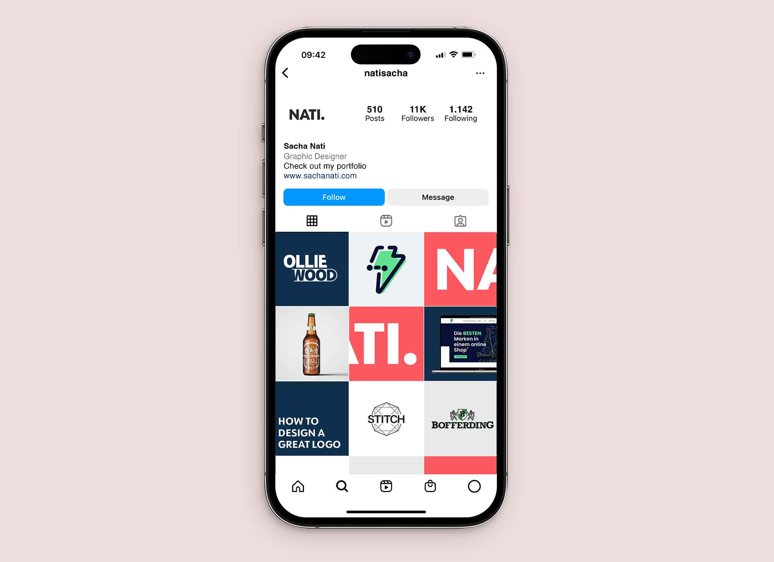
Inactive Users: I identified 26 users who had never posted a photo on Instagram , which could be a target group for promotional emails.
ID USERNAME
5 Aniya_Hackett
7 Kasandra_Homenick
14 Jaclyn81
21 Rocio33
24 Maxwell.Halvorson
25 Tierra.Trantow
34 Pearl7
36 Ollie_Ledner37
41 Mckenna17
45 David.Osinski47
49 Morgan.Kassulke
53 Linnea59
54 Duane60
57 Julien_Schmidt
66 Mike.Auer39
68 Franco_Keebler64
71 Nia_Haag
74 Hulda.Macejkovic
75 Leslie67
76 Janelle.Nikolaus81
80 Darby_Herzog
81 Esther.Zulauf61
83 Bartholome.Bernhard
89 Jessyca_West
90 Esmeralda.Mraz57
91 Bethany20

Slide 8
Contest Winner Declaration: The team has organized a contest where the user with the most likes on a single photo wins.
Your Task: Determine the winner of the contest and provide their details to the team.
SELECT
photos.id AS photo_id,
photos.image_url,
photos.user_id,
users.username,
COUNT(likes.user_id) AS like_count
FROM photos
INNER JOIN likes ON
photos.id = likes.photo_id
INNER JOIN users ON
photos.user_id = users.id
GROUP BY photos.id, photos.image_url, photos.user_id, users.username
ORDER BY like_count
DESC
LIMIT 1;

Slide 9
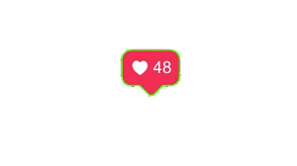


In the contest the user with most likes on a single photo has won and the winner is Zack_kemmer93.
Photo_id | Image_url | User_id | username | Like count
145 | https://jarret.name | 52 | Zack_Kemmer93 | 48

Slide 10
Hashtag Research: A partner brand wants to know the most popular hashtags to use in their posts to reach the most people.
Your Task: Identify and suggest the top five most commonly used hashtags on the platform.
SELECT t.tag_name,
COUNT(pt.tag_id) AS usage_count
FROM tags t JOIN photo_tags pt ON t.id = pt.tag_id
GROUP BY t.tag_name
ORDER BY usage_count
DESC LIMIT 5;

Slide 11

The most commonly used hashtags were identified, providing valuable information for the marketing team to optimize campaigns and improve visibility.
The most common used hashtags are smile, party, fun, concert and beach.
Tag name usage count
smile 59
party 39
fun 38
Concert 24
beach 42

Slide 12
Ad Campaign Launch: The team wants to know the best day of the week to launch ads.
Your Task: Determine the day of the week when most users register on Instagram. Provide insights on when to schedule an ad campaign.
SELECT COUNT(*) AS total_users, DAYNAME(created_at) AS day_of_week
FROM users
GROUP BY day_of_week
ORDER BY total_users
DESC LIMIT 3;

Slide 13
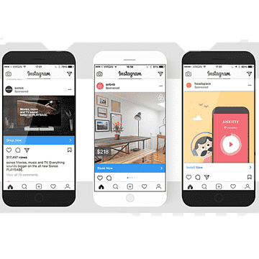
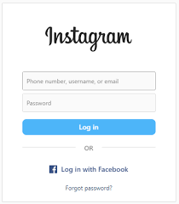
By analyzing user registration data, I found the best day of the week for launching ad campaigns to maximize reach and engagement.
So the best day to schedule advertisement and campaign is on Thursday and Sunday.
Total_users day of the week
16 Thursday
16 Sunday
15 Friday

Slide 14
INVESTOR METRICS
User Engagement: Investors want to know if users are still active and posting on Instagram or if they are making fewer posts.
Your Task: Calculate the average number of posts per user on Instagram. Also, provide the total number of photos on Instagram divided by the total number of users.
SELECT AVG (photo_count) AS avg_posts_per_user,
(SELECT COUNT(*) FROM photos) / (SELECT COUNT(*) FROM users) AS photo_to_user_ratio
FROM (
SELECT user_id, COUNT(*) AS photo_count
FROM photos
GROUP BY user_id
) user_photos;

Slide 15
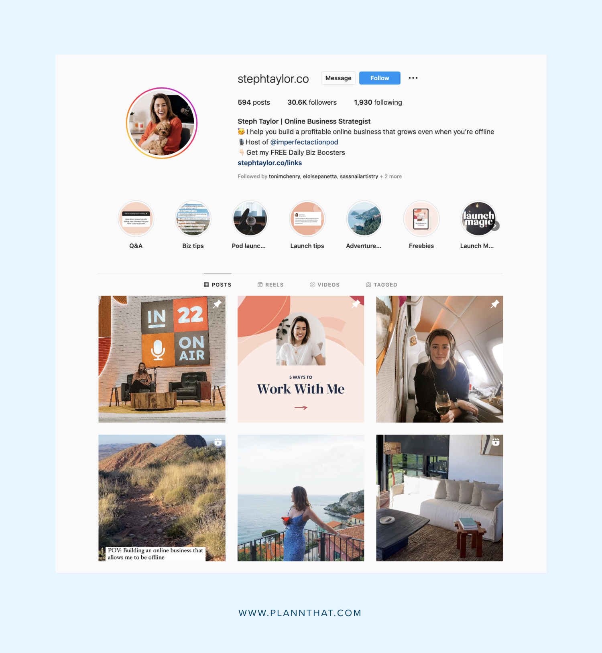

I calculated the average number of posts per user and the overall user-to-photo ratio, helping to assess the platform's overall engagement level.
Based on the data we can say that an average user posts 3-4 times.

Slide 16
Bots & Fake Accounts: Investors want to know if the platform is crowded with fake and dummy accounts.
Your Task: Identify users (potential bots) who have liked every single photo on the site, as this is not typically possible for a normal user.
SELECT u.id AS user_id, u.Username
FROM users u
WHERE NOT EXISTS (
SELECT 1
FROM photos p
WHERE NOT EXISTS ( SELECT 1 FROM likes l
WHERE l.photo_id = p.id AND l.user_id = u.id
));

Slide 17


Users who had liked every single photo on Instagram were flagged as potential bots, helping to ensure platform authenticity.
We have 13 such users based on the data who have liked all 257 posts, user-ld for the same are specified below.
ID username
5 Aniya_Hackett
14 Jaclyn81
21 Rocio33
24 Maxwell.Halvorson
36 Ollie_Ledner37
41 Mckenna17
54 Duane60
57 Julien_Schmidt
66 Mike.Auer39
71 Nia_Haag
75 Leslie67
76 Janelle.Nikolaus81
91 Bethany20

Slide 18
RESULT
Through this project, I successfully accomplished the following:
From this project ,I got an idea how data is used to make data driven decisions.
Generated key insights that can directly impact marketing strategies and ad campaign planning.
Identified potential areas for improving user engagement and re-engaging inactive users.
Provided the marketing and product teams with actionable data that could help shape Instagram’s future growth.
The analysis provided valuable information about user behavior, which could lead to better-targeted campaigns and improved user retention strategies for future product features and updates.

Slide 19
THANK YOU

