Slide 1
Project 1 FINA 6333 – Spring 2024 Group 20

Slide 2
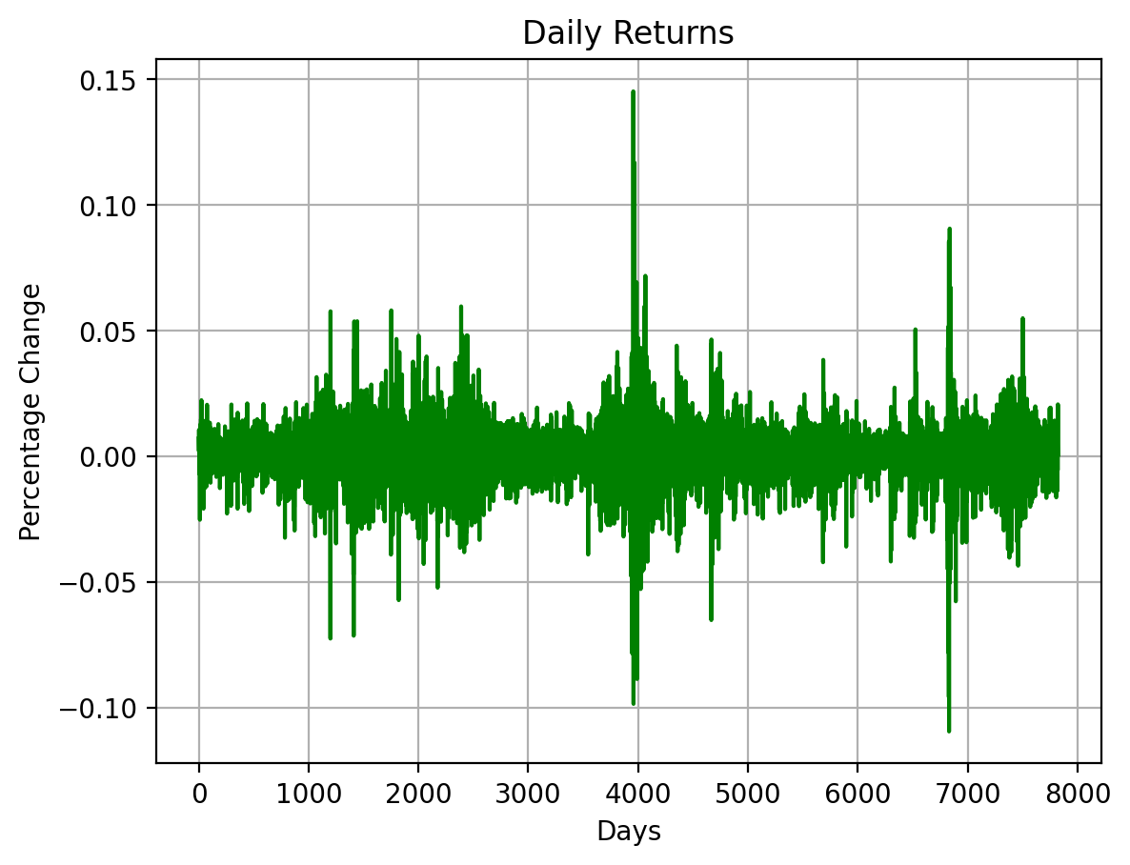
Strategy 1
0 NaN 1 0.0071 2 0.0021 3 0.0106 4 0.0042 ... 7818 -0.0050 7819 -0.0055 7820 0.0009 7821 0.0207 7822 0.0007 Name: Adj Close, Length: 7823, dtype: float64

Slide 3
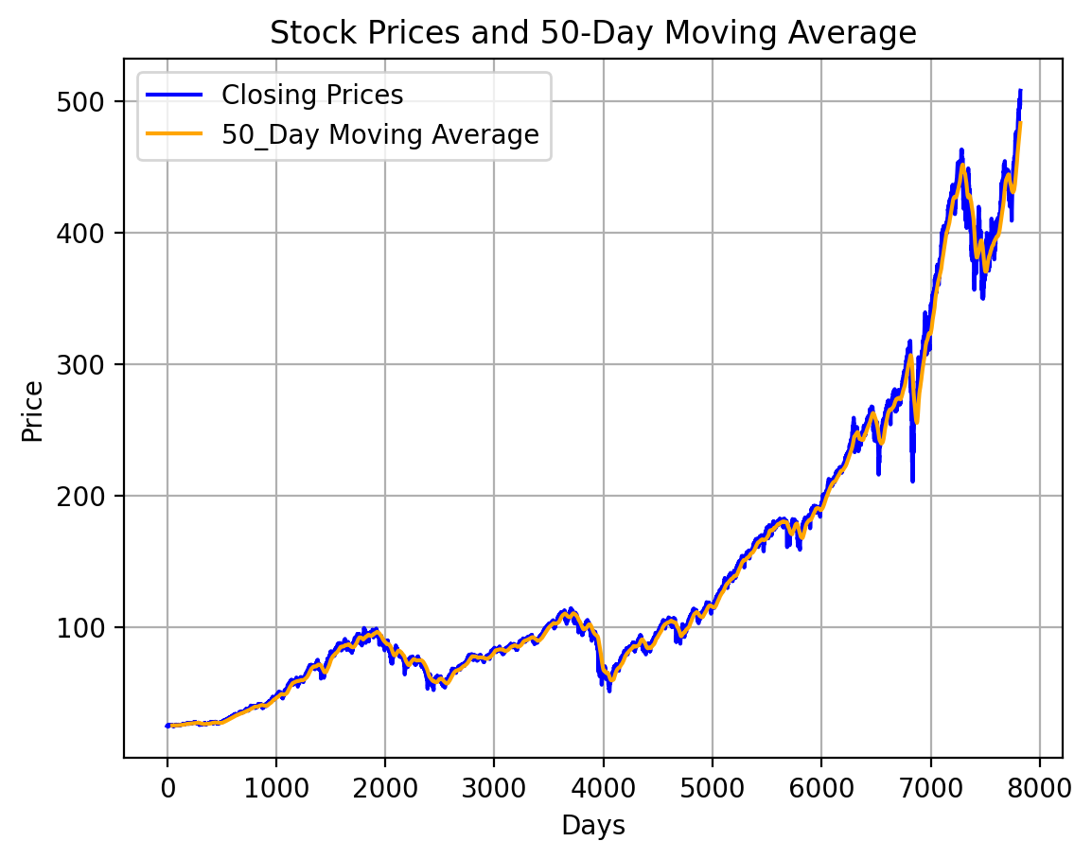
Moving Average
0 NaN 1 NaN 2 NaN 3 NaN 4 NaN ... 7818 479.6298 7819 480.5065 7820 481.3231 7821 482.3063 7822 483.2608 Name: 50_Day_MA, Length: 7823, dtype: float64

Slide 4
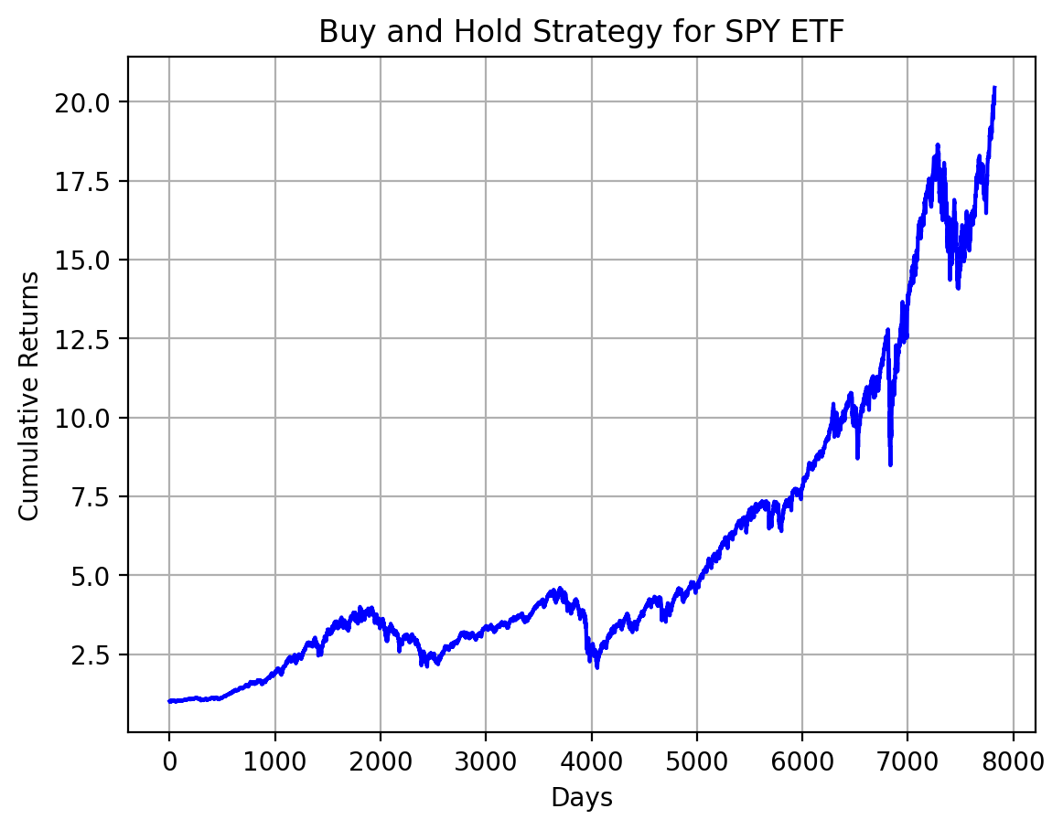
Strategy 1: Buy-and-Hold the SPY ETF
25.0173
399.7226
507.8500
final_investment: 202999.14535302244
Returns on investment: 1929.99%
COMMENTS:
The 1925.87% ROI for the SPY ETF from 1993 to 2023 reflects significant growth, where if $1 was invested during 1993 it would be multiplied nearly 20 times in 30 years. This underscores the effectiveness of long-term strategies particularly through passive vehicles like exchange traded funds while tracking the S&P 500. It signifies the collective performance of diverse companies within the index which is indicative of the broader market’s growth. Investors should exercise caution due to market volatility and consider maintaining a diversified portfolio. While past performance is sugguestiive of the potential, it does not guarantee future outocomes which necessitate prudent risk management.

Slide 5
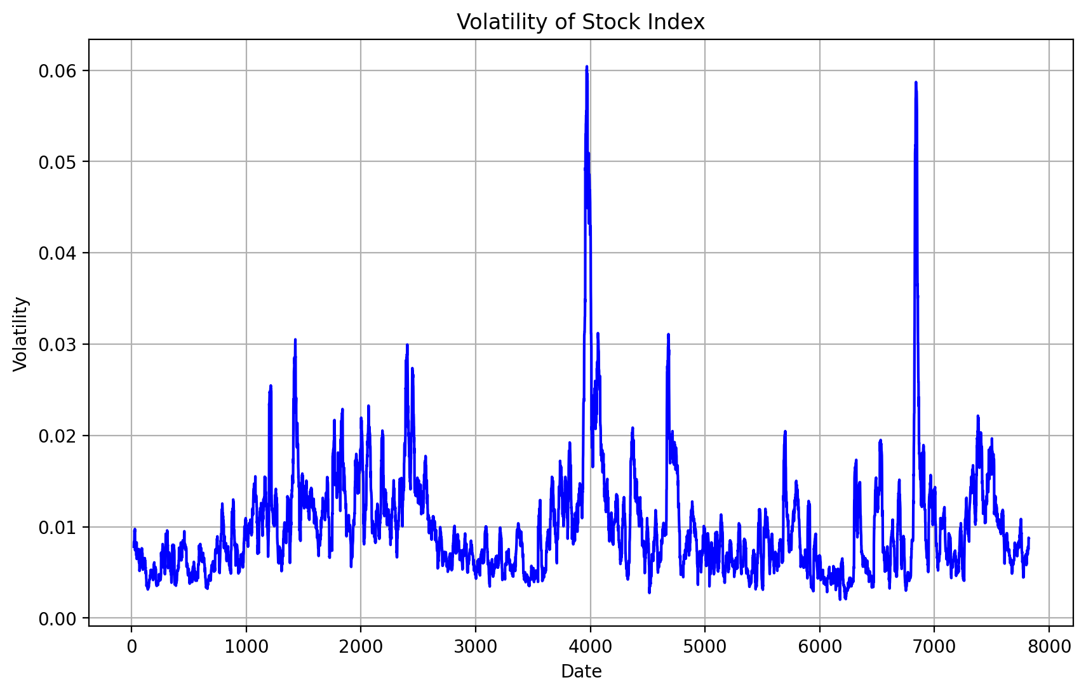
Volatility of Stock Index Returns
0.0101
Comments:
The volatility value of 0.01 for the SPY ETF preresents the standard deviation of its daily returns over the specified time period. This value indicates the average daily fluctuations in the ETF’s returns. A lower volatility suggets less varability and a lower risk in the ETF’s returns thereby making the ETF relatively stable and predicatbale. It is essential to conisder volatility laongside other risk measures and the investor’s risk toelrance.

Slide 6
Sharpe Ratio
0 NaN 1 -0.0001 2 -0.0001 3 -0.0001 4 -0.0001 ... 7818 -0.0002 7819 -0.0002 7820 -0.0002 7821 -0.0001 7822 -0.0002 Name: Adj Close, Length: 7823, dtype: float64
sharpe_ratio: -15.221478058793425
Comments:
A sharpe ratio of -15.22 signifies a negative risk-adjusted return for the investment this suggests that its volatility outweights its return potential. This exceptionally low value indicates significant underperformance as compared to a risk-free asset. Investors aim for a positive sharpe ratio which indicates a favourable balance between risk and return.

Slide 7
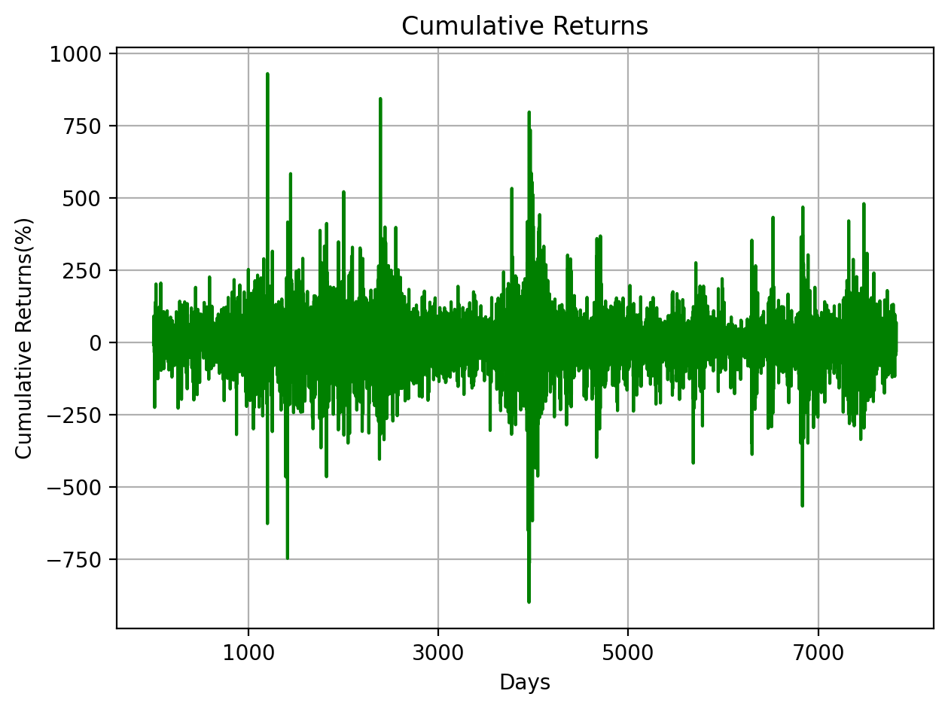
Strategy 2
initial_spy_price: 25.017347 initial_shares: 399.72264045424157 current_spy_price: 507.850006 final_value: 202999.14535302244
0 -7.1073 1 63.9659 2 28.2686 3 91.4849 4 6.9493 ... 7818 -43.6516 7819 -19.2878 7820 36.1305 7821 69.2445 7822 -27.8827 Name: Intraday Returns, Length: 7823, dtype: float64
0 -7.1073 1 63.9659 2 28.2686 3 91.4849 4 6.9493 ... 7818 -43.6516 7819 -19.2878 7820 36.1305 7821 69.2445 7822 -27.8827 Name: Intraday Returns, Length: 7823, dtype: float64
final_valueS2: -278827.15075912356
sharpe_ratioS2: 0.10821730256958988
0 NaN 1 NaN 2 NaN 3 NaN 4 NaN ... 7818 50.3816 7819 50.5935 7820 50.8953 7821 50.3021 7822 51.3012 Name: Intraday Returns, Length: 7823, dtype: float64

Slide 8
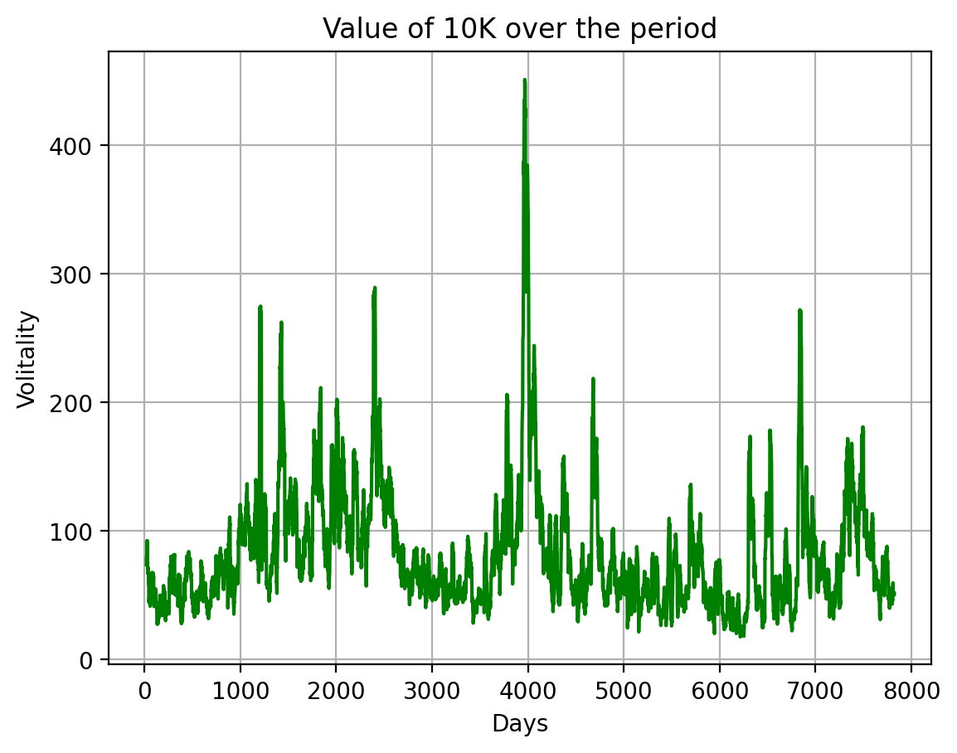

Slide 9
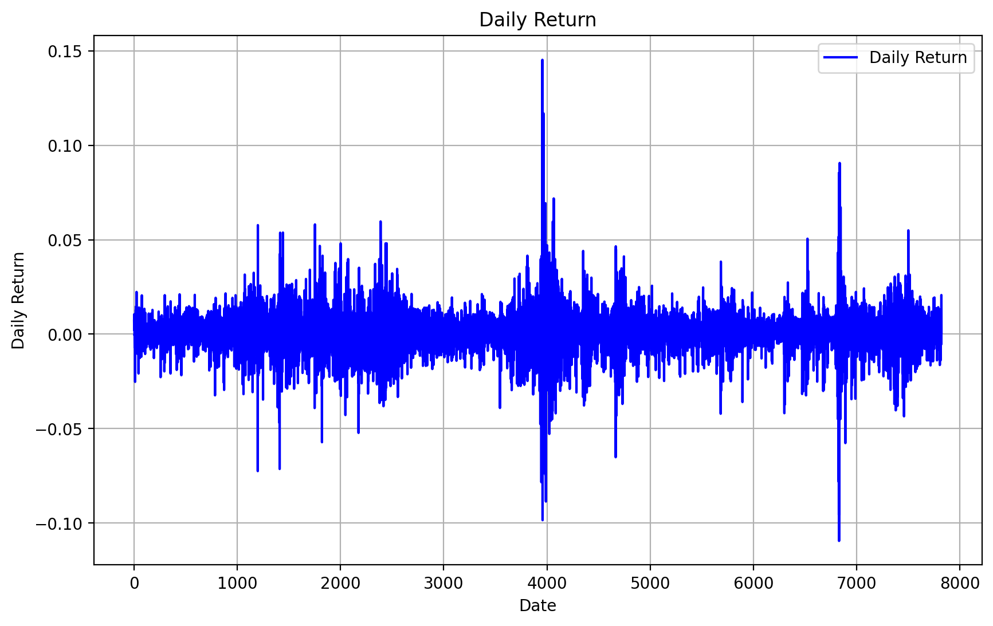
Strategy 3
Daily Return Overnight Return 0 NaN 0.7700 1 0.0071 0.7575 2 0.0021 0.7638 3 0.0106 0.7527 4 0.0042 0.7675 ... ... ... 7818 -0.0050 0.0044 7819 -0.0055 0.0019 7820 0.0009 -0.0036 7821 0.0207 -0.0069 7822 0.0007 0.0028 [7823 rows x 2 columns]
0 0.7700 1 0.7575 2 0.7638 3 0.7527 4 0.7675 ... 7818 0.0044 7819 0.0019 7820 -0.0036 7821 -0.0069 7822 0.0028 Name: Overnight Return, Length: 7823, dtype: float64
final_valueS3: 27.960677035021586
As we have calculated ‘Daily Return’ and ‘Overnight Return’ above

Slide 10
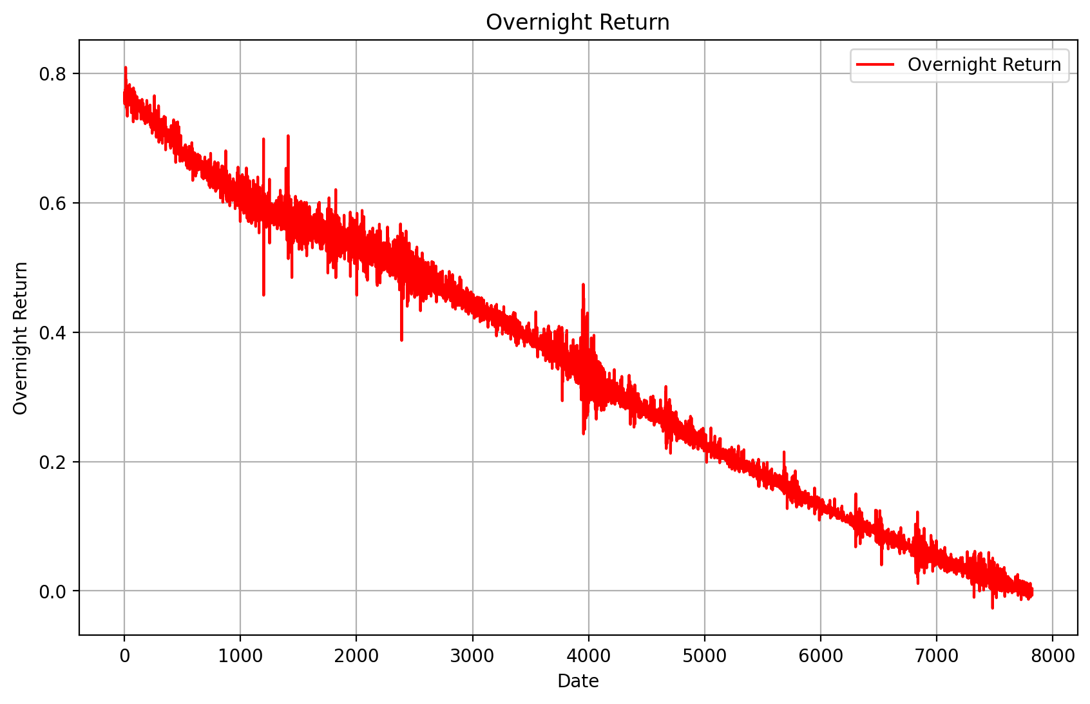

Slide 11
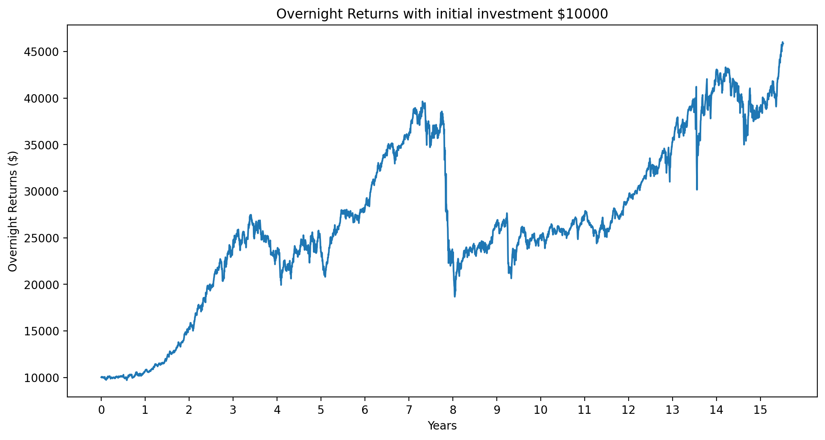
Daily Returns vs Overnight Returns: The daily returns seem to fluctuate around 0, with both positive and negative returns. The overnight returns seem mostly positive, with some periods of negative returns.
This indicates that buying SPY at close and selling at open yields overall positive returns, while holding SPY during the day leads to more variable returns.
Initial shares- 399.7226
Current spy price - 25.0173

Slide 12
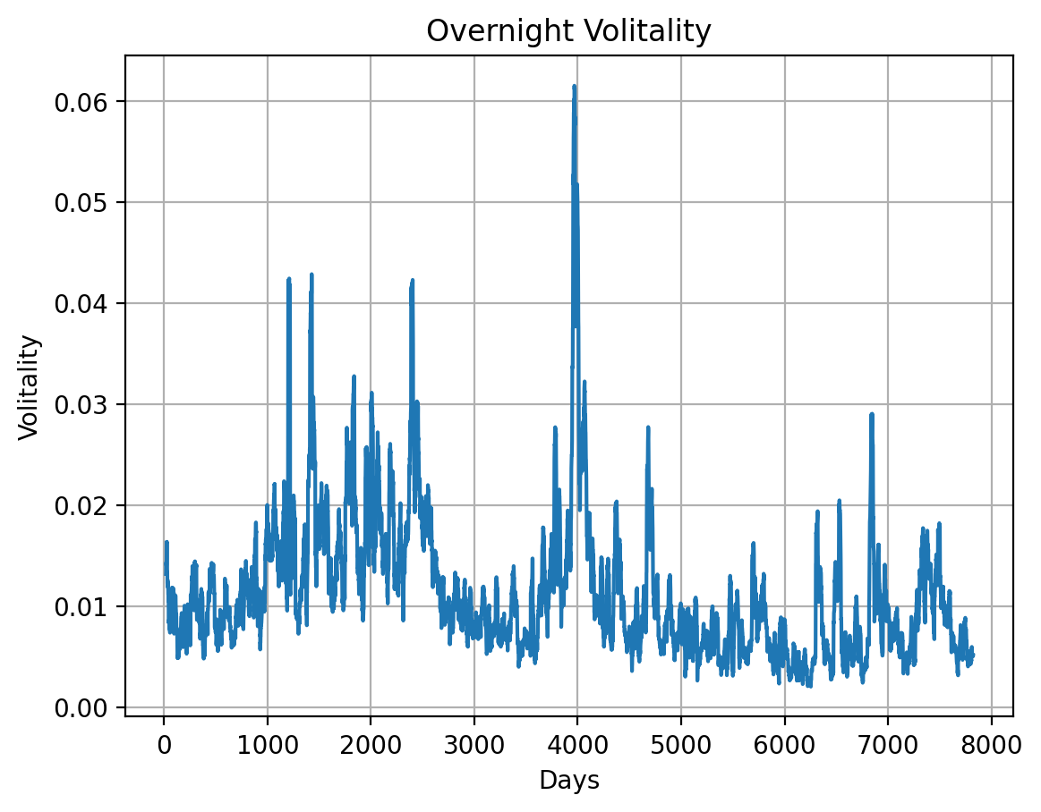
Daily Volatility: 0.01180772372574381
Overnight Returns Plot: The portfolio value increases exponentially over time. This indicates the power of compounding with an overnight strategy. However, the returns seem unrealistic over such a long period. In reality, returns are unlikely to be this consistent.
sharpe_ratioS3: 1.5417658179186282
Sharpe Ratio: The Sharpe ratio of 1.54 indicates decent risk-adjusted returns for the overnight strategy. However, there are some limitations:
The Sharpe ratio only considers the mean and standard deviation of returns. It does not account for other risk factors.
The strategy was backtested over a limited time period. The Sharpe ratio could be lower over a longer time horizon.
The risk-free rate used was very low. A higher risk-free rate would lower the Sharpe ratio.

Slide 13
Limitations:
Ignores trading costs like commissions, slippage and bid-ask spreads. These would lower net returns. Does not account for price jumps between close and open. Gap risk could lead to lower or negative returns. Unlikely to be implementable at scale in real markets due to price impact and liquidity constraints. Backtested over limited dataset. Real performance could vary significantly. Does not consider taxes, which would lower realized returns.
In summary, the overnight strategy looks promising based on backtest, but real-world limitations could significantly affect its viability. More rigorous analysis is needed before implementing this strategy.

Slide 14
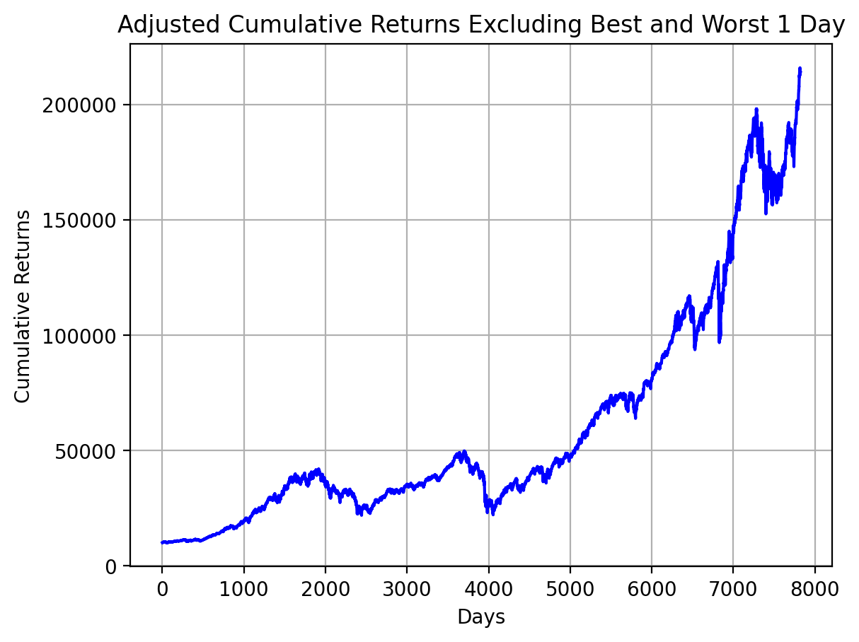
Strategy 4
0 NaN 1 0.0071 2 0.0021 3 0.0106 4 0.0042 ... 7817 0.0069 7818 -0.0050 7819 -0.0055 7820 0.0009 7822 0.0007 Name: Daily Returns, Length: 7759, dtype: float64
0 NaN 1 10071.1229 2 10092.4649 3 10199.1516 4 10241.8276 ... 7817 215970.5750 7818 214895.0458 7819 213711.9636 7820 213905.5507 7822 214053.0743 Name: Daily Returns, Length: 7759, dtype: float64

Slide 15
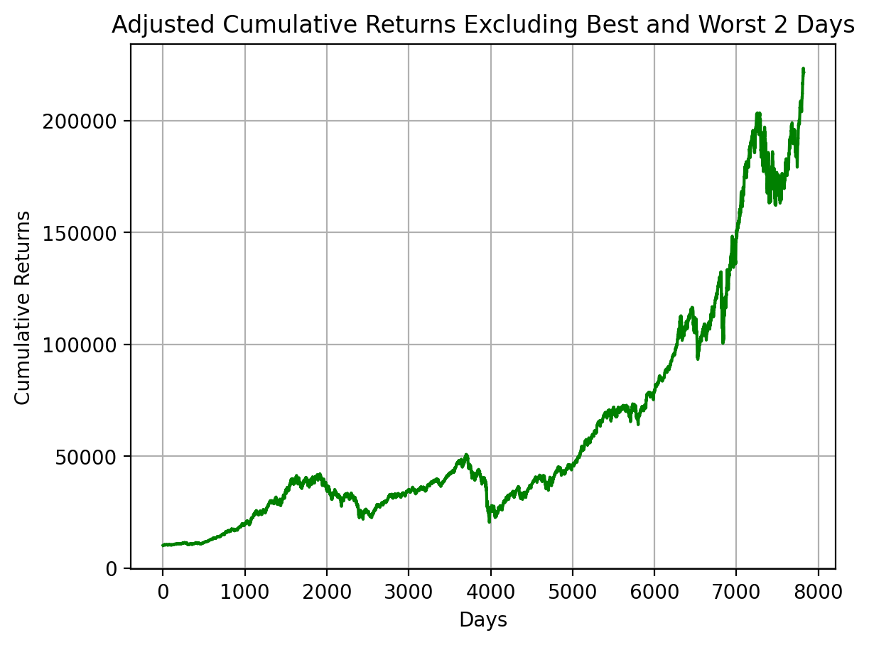
adjusted cumulative return n=1 214053.07433102903
The total return for n=1 came to $214,053.07. This shows a substantial return from the original investment and shows how significant growth may be obtained over time by reducing extreme daily volatility by removing the most positive and negative days. By eliminating days of high volatility, the approach seeks to mitigate the impact of strong market fluctuations and may lead to a more stable and even profitable investment trajectory.

Slide 16
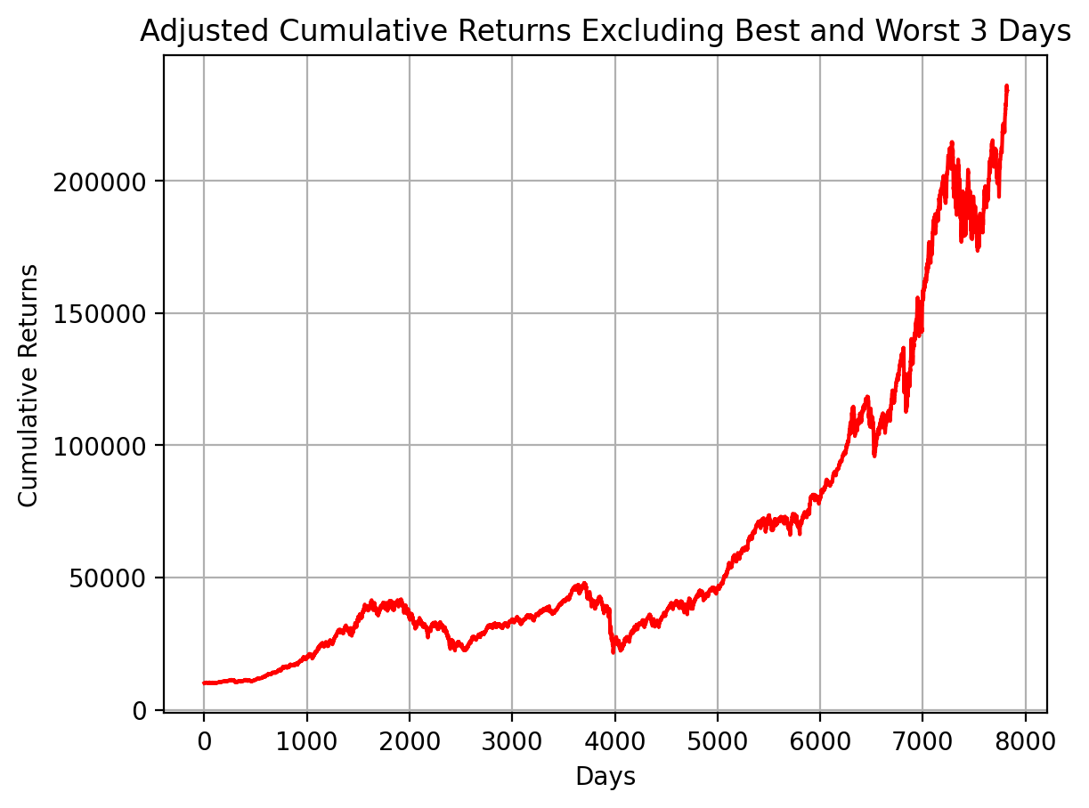
adjusted cumulative return n=2 221506.50584007573
The total return for n=2 increased to $221,506.51. This additional increase shows that removing the top two days of profits and the bottom two days of losses from each year can improve investment performance. It shows that extreme market fluctuations, both good and negative, can have a substantial effect on the overall return. By removing specific days, the investment’s volatility is reduced, which can be helpful for long term growth.

Slide 17
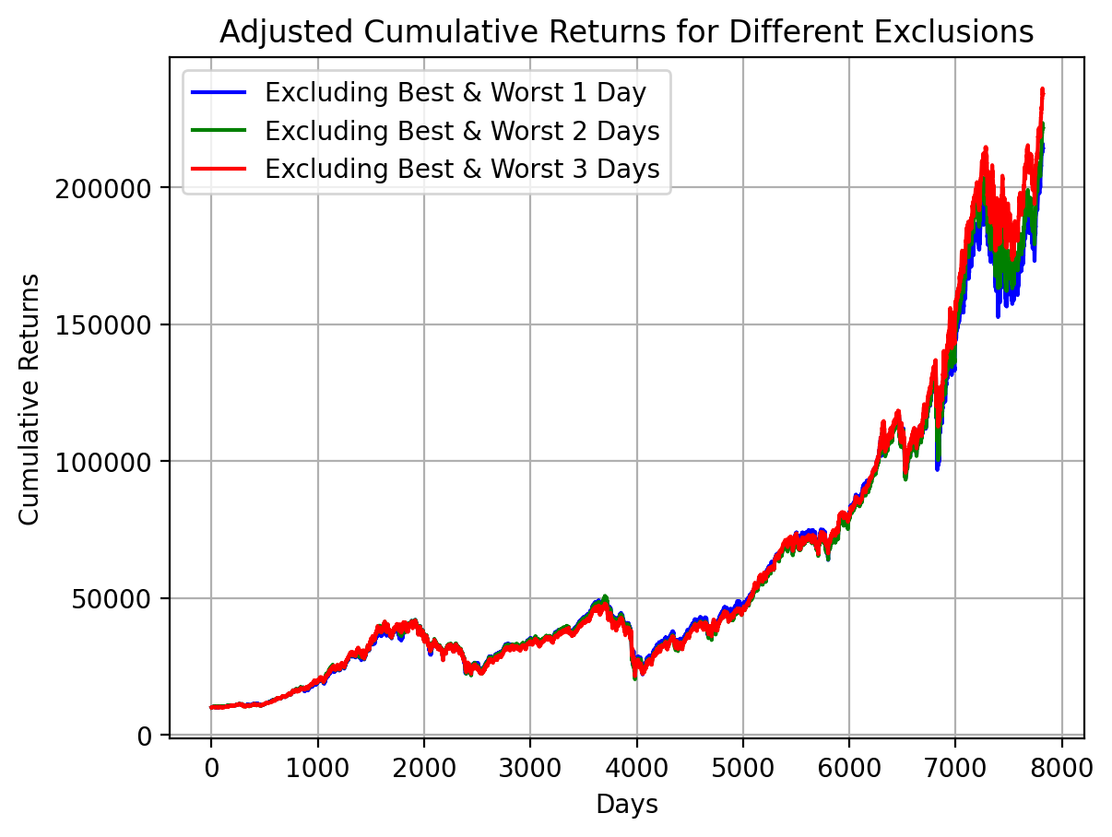
adjusted cumulative return n=3 234007.04962897924
The cumulative return for n=3 increased to $234,007.05. This is the highest return of all three scenarios, showing that removing the three most positive and three most negative days each year can result in more favourable investment outcomes. This scenario highlights the idea that excessive market volatility can have a significant impact on cumulative returns, and averaging them out may result in higher returns.

Slide 18
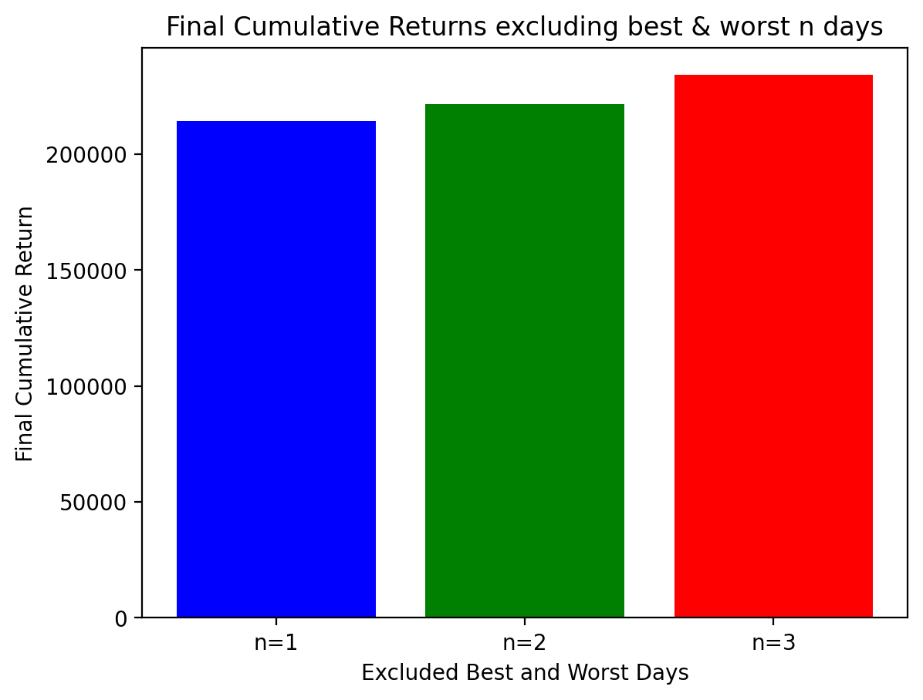
final cumulative return with investment: 214053.07433102903 221506.50584007573 234007.04962897924
Returns on investment n = 1: 2040.53% Returns on investment n = 2: 2115.07% Returns on investment n = 3: 2240.07%
These ROIs illustrate a key component of making investments. While it has the potential to provide big returns, it also contains risks that can have an adverse effect on investment outcomes. It’s essential to recognise the limitations of this strategy in real-world investment. It is not possible to accurately predict which days will be the best or worst, thus this strategy is more of a conceptual exercise than a real investment strategy.

Slide 19
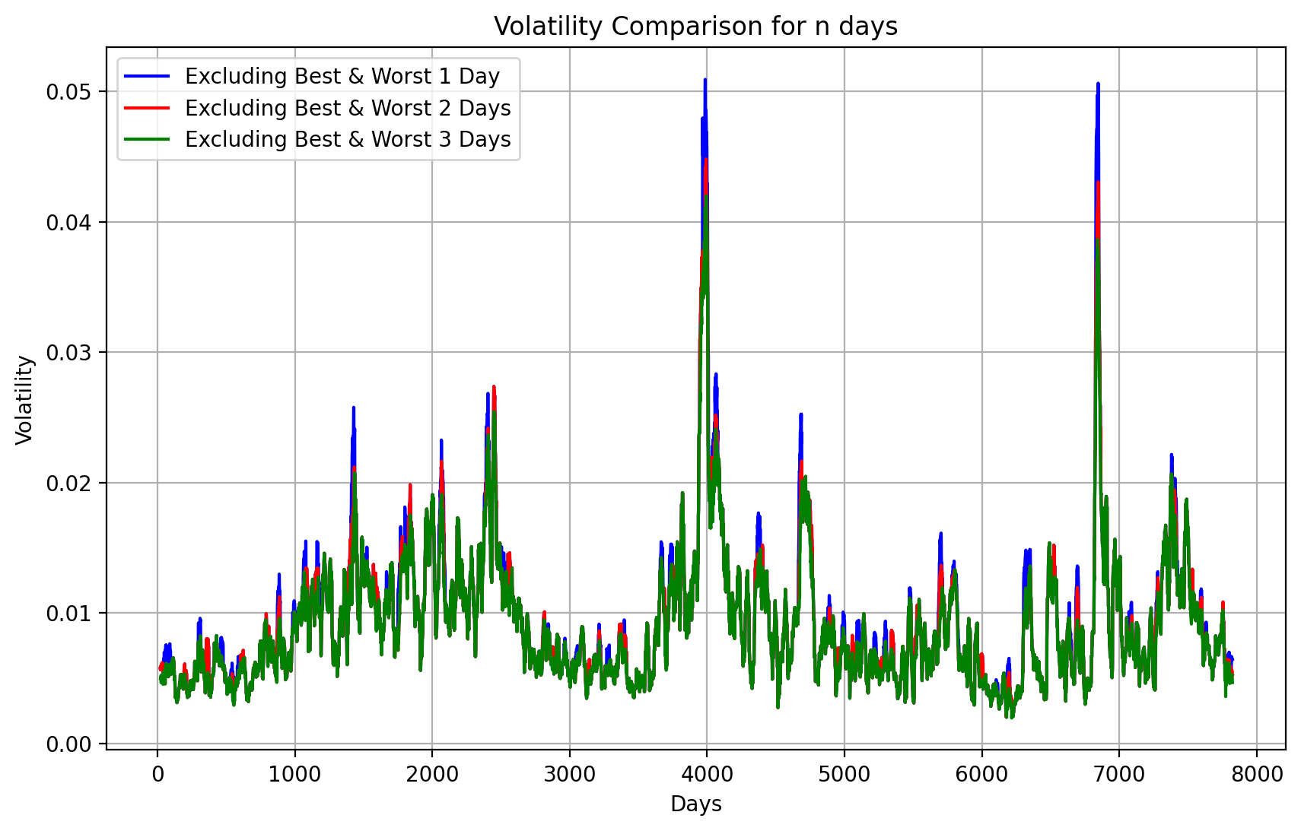
volatility_n1: 0.009621283812935812
The average volatility for n=1 is 0.009621, or about 0.962%. This amount of volatility measures the average variance in returns across 20-day periods, removing the most major positive and negative return days of the year. A volatility of less than 1% implies very small shifts in daily returns, indicating that the investment’s return profile becomes more predictable and possibly less risky for investors.
volatility_n2: 0.009305531931176102
The average volatility for n=2 falls to 0.009306 or about 0.931%. This additional reduction in volatility indicates that removing more extreme days from the dataset can result in a more consistent return pattern. By removing the two most volatile days of the year, the investment has decreased daily return fluctuation, which may make it more appealing to risk-averse investors.
volatility_n3: 0.009048227033717195
The mean volatility for n=3 falls further to 0.009048 or about 0.905%. This is the least volatile of the three scenarios, illustrating the most consistent return pattern. Removing out the three most extreme days of gains and losses each year seems to significantly level out the return on investment’s variations, thus reducing the risk profile even more.

Slide 20
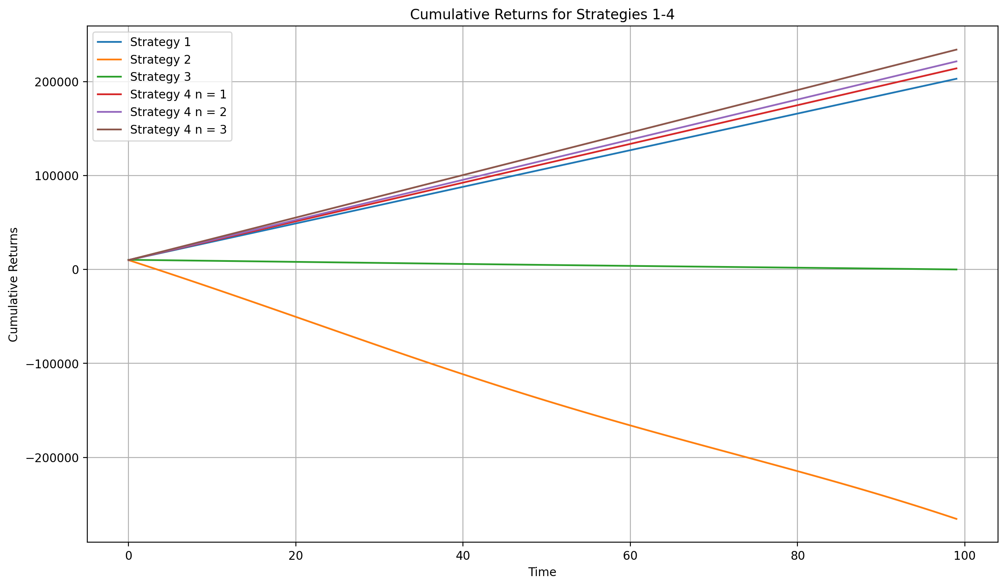
sharpe_ratio_n1: 0.652766062773865
sharpe_ratio_n2: 0.6876117897391778
sharpe_ratio_n3: 0.7231307647067668
The Sharpe Ratios for different scenarios, which exclude the best and worst 1, 2, and 3 days of investment returns, indicate an upward trend from 0.6528 to 0.7231. This pattern shows a rise in risk-adjusted returns as more volatile days are removed, indicating that limiting exposure to high market volatility can lead to more effective investing outcomes. The highest Sharpe Ratio of 0.7231, observed when the best and worst three days are eliminated, shows the potential benefits of a risk-management plan that eliminates extreme volatility, which provides investors with larger returns per unit of risk taken. This progression shows the important role of risk management in increasing investment efficiency, showing the significance of balancing risk and return to reach optimum investment performance.

Slide 21
Final Result :
Considering only the final cumulative return as a success criterion, Strategy 4 n=3 is the best strategy as it has the highest final cumulative return. Though it is essential to keep in mind that the best approach should not be decided only on the basis of the final return. Other aspects to consider include risk, volatility and the and time frames. Based on the results displayed in the graph, Strategy 4 n=3 would be regarded the most successful in terms of final value of investment

