Slide 1


PiVote : A Secure Biometric Voting System
PRESENTED BY:
KIRUTHIKA
PRIYAN
MAGATHI
DARSHITHA

Slide 2


Today's
Agenda
1
Problem statement
Proposed solution
2
Process flow
P
3
4
Future scope
5
Conclusion

Slide 3
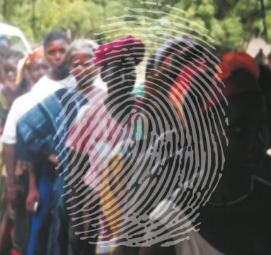
Problem Statement
Traditional voting systems face major issues like fake voting, identity fraud, and lack of transparency.
Manual methods are slow, error-prone, and often lead to mistrust among voters.
There is an urgent need for a smart and secure system that can verify voter identity accurately, prevent fraud, and confirm the vote to the user in real-time.

Slide 4
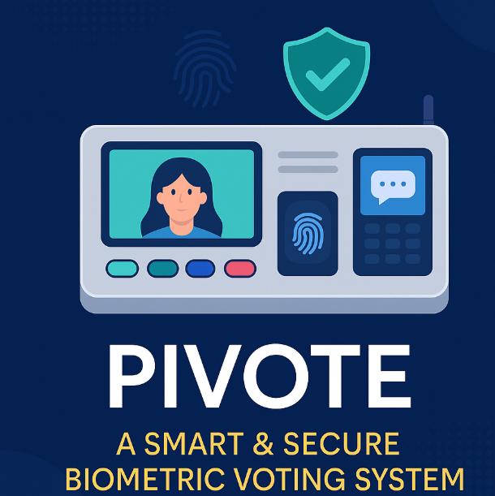
Proposed solution
SDG 16 – Peace, Justice and Strong Institutions
We propose PIVOTE, a smart and secure voting system that uses biometric fingerprint verification and secure SMS confirmation to authenticate voters and record their votes safely.
The system ensures only eligible voters can cast a vote, and it provides real-time confirmation to enhance trust and transparency.
By combining IoT, AI, and cloud technologies, PIVOTE offers
tamper-proof
Paperless
User-friendly solution
that can be deployed across urban and rural areas for more efficient, transparent, and secure elections.

Slide 5
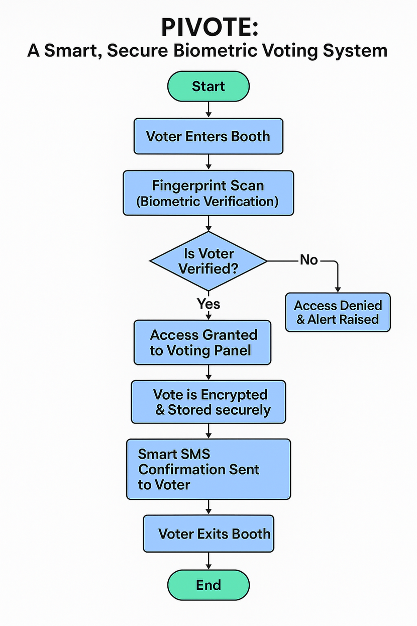
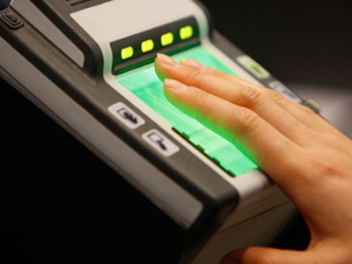
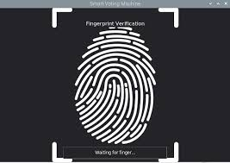

Slide 6
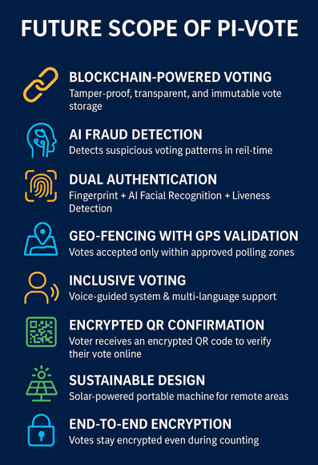
PiVote 2.0

Slide 7

Conclusion
PIVOTE empowers democracy with AI and biometrics — making every vote count, every identity verified, and every voice truly heard.

