Slide 1
PROJECT DOCUMENTATION
STUDENT ENROLLMENT
AND COURSE MANAGEMENT SYSTEM
A web-based platform for course discovery, student enrollment,
and academic profile management
TEAM LEADER: S. PRIYADHARSHINI
Puratchi Thalivar Dr. MGR Government Arts and Science College | College Code: TVU364
Formal 40-slide project documentation

Slide 2
Document Overview
PROJECT DOCUMENTATION
1. TEAM LEADER — S. PRIYADHARSHINI
Reg. No.: 36424U28033 | NM ID: 11f58038c37762c947743c0c36491528@nm2026.in
Email: spriyadhrshini150604@gmail.com
2. TEAM MEMBER — NETHRA S
Reg. No.: 36424U18026 | NM ID: 1C31731263AC3CDB9A664C43AEF6E181C
Email: nethras2489@gmail.com
3. TEAM MEMBER — NADHIYA P
Reg. No.: 36424U18024 | NM ID: 2af7fd3a9958312a69642c993c63278e
Email: 36424u18024@gmail.com
4. TEAM MEMBER — RAJALAKSHMI R
Reg. No.: 36424U18036 | NM ID: EFF9A56FF15672BB16447F250235BEFC
Email: bakiyalakshmi2218@gmail.com
5. TEAM MEMBER — DHILIPKUMAR.S
Reg. No.: 36424U1807 | NM ID: ECD23DA5D1C55D1A5B7480FEBB8A1825
Email: dhilipkumarcs007@gmail.com
STUDENT ENROLLMENT & COURSE MANAGEMENT SYSTEM
02

Slide 3
Project Abstract
PROJECT DOCUMENTATION
• The Student Enrollment and Course Management System is designed to help students view available courses and manage course enrollment through a centralized interface.
• The application presents a login screen, a dashboard with enrollment statistics, a course catalogue, a course enrollment form, and a student profile.
• The system aims to reduce manual enrollment work, make course information easier to access, and provide students with a clear view of their enrollment status.
• An administrator role is represented in the login interface; administrator capabilities should be implemented according to the final requirements.
STUDENT ENROLLMENT & COURSE MANAGEMENT SYSTEM
03

Slide 4
Problem Statement
PROJECT DOCUMENTATION
• Course registration can become difficult when course details and enrollment records are maintained through disconnected or manual processes.
• Students may need to contact staff to confirm course availability, credit values, or enrollment status.
• Manual record handling can lead to duplicate entries, delayed updates, and limited visibility into student course selections.
• The project addresses these challenges with a unified digital interface for course browsing, enrollment, and profile viewing.
STUDENT ENROLLMENT & COURSE MANAGEMENT SYSTEM
04

Slide 5
Project Objectives
PROJECT DOCUMENTATION
• Provide a simple and accessible login interface for authorized users.
• Display course information such as course ID, course name, department, and credits.
• Allow students to select a course and submit an enrollment request.
• Show key dashboard metrics, including total courses and enrolled courses.
• Provide a student profile view with academic and role information.
• Support accurate, consistent, and maintainable enrollment records.
STUDENT ENROLLMENT & COURSE MANAGEMENT SYSTEM
05

Slide 6
Project Scope
PROJECT DOCUMENTATION
• In scope: authentication interface, role selection, student dashboard, course catalogue, enrollment workflow, enrollment overview, and student profile.
• In scope: displaying course metadata and basic enrollment statistics.
• Potential extension: administrator management of courses, students, and enrollment approvals.
• Out of scope unless implemented separately: payment processing, learning content delivery, attendance tracking, grading, and timetable generation.
• Scope should be finalized against the actual project code and approved requirements.
STUDENT ENROLLMENT & COURSE MANAGEMENT SYSTEM
06

Slide 7
Target Users & Stakeholders
PROJECT DOCUMENTATION
• Students: browse the course catalogue, enroll in courses, review their enrollment status, and view profile details.
• Administrator: may maintain course records and oversee enrollment data if the admin module is included.
• Faculty or department staff: may use reports or course information in a future extension.
• College/project guide: reviews the system against academic project requirements.
• Development team: designs, implements, tests, documents, and demonstrates the system.
STUDENT ENROLLMENT & COURSE MANAGEMENT SYSTEM
07

Slide 8
Key Features at a Glance
PROJECT DOCUMENTATION
• Login page with username, password, and role selection.
• Dashboard with Total Courses, Enrolled Courses, Pending Enrollments, and Available Courses.
• Course catalogue table with course ID, course name, department, credits, and Enroll action.
• Enrollment form with a course selector and Enroll Now button.
• Student profile card showing name, course, department, and role.
• Persistent navigation for Dashboard, View Courses, Enroll Course, My Enrollments, Profile, and Logout.
STUDENT ENROLLMENT & COURSE MANAGEMENT SYSTEM
08

Slide 9
Phase 1 — Brainstorming & Ideation
PHASE 1
• Identify common student pain points in course discovery and registration.
• Discuss a centralized portal that combines course details, enrollment actions, and student information.
• Review the supplied reference screens to establish the expected interface and user journey.
• Define the initial concept: a straightforward, role-aware course enrollment portal.
• Outcome: agreed project concept, target users, initial feature list, and project title.
STUDENT ENROLLMENT & COURSE MANAGEMENT SYSTEM
09

Slide 10
Ideation: Proposed User Journey
PHASE 1
• 1. User opens the application and reaches the login screen.
• 2. User enters credentials and selects the applicable role.
• 3. Student lands on the dashboard and reviews course/enrollment summaries.
• 4. Student opens View Courses and examines course details.
• 5. Student selects a course through Enroll Course and submits the enrollment.
• 6. Student checks My Enrollments and views profile information.
STUDENT ENROLLMENT & COURSE MANAGEMENT SYSTEM
10

Slide 11
Phase 2 — Requirement Analysis
PHASE 2
• Collect functional requirements from the reference UI and project objective.
• Identify user roles and the actions each role is permitted to perform.
• Define data fields required for student, course, and enrollment records.
• Document expected validations, success messages, and error states.
• Establish non-functional expectations for usability, security, performance, reliability, and maintainability.
STUDENT ENROLLMENT & COURSE MANAGEMENT SYSTEM
11

Slide 12
Functional Requirements
PHASE 2
• FR-01: The system shall provide a login form for username and password.
• FR-02: The system shall provide a role selector, including the displayed Admin option.
• FR-03: The student dashboard shall show course and enrollment summary values.
• FR-04: The system shall display available courses with ID, name, department, and credits.
• FR-05: The student shall be able to select a course and submit an enrollment request.
• FR-06: The system shall provide a My Enrollments view and a student profile view.
• FR-07: The system shall provide navigation to the listed modules and a logout action.
STUDENT ENROLLMENT & COURSE MANAGEMENT SYSTEM
12

Slide 13
Non-Functional Requirements
PHASE 2
• Usability: clear labels, consistent navigation, readable typography, and understandable feedback.
• Security: authenticated access, role-based authorization, secure password storage, and protected sessions.
• Performance: common screens should load promptly under the expected student workload.
• Reliability: enrollment operations should avoid duplicate records and preserve data consistency.
• Compatibility: responsive layout for common desktop and mobile screen sizes.
• Maintainability: modular code, documented database structure, and testable components.
STUDENT ENROLLMENT & COURSE MANAGEMENT SYSTEM
13

Slide 14
Business Rules & Validations
PHASE 2
• A student should not be enrolled in the same course more than once.
• Enrollment should only be accepted for a valid course that is open for registration.
• Required login fields must not be empty; invalid credentials should be rejected.
• Course credit values must be valid numeric values within the institution's policy.
• Dashboard counts should be calculated from current course and enrollment records.
• Rules such as capacity limits, prerequisites, approval, and credit-load limits should be added only if required by the college.
STUDENT ENROLLMENT & COURSE MANAGEMENT SYSTEM
14

Slide 15
Phase 3 — Project Design
PHASE 3
• Design the system around clearly separated user interface, application logic, and data storage layers.
• Use a consistent navigation layout with a top header, left sidebar, and main content panel.
• Keep common actions prominent: browse courses, enroll, view enrollments, and open profile.
• Use reusable components for cards, forms, tables, alerts, and navigation.
• Outcome: UI layout, user flow, data model, and component-level design.
STUDENT ENROLLMENT & COURSE MANAGEMENT SYSTEM
15

Slide 16
System Architecture (Proposed)
PHASE 3
• Presentation layer: login page, dashboard, course list, enrollment form, enrollments page, and profile.
• Application layer: authentication, role checks, course retrieval, enrollment validation, and dashboard calculations.
• Data layer: student/user records, course records, and enrollment records.
• Request flow: user action → validation and authorization → application operation → database read/write → response shown in UI.
• Architecture is a logical proposal; map the layers to the actual framework and code structure used in the project.
STUDENT ENROLLMENT & COURSE MANAGEMENT SYSTEM
16

Slide 17
Use Case Summary
PHASE 3
• Student — Login: enter credentials and access the student workspace.
• Student — Browse Courses: view course identifiers, names, departments, and credit values.
• Student — Enroll: choose a course and submit an enrollment request.
• Student — View Enrollments: review courses already selected and their status.
• Student — View Profile: review name, program, department, and role.
• Administrator — Manage Records: optional use case if the admin functions are included in the implementation.
STUDENT ENROLLMENT & COURSE MANAGEMENT SYSTEM
17

Slide 18
Data Model / Core Entities
PHASE 3
• User: user_id, username, password_hash, role, account_status.
• Student: student_id, user_id, full_name, registration_number, program, department, email.
• Course: course_id, course_name, department, credits, availability_status.
• Enrollment: enrollment_id, student_id, course_id, enrollment_date, enrollment_status.
• Relationships: one user may map to one student profile; a student may have many enrollments; a course may have many student enrollments.
• Use primary keys, foreign keys, and a unique constraint on the student–course pair to protect data integrity.
STUDENT ENROLLMENT & COURSE MANAGEMENT SYSTEM
18

Slide 19
UI Design Principles
PHASE 3
• Use a stable top navigation bar to show the system title and signed-in user.
• Use a dark sidebar to keep primary modules visible and easy to locate.
• Use a light main canvas and white content cards to improve contrast and grouping.
• Use blue for primary actions and distinct colors for dashboard metric cards.
• Maintain consistent spacing, button sizes, table borders, headings, and form labels.
• Ensure color is not the only way to communicate status; pair it with text.
STUDENT ENROLLMENT & COURSE MANAGEMENT SYSTEM
19

Slide 20
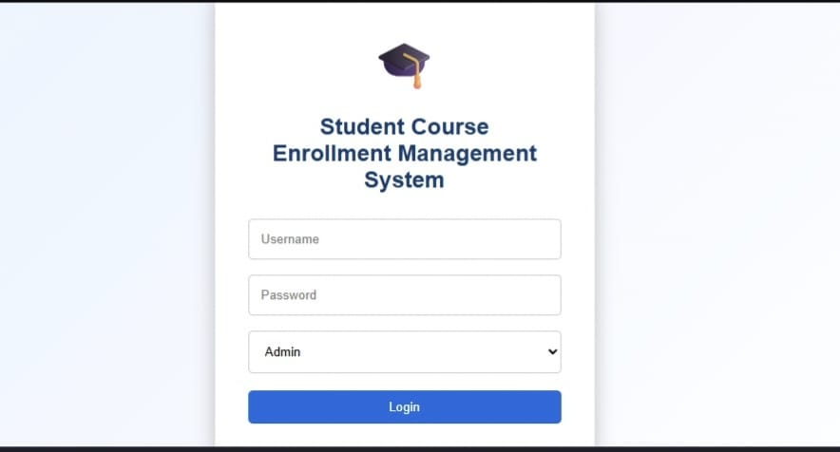
Interface Reference: Login
PHASE 3
Login Screen
• Username and password inputs
• Role selection dropdown
• Single primary Login action
• Centered card layout with graduation-cap icon
STUDENT ENROLLMENT & COURSE MANAGEMENT SYSTEM
20

Slide 21
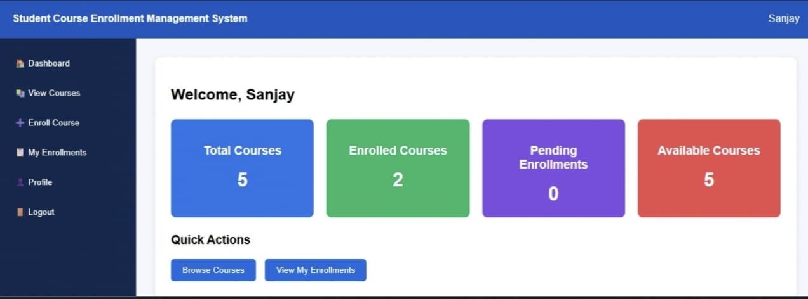
Interface Reference: Student Dashboard
PHASE 3
Dashboard Summary
• Welcome message identifies the signed-in student.
• Metric cards show total, enrolled, pending, and available courses.
• Quick actions provide shortcuts to course browsing and enrollments.
STUDENT ENROLLMENT & COURSE MANAGEMENT SYSTEM
21

Slide 22
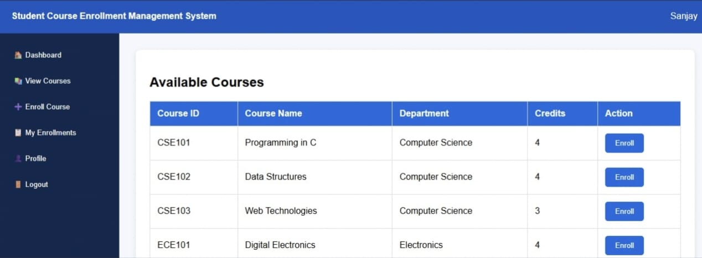
Interface Reference: Available Courses
PHASE 3
Course Catalogue
• Table columns: Course ID, Course Name, Department, Credits, and Action.
• Each course row offers an Enroll action.
• Visible examples include CSE101, CSE102, CSE103, and ECE101.
STUDENT ENROLLMENT & COURSE MANAGEMENT SYSTEM
22

Slide 23
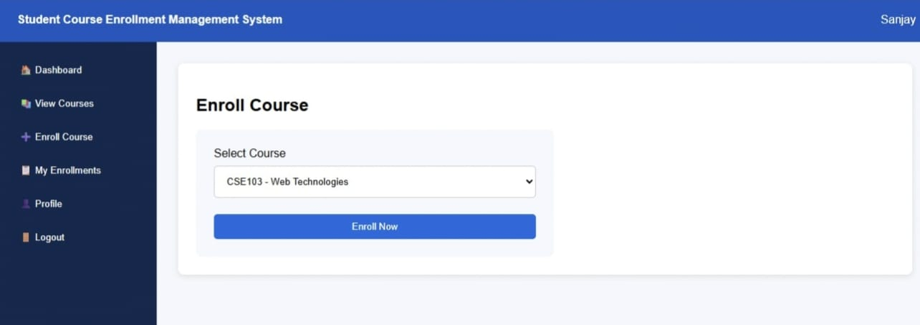
Interface Reference: Enroll Course
PHASE 3
Enrollment Form
• Student chooses a course from a dropdown list.
• Enroll Now submits the selected course for processing.
• The system should confirm success or explain validation errors.
STUDENT ENROLLMENT & COURSE MANAGEMENT SYSTEM
23

Slide 24
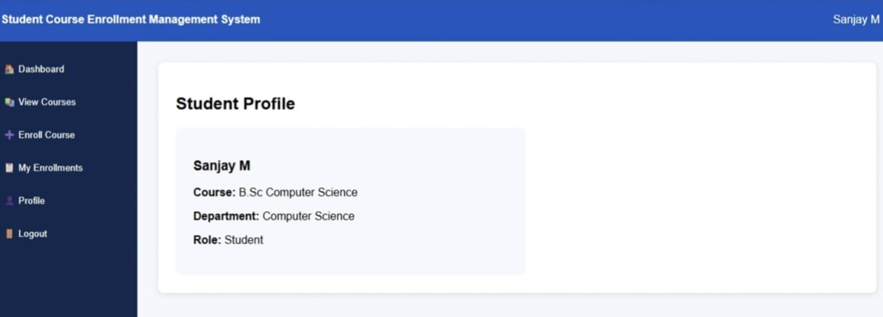
Interface Reference: Student Profile
PHASE 3
Student Profile
• Profile displays the student's name.
• Academic details include course/program and department.
• Role is shown to clarify the user's access context.
STUDENT ENROLLMENT & COURSE MANAGEMENT SYSTEM
24

Slide 25
Phase 4 — Project Planning
PHASE 4
• Break the work into eight documented phases and track deliverables in a shared repository.
• Assign module ownership while keeping integration and review responsibilities shared.
• Plan short iterations: requirements and design first, then core features, testing, documentation, and demo.
• Use issue tracking or a task board to record owner, priority, status, and due date.
• Maintain regular team reviews and keep the repository updated after each milestone.
STUDENT ENROLLMENT & COURSE MANAGEMENT SYSTEM
25

Slide 26
Work Breakdown Structure
PHASE 4
• 1. Brainstorming & Ideation — problem, target users, concept, initial features.
• 2. Requirement Analysis — functional/non-functional requirements, rules, and acceptance criteria.
• 3. Project Design — architecture, navigation, UI mockups, and data model.
• 4. Project Planning — timeline, responsibilities, risks, and milestones.
• 5. Project Development — frontend, backend, database, integration, and seed data.
• 6. Project Testing — test cases, execution, defect fixes, and regression.
• 7. Project Documentation — report, setup instructions, screenshots, and user guide.
• 8. Project Demonstration — prepared walkthrough, voice-over, final output, and public links.
STUDENT ENROLLMENT & COURSE MANAGEMENT SYSTEM
26

Slide 27
Team Structure & Responsibilities
PHASE 4
• Team Leader — S. PRIYADHARSHINI: coordinate tasks, monitor progress, integrate modules, and lead the final demonstration.
• Team Member 1 — Nethra S: support requirements, UI implementation, and testing activities.
• Team Member 2 — Nadhiya P: support data design, enrollment workflow, and integration.
• Team Member 3 — Rajalakshmi R: support course catalogue, interface development, and documentation.
• Team Member 4 — M Thatchana: support profile/dashboard features, validation, and testing.
• These are suggested responsibility areas; adjust them to reflect the work actually completed by each member.
STUDENT ENROLLMENT & COURSE MANAGEMENT SYSTEM
27

Slide 28
Milestone Plan
PHASE 4
• Milestone 1: Project concept and scope approved.
• Milestone 2: Requirements and acceptance criteria reviewed.
• Milestone 3: UI, architecture, and database design completed.
• Milestone 4: Login, dashboard, course list, enrollment, and profile integrated.
• Milestone 5: Functional, validation, and usability testing completed.
• Milestone 6: Documentation, repository cleanup, and demo recording completed.
• Record actual dates and completion status in the team's project tracker.
STUDENT ENROLLMENT & COURSE MANAGEMENT SYSTEM
28

Slide 29
Risk Assessment & Mitigation
PHASE 4
• Risk: duplicate enrollment records. Mitigation: validate in application logic and enforce a database uniqueness constraint.
• Risk: unauthorized access. Mitigation: secure authentication, role checks, and protected routes.
• Risk: inconsistent dashboard totals. Mitigation: calculate counts from the same source records and test edge cases.
• Risk: integration delays. Mitigation: define interfaces early, use version control, and integrate incrementally.
• Risk: incomplete submission links. Mitigation: verify public GitHub access and Drive permissions before submission.
• Risk: mismatch between report and code. Mitigation: review all claims against the final working application.
STUDENT ENROLLMENT & COURSE MANAGEMENT SYSTEM
29

Slide 30
Phase 5 — Project Development
PHASE 5
• Implement the user interface using reusable page layouts and form/table components.
• Implement authentication and session handling according to the selected technology stack.
• Connect course listings to stored course data rather than hard-coded values in the final application.
• Implement enrollment creation with server-side validation and duplicate prevention.
• Populate dashboard metrics from course and enrollment data.
• Integrate profile information and navigation; maintain source control throughout development.
STUDENT ENROLLMENT & COURSE MANAGEMENT SYSTEM
30

Slide 31
Module Development Breakdown
PHASE 5
• Authentication module: credential form, credential verification, session lifecycle, and logout.
• Dashboard module: summary cards and quick navigation.
• Course module: course listing, course details, and availability display.
• Enrollment module: course selection, submission, validation, and status display.
• Profile module: student identity and academic details.
• Administration module (if implemented): manage courses, student records, and enrollment oversight.
STUDENT ENROLLMENT & COURSE MANAGEMENT SYSTEM
31

Slide 32
Enrollment Workflow
PHASE 5
• Step 1 — Student opens the course catalogue or enrollment page.
• Step 2 — System retrieves courses that are available for enrollment.
• Step 3 — Student selects a course and submits the request.
• Step 4 — System verifies authentication, course validity, and enrollment rules.
• Step 5 — System creates the enrollment record if validation passes.
• Step 6 — UI displays confirmation and refreshes enrollment/dashboard information.
• Failure path: show a clear message and do not create a partial or duplicate record.
STUDENT ENROLLMENT & COURSE MANAGEMENT SYSTEM
32

Slide 33
Data Integrity & Security
PHASE 5
• Store passwords as secure hashes; never store plaintext passwords.
• Use parameterized database queries or a safe ORM to reduce injection risk.
• Enforce authorization on the server for every protected action.
• Validate all submitted values on the server, even when client-side validation exists.
• Use database transactions where enrollment operations involve multiple related updates.
• Protect student data, limit unnecessary exposure, and keep credentials out of source control.
STUDENT ENROLLMENT & COURSE MANAGEMENT SYSTEM
33

Slide 34
Phase 6 — Project Testing
PHASE 6
• Testing verifies that features meet the requirements and that common failure cases are handled safely.
• Prepare test cases for login, navigation, course display, enrollment, profile, and dashboard metrics.
• Test both valid and invalid inputs, including empty fields and repeated enrollment attempts.
• Run regression tests after fixes and before the final demonstration.
• Record test ID, preconditions, steps, expected result, actual result, status, and defect reference.
STUDENT ENROLLMENT & COURSE MANAGEMENT SYSTEM
34

Slide 35
Sample Test Cases
PHASE 6
• TC-01 Login with valid credentials → user reaches the appropriate dashboard.
• TC-02 Login with incorrect password → access is denied with a clear message.
• TC-03 Open course list → course ID, name, department, and credits are visible.
• TC-04 Enroll in a valid course → enrollment is recorded and confirmation is shown.
• TC-05 Enroll in the same course again → duplicate request is prevented.
• TC-06 Open profile → displayed identity and academic fields match the student record.
• TC-07 Logout → session ends and protected pages require authentication.
STUDENT ENROLLMENT & COURSE MANAGEMENT SYSTEM
35

Slide 36
Testing Results & Acceptance Criteria
PHASE 6
• Acceptance criteria: all core user journeys can be completed without unexpected errors.
• Course records display correct identifiers, names, departments, and credit values.
• Enrollment requests are validated and duplicate enrollments are blocked.
• Dashboard counts correspond to the underlying course and enrollment records.
• Protected pages require an authenticated user and role permissions are enforced.
• Enter actual test outcomes in the final report; do not mark tests as passed until they have been executed.
STUDENT ENROLLMENT & COURSE MANAGEMENT SYSTEM
36

Slide 37
Phase 7 — Project Documentation
PHASE 7
• Maintain a README with project purpose, features, prerequisites, installation, configuration, and run instructions.
• Document database schema, environment variables, sample data, and any migration or setup steps.
• Include screenshots of the major screens and explain the user workflow.
• Keep the report, source code, test cases, and demonstration consistent with the final implementation.
• Organize the public repository into clear folders for source, documentation, screenshots, and testing artifacts.
STUDENT ENROLLMENT & COURSE MANAGEMENT SYSTEM
37

Slide 38
Phase 8 — Project Demonstration & Submission
PHASE 8
• Record a complete screen-share demonstration with a clear voice-over.
• Introduce the project name, purpose, intended users, and benefits.
• Demonstrate login, dashboard, course browsing, enrollment, My Enrollments, and profile.
• Show the final output and explain the main workflow, validations, and key features.
• Upload the video to Google Drive and set access to Anyone with the link can view.
• Submit a public GitHub repository containing all files organized by the eight project phases.
STUDENT ENROLLMENT & COURSE MANAGEMENT SYSTEM
38

Slide 39
Project Team & Conclusion
CONCLUSION
PROJECT TEAM
CONCLUSION
Team Leader — S. PRIYADHARSHINI
The Student Enrollment and Course Management System brings core course discovery and student enrollment activities into one interface. The documented design emphasizes clear navigation, reliable enrollment handling, accurate course information, and student profile access. With thorough testing, secure implementation, and clear documentation, the system can support a more organized course registration experience.
Reg. No.: 36424U28033 | NMID: 11f58038c37762c947743c0c36491528@nm2026.in
Email: spriyadhrshini150604@gmail.com
Member 1 — Nethra S
Reg. No.: 36424U18026 | NMID: 1C31731263AC3CDB9A664C43AEF6E181C
Email: nethras2489@gmail.com
Member 2 — Nadhiya P
Reg. No.: 36424U18024 | NMID: 2af7fd3a9958312a69642c993c63278e
Email: 36424u18024@gmail.com
Member 3 — Rajalakshmi R
Reg. No.: 36424U18036 | NMID: EFF9A56FF15672BB16447F250235BEFC
Email: bakiyalakshmi2218@gmail.com
Member 4 — Dhilipkumar.S
Reg. No.: 36424U18000 | NMID: ECD23DA5D1C55D1A5B7480FEBB8A1825
Email: dhilipkumarcs007@gmail.com
Institution: Puratchi Thalivar Dr. MGR Government Arts and Science College
College Code: TVU364
STUDENT ENROLLMENT & COURSE MANAGEMENT SYSTEM
39

Slide 40
THANK YOU
Student Enrollment and Course Management System
Team Leader: S. PRIYADHARSHINI | College Code: TVU364
Questions & Discussion

