Slide 1
Project Name: Cricketers
Priyank Bhaveshbhai Siddhapura
Meet Hitesh Mistry
Karankumar Patel
Raj Tandel

Slide 2
Project Summary
Dataset:
For dataset we have taken the live dataset of the cricketers those who have played the international cricket from 1970- 2023.
The only reason why we have taken this dataset is because, we have a lot more knowledge about cricket and we can explore more about the dataset.
There are total 15 international teams.
The dataset include the data of ODI world cup mataches.
Reference: https://www.espncricinfo.com/records/trophy/batting-most-runs-career/world-cup-12

Slide 3
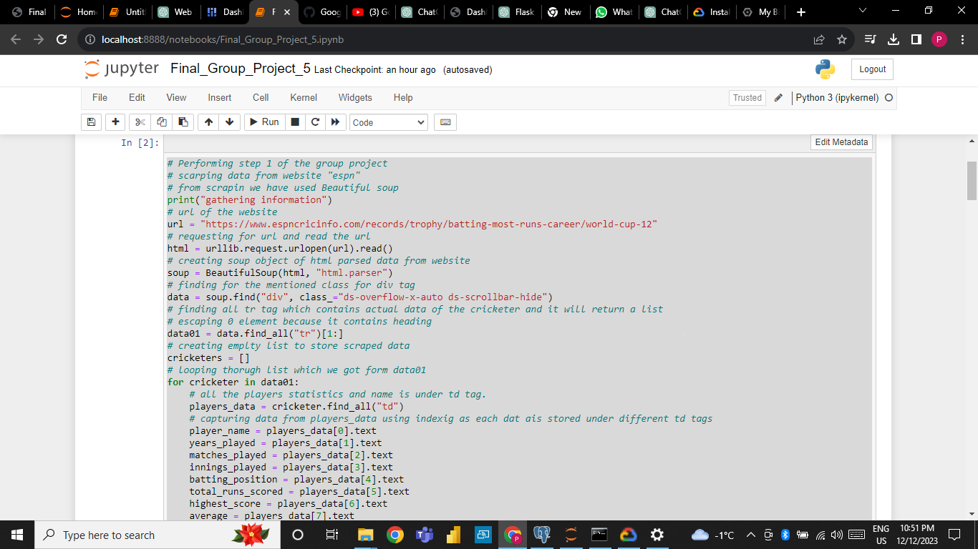
Project Summary

Slide 4
Project Summary
For step 1 we have done scrapping data from the url of espn.
For scrapping we have used beautiful soap.
We have creates the empty list to store the scrap data.
After that we have done looping through the list which we got from the data.

Slide 5
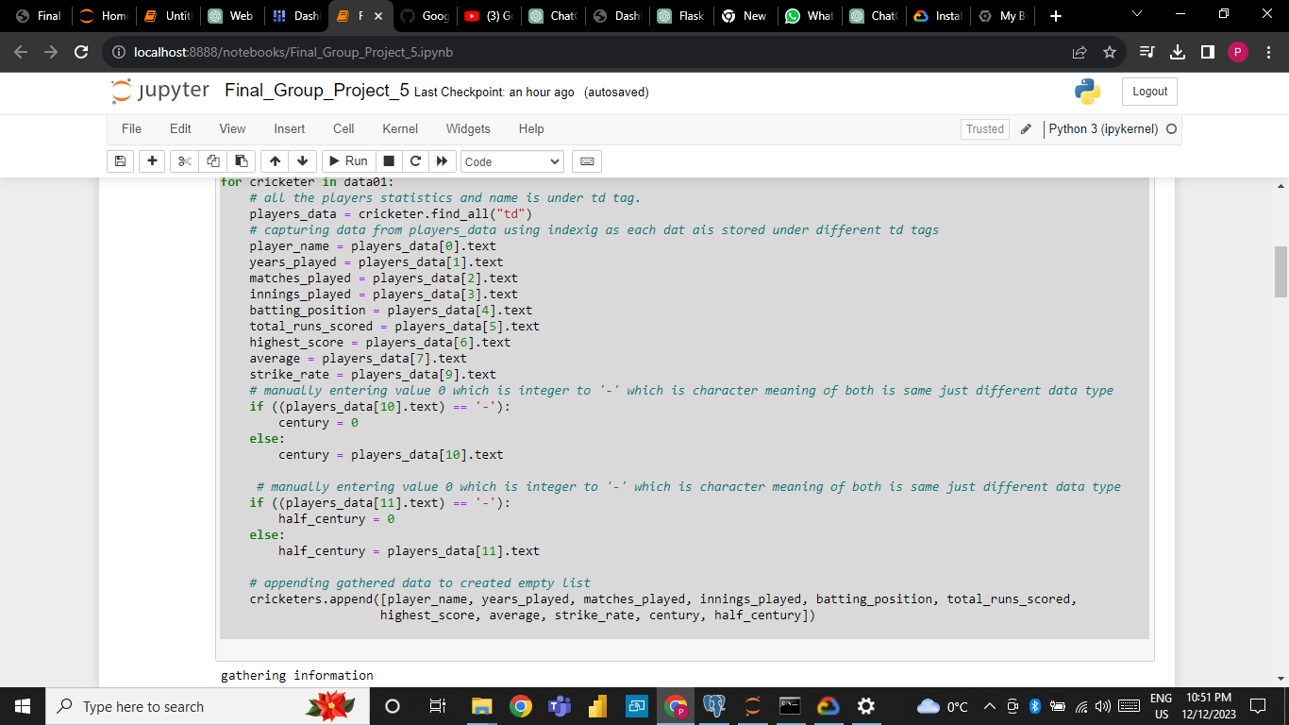
Project Summary

Slide 6
Project Summary
So we have filtered few rows from the original dataset.
The rows that we have selected are as below:
Player name
Years played
Matches played
Innings played
Batting position
Total runs scored
Highest runs
Average runs per match
Strike rate

Slide 7
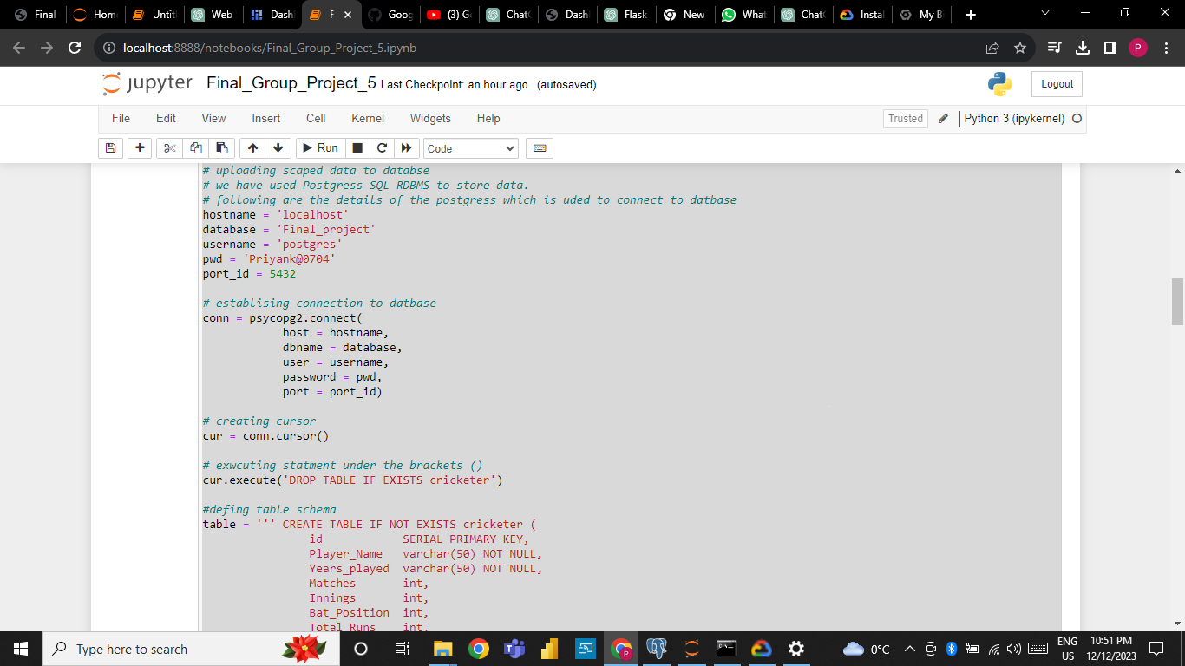
Project Summary

Slide 8
Project Summary
Upload the scrap data to the local DB.
We have used PostgreSQL to data.
We have used port 5432 to connect the local DB.
Then we have successfully established the connection to DB.
Then we have created cursor.

Slide 9
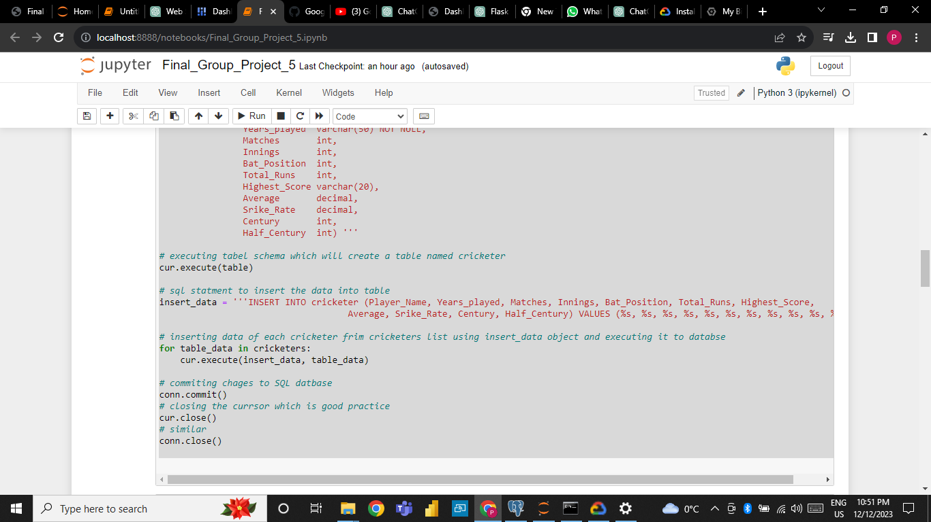
Project Summary

Slide 10
Project Summary
We have created the table names cricketer.
Then we have inserted the data in to table.
Inserting data of each cricketer from cricketers List using insert data inject and executing it to database.
Then we have committed the changes in sql.

Slide 11
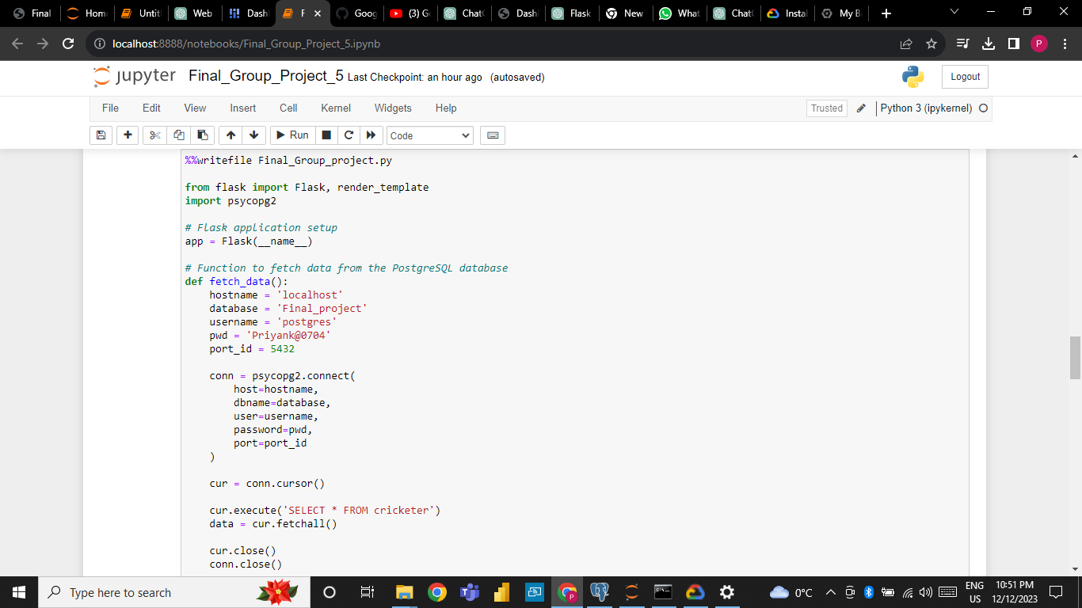
Project Summary
Function to fetch data from the PostgreSQL database

Slide 12
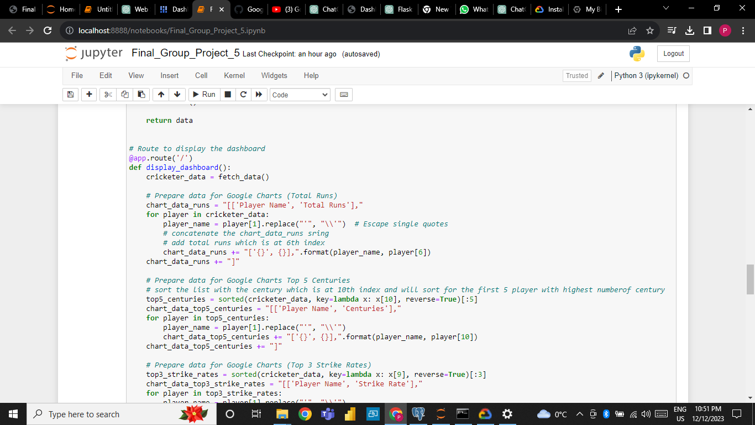
Project Summary

Slide 13
PROJECT SUMMARY
We have Prepare data for Google Charts (Total Runs).
We have concatenate the chart_data_runs string and add total runs which is at 6th index
Then we have prepare data for Google Charts Top 5 Centuries.
Then we sort the list with the century which is at 10th index and will sort for the first 5 player with highest number of century.
Then we have prepared data for google charts.

Slide 14
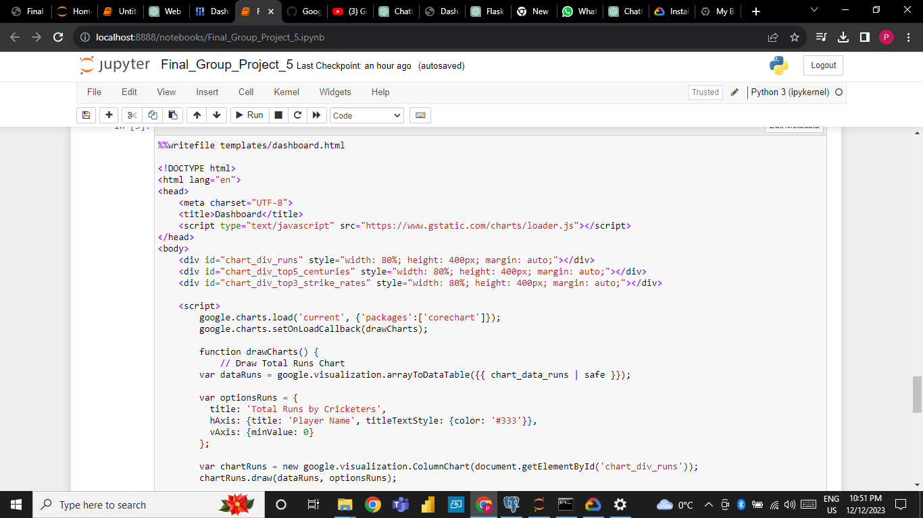
Project Summary

Slide 15
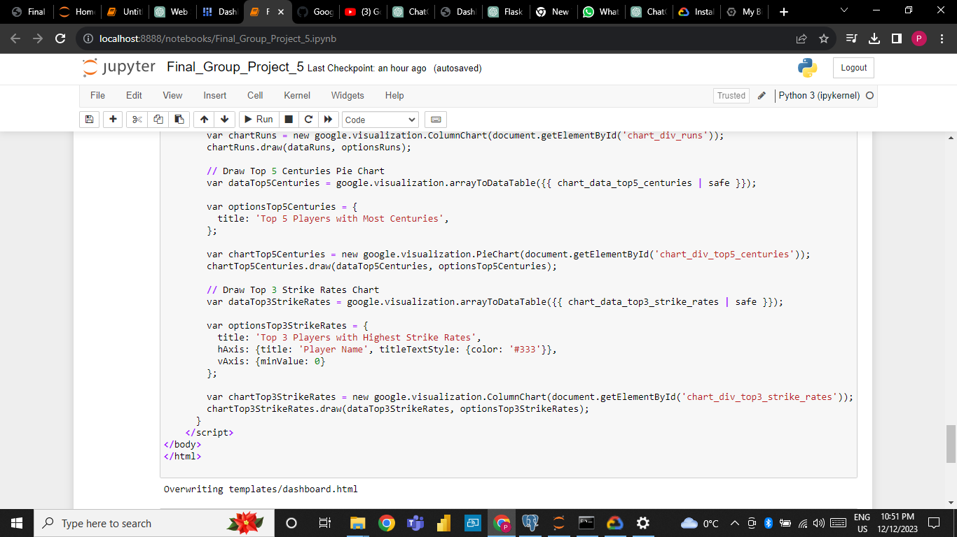
Project Summary

Slide 16
Project Summary
The following to Screenshots shows that we have used JavaScript as well as HTML for the website frontend.
Which will show the data dashboard visualization of data using charts and graphs.
We have also performed the fit analysis.
We have used flask.

Slide 17
TEAM
Karankumar Patel: Project manager
Priyank Bhaveshbhai Siddhapura: Data Analyst
Meet Hitesh Mistry: Programmer
Raj Tandel: Business Analyst

Slide 18
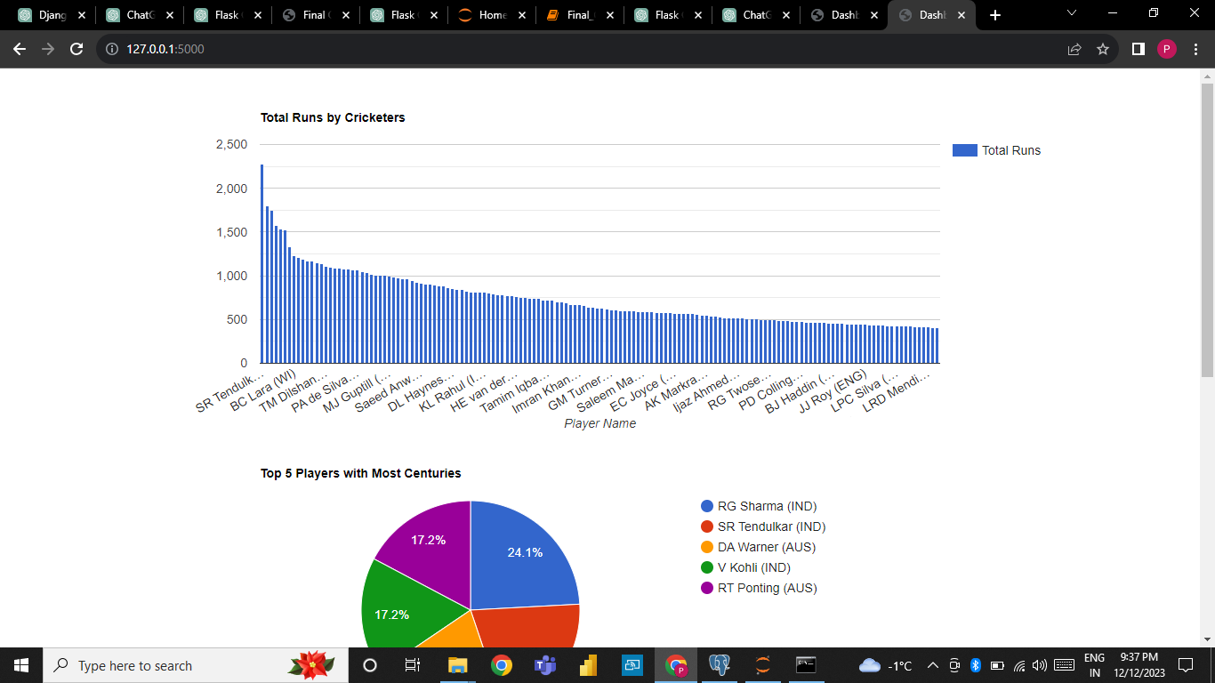
Output Of Project

Slide 19
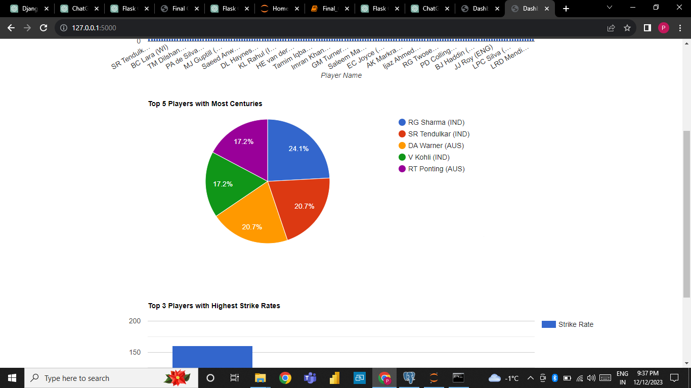
Output Of Project

Slide 20
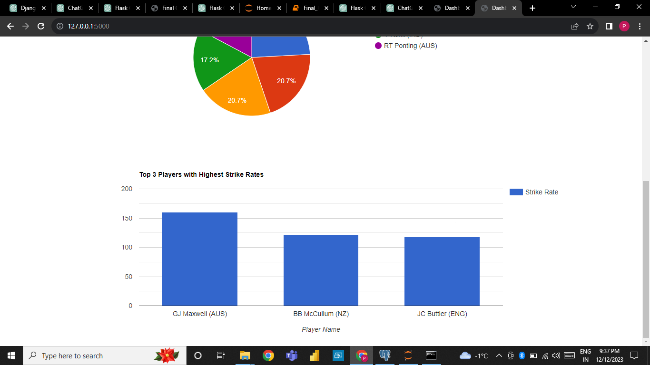
Output Of Project

Slide 21
THANKYOU !

