Slide 1







AI/ML IN SECURITY
CREDIT CARD FRAUD DETECTION SYSTEM
By - PRIYANK SINHA : 590023136
BATCH: 31

Slide 2
Problem Statement – The Financial Fraud Crisis
The rapid expansion of digital payment systems has significantly increased exposure to financial fraud, particularly in online and card-not-present transactions.
Fraudulent transactions constitute a very small percentage of the dataset, making detection extremely challenging due to class imbalance.
Traditional rule-based systems rely on static thresholds and fail to adapt to evolving fraud strategies.
There is critical need for intelligent, data-driven systems capable of identifying hidden patterns and anomalies in transactions of behavior.

Slide 3
Project Objectives & System Architecture
Exploratory Data Analysis (EDA) & Preprocessing
Feature Correlation: Analyzing how transaction magnitude (Amount) and merchant categories correlate with fraudulent behavior.
Handling Class Imbalance: Fraud is rare (often <1% of data). Our EDA process ensures the model doesn't become "biased" toward legitimate transactions.
The Data Pipeline:
Cleaning: Removing corrupted entries and handling missing values via Pandas.
Scaling: Normalizing numerical features so high-value transactions don't skew the model's perception.
Encoding: Converting categorical metadata into mathematical vectors for model ingestion.
Objectives:
T o develop a machine learning-based fraud detection system capable of identifying anomalous transactions.
To address class imbalance using advanced resampling techniques.
To maximize fraud detection capability while minimizing false negatives.
To evaluate and compare performance of multiple classification model.
System Approach:
Data preprocessing and validation.
Exploratory Data Analysis(EDA).
Feature Scaling and Normalization.
Data balancing using SMOTE.
Model training and evaluation.

Slide 4


Data Preprocessing & Validation
The dataset was analyzed for completeness and consistency using Pandas.
No missing values were identified across features, ensuring data integrity.
Duplicate records were detected and removed to eliminate redundancy.
All features were verified to be numerical due to prior PCA transformation.
This step ensures a clean and reliable dataset for downstream analysis.
Project Objectives & System Architecture
End-to-End Automation: To develop a high-speed analytical pipeline that ingests raw transaction logs and outputs actionable risk scores.
ML-Powered Accuracy: Utilizing Ensemble Learning (Random Forest) to detect non-linear fraud patterns that human auditors would miss.
The Architecture:
Frontend: Minimalist dashboard for data upload and visualization.
Backend (Python/Flask): The central hub for file handling, data cleaning, and model routing.
ML Layer: A pre-trained classifier capable of millisecond inference.
Scalability: Designed to handle thousands of transactions in a single batch processing request.

Slide 5
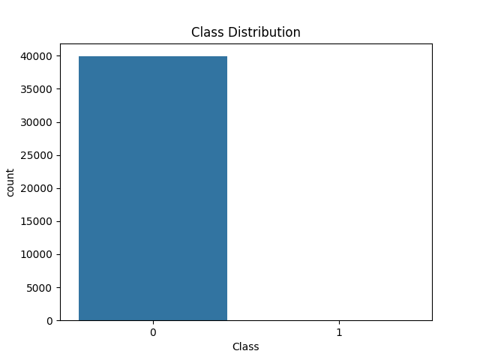
Exploratory Data Analysis
The dataset exhibits extreme class imbalance, with fraud cases forming a negligible portion of total transactions.
Transaction amount show a skewed distribution, with most transactions clustered at lower class.
Presence of outliers indicate unusual transaction behavior, often linked to fraud patterns.
These insights highlight the need for specialized techniques to handle imbalance.

Slide 6
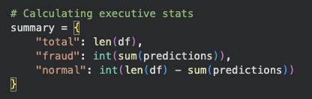
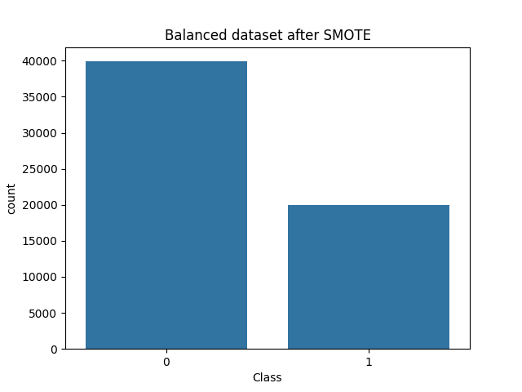
Handling Class Imbalance
Technical Breakdown: Risk & Summary Logic
Human-Centric Categorization: The backend translates raw percentages into a "Traffic Light" risk system:
HIGH (>80%): Immediate red flag; likely unauthorized access or stolen credentials.
MEDIUM (50-80%): Anomalous behavior; requires secondary authentication or manual review.
LOW (<50%): Verified pattern; standard transaction.
Strategic Summary Logic:
JSON Response: The data is sent as a structured object, making it easy for any UI to display results dynamically.
SMOTE (Synthetic Minority Oversampling Technique)
SMOTE is used to address the imbalance between legitimate and fraudulent transactions.
It generates synthetic samples of the minority class by interpolating between existing instances.
This prevents the model from being biased towards the majority class.
As, a result the model improves its ability to learn and detect fraud patterns effectively.
After applying SMOTE , the dataset becomes more balanced, leading to better classification performance.

Slide 7




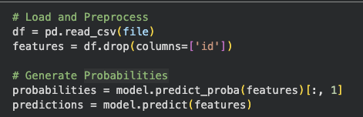
Machine Learning Models
Cybersecurity, Privacy & DPDP Compliance
Data Minimization: Adhering to the principle that only the minimum data required for a specific purpose (fraud detection) should be processed.
Volatile Processing: Data is handled in RAM and not permanently written to the server's disk, significantly reducing the "Attack Surface" for data breaches.
IT Act & DPDP 2023: The system is designed to provide "Reasonable Security" under Section 43A of the IT Act while respecting the consent and privacy mandates of the new Digital Personal Data Protection Act.
Input Sanitization: Strict validation of CSV structures prevents common exploits like CSV Injection or Malicious File Uploads.
Models Implemented:
Logistic Regression:
A linear classification model used as a baseline for comparison.
Computationally efficient and easy to interpret.
Limited in capturing complex, non-linear relationships in data.
Random Forest:
An ensemble learning algorithm that builds multiple decision trees.
Combines predictions using majority voting.
Capable of capturing complex and non-linear patterns.
Provides improved accuracy and robustness compared to single models.
Technical Breakdown: The Analysis API (app.py)
Request Handling: The @app.route('/analyze') function manages the POST request, ensuring the file is valid and readable.
Data Orchestration: Converting the raw CSV buffer into a structured Pandas DataFrame for high-speed feature extraction.
Model Inference:

Slide 8
Implementation and Model Working
System Implementation:
Data processing performed using Pandas and NumPy for efficient handling of large datasets.
Feature Scaling applied using Standard Scalar to normalize input values.
SMOTE implemented using the imbalanced-learn library to balance dataset.
Models trained and evaluated using the Scikit-learn framework.
Random Forest Working:
Constructs multiple decision trees using random subset of data and features.
Each tree makes an independent prediction. Final output is determined by majority voting.
This approach reduces overfitting and improves generalization.
Technical Breakdown: Risk & Summary Logic
Human-Centric Categorization: The backend translates raw percentages into a "Traffic Light" risk system:
HIGH (>80%): Immediate red flag; likely unauthorized access or stolen credentials.
MEDIUM (50-80%): Anomalous behavior; requires secondary authentication or manual review.
LOW (<50%): Verified pattern; standard transaction.
Strategic Summary Logic:
JSON Response: The data is sent as a structured object, making it easy for any UI to display results dynamically.

Slide 9
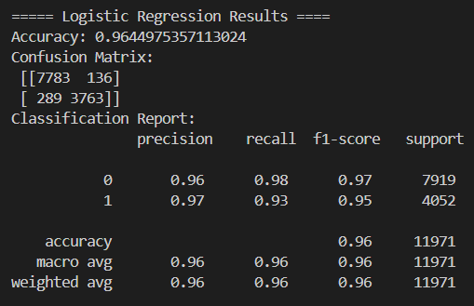
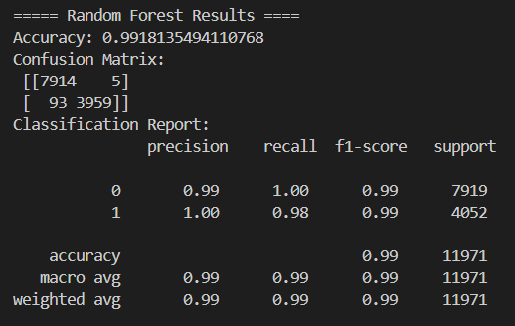
Results & Analysis
Model Analysis
Analysis:
Random Forest significantly outperforms Logistic Regression across evaluation metrics.
Higher recall indicated improved ability to correctly identify fraudulent transactions.
Reduction in false negatives enhances system reliability and effectiveness.
These result demonstrates the advantage of ensemble learning in fraud detection.
MODEL | ACCURACY | RECALL
Logistic Regression | 96% | 0.93
Random Forest | 99% | 0.98

Slide 10
Key Insight & Conclusion
Data Minimization: Adhering to the principle that only the minimum data required for a specific purpose (fraud detection) should be processed.
Volatile Processing: Data is handled in RAM and not permanently written to the server's disk, significantly reducing the "Attack Surface" for data breaches.
IT Act & DPDP 2023: The system is designed to provide "Reasonable Security" under Section 43A of the IT Act while respecting the consent and privacy mandates of the new Digital Personal Data Protection Act.
Input Sanitization: Strict validation of CSV structures prevents common exploits like CSV Injection or Malicious File Uploads.
Key Insight:
Recall is more important than accuracy in fraud detection.
False negatives represent undetected fraud cases.
Undetected fraud leads to financial and reputational losses.
Therefore, maximizing recall is essential for effective fraud cases.
Conclusion:
Machine Learning provides and effective solution for detecting fraudulent transactions.
SMOTE successfully addresses class imbalance and improves model learning.
Random Forest delivers superior performance due to its ability to capture complex patterns.
Future Scope:
Real-time fraud detection systems.
Integration with banking and financial platforms.
Use of deep learning and anomaly detection techniques.
Cybersecurity, Privacy & DPDP Compliance
THANK YOU!

Slide 11
THANK YOU!

