Slide 1

Seasonal Agriculture Performance Analysis
Priyanka Subhas Chavan
AICTE id: STU6a67387ce66c31785149564

Slide 2

PROBLEM STATEMENT
Agricultural activities are significantly influenced by seasonal variations in environmental conditions, farming practices, resource availability, and market conditions. These variations can lead to differences in crop yield, production, resource utilization, and economic performance across seasons. However, raw agricultural data does not clearly reveal these seasonal differences or the underlying patterns and relationships.

Slide 3
1.Seasonal Agriculture Performance Analysis analyzes agricultural data to understand how farming performance changes across different seasons. 2. The project studies crop yield, production, resource usage, environmental conditions, and economic performance. 3.Factors such as rainfall, temperature, soil conditions, irrigation, fertilizer, and water usage are analyzed. 4.Data analysis and visualization techniques are used to identify patterns, trends, and relationships. 5.The project helps in comparing seasonal performance and identifying better-performing crops and farming practices. 6.The analysis provides data-driven insights for better agricultural planning, resource management, and productivity.
Project Description

Slide 4

WHO ARE THE END USERS?
Farmers – To understand seasonal crop performance and improve farming decisions.
Agricultural Planners – To plan crops and resources based on seasonal trends.
Agricultural Researchers – To study relationships between environmental factors and crop performance.
Government & Policy Makers – To support data-driven agricultural planning and policies.
Agribusinesses – To analyze production, market, and profitability trends.

Slide 5

Technology Used
Python – Main programming language for data analysis
Pandas – Data cleaning, manipulation, and analysis
NumPy – Numerical calculations
Matplotlib – Data visualization
Seaborn – Statistical charts and visualizations
Jupyter Notebook – Development and presentation of analysis
CSV Dataset – Source of agricultural data

Slide 6
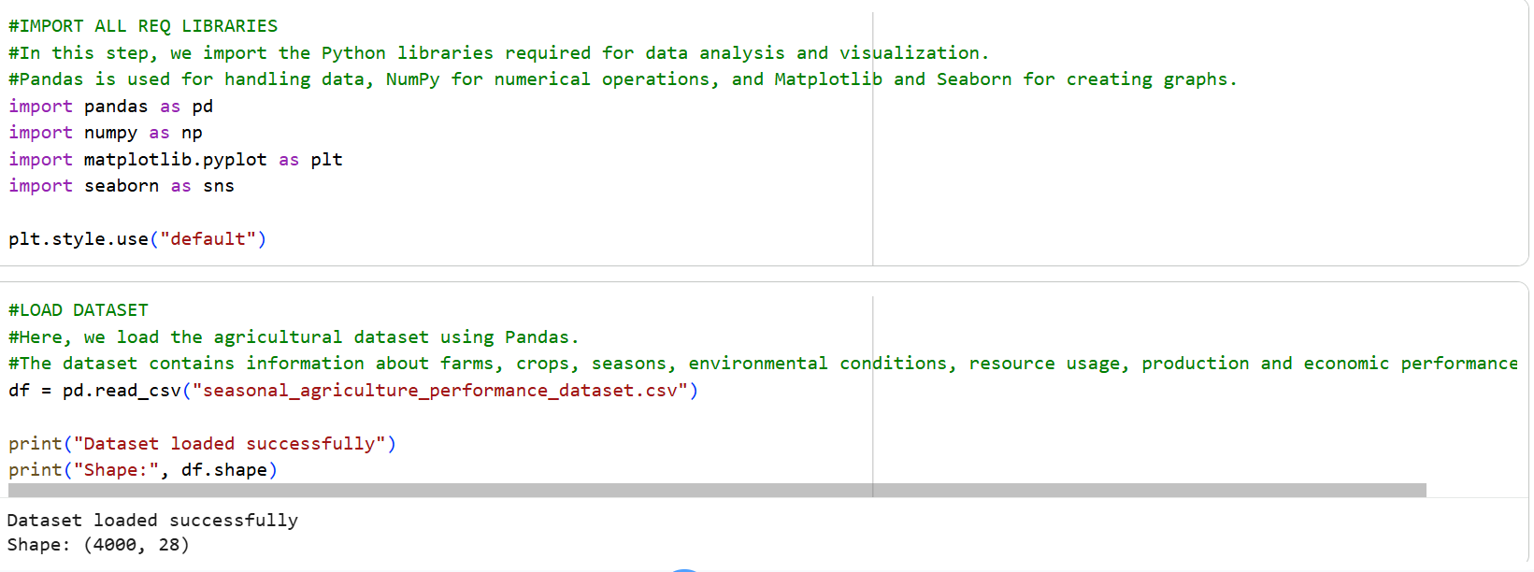
RESULTS
[Add screen shots of your code ]

Slide 7
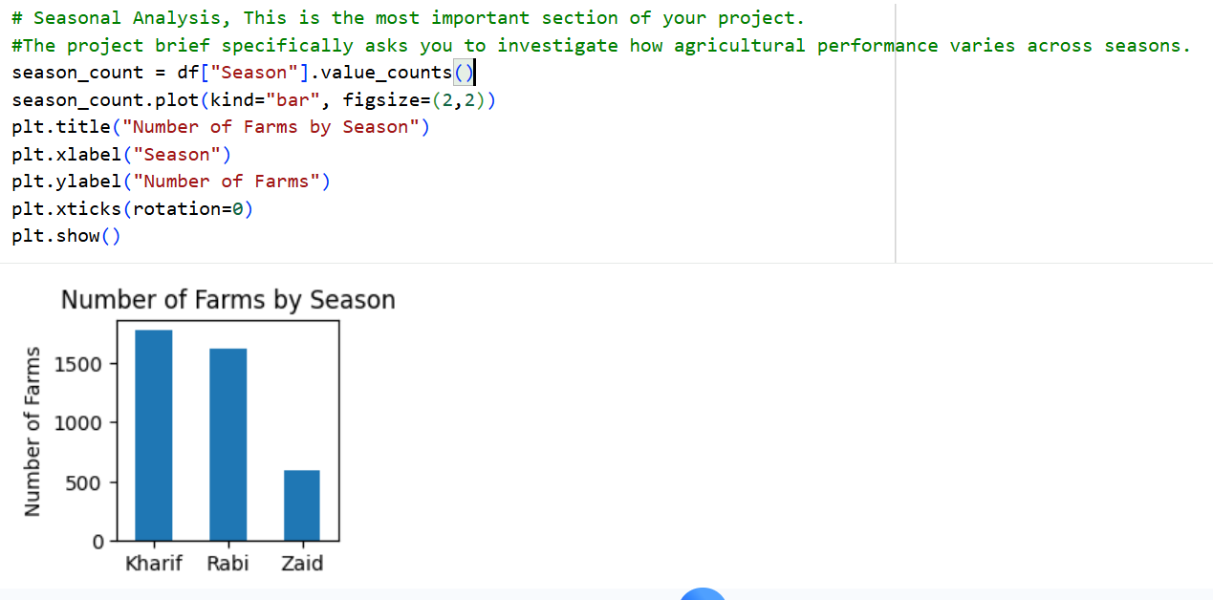
RESULTS

Slide 8
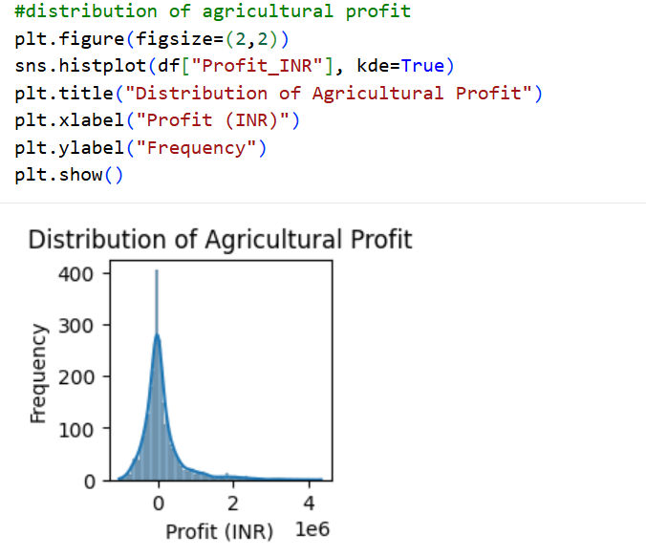
RESULTS

Slide 9
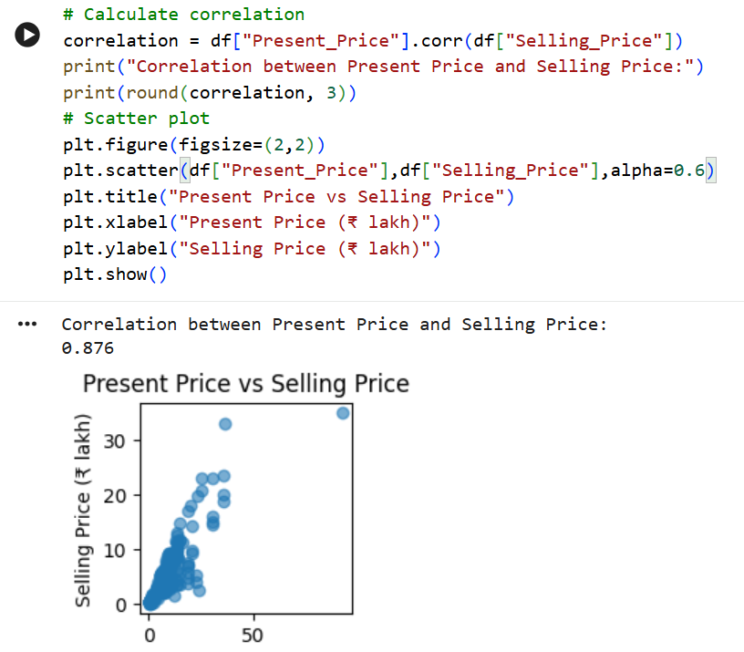
RESULTS

Slide 10
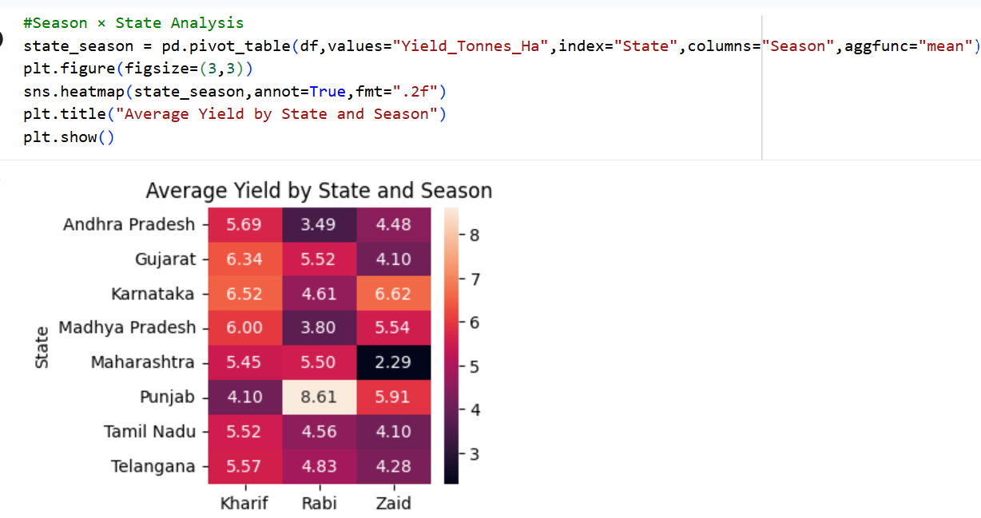
RESULTS
[Add screen shots of your code ]

Slide 11
Future scope
Predictive Analysis – Predict crop yield and agricultural performance for future seasons.
Machine Learning – Develop models to predict yield, profit, and disease/pest risk.
Real-Time Data – Integrate live weather and environmental data for better analysis.
Smart Farming – Support intelligent irrigation, fertilizer, and resource management.
Regional Analysis – Expand the analysis to more states, districts, and crops.
Decision Support System – Develop a system that provides recommendations to farmers based on seasonal conditions.

Slide 12
GitHub Link
https://github.com/Priyank1605/Seasonal-Agriculture-Performance-Analysis

Slide 13
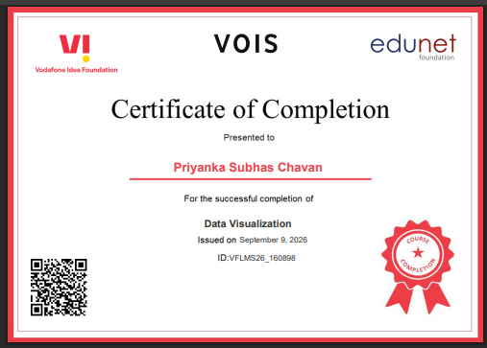
VOIS Course completion certificate - Course name- Data Visualization

Slide 14
Thank you
.
.

