Slide 1
Chicago Crime ETL Implementation
Team# 3 :
Priyank Dsilva
Sonam Manhas
Saurabh Dhoble

Slide 2
Agenda
OLAP
Methodology: Push
Dimensional History
Data Load
Transformations
Control Flow
Potential Points of Failure
Error Handling Techniques
Impediment
Highlights
References

Slide 3
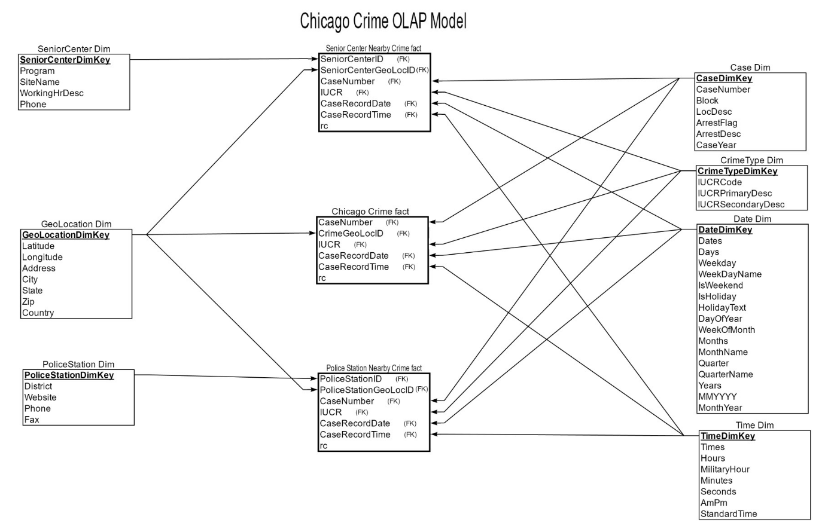
OLAP

Slide 4
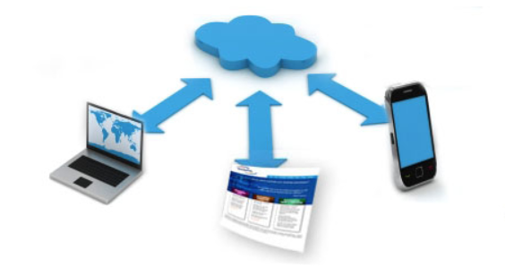
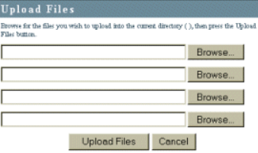
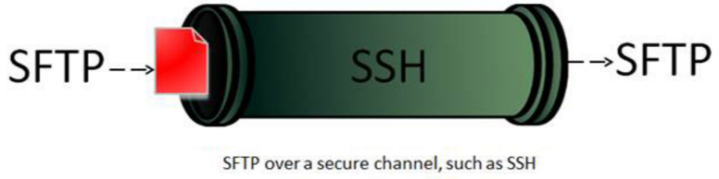

Methodology: Push
Web Portal
Upload Files OR SFTP
Trigger Pentaho Job

Slide 5
Dimensional History
Type 0
Date Dim
Time Dim
Type 1
SeniorCenter Dim
GeoLocation Dim
PoliceStation Dim
Case Dim
CrimeType Dim

Slide 6


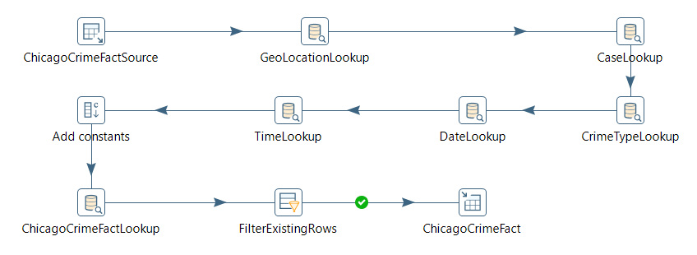
Data Load
Data Load
CSV /XLS-> Staging
Staging -> Dimension
Staging (Lookup-Dimension) -> Fact
Notes:
Data stored in the server in form of excel files.
These Source files are then loaded into staging tables.
Data is loaded in Dimension tables after data transformation is done on staging tables.
* Discuss Order of Loading and Impacts if not done so!! Refrence Key Constraints

Slide 7



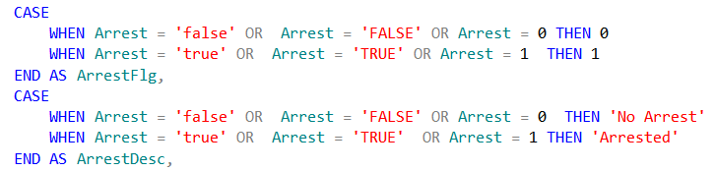

Transformations
Transformations
Location -> Latitude/Longitude
DateTime -> Date/Time
NA Values -> ‘No Value’
Flag -> Flag/Description
Notes:
Replace NULL values with “No Value”
Converted Latitude and Longitude values from string type to decimal
Latitude and Longitude data points trimmed to 5 decimal point precision

Slide 8
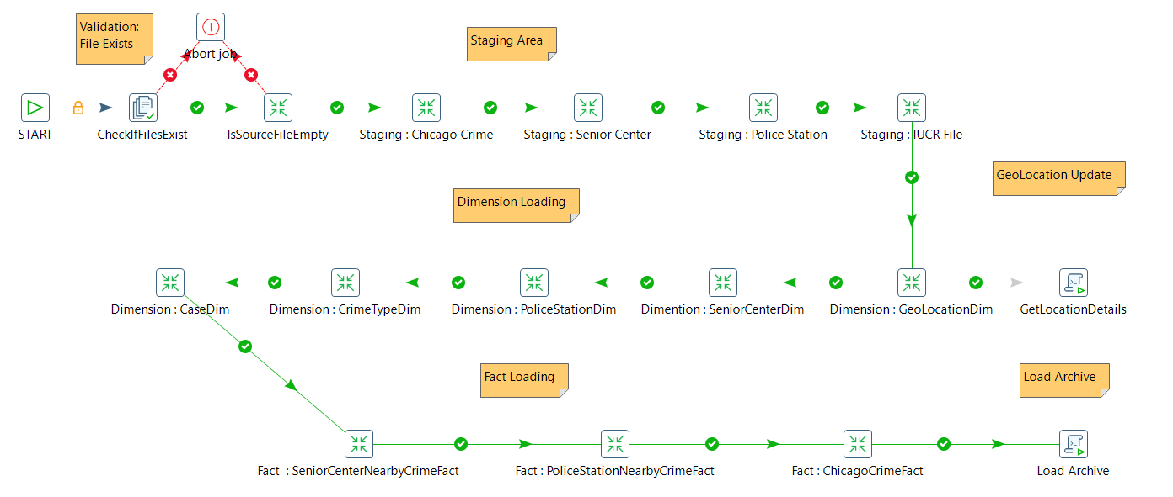
Control Flow

Slide 9
Potential Points of Failure
File not Present
Empty File
Server Unavailable(DB/ETL/Portal)
Corrupt File
Null in Primary Key
Untranslatable Characters
Fetching Location details (GeoCode API Daily Limit)

Slide 10
Error Handling Techniques

Slide 11

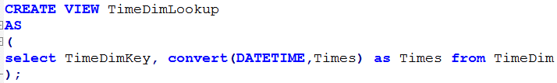

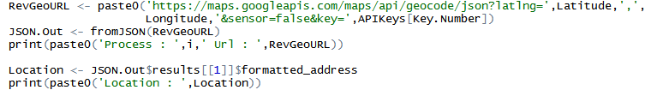
Impediments
Time Dimension Lookup
Connectivity with R and Batch
Archive Files Via R
Google GeoCode API
Notes:
Limitations Of API 2500 Per Day
Unable to lookup values

Slide 12
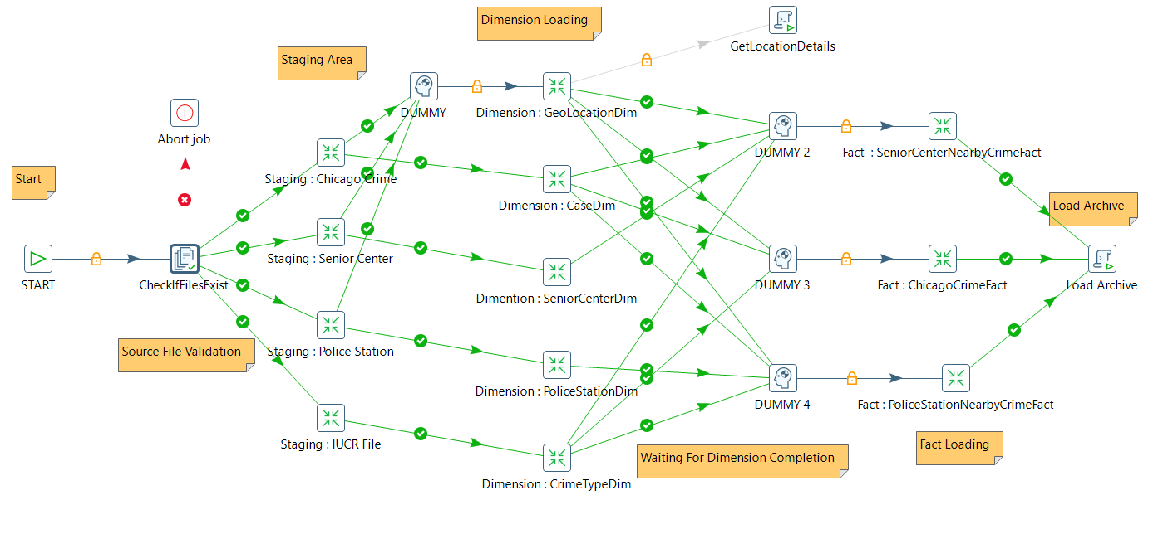
Impediments Cont. . .
Parallel Implementation

Slide 13
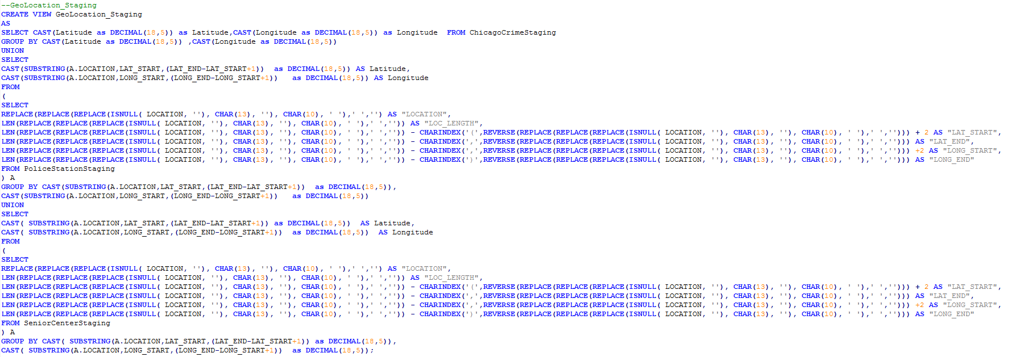
Impediments Cont. . .
SQL Queries

Slide 14
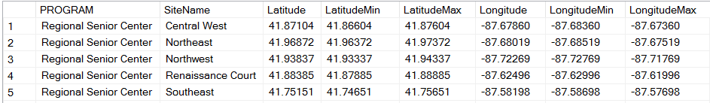
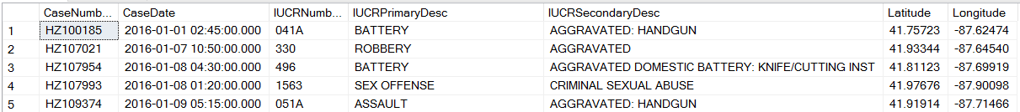
Impediments Cont. . .
Fact Tables Loading

Slide 15
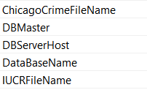
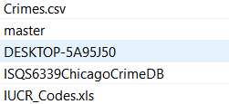
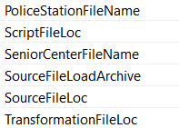
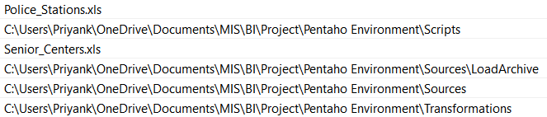
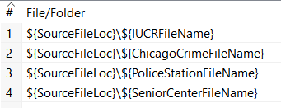
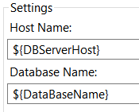
Highlights
Environmental Variables
Usage

Slide 16
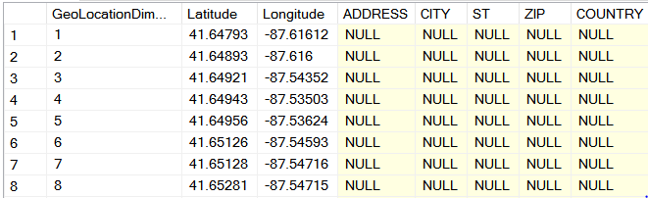
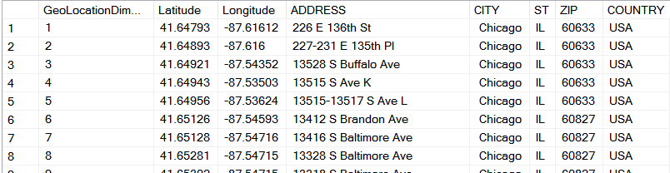
Highlights
Google Geo Code API

Slide 17
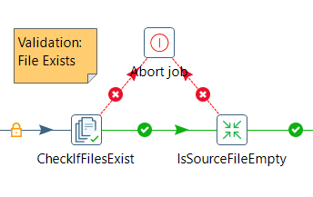
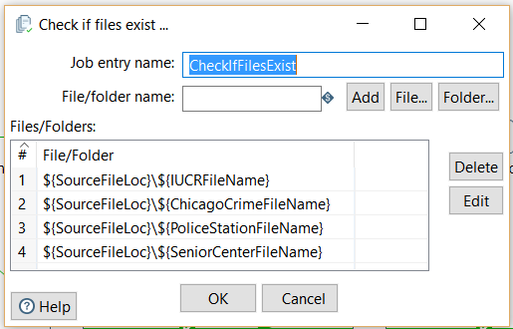
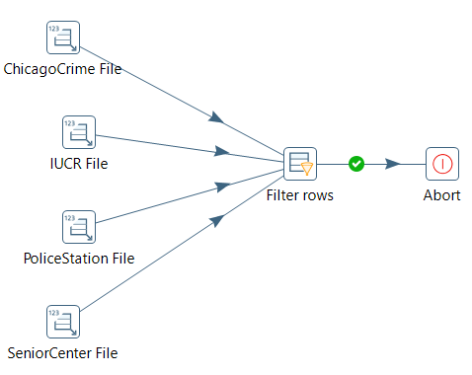
Highlights
CheckIfSourceExist AND IsSourceFileEmpty

Slide 18
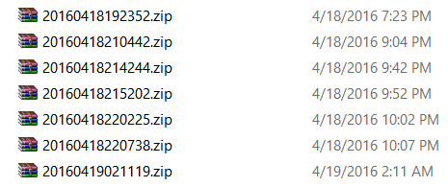
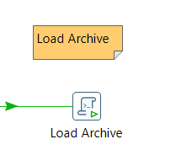
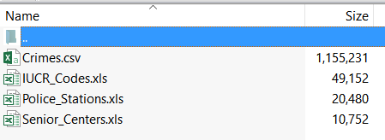
Highlights
Load Archive

Slide 19



References
Date Dimension
https://www.mssqltips.com/sqlservertip/4054/creating-a-date-dimension-or-calendar-table-in-sql-server
Time Dimension
http://www.sqlservercentral.com/scripts/Data+Warehousing/65762

Slide 20


Slide 21

Q&A Session

