Slide 1
Chicago Crime Study
Team# 3 :
Priyank Dsilva
Sonam Manhas
Saurabh Dhoble

Slide 2
Agenda
Business Solutions
Business Benefits
Data Sources & Definitions
OLAP Model
Table Definition
Q&A Session

Slide 3
Business Solutions
Analysis
  Crime Type
  Location Description
  Arrests
Integrated Data
  Police Stations
  Senior Centers

Slide 4
Business Benefits
Predict and Prevent Crime
Identify High Risk Areas
Deploy Surveillance
Easy Access to Crime Data
Resource Management

Slide 5
Data Sources & Definitions
Chicago Crime Reports
https://data.cityofchicago.org/Public-Safety/Crimes-2001-to-present/ijzp-q8t2
Illinois Uniform Crime Reporting (IUCR) Codes
https://data.cityofchicago.org/Public-Safety/Chicago-Police-Department-Illinois-Uniform-Crime-R/c7ck-438e
Chicago Police stations
https://data.cityofchicago.org/Public-Safety/Police-Stations/z8bn-74gv
Senior Centers
https://data.cityofchicago.org/Health-Human-Services/Senior-Centers/qhfc-4cw2

Slide 6
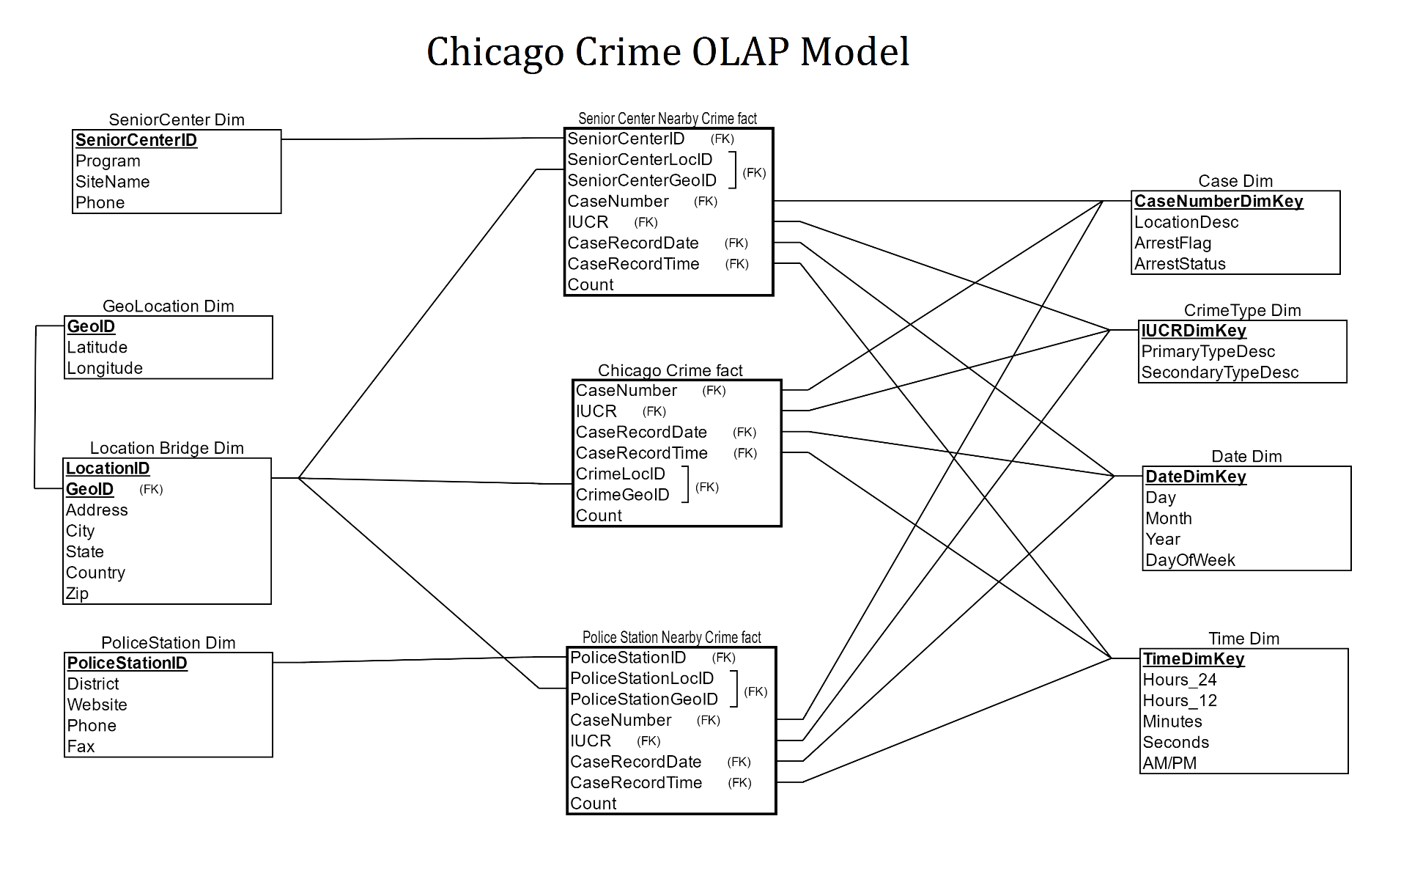
OLAP Model

Slide 7
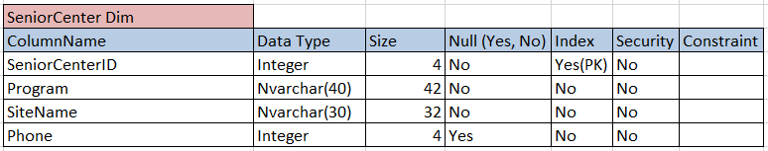
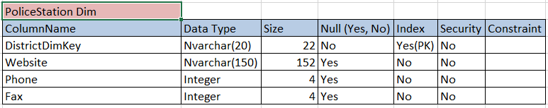
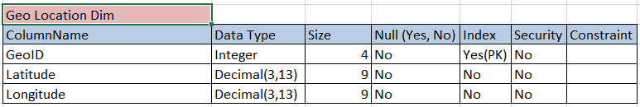
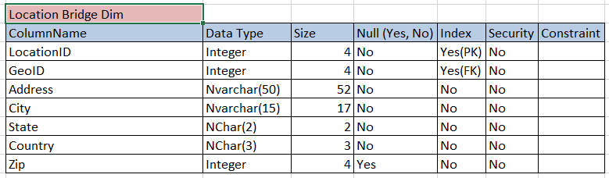
Table Definition
Dimension Tables

Slide 8
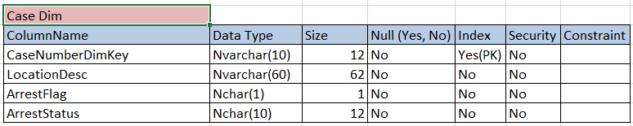
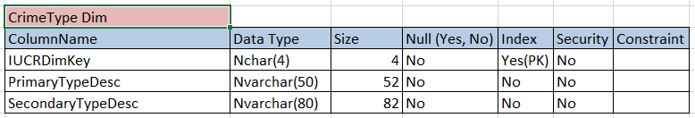
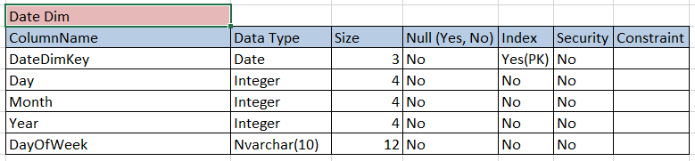
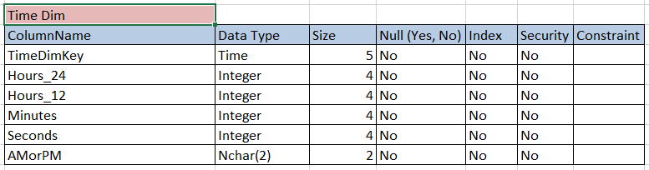
Table Definition

Slide 9
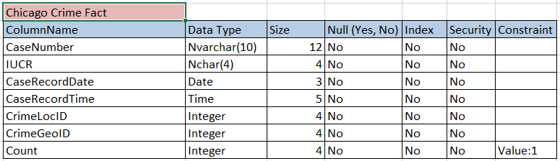
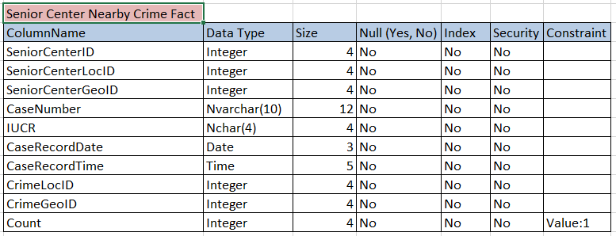
Table Definition
Fact Tables

Slide 10
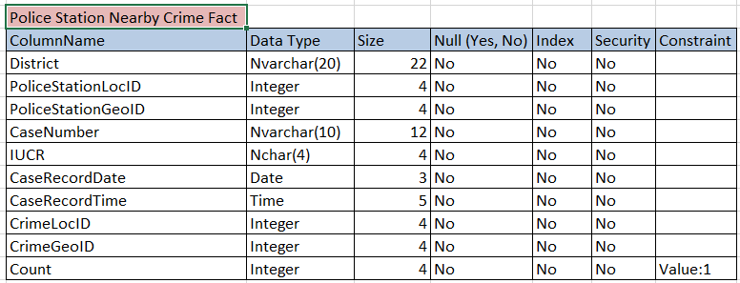
Table Definition

Slide 11

Q&A Session

Slide 12


