Slide 1
Chicago Crime Visualization
Team# 3 :
Priyank Dsilva
Sonam Manhas
Saurabh Dhoble

Slide 2
Agenda
Visualization Tool : Benefits and Limitations
Dashboard 1 – Analysis on Crime And Location Types
Dashboard 2 – Crime Comparison : Date & Time
Adherence to 4VP, Gestalt, to Viewer Knowledge
Query Validation

Slide 3
Visualization Tool
BI Tool : Tableau (9.3)
Benefits
Automatic Best Graph type selection
Data Integration
Live & Extract Connectivity
Easy to Use
Great support to Map Type Graph
Issues
Setting a Circular Radius for map points
Graph Alignment on dashboard is not User Friendly

Slide 4
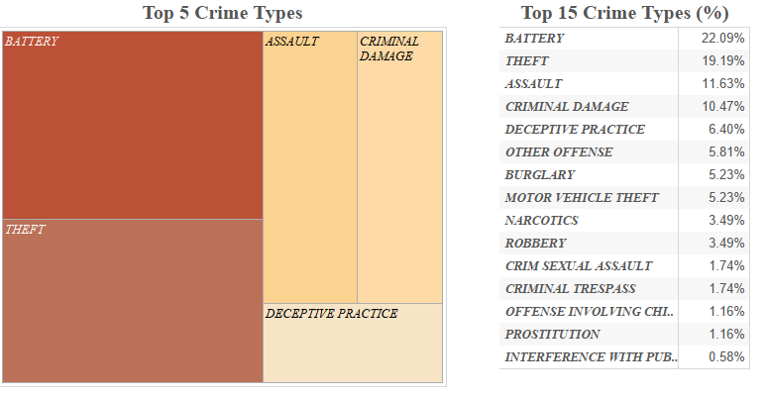
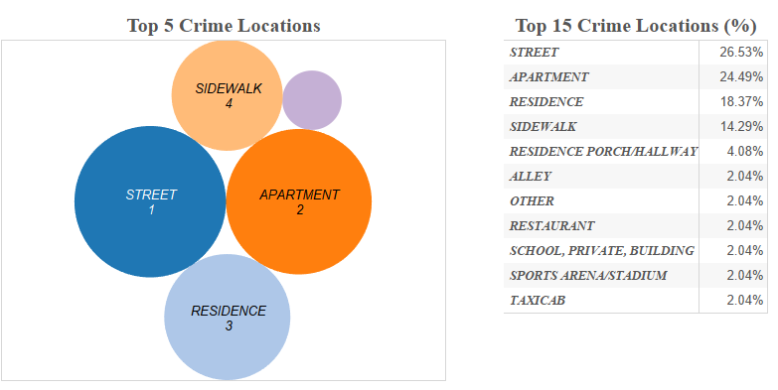
Dashboard 1: Analysis on Crime And Location Types
Top 5 Crime Types
Benefits: Understanding the types
of crime.
Top 5 Crime Locations
Benefits: Understanding of type of
places in cities prone to high
crime rates.

Slide 5
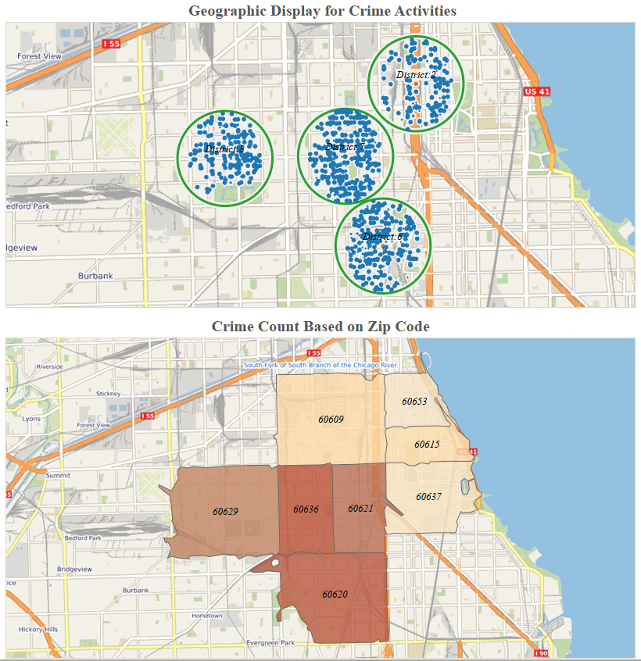
Dashboard 1: Analysis on Crime And Location Types
Map Location & Heat Map
Benefits: Understanding the actual
crime location and understanding
the crime rate based on zip code.
Adherence
4VP
Gestalt
Viewer Knowledge

Slide 6
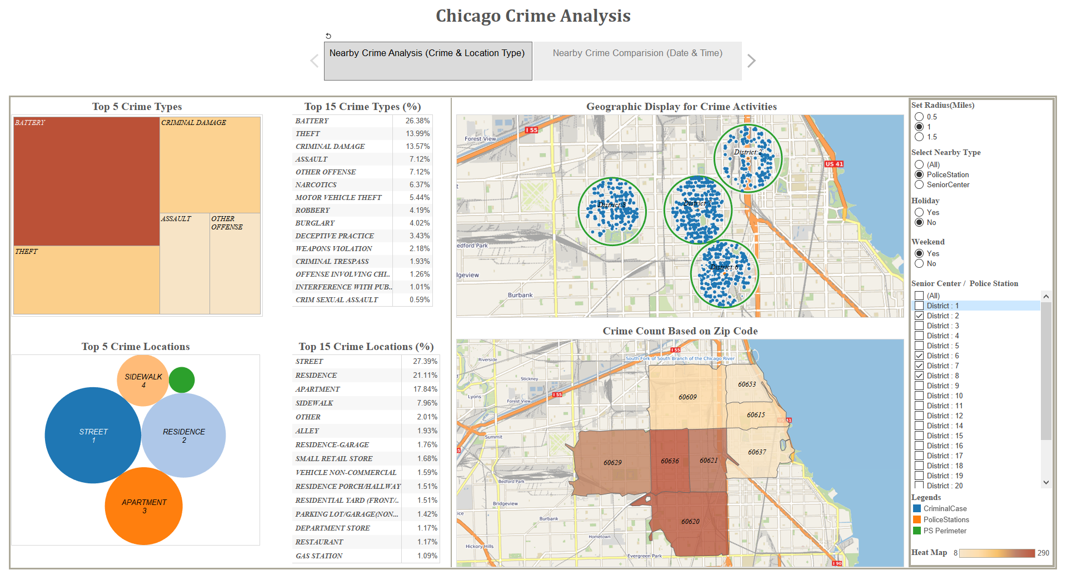
Dashboard 1 :Analysis on Crime And Location Types

Slide 7
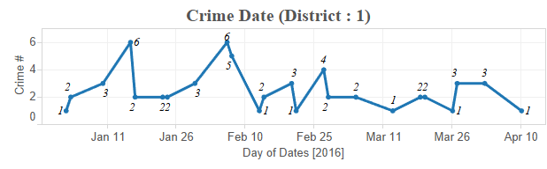
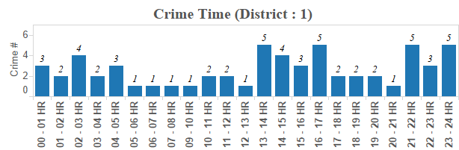
Dashboard 2:Crime Comparison Date and Time
Crime Date
Benefits: Understanding of Crime
rate in different months and days.
Crime Time
Benefits: Understanding of what
time of day crime rate varies.

Slide 8
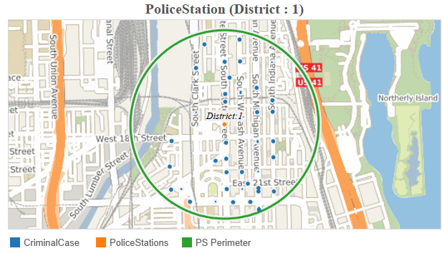
Dashboard 2:Crime Comparison Date and Time
Map Locations
Benefits: Understanding the
actual crime location based
on Time and Day.
Adherence
4VP
Gestalt
Viewer Knowledge

Slide 9
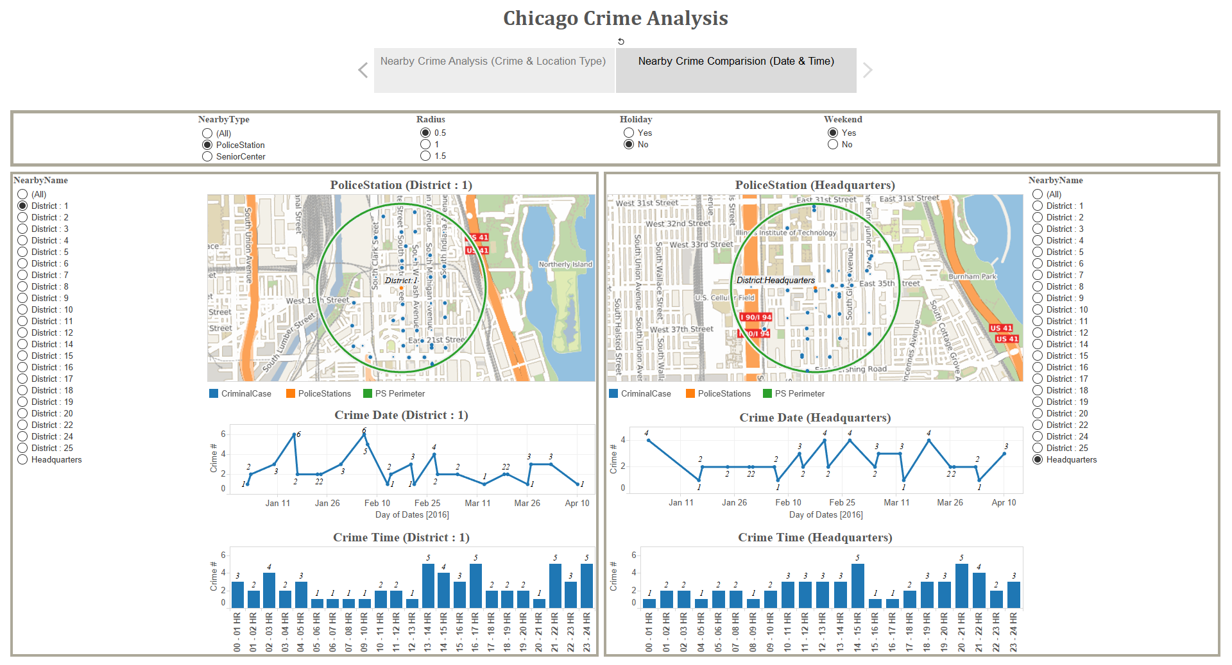
Dashboard 2:Crime Comparison Date and Time

Slide 10
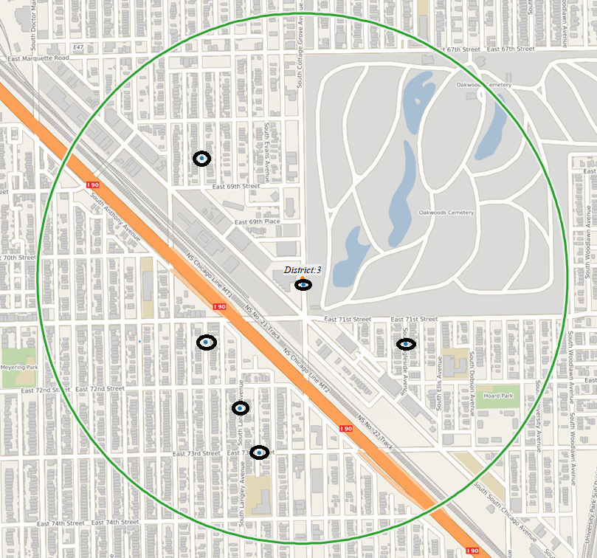
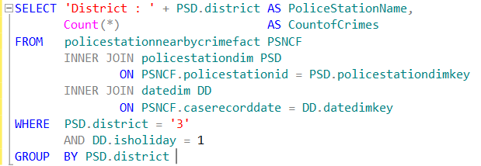

Query Validation
Crimes Near Police Station (District 3)
Filters :Near by Center Type : Police Station
Police Station Name : District 3
Holiday : Yes

Slide 11
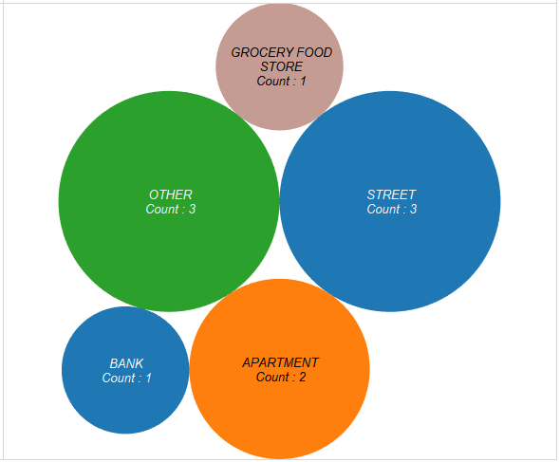
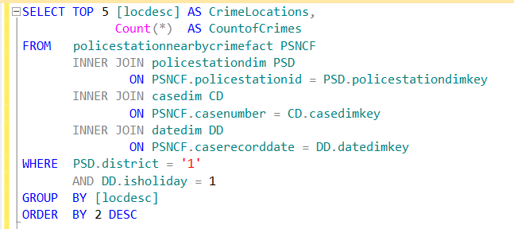
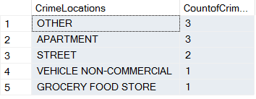
Query Validation
Crime Location (District 1)
Filters :Near by Center Type : Police Station
Police Station Name : District 1
Holiday : Yes

Slide 12
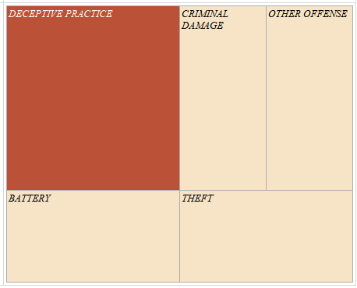
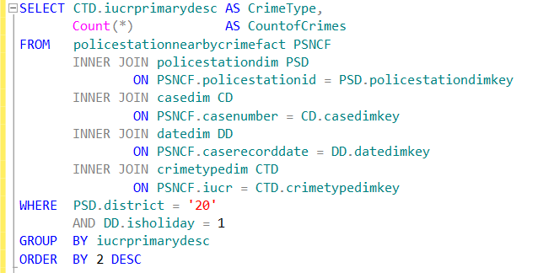
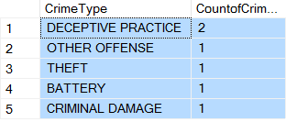
Query Validation
Crime Type (District 20)
Filters :Near by Center Type : Police Station
Police Station Name : District 20
Holiday : Yes

Slide 13


Slide 14

Q&A Session

