Slide 1
From Fog Nets to Neural Nets
Prepared For -
Larry Fulton
Presented By -
Priyank Dsilva
Sonam Manhas
Neha Singh
Saurabh Dhoble

Slide 2
Table of Contents
Problem Statement
Data Preparation: Data Mining and Cleaning
Application of Algorithm & Techniques
Approach Followed
Submission to Driven Data
Literature Reference

Slide 3
Problem Statement
Dar Si Hmad (DSH) manages a network of fog nets that collect and disseminate fresh water to landlocked communities in Southwest Morocco.
DSH has assembled years of data about weather patterns and water yield. They are in search of clever ways to predict how much water they can expect in the future and clear and insightful ways to visualize their collections system.

Slide 4
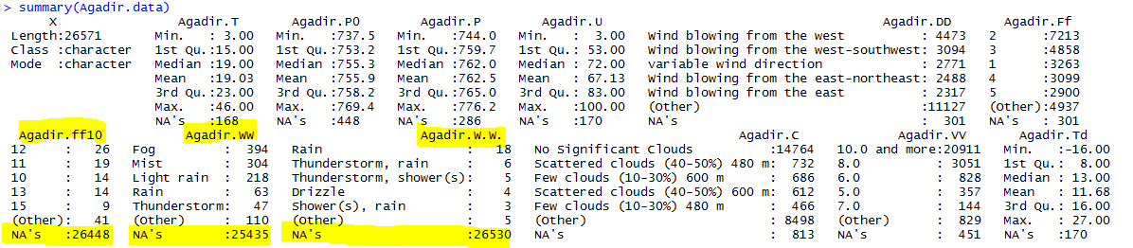
Data Preparation: Data Mining and Cleaning
Agadir Airport Data
1 Hour Intervals.
Columns (WW,W’W’,ff10) have too many missing Values. Replace them with ‘Unknown’ and 0.
Calculated Field (Year, Month, Day)
Impute the remaining Missing Values with ImputeTS/Mice

Slide 5
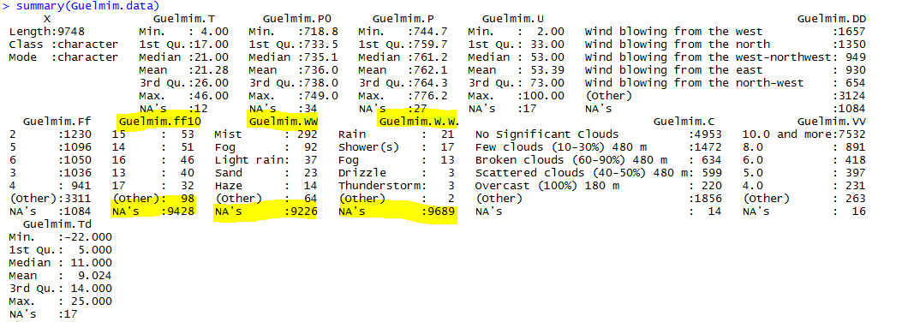
Data Preparation: Data Mining and Cleaning
Guelmim Airport Data
1 Hour Intervals (6:00 -17:00).Add additional rows required for prediction Interval of 2 Hours ( 00,02,04,18,20,22).
Columns (WW,W’W’,ff10) have too many missing Values. Replace them with ‘Unknown’ and 0.
Calculated Field (Year, Month, Day)
Impute the remaining Missing Values with ImputeTS/Mice

Slide 6
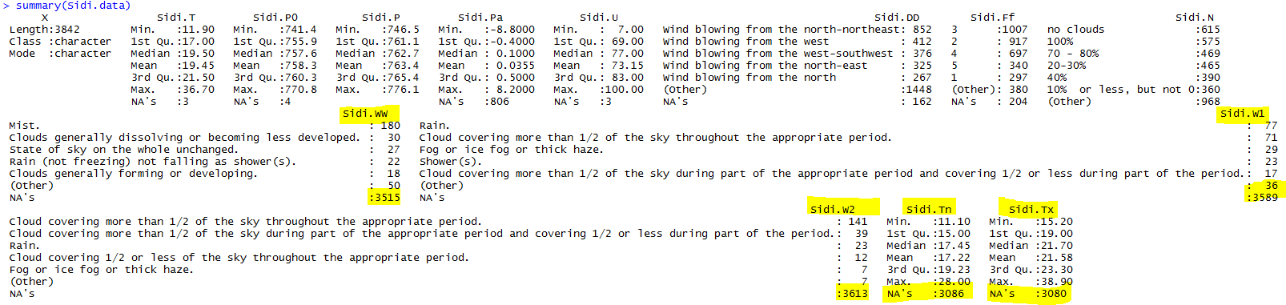
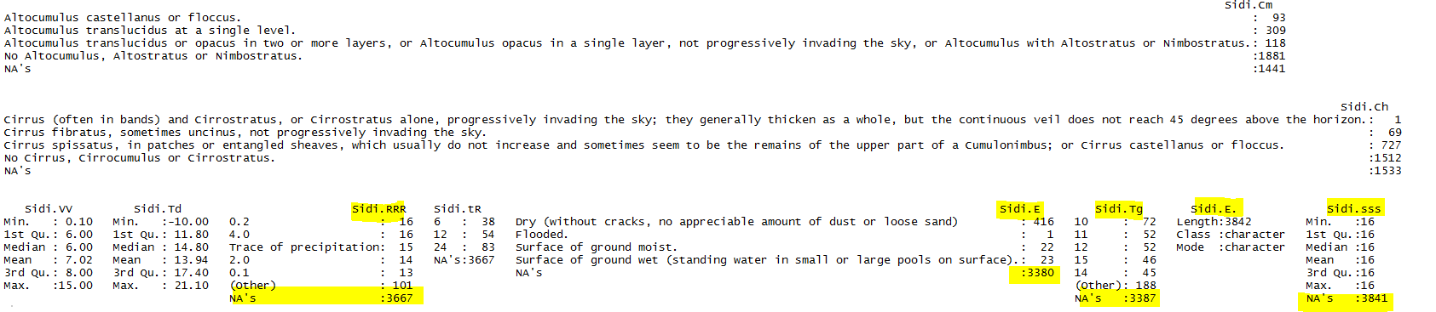
Data Preparation: Data Mining and Cleaning
Sidi Ifni Airport Data
3 Hour Intervals (6:00 -18:00).Add additional rows required for prediction Interval of 2 Hours ( 00,02,04,20,22).
Columns (WW,W1,W2) have too many missing Values. Replace them with ‘Unknown’ .Columns(E’,SSS) had only one value hence removed it. Columns(Tn,Tx) had values for Specific Time,so imputed the Rest.
Calculated Field (Year, Month, Day)
Impute the remaining Missing Values with ImputeTS/Mice

Slide 7
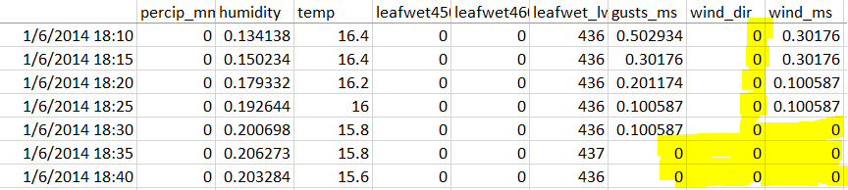
Data Preparation: Data Mining and Cleaning
Training/Testing Data
5 min & 2 Hours Interval Data
Missing Values in 2 Hours Interval - Some values present in 5 min Interval.
Merged both Source for Better Imputation.
Some 0 values were Actual NA’s. Replaced them with NA.
If NA’s had values in other source then we replace them with proper values.
Calculated Field (Year, Month, Day)
Impute the remaining Missing Values with ImputeTS/Mice
Snap 1 : Some 0 values were Actual NA’s
Snap 2 : Fetch Proper Values

Slide 8
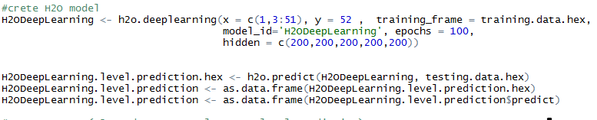
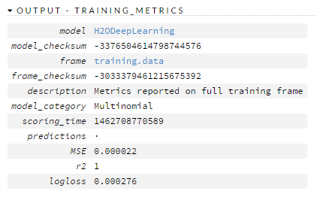
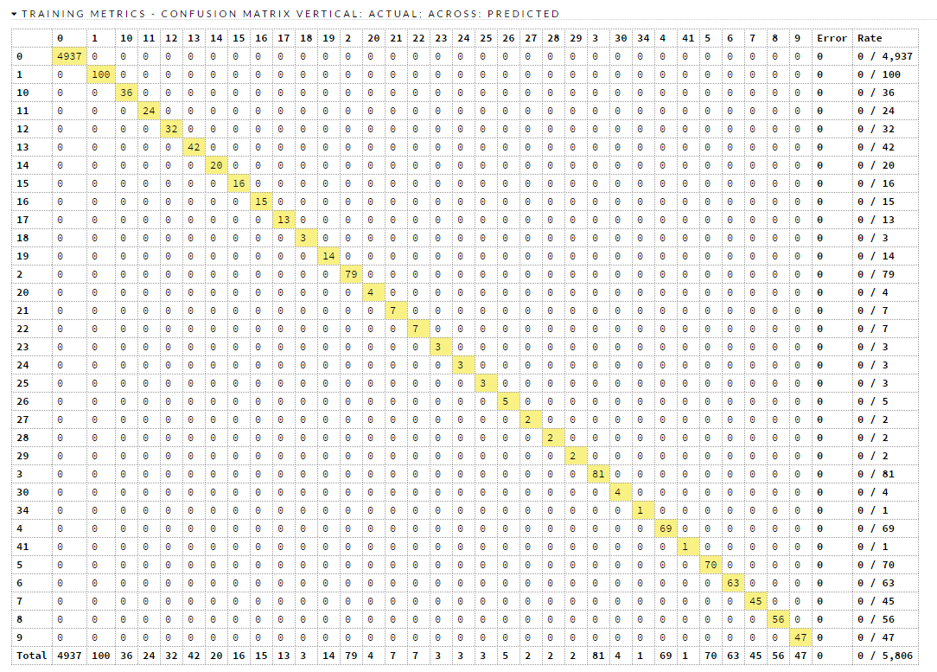
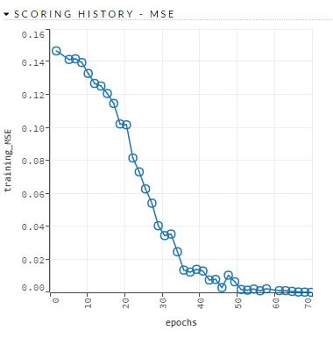
Application of Algorithm & Techniques
H2O : Deep Learning

Slide 9
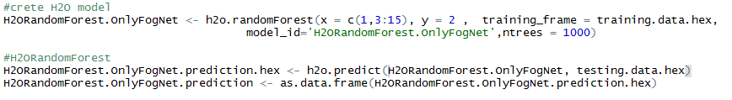
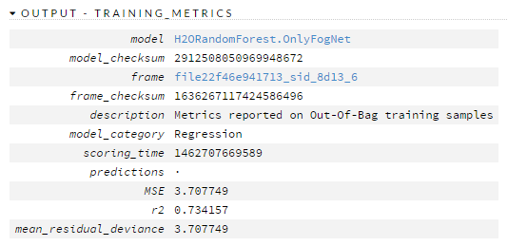
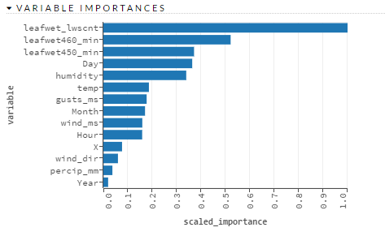
Application of Algorithm & Techniques
H2O : Random Forest

Slide 10
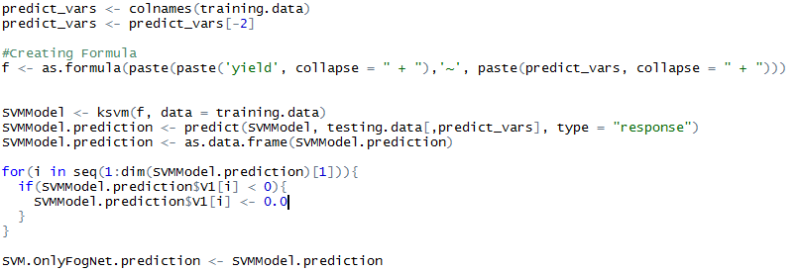

Application of Algorithm & Techniques
Support Vector Machine

Slide 11
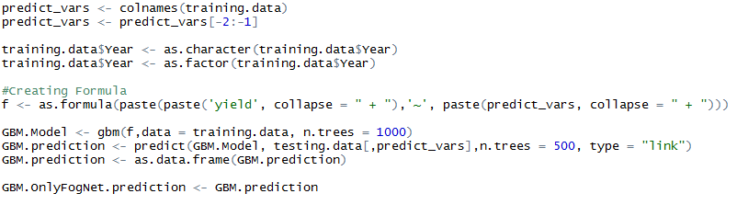
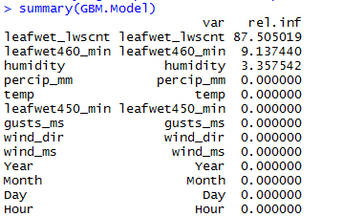
Application of Algorithm & Techniques
GBM

Slide 12
Approach Followed
Data Sets
Fog Nets Data
Fog Nets Data & Sidi Ifni Airport Data
Fog Nets Data & Guelmim Airport Data
Fog Nets Data & Agadir Airport Data

Slide 13
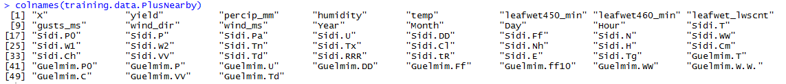
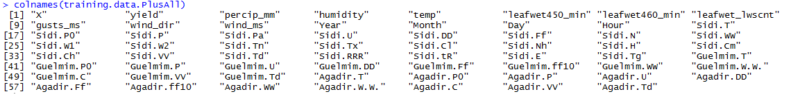
Approach Followed
Data Sets
Fog Nets Data & Near by Airport Data (Sidi Ifni & Guelmim)
Fog Nets Data & Airport Data (Sidi Ifni & Guelmim & Agadir)

Slide 14
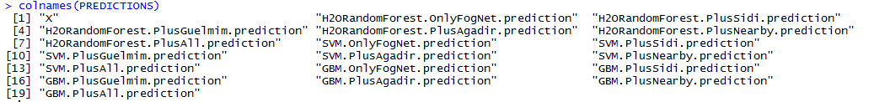
Approach Followed
Prediction Models
H20 : Random Forest
Support Vector Machine
GBM
6 Data Sets * 3 types of Prediction Models = 18 Prediction Models
Which Value To Select ??

Slide 15
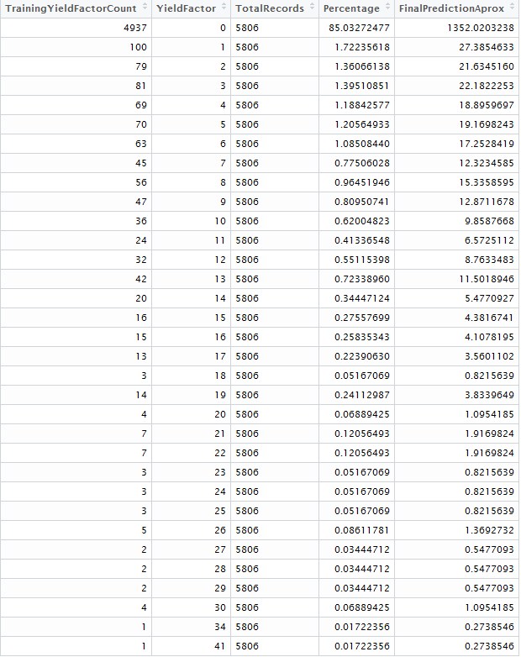

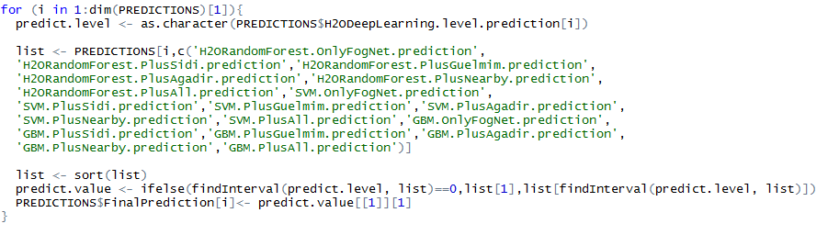
Approach Followed
Yield Factor Nearby Fit Model
Convert Yield value to Factors
H20 : Deep Learning
- Predict Yield Factors
Find Prediction Near to Yield Factor

Slide 16
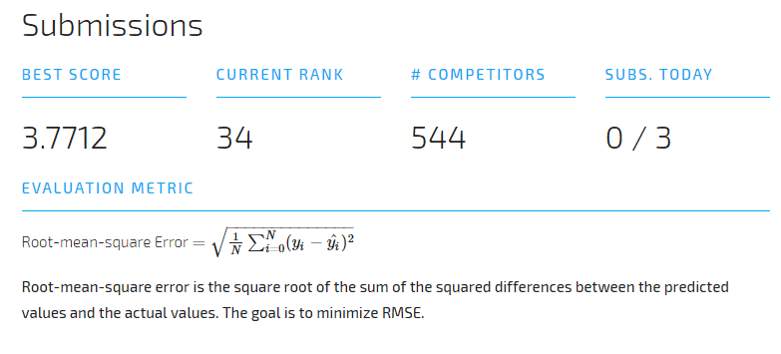
Submission to Driven Data

Slide 17
Literature Reference
Time Series Prediction Algorithm
Support Vector Machines (SVM) SVM is related to statistical learning theory. It is popular because of its success in digit recognition. SVM is now regarded as an important example of “kernel methods”, one of the key area in machine learning. Support vector machines have the basics of linear learning machines. The basic problem of linear learning machine is deciding the decision boundary.
(http://www.slideshare.net/tharindurusira/time-series-prediction-algorithms-literature-review)
Random Forest & ARIMA
Comparison of ARIMA and Random Forest time series models for prediction
(http://bmcbioinformatics.biomedcentral.com/articles/10.1186/1471-2105-15-276)
GBM iteration busting
The main idea in boosting is to use a sequence or collection of relatively simple or “weak” models to form a stronger functional model in the end. Observations are re-weighted at each step to give more weight to those with greater errors from the previous iteration. The final model hopefully yields greater predictive performance than the individual models
(http://statistics.ucla.edu/system/resources/BAhbBlsHOgZmSSJWMjAxNC8wMi8wNi8xMF8yOV8xMV82MDdfQW5hbHlzaXNfb2ZfVGltZV9TZXJpZXNfTW9kZWxzX3dpdGhfSXRlcmF0ZWRfQm9vc3RpbmcucGRmBjoGRVQ/Analysis%20of%20Time%20Series%20Models%20with%20Iterated%20Boosting.pdf)
Notes:
lit
http://www.slideshare.net/tharindurusira/time-series-prediction-algorithms-literature-review
SVM'
2.3 Support Vector Machines (SVM) SVM is related to statistical learning theory. It is popular because of its success in digit recognition. SVM is now regarded as an important example of “kernel methods”, one of the key area in machine learning. Support vector machines have the basics of linear learning machines. The basic problem of linear learning machine is deciding the decision boundary.
Random Forest
http://bmcbioinformatics.biomedcentral.com/articles/10.1186/1471-2105-15-276
Random forest over Arima
GBM iteratiion busting
https://www.google.com/url?sa=t&rct=j&q=&esrc=s&source=web&cd=3&cad=rja&uact=8&ved=0ahUKEwj9ssCmyMbMAhUFwiYKHcUTAo4QFggpMAI&url=http%3A%2F%2Fstatistics.ucla.edu%2Fsystem%2Fresources%2FBAhbBlsHOgZmSSJWMjAxNC8wMi8wNi8xMF8yOV8xMV82MDdfQW5hbHlzaXNfb2ZfVGltZV9TZXJpZXNfTW9kZWxzX3dpdGhfSXRlcmF0ZWRfQm9vc3RpbmcucGRmBjoGRVQ%2FAnalysis%2520of%2520Time%2520Series%2520Models%2520with%2520Iterated%2520Boosting.pdf&usg=AFQjCNGq7z10sOJOdkQViQ4J1tOUoWWxAg&sig2=-jKN3Vc7ydej5rvEOQ5UQQ&bvm=bv.121421273,d.eWE
The main idea
in boosting is to use a sequence or collection of relatively simple or “weak” models
to form a stronger functional model in the end. Observations are re-weighted at
each step to give more weight to those with greater errors from the previous
iteration. The final model hopefully yields greater predictive performance than
the individual models
Data Imputatuion
https://www.google.com/url?sa=t&rct=j&q=&esrc=s&source=web&cd=1&cad=rja&uact=8&ved=0ahUKEwj7_tKYycbMAhXBUyYKHd83C2IQFgghMAA&url=http%3A%2F%2Fgking.harvard.edu%2Ffiles%2Fpr.pdf&usg=AFQjCNGpnhU_8okmEeNqnvRLCppKDEromw&sig2=LwhjL0vN2LeBLb__V6jkTg&bvm=bv.121421273,d.eWE
https://www.google.com/url?sa=t&rct=j&q=&esrc=s&source=web&cd=5&cad=rja&uact=8&ved=0ahUKEwj7_tKYycbMAhXBUyYKHd83C2IQFghGMAQ&url=https%3A%2F%2Farxiv.org%2Fpdf%2F1510.03924&usg=AFQjCNHUezfn_n0nmt-tYKQ9r8oQMEb7rw&sig2=vAABECzFHkd22Fk8SN1Vow&bvm=bv.121421273,d.eWE

Slide 18
Literature Reference
Data Imputation
What to Do about Missing Values in Time-Series Cross-Section Data
(http://gking.harvard.edu/files/pr.pdf)
Comparison of different Methods for Univariate Time Series Imputation in R
(https://arxiv.org/ftp/arxiv/papers/1510/1510.03924.pdf)
R Libraries
library(h2o)
library(mice)
library(gbm)
library(imputeTS)
library(ksvm)
Notes:
lit
http://www.slideshare.net/tharindurusira/time-series-prediction-algorithms-literature-review
SVM'
2.3 Support Vector Machines (SVM) SVM is related to statistical learning theory. It is popular because of its success in digit recognition. SVM is now regarded as an important example of “kernel methods”, one of the key area in machine learning. Support vector machines have the basics of linear learning machines. The basic problem of linear learning machine is deciding the decision boundary.
Random Forest
http://bmcbioinformatics.biomedcentral.com/articles/10.1186/1471-2105-15-276
Random forest over Arima
GBM iteratiion busting
https://www.google.com/url?sa=t&rct=j&q=&esrc=s&source=web&cd=3&cad=rja&uact=8&ved=0ahUKEwj9ssCmyMbMAhUFwiYKHcUTAo4QFggpMAI&url=http%3A%2F%2Fstatistics.ucla.edu%2Fsystem%2Fresources%2FBAhbBlsHOgZmSSJWMjAxNC8wMi8wNi8xMF8yOV8xMV82MDdfQW5hbHlzaXNfb2ZfVGltZV9TZXJpZXNfTW9kZWxzX3dpdGhfSXRlcmF0ZWRfQm9vc3RpbmcucGRmBjoGRVQ%2FAnalysis%2520of%2520Time%2520Series%2520Models%2520with%2520Iterated%2520Boosting.pdf&usg=AFQjCNGq7z10sOJOdkQViQ4J1tOUoWWxAg&sig2=-jKN3Vc7ydej5rvEOQ5UQQ&bvm=bv.121421273,d.eWE
The main idea
in boosting is to use a sequence or collection of relatively simple or “weak” models
to form a stronger functional model in the end. Observations are re-weighted at
each step to give more weight to those with greater errors from the previous
iteration. The final model hopefully yields greater predictive performance than
the individual models
Data Imputatuion
https://www.google.com/url?sa=t&rct=j&q=&esrc=s&source=web&cd=1&cad=rja&uact=8&ved=0ahUKEwj7_tKYycbMAhXBUyYKHd83C2IQFgghMAA&url=http%3A%2F%2Fgking.harvard.edu%2Ffiles%2Fpr.pdf&usg=AFQjCNGpnhU_8okmEeNqnvRLCppKDEromw&sig2=LwhjL0vN2LeBLb__V6jkTg&bvm=bv.121421273,d.eWE
https://www.google.com/url?sa=t&rct=j&q=&esrc=s&source=web&cd=5&cad=rja&uact=8&ved=0ahUKEwj7_tKYycbMAhXBUyYKHd83C2IQFghGMAQ&url=https%3A%2F%2Farxiv.org%2Fpdf%2F1510.03924&usg=AFQjCNHUezfn_n0nmt-tYKQ9r8oQMEb7rw&sig2=vAABECzFHkd22Fk8SN1Vow&bvm=bv.121421273,d.eWE

Slide 19


Slide 20


