Slide 1
Titanic: Machine Learning From Disaster
Prepared For -
Larry Fulton
Presented By -
Priyank Dsilva
Sonam Manhas
Neha Singh
Saurabh Dhoble

Slide 2
Table of Contents
Problem Statement
Data Preparation: Data Mining and Cleaning
Application of Algorithm & Techniques
Approach Followed
Submission to Kaggle.com
Literature Reference

Slide 3
Problem Statement
On April 15th, 1912, the infamous Titanic shipwreck occurred, leaving only 32% of the passengers alive. We investigated what factors would be crucial in determining the survival of each passenger

Slide 4
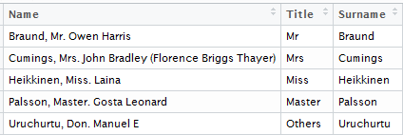
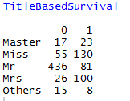
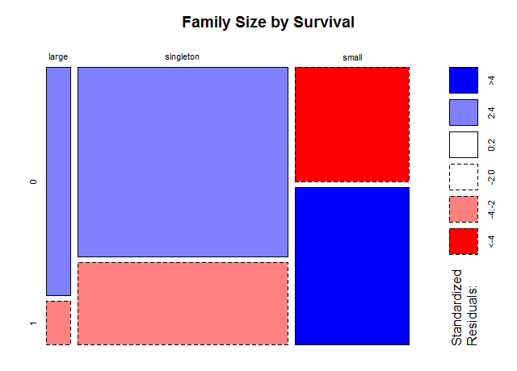



Data Preparation: Data Mining and Cleaning
Name -> Title , Surname
SibSp , PArch -> FamilyFlag , FamilySize , FamilySizeCategory
Notes:
Family Flag -> Identifies if the passenger is alone or with family
Family Size -> No of Members in a Family
Family Size Category -> Categorizes family in three groups Singleton(1),Small(2-4) and Large(5+)

Slide 5
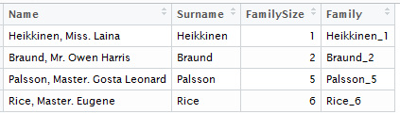
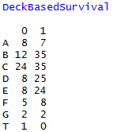
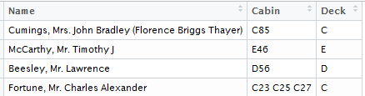
Data Preparation: Data Mining and Cleaning
Surname , FamilySize -> Family
Cabin -> Deck
Notes:
Family -> Combination of Surname and Family Size

Slide 6
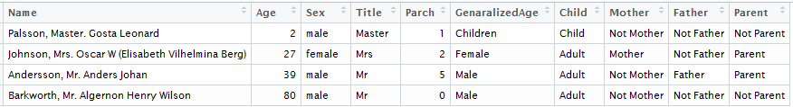




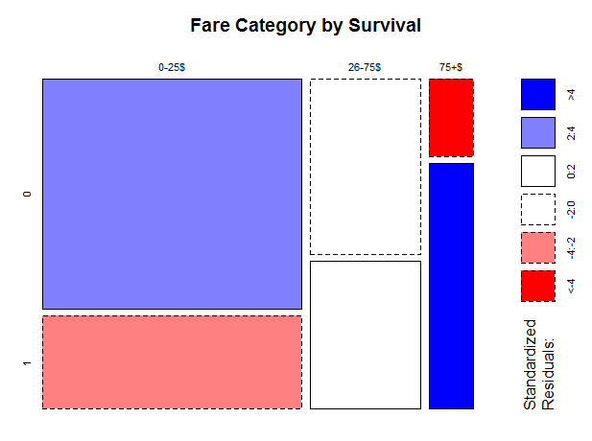

Data Preparation: Data Mining and Cleaning
Age , Title , Parch , Sex -> GenaralizedAge , Flags(Child,Mother,Father,Parent)
Fare -> FareCategory
Notes:
Children/Child < 16
Mother/Father Should be Mr/Mrs with Parch>0

Slide 7

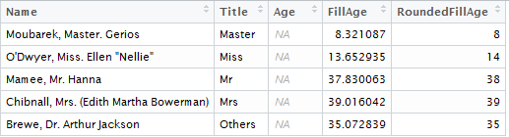
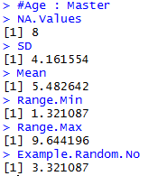
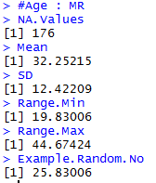
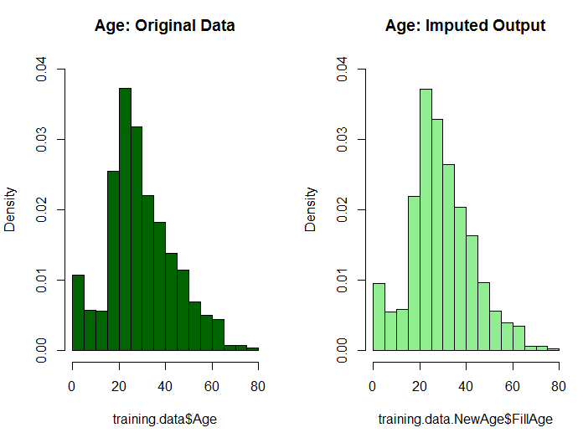
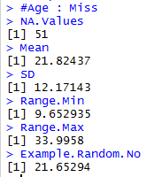
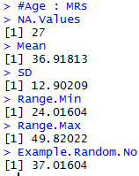
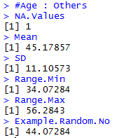
Data Preparation: Data Mining and Cleaning
NA Fill – Embarked
fill the two missing values with the most occurred value,
which is "S"
NA Fill – Age
Divide into groups by Title
Calculate Mean and SD
Select Random No from
Range(Mean±SD)
Notes:
Ethnicity: Arabs

Slide 8
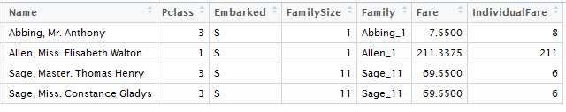
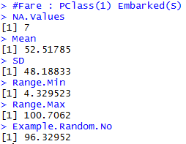
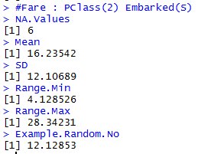
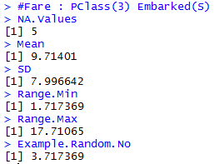

Data Preparation: Data Mining and Cleaning
NA Fill – Fare
Divide into groups by PClass and Embarked
Calculate Mean and SD
Select Random No from Range(Mean±SD)
Analysis: Missing Values only for Passenger Embarked at ‘S’ and Singleton Group.
: Multiple Passengers on Same ticket had consolidated Fare.
Notes:
Explain Why PClass and Embarked as groups.
How Ticket Fare is Consolidated.
Only Few values had NA so no need to show the Distribution

Slide 9

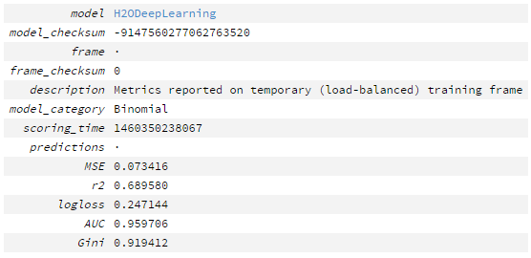
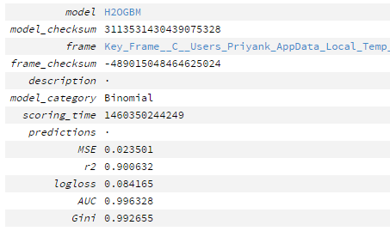
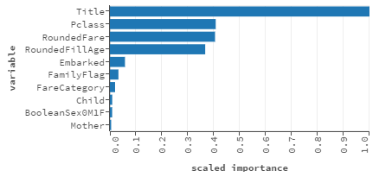
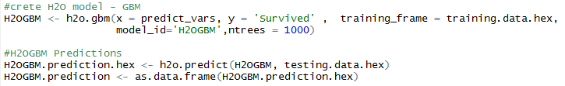
Application of Algorithm & Techniques
H2O : Deep Learning
H2O : GBM

Slide 10
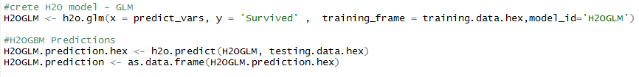
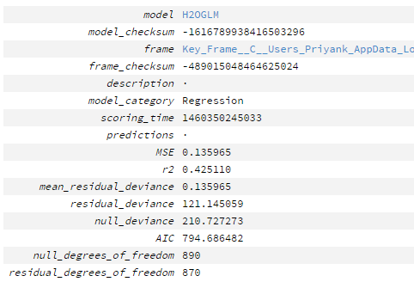
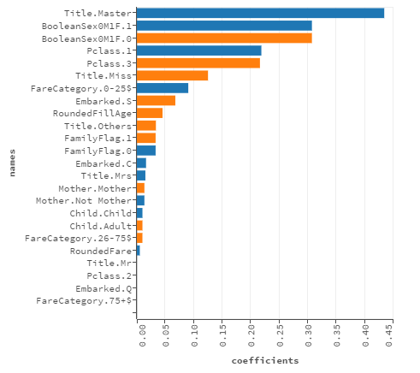
Application of Algorithm & Techniques
H2O : GLM

Slide 11
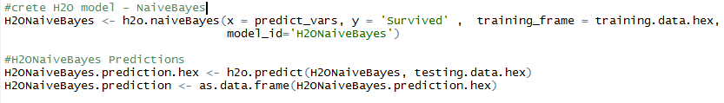
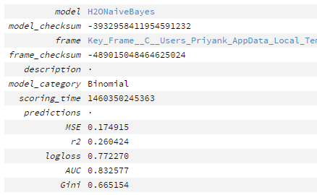
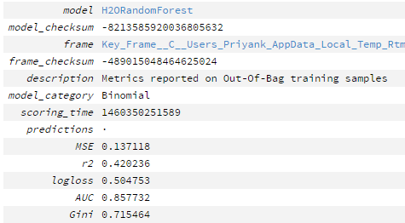
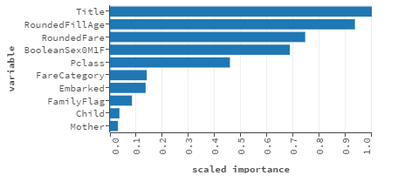
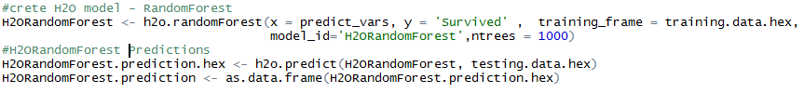
Application of Algorithm & Techniques
H2O : Naïve Bayes
H2O : Random Forest

Slide 12

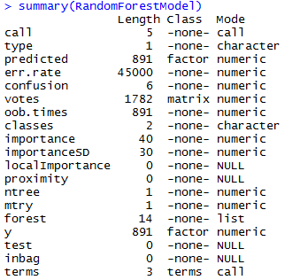
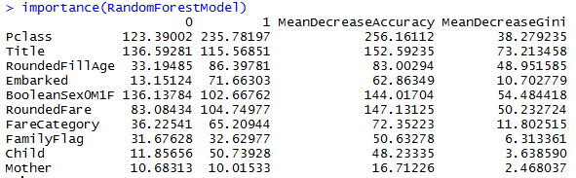

Application of Algorithm & Techniques
Random Forest
Support vector Machine

Slide 13
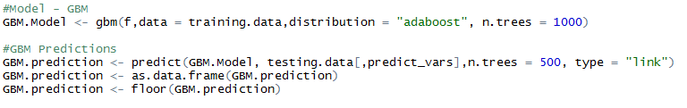
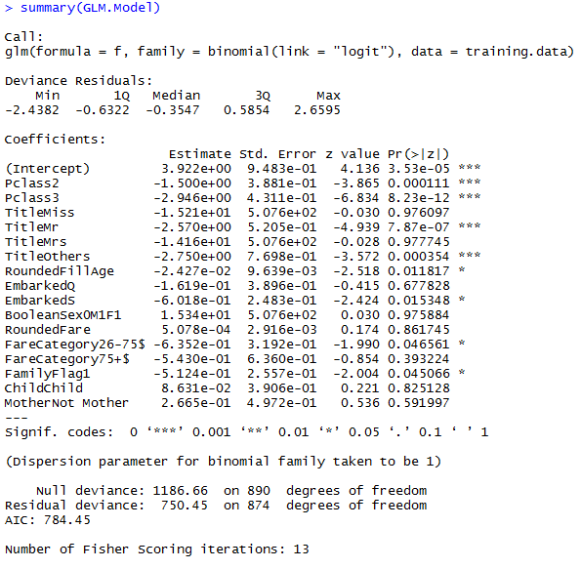
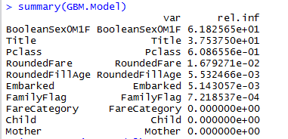
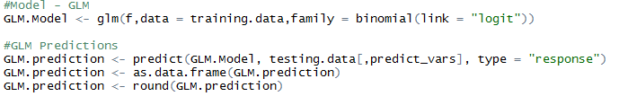
Application of Algorithm & Techniques
GBM
GLM

Slide 14
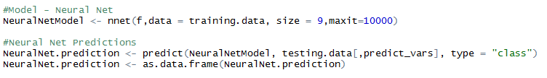
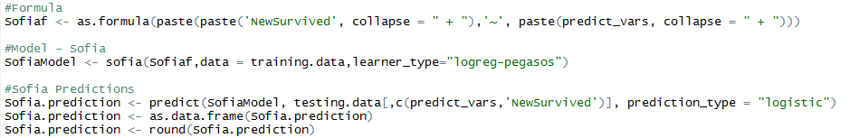
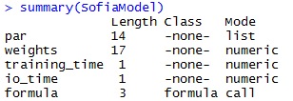
Application of Algorithm & Techniques
Neural Net
Sofia

Slide 15
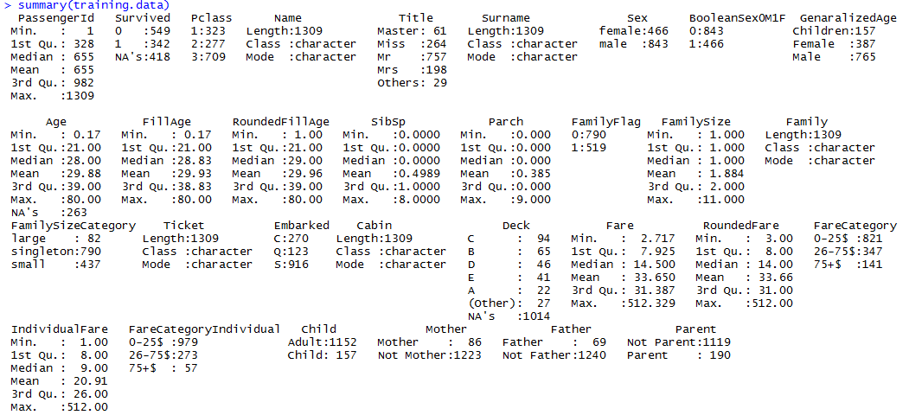
Approach Followed
Data for Modelling

Slide 16
Approach Followed
Predictors for Model
Final Predictors:
'Pclass','Title','RoundedFillAge','Embarked','BooleanSex0M1F','RoundedFare','FareCategory','FamilyFlag','Child','Mother'
Notes:
RMSE
Subset of Training Data

Slide 17
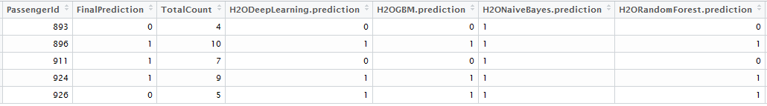
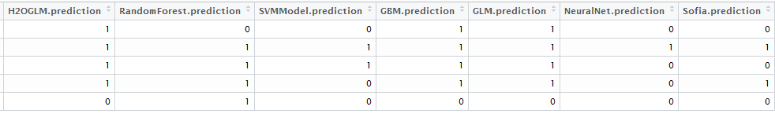
Approach Followed
Aggregate the Results of 11 Models
TotalCount >= 6
Additional Approach:
Top 3 Model Approach
Second Layer Approach
Adjust Ratio Approach
Notes:
Total Count > 6 then Survived

Slide 18
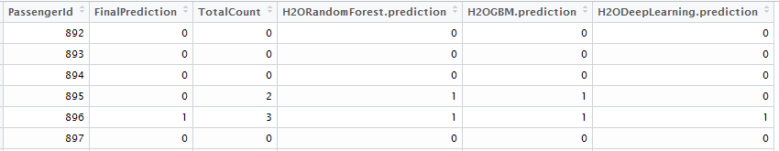
Approach Followed
Identifying Top 3 Models And Prediction
Top 3 Models :
H2ODeepLearning.prediction
H2OGBM.prediction
H2ORandomForest.prediction
Notes:
If the result matched the Actual Values. Training Subset

Slide 19
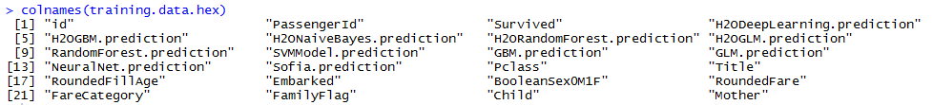
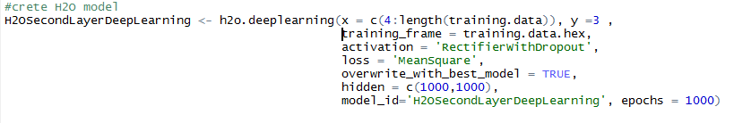
Approach Followed
Second Layer Deep Learning on 11 Model Predictions
Training Frame:
Make Predictions on Training Date or Subset of Training Data
Anomaly:
Notes:
If the result matched the Actual Values. Training Subset

Slide 20



Approach Followed
Adjust Ratio of the 11 Model Prediction
When Ratio is Equal (TotalCount >=6)
When Ratio is Equal (TotalCount >=8)
When Ratio is Equal (TotalCount >=9)
Notes:
If the result matched the Actual Values. Training Subset

Slide 21





Submission to Kaggle.com
11 Models Aggregate
Top 3 Models
Second Layer Deep Learning
Adjusted Ratio of 11 Models(8)
Adjusted Ratio of 11 Models(9)

Slide 22
Literature Reference
Exploring the Titanic Dataset
(https://www.kaggle.com/mrisdal/titanic/exploring-survival-on-the-titanic/notebook)
Titanic: Getting Started With R
(http://trevorstephens.com/post/72916401642/titanic-getting-started-with-r)
R Libraries
library(h2o)
library(randomForest)
library(plyr)
library(kernlab)
library(gbm)
library(nnet)
library(RSofia)
library(deepnet)
library(dplyr)

Slide 23


Slide 24


