Slide 1

Introduction to
Mosin Hasan
Khushbu Panchal
Pranay Patel

Slide 2

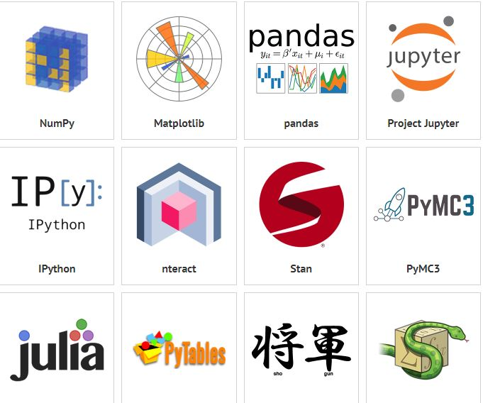
What is IT?
Originally written by Wes McKinney
Open source, BSD-licensed library
High-performance, easy-to-use data structures and data analysis tools
A NumFOCUS sponsored project
Non-profit organization supporting open source scientific computing
One of the most preferred and widely used tools in data munging/wrangling
Notes:
Benevolent dictator for life

Slide 3

Working with Pandas: Reading Data
Takes data (like a CSV or TSV file, or a SQL database), creates a Python object with rows and columns called data frame
Makes our work easier compared to working with Lists or Dictionaries
Reading from TSV file
Notes:
TSV: Tab Separated Values

Slide 4
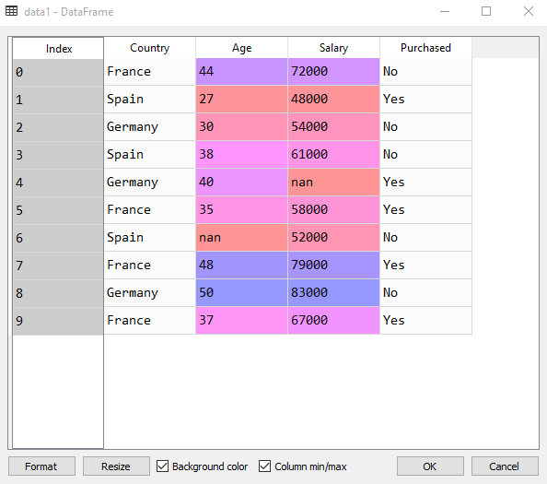
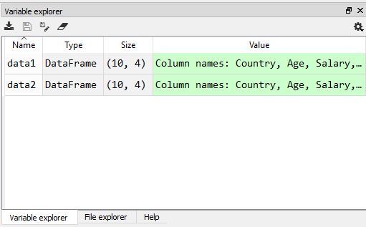

Slide 5
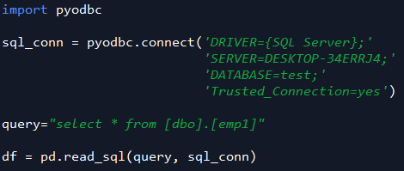
Reading from MS Sql Server

Slide 6
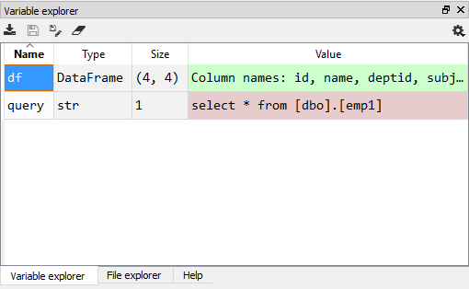
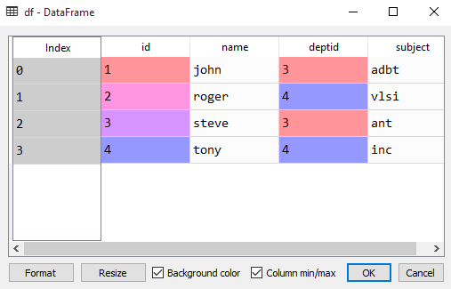

Slide 7
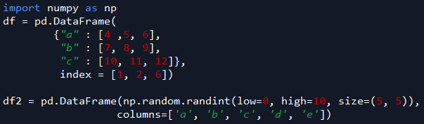

Create data frame
Save data frame to file

Slide 8
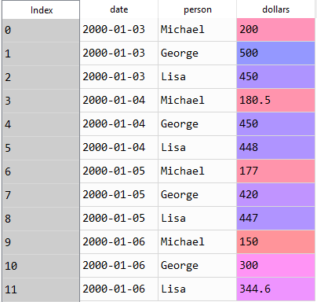

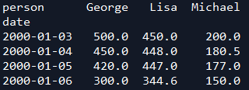
Working with Pandas: Reshaping Data
Pivoting Data
Notes:
we might be interested in visually comparing the balance of the individuals by date.

Slide 9



Transposing data

Slide 10

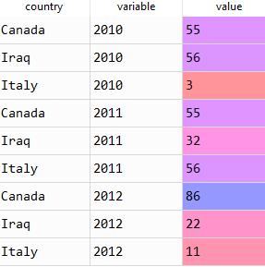
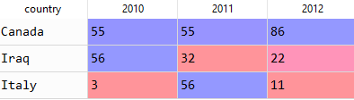
Unpivoting data

Slide 11
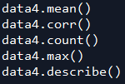
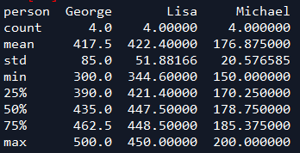
Statistics on data

Slide 12
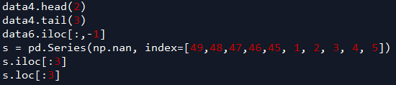
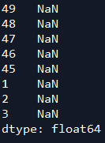

Selection of data

Slide 13
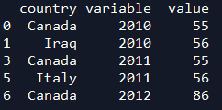
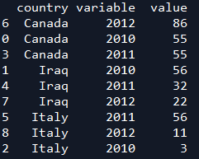
Filtering & Sorting

Slide 14
Join & Combine
df.append(df2)— add the rows in df1 to the end of df2 (columns should be identical)
df.concat([df1, df2]) — add the columns in df1 to the end of df2 (rows should be identical)

Slide 15
The End

