Slide 1
Project Description Priyank Viradia
We have developed the online movie booking portal keeping in mind 2 types of primary interactions
→User interaction
→ Employee’s interaction
Employee manages the Movie Pool (which contains all the movies in the database) and selects which movies are going to be screened . Employees also have access to the ticket that are booked by the users.
User can view the movies on the Web UI according to Genre, time and check the available seats and accordingly decide which movie to watch.

Slide 2

Er diagram

Slide 3
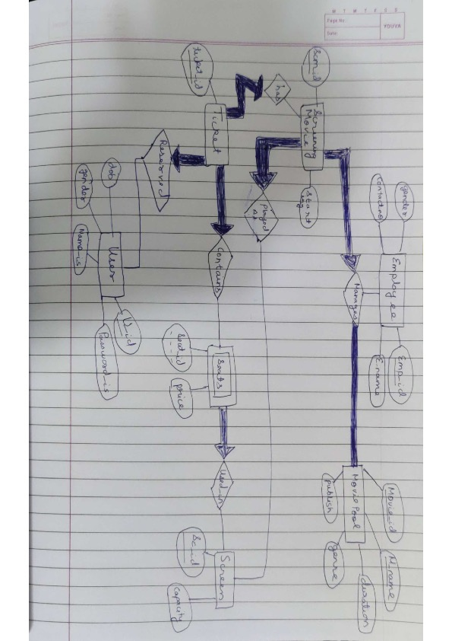
Business rules

Slide 4
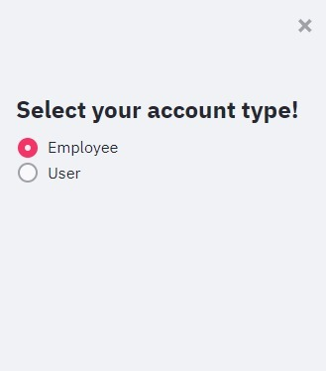
Select the type of account

Slide 5
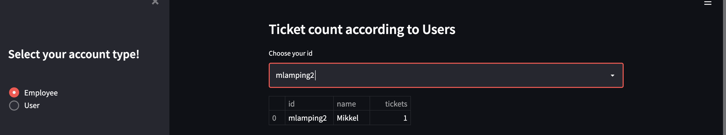
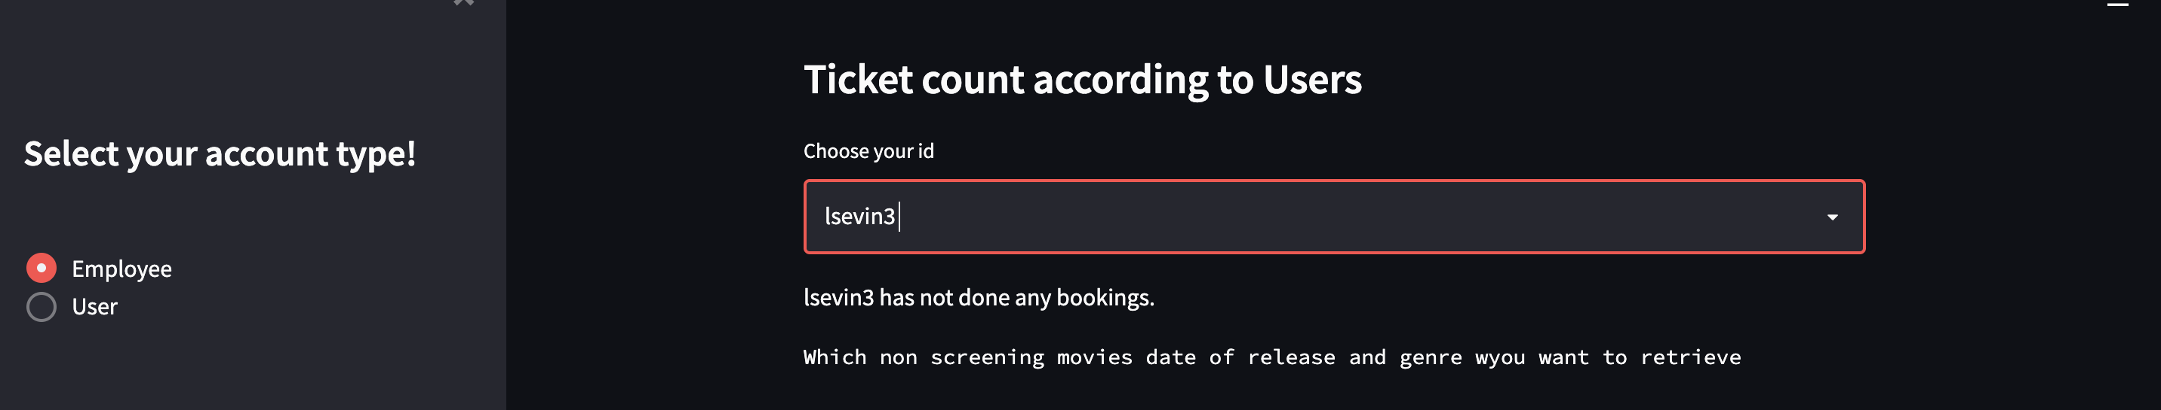
In this the employee can see how many tickets each user has booked .If a user has not booked any tickets, then an appropriate message will be displayed as shown in the second screenshot

Slide 6
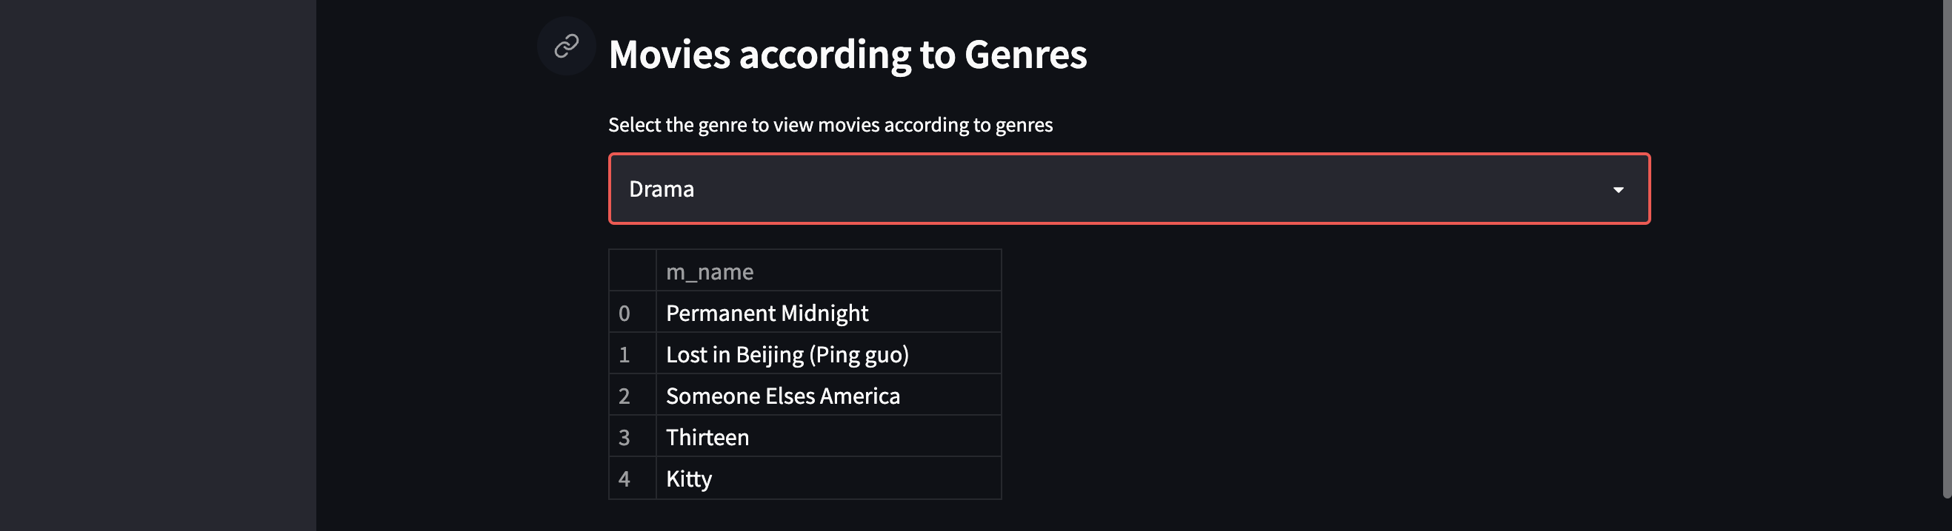
The employee can select the movie sorted by genres and decide which movie to be put in the screening movie list.

Slide 7
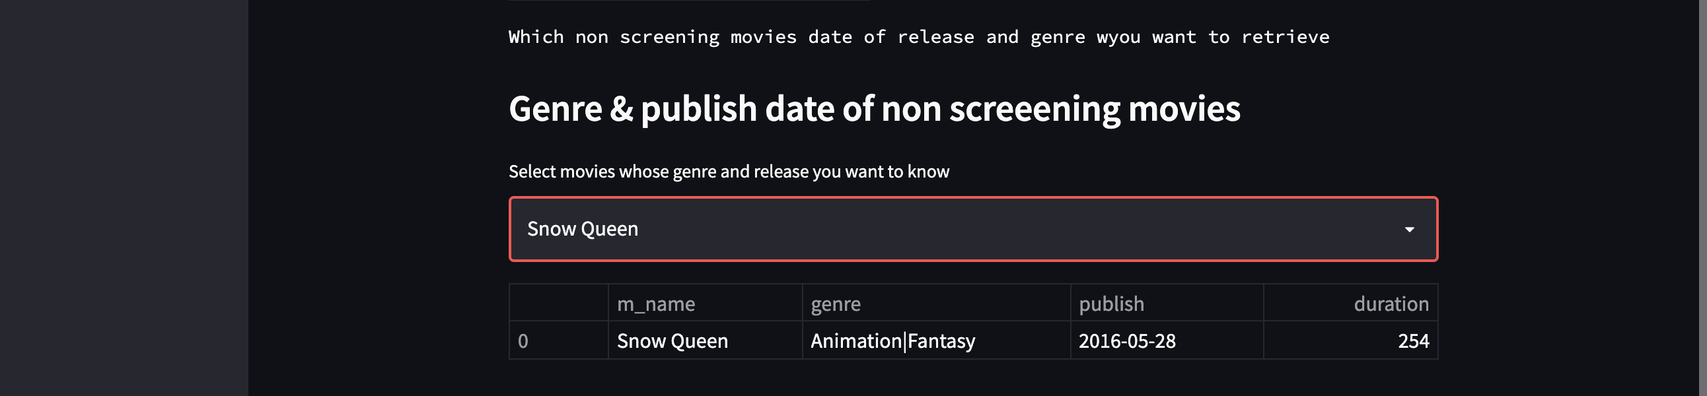
Employee can view the movie information about movie that are not currently being displayed in any of the screen

Slide 8
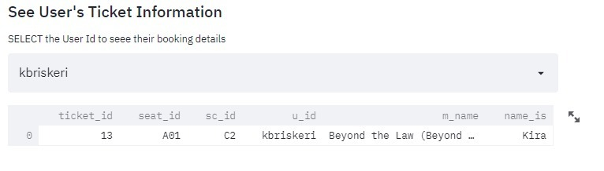
Employees can check which seats are booked by which users and their ticket details

Slide 9
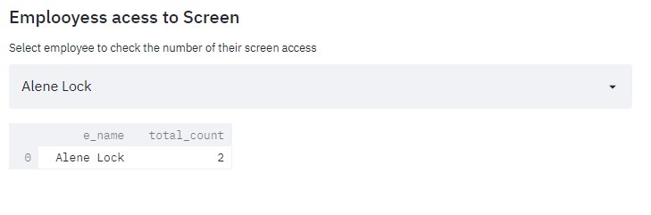
employees manages THE MOVIE DISPLAYED IN THE MOVIE SCREENS .HERE EACH EMPLOYEE CAN THE NUMBER OF SCREENS EACH EMPLOYEE HAS ACESSS TO

Slide 10
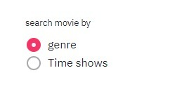
User can search movies according to genre of the movie which are currently screening in cinema .
(genre of the movie is not store in screening movie table but it is store in movie pool table so to access the information I have join the movie pool table with screening movie table )
If user wants to search movie based on its starting time, then he can select the second radio button (Time shows).

Slide 11
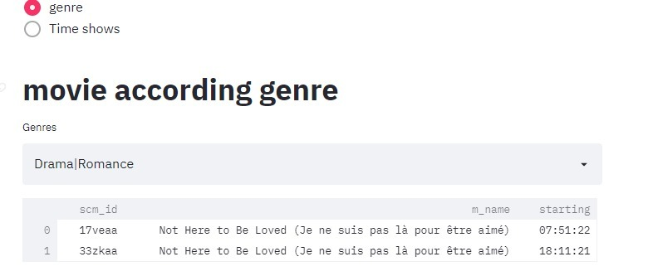
As I have explained user can see the details like unique scm_id movie name and starting time of its

Slide 12
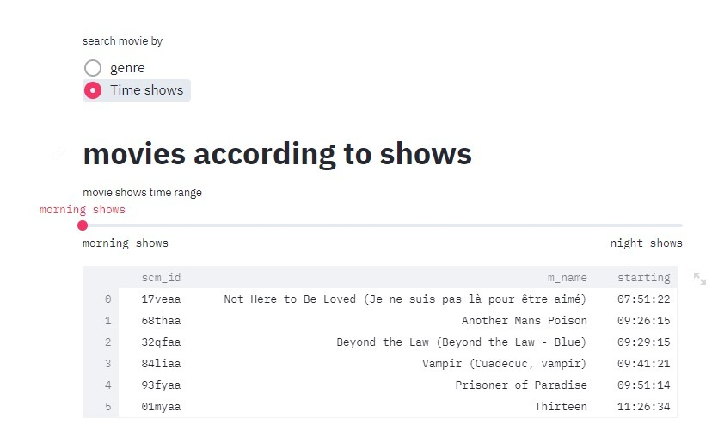
For the time shows I have taken general scenario like morning show( Between 6 am to 12 pm but in 24 hours format)
afternoon show (between 12 pm to 4 pm)
evening show(between 4pm to 11 pm)
night show (between 11 pm to 6 am)

Slide 13
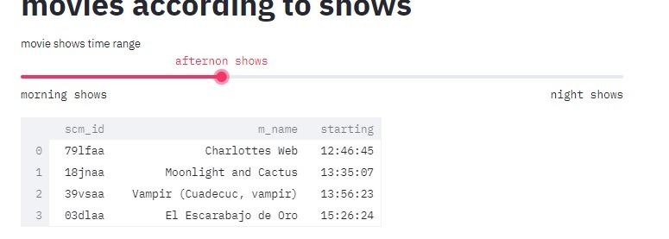
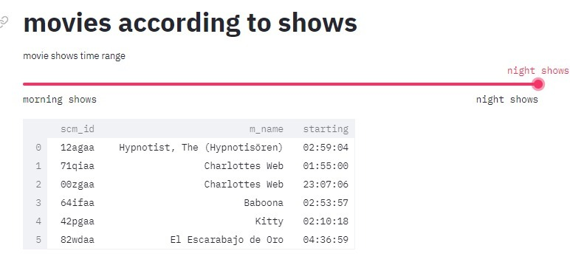
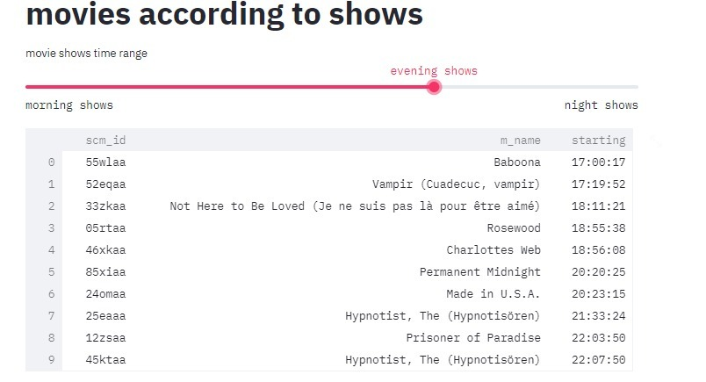

Slide 14
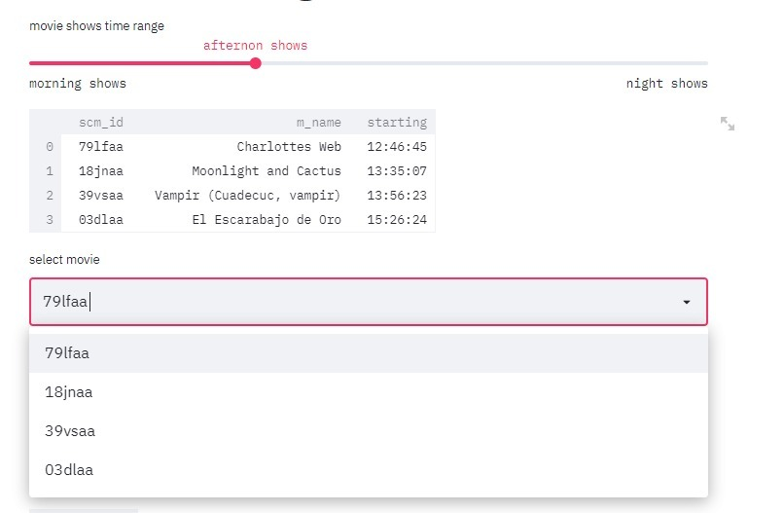
Now according to Time Shows or Genre that particular movie has assigned a uniqe scm_id number so using that user can see that particular movie is avialable in which screen on different different time
there might be possibility that same movie name shows go simultaneously but the screen in which they are showing will be different so using scm_id I can clearly mention that that particular movie is available on which screen

Slide 15
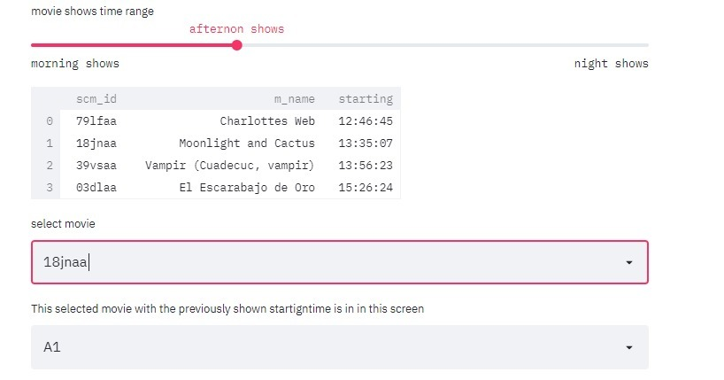
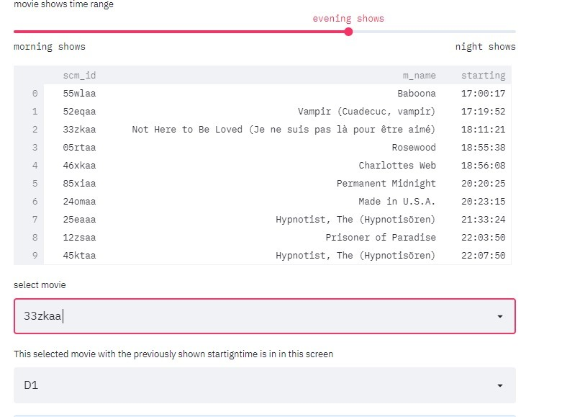
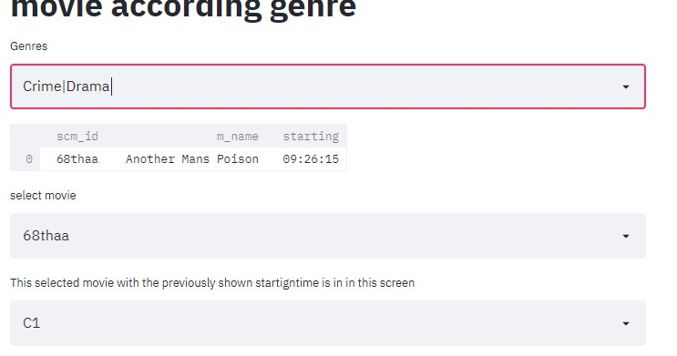

Slide 16
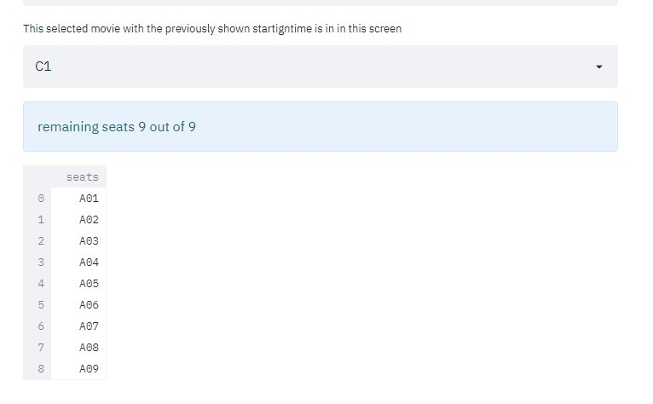
To move forward now user has already decided which screen and which movie I have declare a count of remaining seats for that show for that exact starting time
If there are 2 same movie shows in same screen but different time so the count of remaining seats will be different for the both.
as you can see in the picture, I have also given output of which seats are remaining

Slide 17

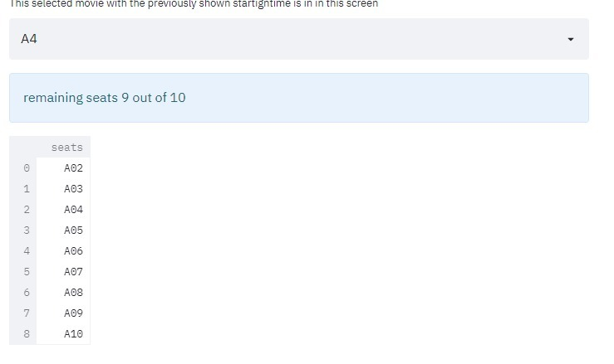
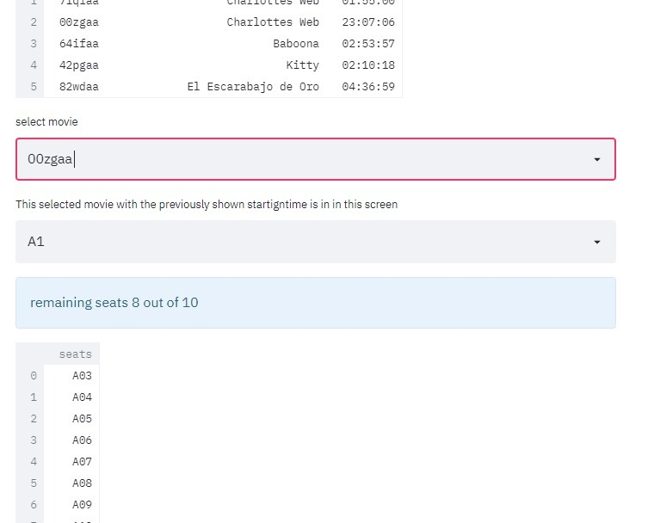

Slide 18
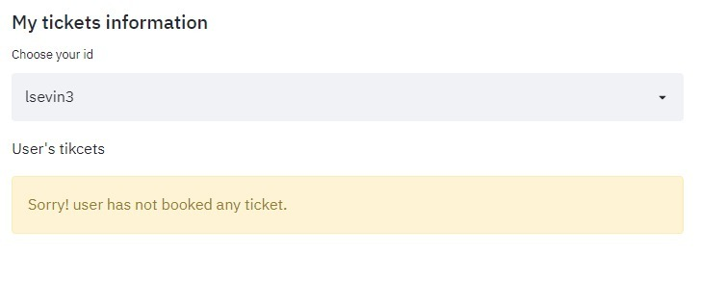
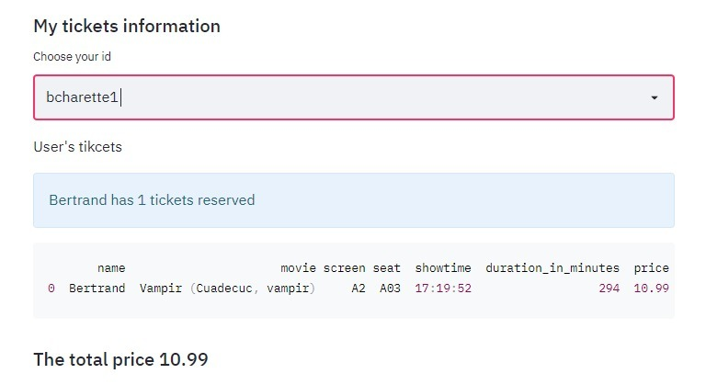
For this whole portion user can see how many tickets he/she has reserved if non For this whole portion user can see how many tickets, he/she has reserved if non then It will show him/her this warning then It
and if they have reserved the ticked then it will show the ticket details like (user name, movie name, screen, seat, show time , length of the show, price of the ticket)

Slide 19
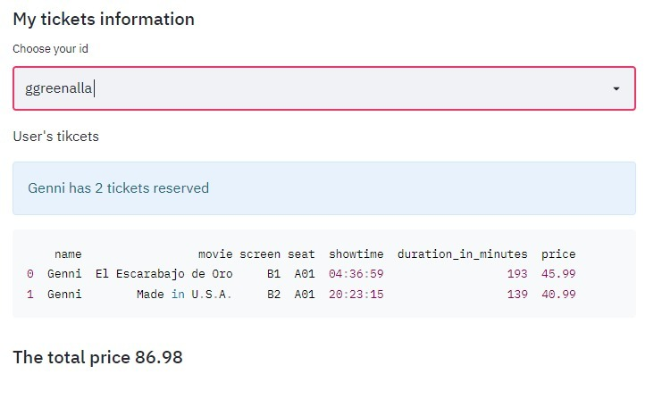
And if they have booked more than one then also the details of ticket and the total ammount to pay will be show here

Slide 20
Thank you!

