Slide 1
Interactive Sales Dashboard – Superstore Data
Created using Power BI
Priyanka Sanjay Borude
11 April 2025

Slide 2
Dashboard Objective
Design an interactive dashboard to analyze Superstore sales data.
Track key KPIs: Total Sales, Total Profit, Total Quantity, and Orders.
Enable users to filter data using slicers (Region, Segment, Category, Order Date).
Provide time-based and category-wise business insights for decision-making.

Slide 3
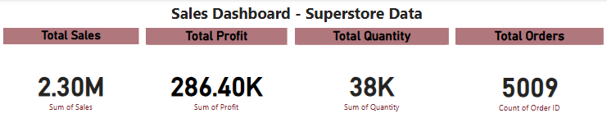
KPI Metrics Tracked
Total Sales: 2.30M
Total Profit: 286.40K
Total Quantity: 38K
Total Orders: 5009

Slide 4
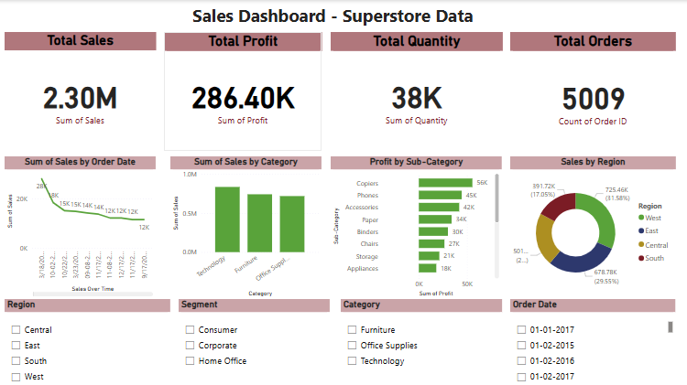
Charts and Slicers Used
Charts Used:
Sales Over Time (Line Chart) – shows monthly/yearly sales trend.
Sales by Category (Bar Chart) – compares sales of Furniture, Office Supplies, and Technology.
Profit by Sub-Category (Bar Chart) – displays profit distribution among items.
Sales by Region (Donut Chart) – shows which region contributed most to sales.
Slicers Used:
Region – filters data by geographical region.
Segment – filters data by customer type.
Category – filters data by product category.
Order Date – allows filtering data by date range.

Slide 5
Key Insights
The Technology category generated the highest total sales and profit among all categories.
The West region contributed the most to overall sales performance across all regions.
The Consumer segment had the highest number of orders compared to Corporate and Home Office.
Sales and profits showed seasonal variation with noticeable peaks in Q4 months.
Office Supplies had lower profit margins despite decent sales volume.
Sub-category analysis shows that Copiers and Phones bring in significant profits.
Most sales occurred between 2017 and 2018, with steady year-over-year growth.

Slide 6
Tools Used & Credits
Tool Used: Microsoft Power BI
Dataset: Superstore Sales Dataset (from Kaggle)
Purpose of Task:
To design an interactive sales dashboard to support business decisions.
Track key KPIs and visualize sales performance using dynamic charts and filters.
Submitted By:
Priyanka Borude
April 2025

