Slide 1

CircuitWise AI
AI-assisted Energy-efficient Design For Iot Devices
Primary SDG: SDG 12 – Responsible Consumption & Production
Submitted by:
PRIYANKA BALAKUMAR
CMR INSTITUTE OF TECHNOLOGY
Internship ID:INTERNSHIP_17828984086a44dee80acf6

Slide 2
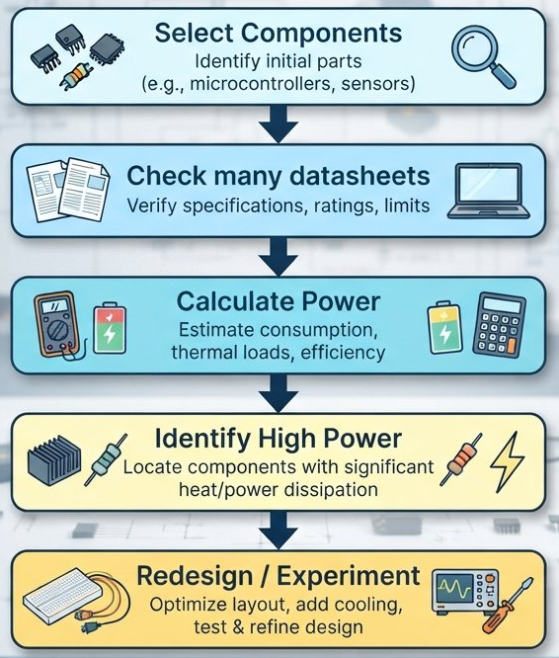
PROBLEM STATEMENT
IoT devices often operate using limited battery power.
Different components consume different amounts of energy.
Power consumption changes with operating modes and usage time.
Manual calculations and component comparison can be time-consuming.
Engineers need to identify power-hungry components before building the device.
There is a need for a tool that combines electronics calculations with AI-based analysis.

Slide 3

PROJECT & SDG ALIGNMENT
CircuitWise AI
  An AI-assisted system for:
  Power consumption analysis
  Energy prediction
  Anomaly detection
  Power optimization
  Engineering recommendations
SDG 12 — Responsible Consumption & Production
  CircuitWise AI promotes:
  Responsible energy consumption
  Energy-efficient electronic design
  Data-driven design decisions
  Sustainable IoT development

Slide 4
Proposed Solution
CircuitWise AI is an AI-assisted system for analysing and improving IoT power consumption.
It helps engineers to:
  Calculate component and system power consumption.
  Estimate energy usage for a given operating period.
  Predict energy consumption using Machine Learning.
  Detect unusual power configurations.
  Explore lower-energy design options.
  Generate understandable engineering recommendations using IBM BOB.

Slide 5
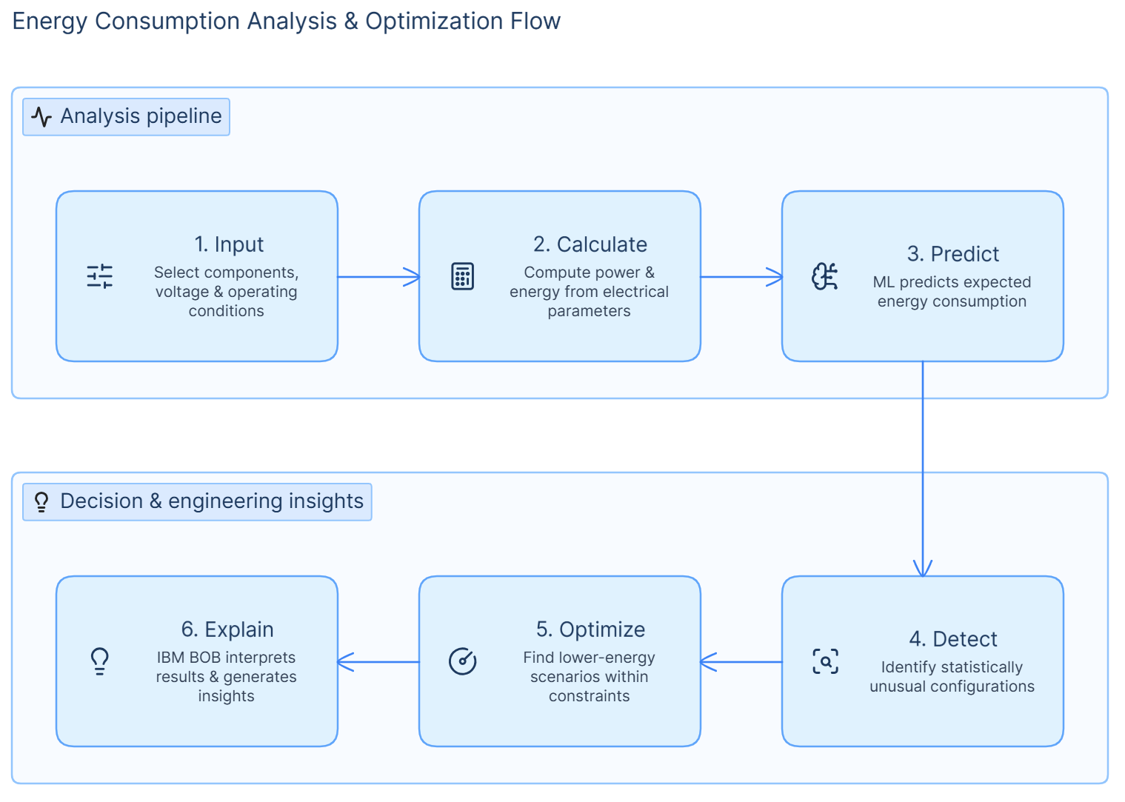
How CircuitWise AI Works
Input
  Select components, voltage and operating conditions.
Calculate
  Calculate power and energy using electrical parameters.
Predict
  ML predicts expected energy consumption.
Detect
  Identify configurations that are statistically unusual.
Optimize
  Search for lower-energy operating scenarios while respecting constraints.
Explain
  IBM BOB helps interpret the results and generate engineering insights.

Slide 6
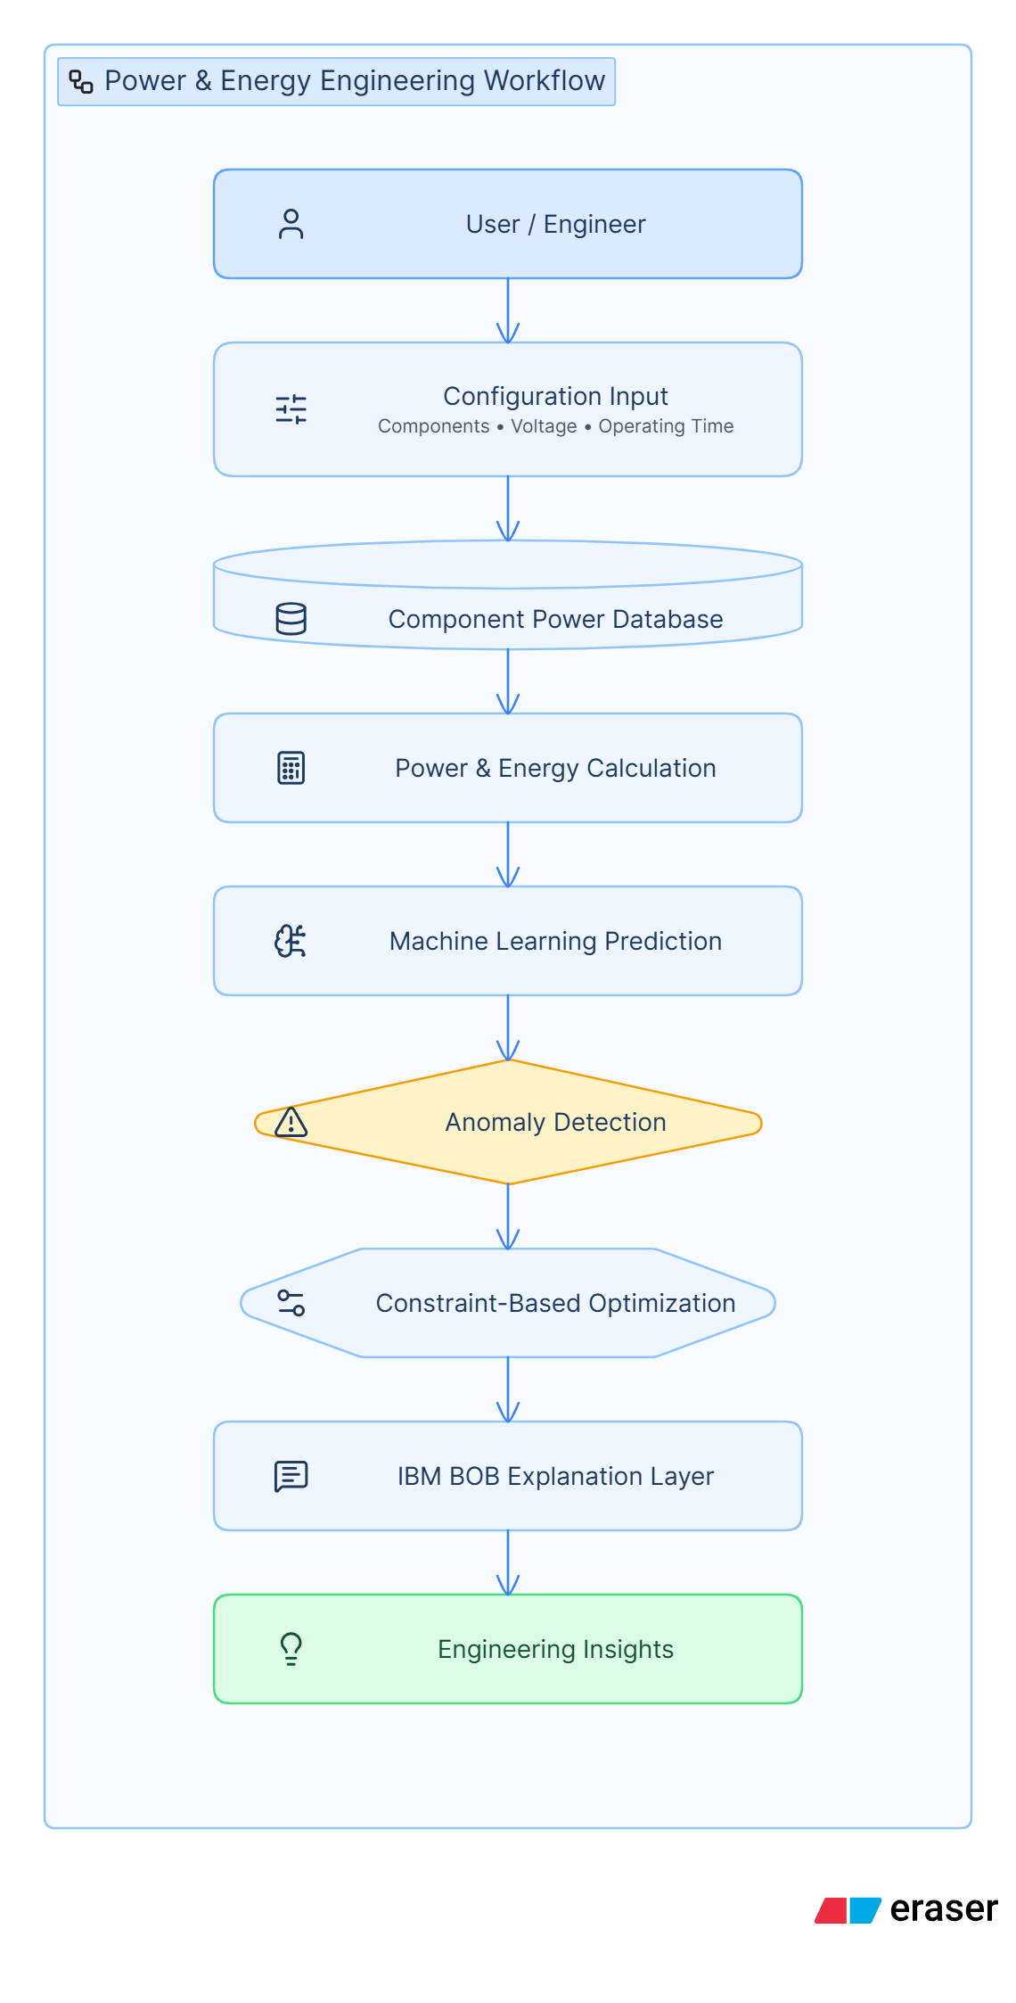
System Architecture
Technology Used
  Python
  Pandas & NumPy
  Scikit-learn
  Random Forest
  IBM BOB

Slide 7
AI Components
🤖 Energy Prediction
  Uses a Random Forest regression model.
  Predicts target energy consumption from system characteristics.
  Helps compare calculated and ML-estimated energy.
🔎 Anomaly Detection
  Uses Isolation Forest.
  Identifies configurations that are statistically unusual.
  Helps engineers investigate unexpected combinations.
⚙️ Energy Optimization
  Searches different operating scenarios.
  Applies user-defined constraints.
  Identifies potential lower-energy configurations.
💬 IBM BOB
  Explains technical results.
  Helps interpret predictions and anomalies.
  Generates engineering recommendations.
  Supports AI-assisted development and documentation.

Slide 8
Engineering Calculation + AI
How Engineering and AI Work Together
CircuitWise AI does not replace engineering calculations with AI.
Baseline Calculation
  Power : P = V × I
  Energy : E = P × t
  The calculated value provides the engineering baseline.
AI Layer
The ML model uses system features such as:
  Number of components
  Voltage
  Active/sleep duration
  Average current
  Peak current
  Analysis period
Why Both?
Calculation → Physical baseline
ML → Pattern-based prediction
Comparison → Engineering insight

Slide 9
IBM BOB Integration
IBM BOB is integrated as an AI-assisted explanation and development layer.
BOB can help explain:
  Why a prediction differs from the calculated value.
  What an anomaly means.
  Which component or operating condition needs attention.
  What optimization scenario was identified.
  What limitations should be considered.
Important
BOB explains the results; it does not replace the underlying calculations or ML models.

Slide 10
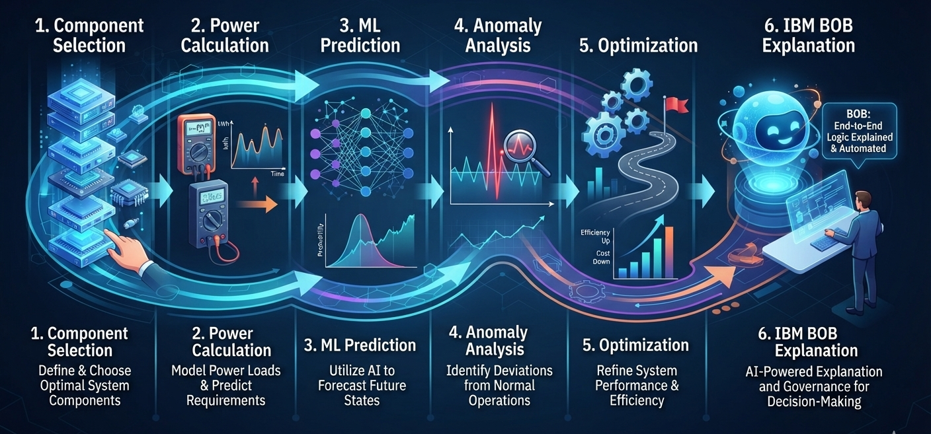
Prototype Demonstration
Prototype: ESP32 + DHT22
  Example IoT Device: Environmental monitoring system
  Configuration:
    ESP32
    DHT22 temperature/humidity sensor
    Supply voltage: 3.3 V
    Analysis period: 60 minutes
CircuitWise AI performs

Slide 11
Results
Example Results
Parameter | Result
Components | ESP32 + DHT22
Voltage | 3.3 V
Analysis period | 60 min
Calculated energy | 47.81 mWh
ML predicted energy | 22.42 mWh
Difference | 53.1%
What does this mean?
The calculated value is the engineering baseline.
The ML prediction differs significantly for this test case.
This highlights the importance of model validation.
The current model is trained on synthetic/component-derived data.
Hardware measurements are required before using the model for real-world design decisions.

Slide 12
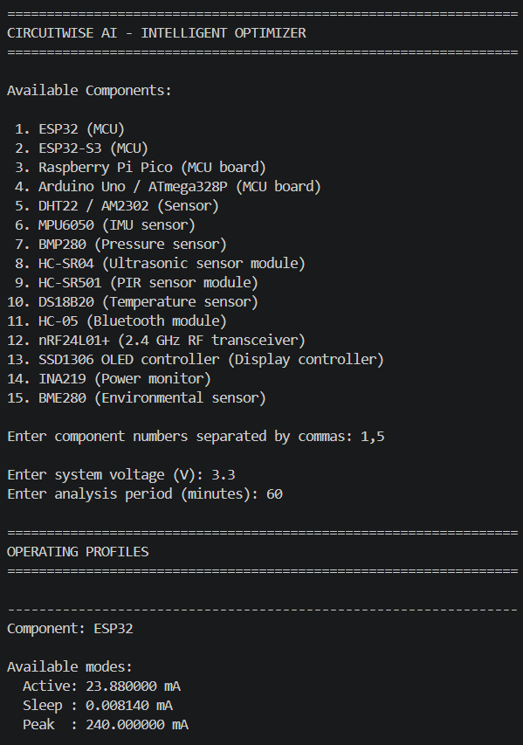
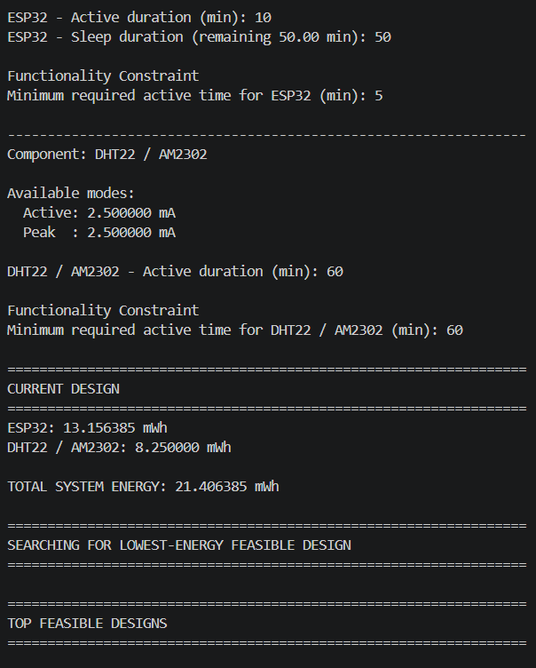

Slide 13
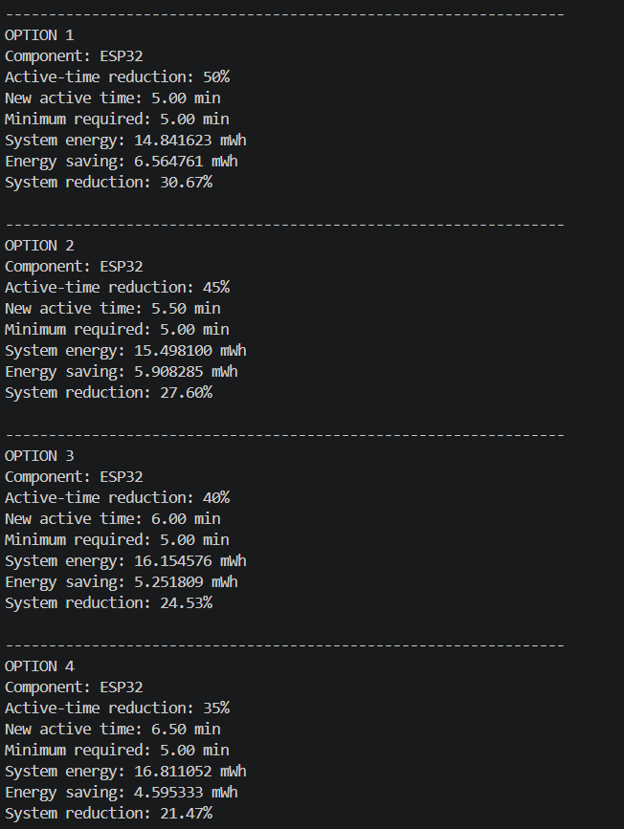
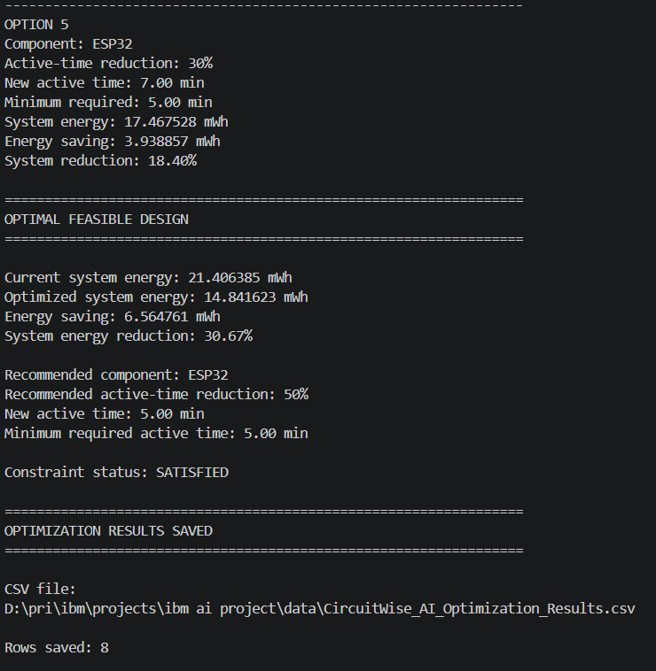
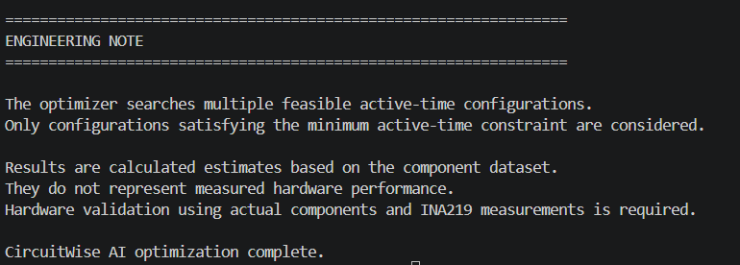

Slide 14
GITHUB LINK
https://github.com/Priyanka-Balakumar/CircuitWise_AI

Slide 15
Optimization & Responsible AI
Energy Optimization
For a tested ESP32 + DHT22 scenario:
  ESP32 active time: 10 min → 5 min
  Minimum active-time constraint: 5 min
  Calculated potential energy reduction: 30.67%
  This is a simulated/calculated scenario, not a hardware measurement.
Responsible AI
CircuitWise AI follows these principles:
  Transparency: Calculation and AI prediction are shown separately.
  Honesty: Synthetic data is clearly identified.
  Human Oversight: Engineers make the final design decision.
  No Fabricated Measurements: Hardware results are not claimed before testing.
  Limitations: Model uncertainty and data limitations are reported.

Slide 16
Impact & Future Scope
For Engineers
  Faster power analysis.
  Easier comparison of IoT configurations.
  Early identification of energy-intensive conditions.
For Developers & MSMEs
  Lower-cost design exploration.
  Reduced trial-and-error during development.
For Sustainability
  Supports energy-conscious IoT design.
  Contributes to SDG 12 – Responsible Consumption and Production.
Future Scope
  Real Power Dataset
  ML Model Retraining
  Improved Energy Prediction
  Real-World Energy-Efficient IoT Design

Slide 17

CircuitWise AI
Design Smarter. Predict Earlier. Optimize Energy. Build Sustainably.

