Slide 1

Project Title - Seasonal Agriculture Performance Analysis
Name – Priyanka Balakumar
College Name - CMR Institute of Technology
AICTE STU ID - STU6a5e35a17d6731784559009

Slide 2

PROBLEM STATEMENT
Agricultural activities are influenced by seasonal variations in environmental conditions, farming practices, resource availability and market conditions. As a result, agricultural performance may differ from one season to another.
However, raw agricultural data does not clearly explain how agricultural performance changes across seasons or what patterns can be observed in different seasonal conditions.
The problem is to analyze the given agricultural dataset and investigate seasonal differences in agricultural performance by identifying meaningful patterns, trends, relationships and variations within the available data.

Slide 3
PROJECT DESCRIPTION
Overview: A comprehensive exploratory data analysis (EDA), statistical evaluation, and multi-variable modeling of agricultural performance across diverse states, districts, and seasons.
Data Scope: Evaluates 4,000 agricultural records examining crop yields, total costs, revenues, net profitability, fertilizer application, and environmental factors.
Analytical Techniques Applied:
Univariate distribution analysis (yield histograms, crop and season frequency distributions).
Bivariate relationships (fertilizer vs. yield scatter plots, profit by irrigation methods).
Multivariate performance dashboards and risk-ROI quadrant mapping.
Correlation matrix heatmaps mapping interdependencies between climate, inputs, and financial returns.

Slide 4

WHO ARE THE END USERS?
Farmers & Agricultural Producers: To optimize crop selection, input expenditures (fertilizers/labor), and irrigation strategies for maximum profitability.
Agricultural Economists & Analysts: To evaluate market pricing trends, cost-structure burdens, and regional agricultural productivity.
Policymakers & Agricultural Planners: To design resource-allocation frameworks, subsidy programs, and sustainable food security policies across different agro-climatic zones.

Slide 5

Technology Used
Programming Language: Python
Data Manipulation & Analysis: Pandas, NumPy
Data Visualization: Matplotlib, Seaborn
Development Environment: Google Colab
Version Control: GitHub

Slide 6
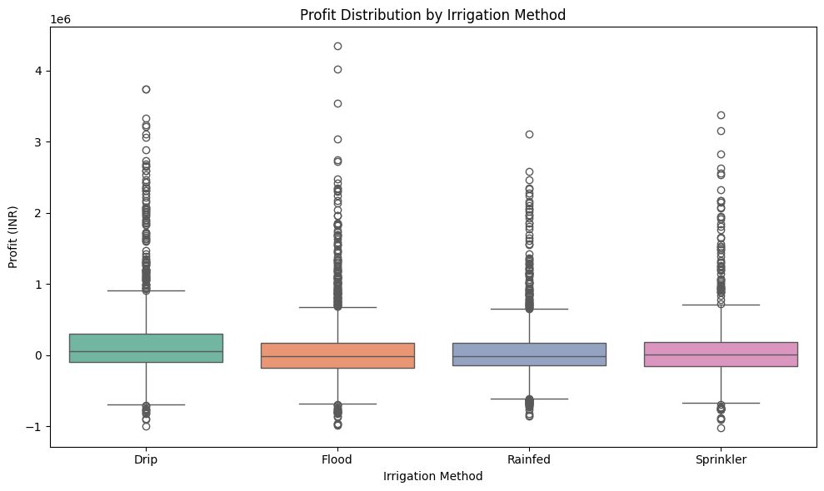
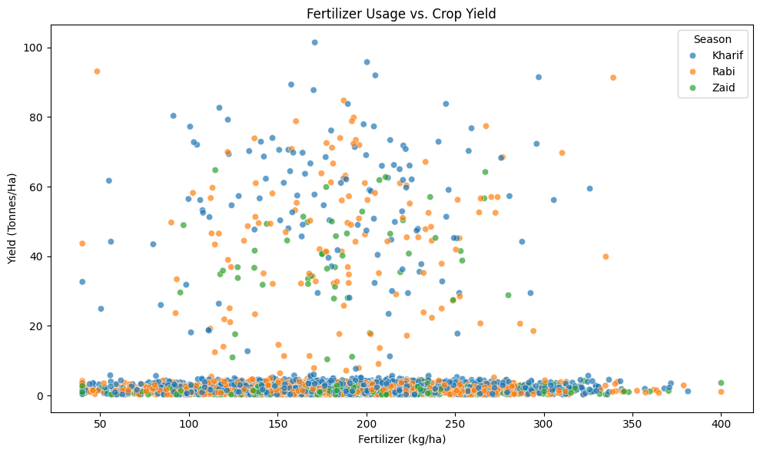
RESULTS
FIG 1: PROFIT DISTRIBUTION BY IRRIGATION METHOD
The box plot compares net profit distributions across four irrigation methods (Drip, Flood, Rainfed, and Sprinkler), demonstrating that Drip irrigation achieves a higher median profitability and a positive baseline shift compared to traditional or rainfed approaches.
FIG 2: FERTILIZER USAGE VS CROP YIELD
It reveals that while moderate-to-high fertilizer application (between 100 to 300 kg/ha) supports higher yield clusters, excessive application does not guarantee proportional yield increases, reflecting diminishing marginal returns across all seasons.

Slide 7
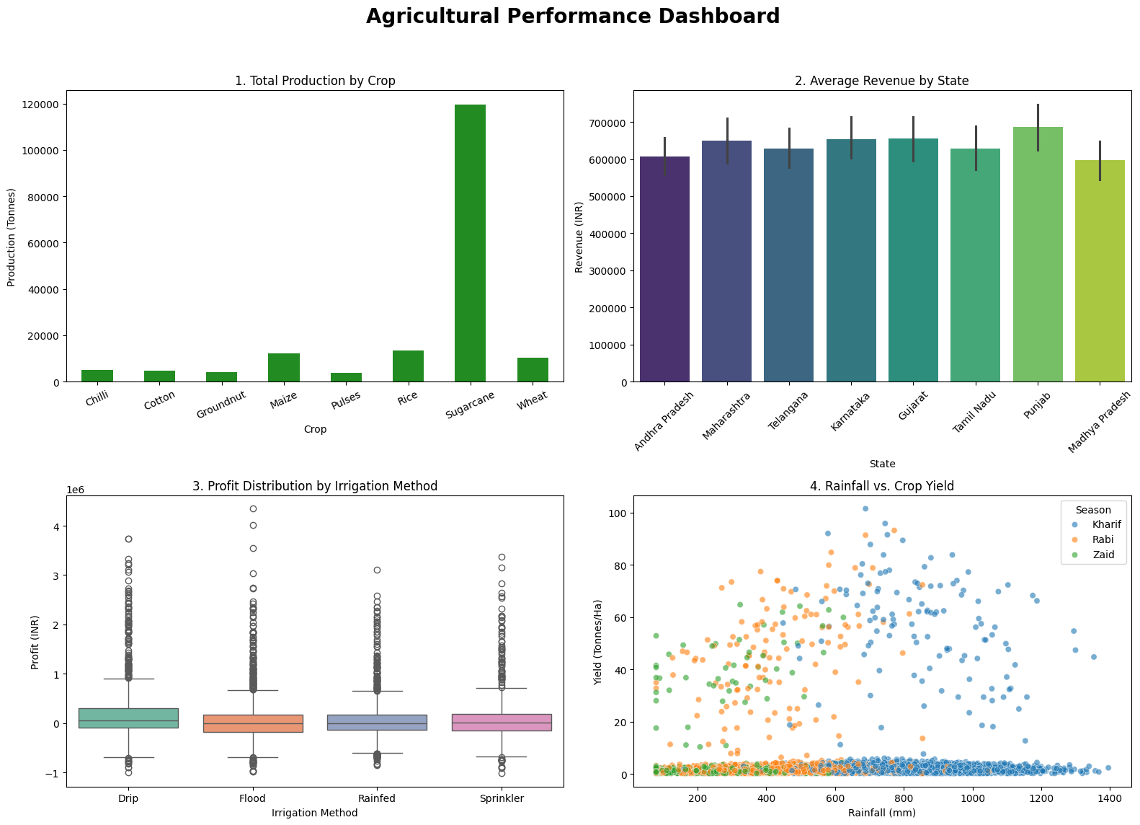
RESULTS
FIG 3: AGRICULTURAL PERFORMANCE DASHBOARD
It demonstrates how commercial crops like Sugarcane dominate aggregate production volume while illustrating that advanced irrigation methodologies and environmental factors strongly dictate farm-level profitability and crop yield outcomes.

Slide 8
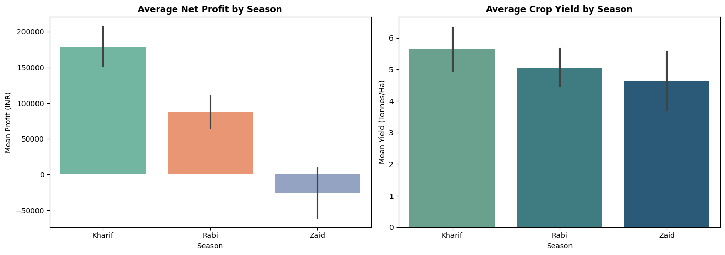
RESULTS
FIG 4: AVERAGE NET PROFIT AND YIELD BY SEASON
It illustrates that Kharif yields the highest mean net profit and average yield due to favourable monsoon conditions, while Zaid experiences negative average net profitability despite comparable crop yields.

Slide 9
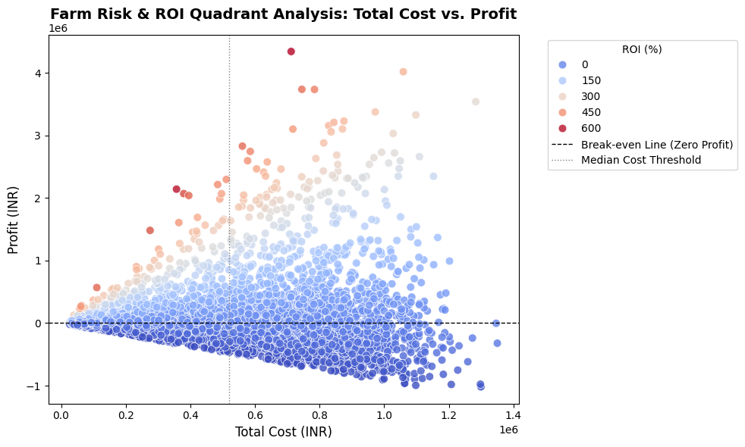
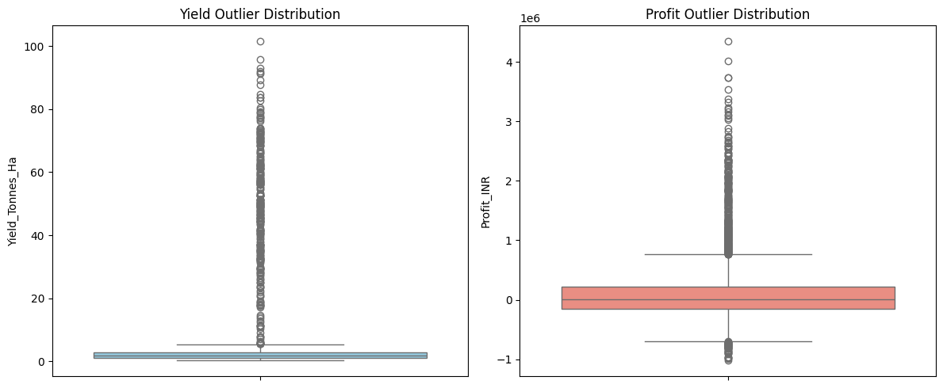
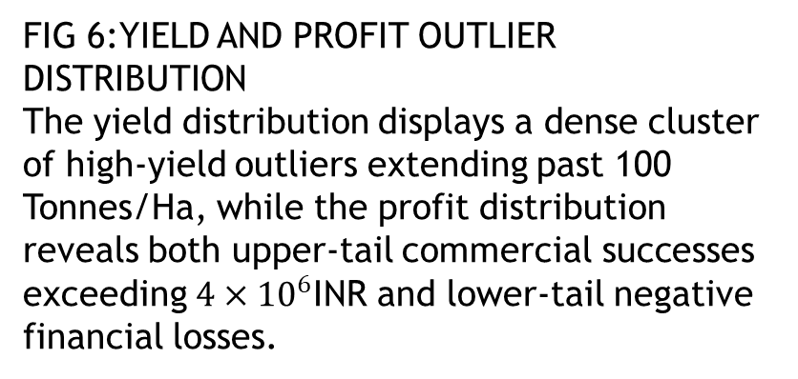
RESULTS
FIG 5: FARM RISK & ROI QUADRANT ANALYSIS
The scatter plot maps Total Cost (INR) against Profit (INR), categorized into quadrants using a break-even zero-profit line and a median cost threshold, with markers color-coded by Return on Investment (ROI %).
It demonstrates that higher total expenditures do not guarantee high returns, as many farms operating above the median cost threshold fall below the break-even line into negative profit zones, while high-ROI operations cluster in lower-to-moderate cost brackets.
FIG 6:YIELD AND PROFIT OUTLIER DISTRIBUTION
The yield distribution displays a dense cluster of high-yield outliers extending past 100 Tonnes/Ha, while the profit distribution reveals both upper-tail commercial successes exceeding $4×{10}^{6}$INR and lower-tail negative financial losses.

Slide 10
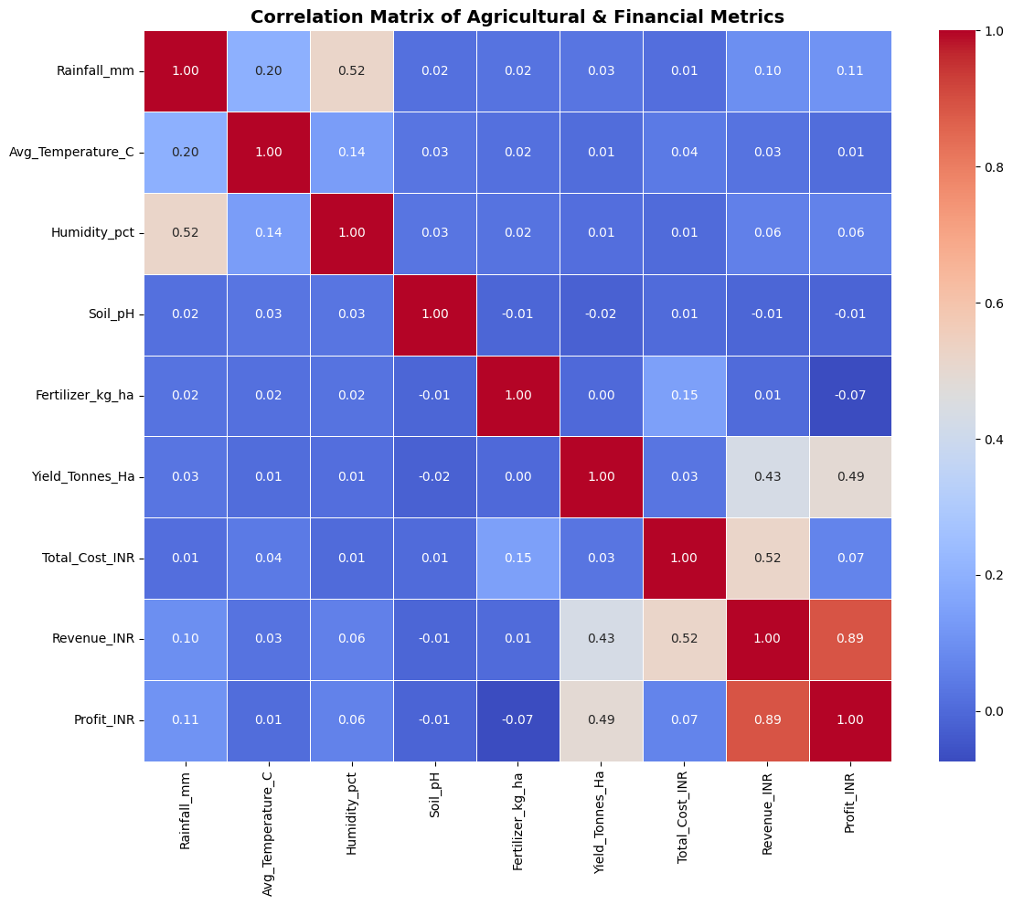
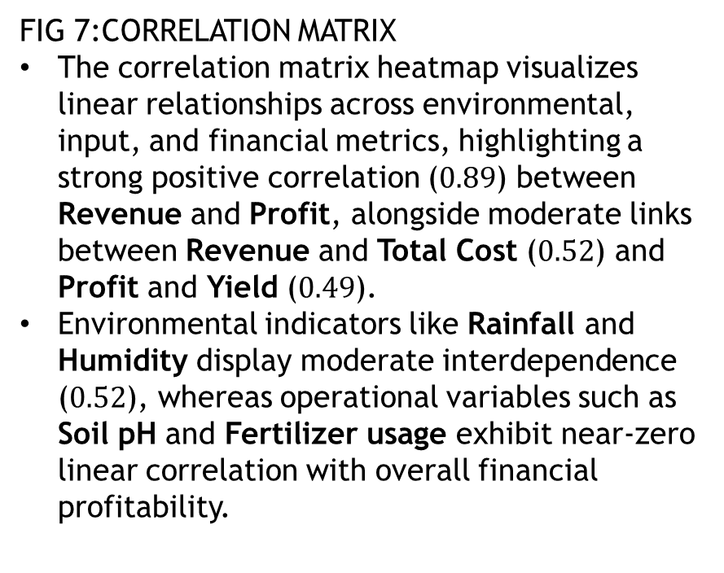
RESULTS
FIG 7:CORRELATION MATRIX
The correlation matrix heatmap visualizes linear relationships across environmental, input, and financial metrics, highlighting a strong positive correlation ($0.89$) between Revenue and Profit, alongside moderate links between Revenue and Total Cost ($0.52$) and Profit and Yield ($0.49$).
Environmental indicators like Rainfall and Humidity display moderate interdependence ($0.52$), whereas operational variables such as Soil pH and Fertilizer usage exhibit near-zero linear correlation with overall financial profitability.

Slide 11
Future scope
Real-Time IoT Integration: Incorporating live soil sensor and weather API feeds for real-time crop health monitoring and automated irrigation scheduling.
Advanced Machine Learning Predictive Modeling: Expanding the pipeline from descriptive EDA to predictive yield and price forecasting using advanced regression and ensemble models (e.g., XGBoost, Random Forest).
Geographical Expansion: Scaling the analytical framework to encompass broader national and international agro-ecological zones.

Slide 12
GitHub Link
https://github.com/Priyanka-Balakumar/Seasonal-Agriculture-Performance-Analysis

Slide 13

VOIS Course completion certificate - Course name- Data Visualization

Slide 14

.
.

