Slide 1
Chapter 1 – Introduction
1

Slide 2
Contents
Network-centric computing and network-centric content.
Cloud computing.
Delivery models and services.
Ethical issues in cloud computing.
Cloud vulnerabilities.
Cloud Computing: Theory and Practice.
Chapter 1
2

Slide 3
Network-centric computing
Information processing can be done more efficiently on large farms of
computing and storage systems accessible via the Internet.
Grid computing – initiated by the National Labs in the early 1990s; targeted primarily at scientific computing.
Utility computing – initiated in 2005-2006 by IT companies and targeted at enterprise computing.
The focus of utility computing is on the business model for providing computing services; it often requires a cloud-like infrastructure.
Cloud computing is a path to utility computing embraced by major IT
companies including: Amazon, HP, IBM, Microsoft, Oracle, and others.

Slide 4
Network-centric content
Content: any type or volume of media, be it static or dynamic, monolithic or modular, live or stored, produced by aggregation, or mixed.
The “Future Internet” will be content-centric.
The creation and consumption of audio and visual content is likely to transform the Internet to support increased quality in terms of resolution, frame rate, color depth, stereoscopic information.

Slide 5
Network-centric computing and content
Data-intensive: large scale simulations in science and engineering require large volumes of data. Multimedia streaming transfers large volume of data.
Network-intensive: transferring large volumes of data requires high bandwidth networks.
Low-latency networks for data streaming, parallel computing, computation steering.
The systems are accessed using thin clients running on systems with limited resources, e.g., wireless devices such as smart phones and tablets.
The infrastructure should support some form of workflow
management.

Slide 6
Evolution of concepts and technologies
The concepts and technologies for network-centric computing and content evolved along the years.
The web and the semantic web - expected to support composition of services. The web is dominated by unstructured or semi-structured data, while the semantic web advocates inclusion of sematic content in web pages.
The Grid - initiated in the early 1990s by National Laboratories and Universities; used primarily for applications in the area of science and engineering.
Peer-to-peer systems.
Computer clouds.

Slide 7
Cloud computing
Uses Internet technologies to offer scalable and elastic services. The term “elastic computing” refers to the ability of dynamically acquiring computing resources and supporting a variable workload.
The resources used for these services can be metered and
the users can be charged only for the resources they used.
The maintenance and security are ensured by service providers.
The service providers can operate more efficiently due to specialization and centralization.

Slide 8
Cloud computing (cont’d)
Lower costs for the cloud service provider are past to the cloud users.
Data is stored:
closer to the site where it is used.
in a device and in a location-independent manner.
The data storage strategy can increase reliability, as well as security,
and can lower communication costs.

Slide 9
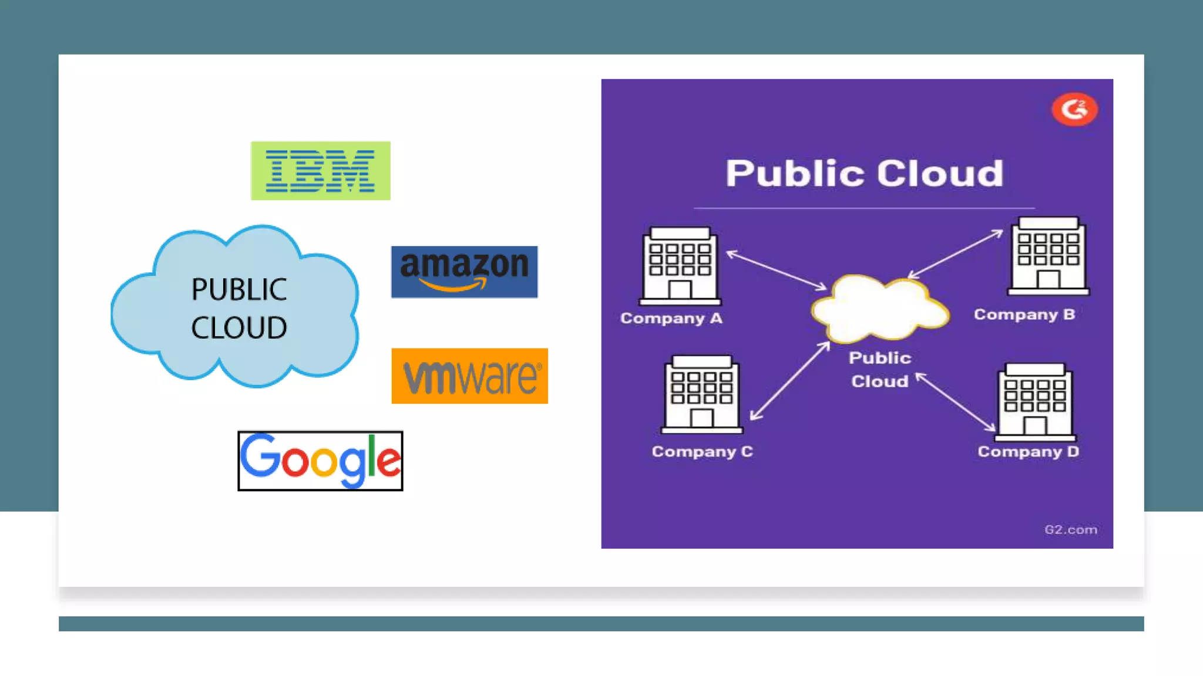
Types of clouds
Public Cloud - the infrastructure is made available to the general public or a large industry group and is owned by the organization selling cloud services.

Slide 10
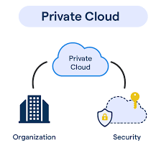
Types of clouds
Private Cloud – The infrastructure is operated solely for an organization.

Slide 11
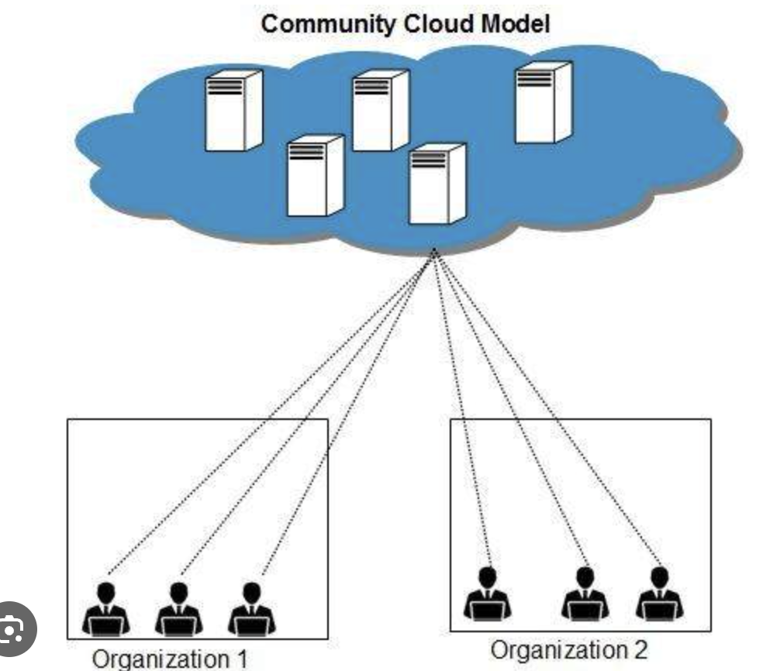
Types of clouds
Community Cloud - the infrastructure is shared by several organizations and supports a community that has shared concerns.

Slide 12
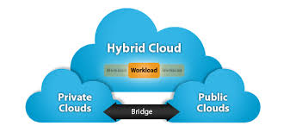
Types of clouds
Hybrid Cloud - composition of two or more clouds (public, private, or community) as unique entities but bound by standardized technology that enables data and application portability.

Slide 13
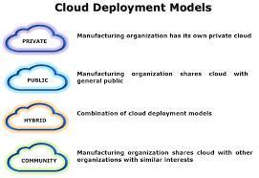
Types of clouds

Slide 14
The “good” about cloud computing
Resources sharing and Multiplexing
a. used shared resource pool (cpu, storage, bandwidth)
b. Benefit: Resource Utilization
Resources Aggregation and Data-Intensive Apps: a. clumb 100’s or 1000’s of smaller computers b. Example: DNA sequencing problem, LLM
Collboration and Data sharing: a. Data is stored in cloud rather than physical harddrive in the office b. googleDocs
Economic Shifts: capEx to opEx a. Eliminating Initial investment b. pay-as-you-go

Slide 15
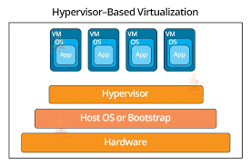
More “good” about cloud computing
User convenience: virtualization allows users to operate in familiar environments rather than in idiosyncratic ones.

Slide 16
Challenges for cloud computing
Availability of service; what happens when the service provider
cannot deliver?
Data confidentiality and auditability, a serious problem.
Data transfer bottleneck; many applications are data-intensive.

Slide 17
More challenges
Performance unpredictability, one of the consequences of resource
sharing.
How to use resource virtualization and performance isolation for QoS guarantees?
How to support elasticity, the ability to scale up and down quickly?

Slide 18
Delivery models
Software as a Service (SaaS)
Deployment models
Platform as a Service (PaaS)
Public cloud
Private cloud
Community cloud
Hybrid cloud
Infrastructure as a Service (IaaS)
Cloud computing
Infrastructure
Distributed infrastructure
Defining attributes
Resource virtualization
Massive infrastructure
Autonomous systems
Resources
Utility computing. Pay-per-usage
Compute & storage servers
Accessible via the Internet
Networks
Services
Elasticity
Applications

Slide 19
Cloud delivery models
Software as a Service (SaaS)
Platform as a Service (PaaS)
Infrastructure as a Service (IaaS)

Slide 20
Software-as-a-Service (SaaS)
Applications are supplied by the service provider.
The user does not manage or control the underlying cloud infrastructure or individual application capabilities.
Services offered include:
Enterprise services such as: workflow management, group-ware and collaborative, supply chain, communications, digital signature, customer relationship management (CRM), desktop software, financial management, geo-spatial, and search.
Web 2.0 applications such as: metadata management, social networking, blogs, wiki services, and portal services.
Not suitable for real-time applications or for those where data is not allowed to be hosted externally.
Examples: Gmail, Google search engine.

Slide 21
Platform-as-a-Service (PaaS)
Allows a cloud user to deploy consumer-created or acquired applications using programming languages and tools supported by the service provider.
The user:
Has control over the deployed applications and, possibly, application hosting environment configurations.
Does not manage or control the underlying cloud infrastructure including network, servers, operating systems, or storage.
Not particularly useful when:
The application must be portable.
Proprietary programming languages are used.
The hardware and software must be customized to improve the performance of the application.

Slide 22
Infrastructure-as-a-Service (IaaS)
The user is able to deploy and run arbitrary software, which can
include operating systems and applications.
The user does not manage or control the underlying cloud infrastructure but has control over operating systems, storage, deployed applications, and possibly limited control of some networking components, e.g., host firewalls.
Services offered by this delivery model include: server hosting, Web servers, storage, computing hardware, operating systems, virtual instances, load balancing, Internet access, and bandwidth provisioning.

Slide 23
Infrastructure as a Service
Presentation
API
Applications
Platform as a Service
Data Metadata
Integration and middleware
Integration and middleware
API
Hardware Facilities
Software as a Service
API
Hardware Facilities
API
Abstraction
Core connectivity
Abstraction
Core connectivity
Abstraction
Core connectivity
Hardware
Facilities

Slide 24
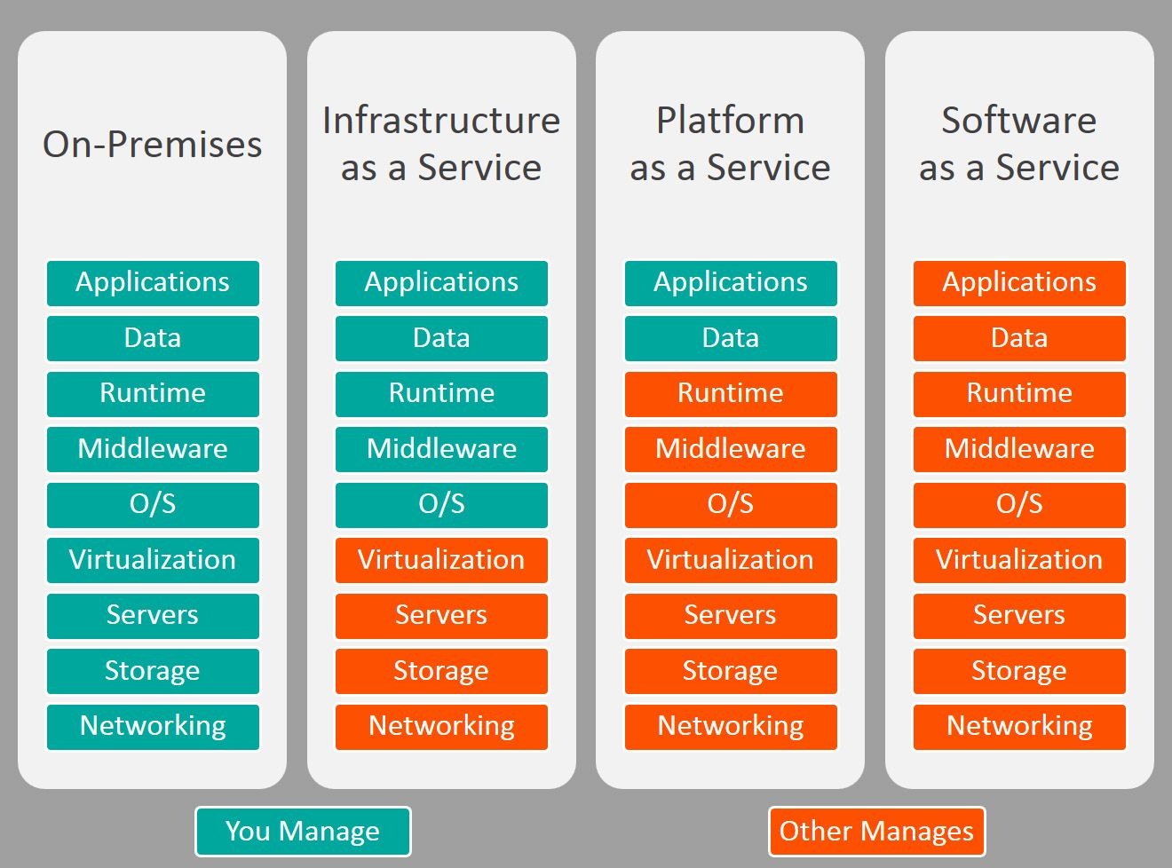

Slide 25
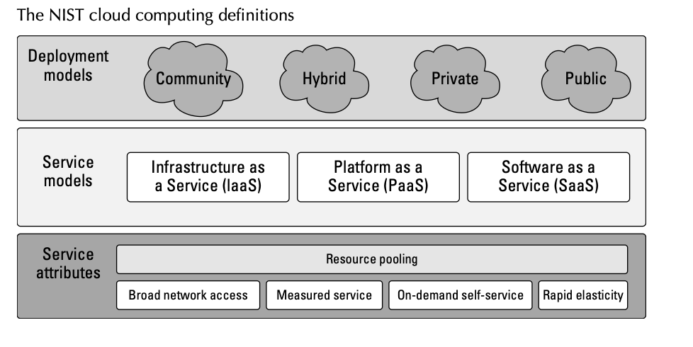
NIST cloud reference model

Slide 26
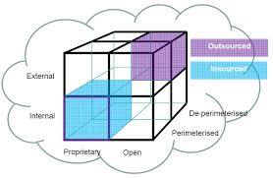
The Cloud Cube Model

Slide 27
The Cloud Cube Model
1. Physical Location: Internal vs. External
This dimension defines the physical boundaries of the data. It answers the question: Where are the servers?
Internal (I): The data and infrastructure are physically located within the organization’s own boundaries. This usually equates to a Private Cloud managed on-premises.
External (E): The data and infrastructure are located outside the organization’s physical boundaries, typically in a third-party data center (like AWS, Azure, or Google Cloud).

Slide 28
The Cloud Cube Model
2. Ownership: Proprietary vs. Open
This dimension measures interoperability and vendor lock-in. It answers: How easy is it to move my data?
Proprietary (P): The cloud provider uses unique, closed-source technology. This offers specific features but makes it very difficult to migrate to another provider without significant re-coding or data formatting.
Open (O): The provider uses industry-standard technologies (like OpenStack or Kubernetes). This allows for easier "portability," meaning you can move your applications between different cloud providers with minimal friction.

Slide 29
The Cloud Cube Model
3. Security Boundary: Perimeterised vs. De-perimeterised
This is the most critical dimension for security professionals. It answers: Is the service inside or outside our firewall?
Perimeterised (Per): The cloud service operates within the organization's existing security "perimeter." Users access it via a VPN or a dedicated leased line. It feels like a traditional extension of the local network.
De-perimeterised (D-p): The service is accessed over the public internet. The traditional "firewall" no longer protects the data. Security must instead rely on Identity and Access Management (IAM) and Encryption.

Slide 30
The Cloud Cube Model
3. Security Boundary: Perimeterised vs. De-perimeterised
This is the most critical dimension for security professionals. It answers: Is the service inside or outside our firewall?
Perimeterised (Per): The cloud service operates within the organization's existing security "perimeter." Users access it via a VPN or a dedicated leased line. It feels like a traditional extension of the local network.
De-perimeterised (D-p): The service is accessed over the public internet. The traditional "firewall" no longer protects the data. Security must instead rely on Identity and Access Management (IAM) and Encryption.

Slide 31
The Cloud Cube Model
4. Sourcing: Insourced vs. Outsourced
This dimension defines operational responsibility. It answers: Who is pulling the levers?
Insourced: The service is managed by the organization’s own staff. Even if the hardware is external, your team handles the OS, patches, and security configurations.
Outsourced: The service is managed by the provider (e.g., a SaaS like Salesforce). You consume the service, but the provider is responsible for the "plumbing."

Slide 32
Ethical issues
Paradigm shift with implications on computing ethics:
The control is relinquished to third party services.
The data is stored on multiple sites administered by several organizations.
Multiple services interoperate across the network.
Implications
Unauthorized access.
Data corruption.
Infrastructure failure, and service unavailability.

Slide 33
Privacy issues
1. Data Sovereignty and Legal Jurisdiction
while your data is "in the cloud," it physically sits on a server in a specific country. This matters because the laws of that country—not necessarily your own—often dictate who can access that data.
The Issue: A cloud provider might be headquartered in the US, but your data could be stored in a data center in Germany or Singapore.

Slide 34
Privacy issues
2. Cultural Ambivalence Toward Privacy
"privacy" isn't a universal concept; it is valued differently across the globe, making it hard to create a single standard for a global internet.
Individualist vs. Collectivist Cultures:
a. Privacy-focused: In many Western European cultures, privacy is viewed as a fundamental human right. People are often skeptical of both government and corporate data collection.
b. Community/Utility-focused: In some East Asian or Nordic cultures, there is often a higher level of trust in the state or a greater emphasis on social transparency for the "greater good" (e.g., public safety or efficient social services).

Slide 35
Cloud vulnerabilities
Clouds are affected by malicious attacks and failures of the infrastructure, e.g., power failures.
Such events can affect the Internet domain name servers and
prevent access to a cloud or can directly affect the clouds:
in 2004 an attack at Akamai caused a domain name outage and a major blackout that affected Google, Yahoo, and other sites.
in 2009, Google was the target of a denial of service attack which took down Google News and Gmail for several days;
in 2012 lightning caused a prolonged down time at Amazon.

Slide 36
Benefits of Cloud Computing
On-demand self-service
Broad network access
Resource pooling
Rapid elasticity
Measured service

Slide 37
Benefits of Cloud Computing
Lower costs: Because cloud networks operate at higher efficiencies and with greater utilization, significant cost reductions are often encountered.
Ease of utilization: Depending upon the type of service being offered, you may find that you do not require hardware or software licenses to implement your service.
Quality of Service: The Quality of Service (QoS) is something that you can obtain under contract from your vendor.
Reliability: The scale of cloud computing networks and their ability to provide load balancing and failover makes them highly reliable, often much more reliable than what you can achieve in a single organization.

Slide 38
Disadvantages of Cloud Computing
1. Lack of Customization and Feature Parity
In the cloud, you are often using "Multi-tenant" software. This means you are sharing the same code base with thousands of other companies. Because of this, the provider cannot let you change the underlying engine to suit your specific needs. 2. Latency and "Architectural Disconnect"
Because the internet is stateless and unidirectional, every interaction is a series of "requests" and "responses" traveling over long distances (WAN). This is inherently slower than a computer talking to a server in the same room (LAN).

Slide 39
Disadvantages of Cloud Computing
3. The Middleware Performance Hit
To make a "stateless" system act like it has "state" (meaning it remembers who you are and what you just did), developers have to add middleware and transaction managers. This is extra "paperwork" for the computer to process.
4. Privacy, Security, and Sovereignty
Once data leaves your physical building, you lose "custody." You are trusting the provider’s employees, their encryption, and their ability to resist government subpoenas. 5. The "Wild West" of Regulatory Compliance
The burden of compliance (HIPAA, GDPR, etc.) almost always falls on you, not the cloud provider.

Slide 40
quiz
Q1. According to Marinescu, what does 'Elastic Computing' allow a system to do?
Use multiple programming languages simultaneously.
Dynamically acquire and release computing resources in response to variable demand.
Physically bend hardware components to fit in smaller racks.
Pay a fixed monthly fee regardless of actual resource usage.
Q2. Which delivery model provides the most control, allowing users to deploy arbitrary software and operating systems?
Software as a Service (SaaS)
Platform as a Service (PaaS)
Infrastructure as a Service (IaaS)
Communication as a Service (CaaS)

Slide 41
quiz
Q3. In the Cloud Cube Model, what does the 'Physical Location' dimension define?
Whether the user is an internal employee or an external contractor.
Whether data is located within the organization’s boundary (Internal) or outside (External).
Whether the code is open-source or proprietary.
Whether the service is public or private.
Q4. What is the primary 'Economic Shift' described in the presentation?
Shifting from Operating Expenses (OpEx) to Capital Expenses (CapEx).
Reducing the total number of IT employees in a company.
Shifting from Capital Expenses (CapEx) to Operating Expenses (OpEx).
Moving all IT budget to marketing.

Slide 42
quiz
Q5. Why is 'Lack of Customization' a disadvantage of Multi-tenant software?
Because providers charge more for customized versions.
Because thousands of companies share the same underlying code base.
Because the Internet is too slow to support custom code.
Because browsers do not support custom plugins anymore.
Q6. The 'Future Internet' is expected to transform from network-centric to what?
Hardware-centric
Content-centric
Security-centric
Storage-centric

Slide 43
quiz
Q7. What does 'De-perimeterised' mean in the context of cloud security?
The system is protected by a single, strong physical firewall.
Data is outside the organization’s traditional network boundary.
The system is only accessible from within the organization.
The system has no security measures at all.
Q8. Which deployment model is operated solely for a single organization?
Public Cloud
Hybrid Cloud
Private Cloud
Community Cloud

Slide 44
quiz
Q9. How does 'Data Sovereignty' affect privacy in the cloud?
It ensures the user always owns the data.
Data is subject to the laws of the country where the server is physically located.
It forces all data to be encrypted by the user's government.
It prevents any government from accessing user data.
Q10. What challenge arises from 'Resource Sharing' (Multi-tenancy)?
Lower utility costs for the provider.
Increased hardware lifespan.
Performance unpredictability (The 'Noisy Neighbor' effect).
Simplified legal compliance.

Slide 45
quiz
Q11. Grid Computing (1990s) was primarily targeted at what field?
Enterprise business computing.
Scientific computing.
Social media and entertainment.
Global banking systems.
Q12. What does the 'Proprietary' (P) dimension of the Cloud Cube Model dictate?
The physical weight of the servers.
The degree of vendor lock-in and ease of data migration.
The color and design of the user interface.
The physical location of the data center.

Slide 46
quiz
Q13. Network-centric content requires the Future Internet to support increased quality in what areas?
Resolution, frame rate, and stereoscopic information.
Text processing speed and email delivery.
Physical hardware durability and battery life.
The number of users who can use a single keyboard.
Q14. What is the ethical risk of 'Indirect Surveillance' in the cloud?
Users can watch the provider's employees through webcams.
Providers can monitor user activity without physical access to their building.
It requires the user to install cameras in their office.
It is only a risk if the user is using a public computer.

Slide 47
quiz
Q13. Network-centric content requires the Future Internet to support increased quality in what areas?
Resolution, frame rate, and stereoscopic information.
Text processing speed and email delivery.
Physical hardware durability and battery life.
The number of users who can use a single keyboard.
Q14. What is the ethical risk of 'Indirect Surveillance' in the cloud?
Users can watch the provider's employees through webcams.
Providers can monitor user activity without physical access to their building.
It requires the user to install cameras in their office.
It is only a risk if the user is using a public computer.

Slide 48
quiz
Q13. Network-centric content requires the Future Internet to support increased quality in what areas?
Resolution, frame rate, and stereoscopic information.
Text processing speed and email delivery.
Physical hardware durability and battery life.
The number of users who can use a single keyboard.
Q14. What is the ethical risk of 'Indirect Surveillance' in the cloud?
Users can watch the provider's employees through webcams.
Providers can monitor user activity without physical access to their building.
It requires the user to install cameras in their office.
It is only a risk if the user is using a public computer.

Slide 49
quiz
Q15. What is the main cause of the 'Noisy Neighbor' effect?
Physical noise from cooling fans in the server room.
Resource contention in a multi-tenant environment.
Loud employees working in a shared office space.
Interference from radio waves outside the data center.
Q16. According to the text, what do Cloud SLAs generally limit?
The number of users who can log in.
The provider's financial liability in case of service failure.
The type of data a user can store.
The speed of the user's local internet connection.

Slide 50
quiz
Q17. What does 'Internal/Proprietary' (I/P) mean in the Cloud Cube Model?
Data is external and uses open-source software.
Data is inside the organization and uses a unique, non-standard stack.
Data is public and accessible by everyone.
Data is stored on a mobile device only.
Q18. Utility Computing focuses primarily on what?
Improving CPU clock speeds.
The business model for providing computing services.
Creating better graphics for video games.
Building private fiber-optic networks for schools.

Slide 51
quiz
Q19. What is the risk of an 'External' (E) physical location?
The user loses physical 'custody' of the data.
The data becomes 100% unencrypted.
The data cannot be accessed from a mobile phone.
The servers are more likely to be stolen by employees.
Q20. What is the ethical risk of 'Indirect Surveillance' in the cloud?
Users can watch the provider's employees through webcams.
Providers can monitor user activity without physical access to their building.
It requires the user to install cameras in their office.
It is only a risk if the user is using a public computer.

