Slide 1
Wireframes
Log in & Get well soon card

Slide 2
Log in System

Slide 3
Header
Logo
Navigation
User name:
Password:
Log in
Footer

Slide 4
Header
Logo
Navigation
Welcome back, Paul
Your Parking registration
Your Job application
Your Card Order
Footer

Slide 5
Get well soon Card

Slide 6
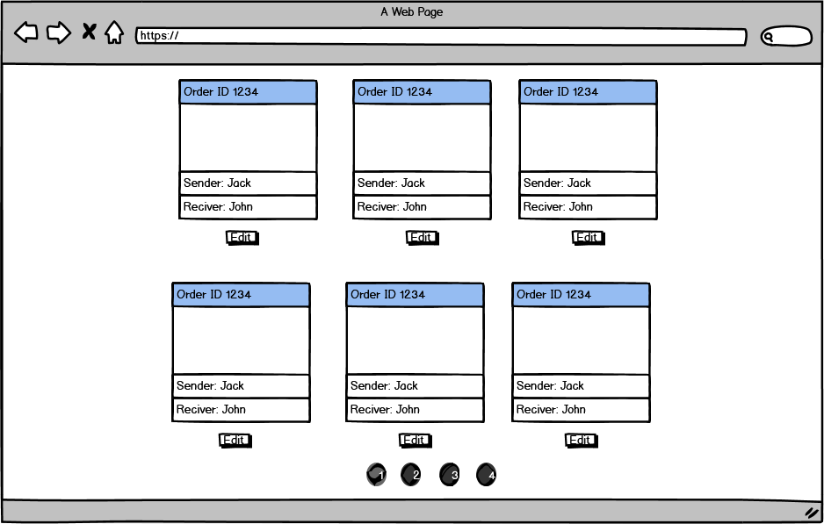

Slide 7
Header
Logo
Navigation
Choose card
Additional information
Review
Please choose the style*:
Send your good thought:
Submit
*Field required
Footer

Slide 8
Header
Logo
Navigation
Choose card
Additional information
Review
Please enter additional information:
Patient’s name*:
Patient’s phone*:
Patient’s email*:
Your name*:
Your phone*:
Your Email*:
Submit
*Field required
Footer

Slide 9
Header
Logo
Navigation
Choose card
Additional information
Review
Please review your card:
Edit
Delete
Send
Footer

Slide 10
Header
Logo
Navigation
Choose card
Additional information
Review
Please choose the style:
I am sure you will get back in your feet in no time. Please be strong.
Your best friend, Paul.
Send your good thought:
Submit
*Field required
Footer

