Slide 1
Wireframes
Log in & Get well soon card

Slide 2
Log in System

Slide 3
Header
Logo
Navigation
User name:
Password:
Log in
Footer

Slide 4
Header
Logo
Navigation
Welcome back, Paul
Your Parking registration
Your Job application
Your Card Order
Footer

Slide 5
Get well soon Card

Slide 6
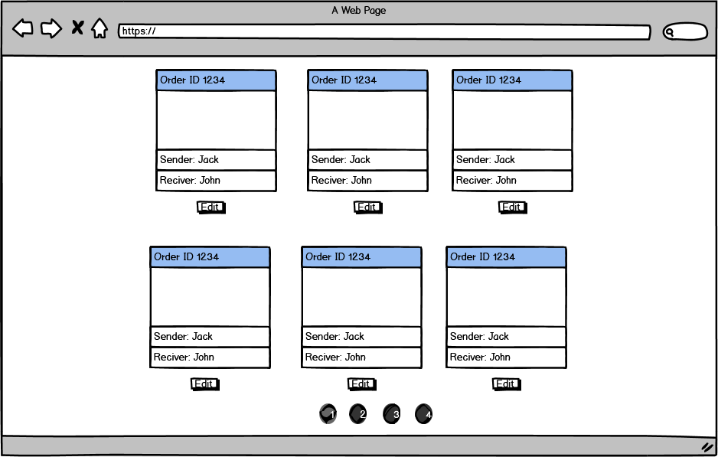
Admin & editor can see all the cards
The registered user can only see their cards

Slide 7
Patient’s name*:
Room Number*:
Patient’s email*:
Your name*:
Your phone*:
Your Email*:
Please choose the style*:
Send your good thought*:
Submit
*Field required

Slide 8
Header
Logo
Navigation
Please review your card:
Your message:
Edit
Delete
Send
Footer

Slide 9
Patient’s name:
Room Number:
Patient’s email:
Jack
A113
jack@example.com
Your name:
Your phone:
Your Email:
Paul
6471234567
paultran0307@gmail.com
Please choose the style:
I am sure you will get back in your feet in no time. Please be strong.
Your best friend, Paul.
Send your good thought:
Submit
*Field required

