Slide 1

ACCESS DENIED

Slide 2






Content
1. Introduction to the use case
2. Dataset used
3. Objectives
4. Solutions
6. Demo

Slide 3

Introduction to the use case
The company wants to select the best offers to recommend to each of their customers so they can satisfy and expand their customer base.

Slide 4
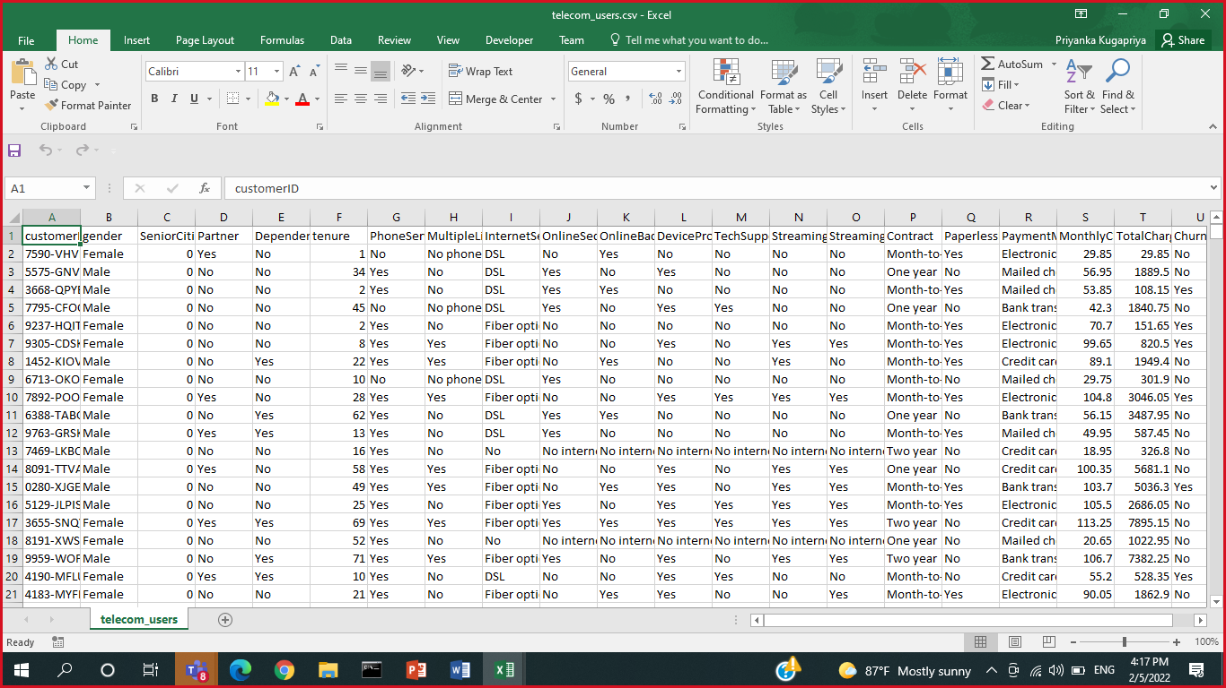
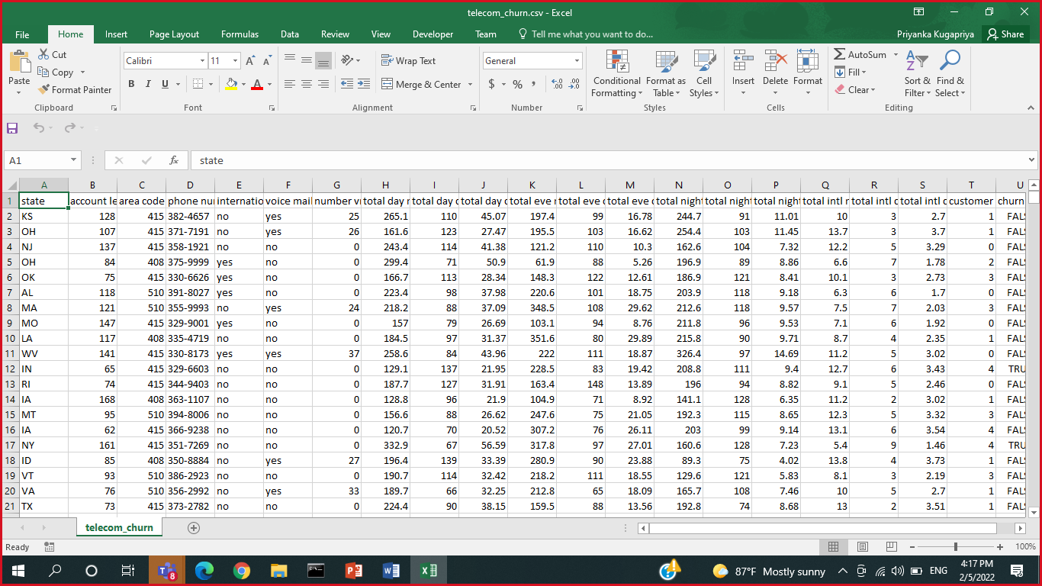
DATASET USED
Telcom_churn.csv
Telcom_users.csv

Slide 5
Objectives
Main Objective
(1) Provide Next Best Offer (NBO) for customers.
(2) Provide Next Best Action (NBA) for customers.

Slide 6
Solutions for NBO
,
Offer newly upgraded package to Phone Service customers
Offer night time package to customers with long night calls
Offer international call service to customers with high international calls

Slide 7
Solutions for NBA
Promote existing products to customers
Find frequent itemsets using A priori and FP Growth algorithms
Recommend products using campaigns, advertisements or emails

Slide 8


