Slide 1


CREDIT RISK ANALYSIS

Slide 2


Executive Summary
The goal of this project is to define a new credit card strategy and compare it with the existing strategy.
After comparing, we came to the conclusion to use XGBoost because it has the best AUC scores.

Slide 3
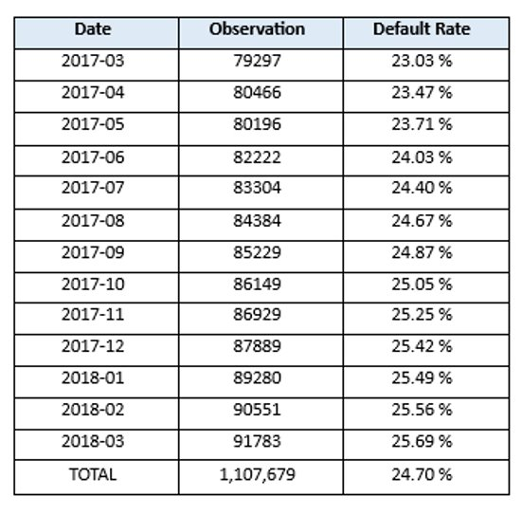
DATA
Our objective is to predict the probability of customers defaulting on their payments. To achieve this, we'll analyze payment behaviors, account balances, risk metrics, delinquency indicators, and spending habits of each customer.
The target variable in our dataset indicates whether a customer has experienced a default, specifically defined as failing to pay their due amount within 120 days after their latest statement date.

Slide 4
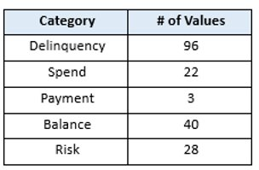
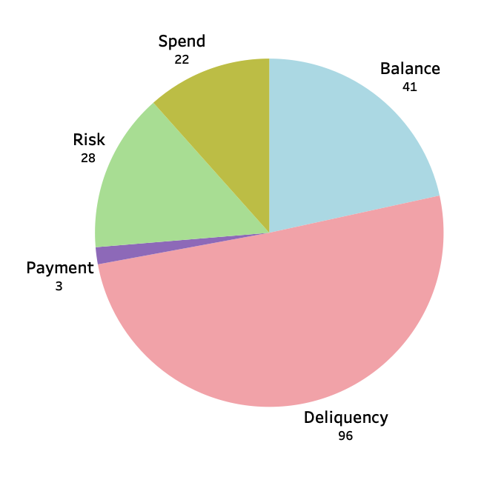
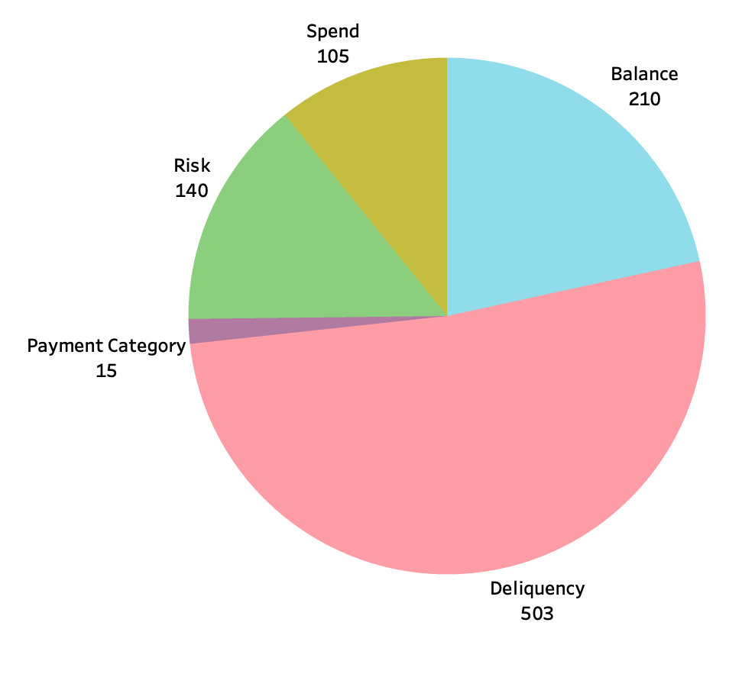
FEATURES – Categorical Variable
Before Feature Engineering
After Feature Engineering

Slide 5
FEATURES ENGINEERING
We have 885 features
We performed feature engineering on all numeric columns in the dataset by aggregating their mean, standard deviation, minimum, maximum, and latest value, grouped by customer ID. This process resulted in a total of 855 engineered features.

Slide 6
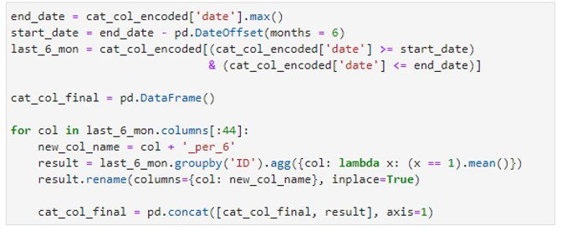
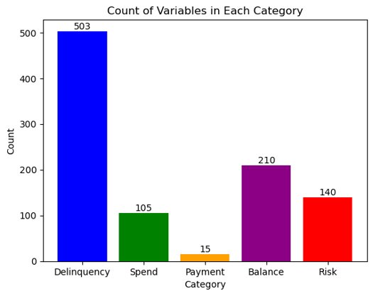
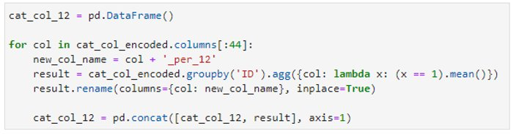
FEATURES ENGINEERING- Data processing/ one-hot encoding
Response rate in
the last 6 months
44 features
Response rate in
the last 12 months
44 features
Total features- 973

Slide 7
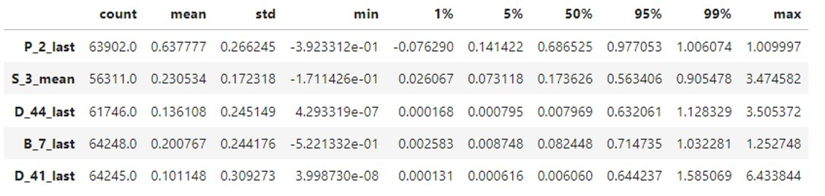
FEATURES ENGINEERING
TOP 5 features with the highest SHAP values in the best XGBoost model

Slide 8
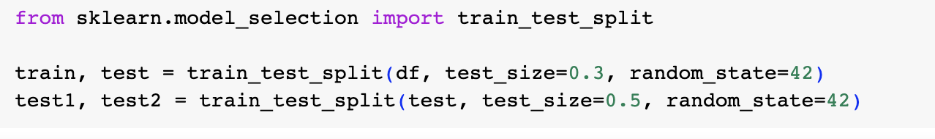
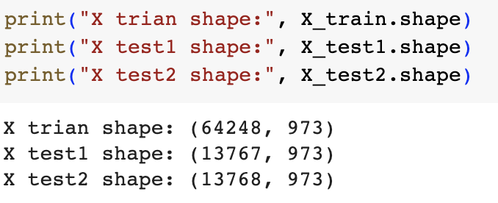
Train Test Split
The code initially splits the data into 'train' (70%) and 'test' (30%) sets.
The 'test' set is further divided into 'test1' and 'test2' (15% each) for distinct evaluation scenarios.

Slide 9

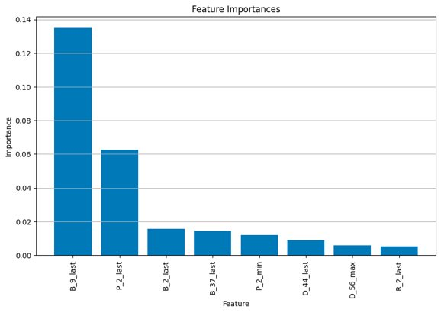
FEATURES SELECTION
Select 20 features with greater feature importance.

Slide 10
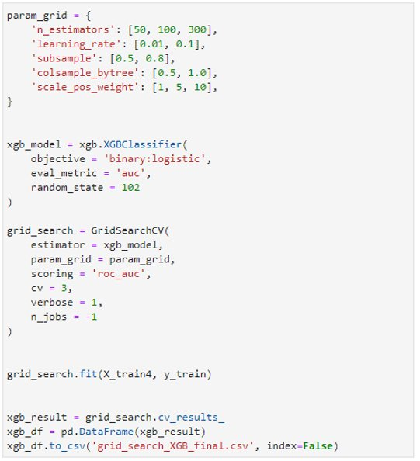
XGBoost – Grid Search
The following parameters are used for the best result
Number of trees: 50, 100, and 300
Learning Rate: 0.01, 0.1
Percentage of observations used in each tree: 50%, 80%
Percentage of features used in each tree: 50%, 100%
Weight of default observations: 1, 5, 10The following

Slide 11
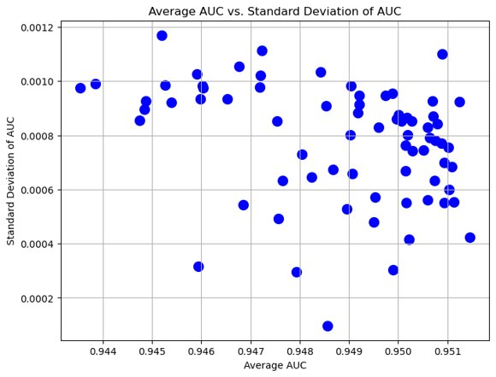
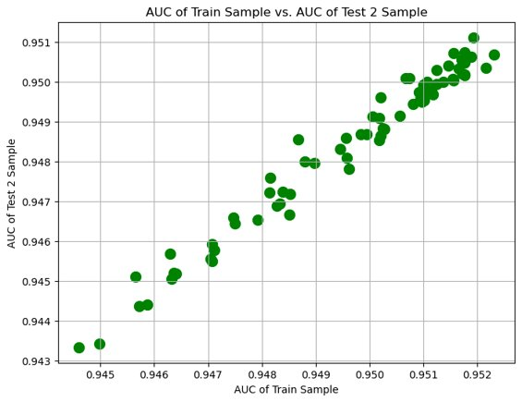
XGBoost – Grid Search
The XGBoost model achieves the highest AUC value when trained on the 'Train' sample and evaluated on the 'Test 2' sample, making it the optimal choice.

Slide 12
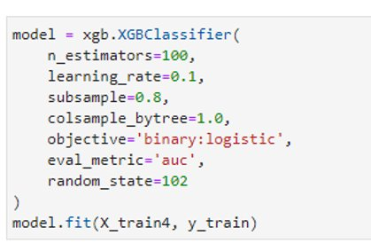
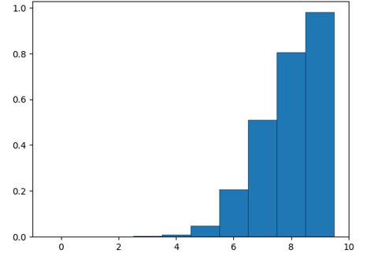
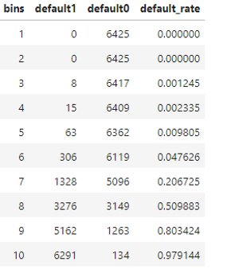
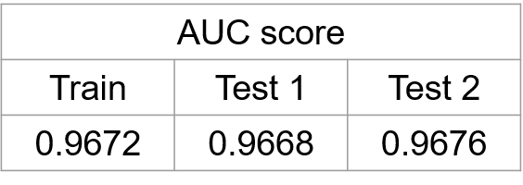
XGBoost – Final Model

Slide 13
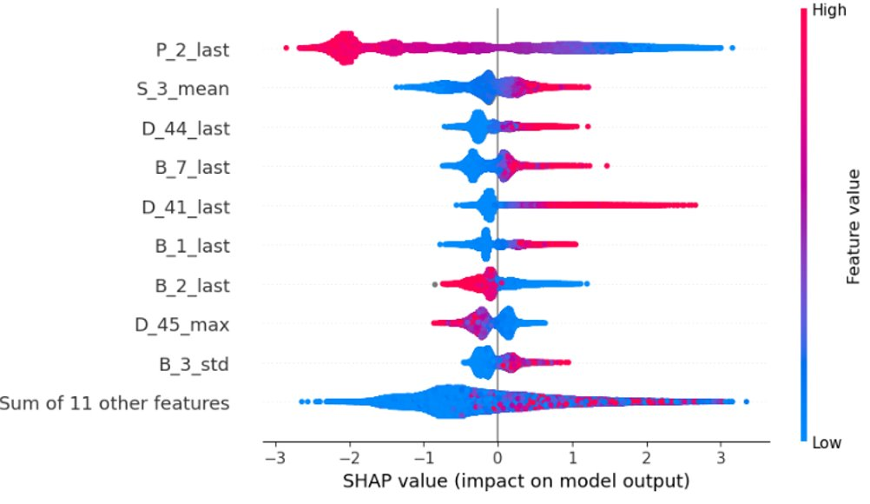
XGBoost – SHAP analysis

Slide 14
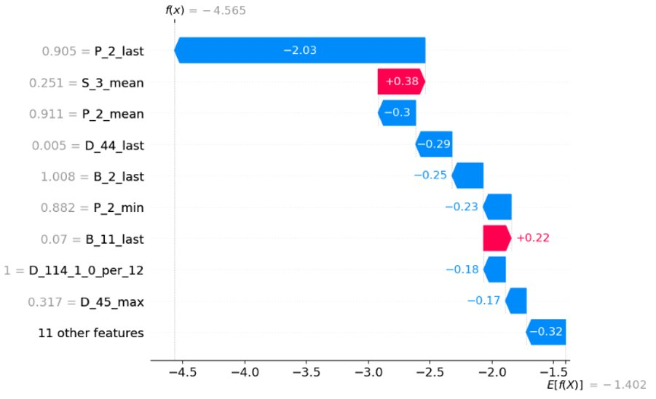
XGBoost – SHAP analysis

Slide 15
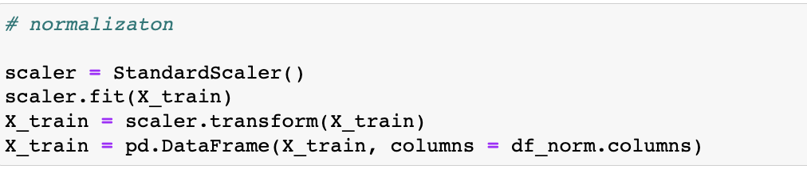
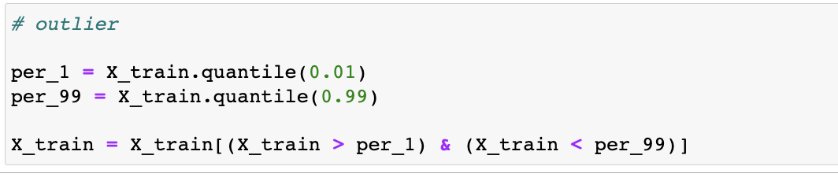
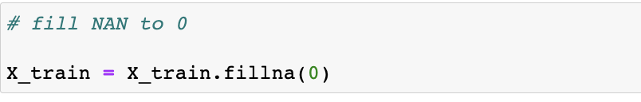
Neural Network – Data Processing
1. **Outlier Handling**: We removed outliers by retaining data within the 1st and 99th percentiles of the training dataset.
2. **Normalization**: Data was standardized using Scikit-Learn's StandardScaler to maintain uniformity across features.
3. **Handling Missing Values**: Missing data points in X_train were replaced with zeros, ensuring completeness in the dataset.

Slide 16
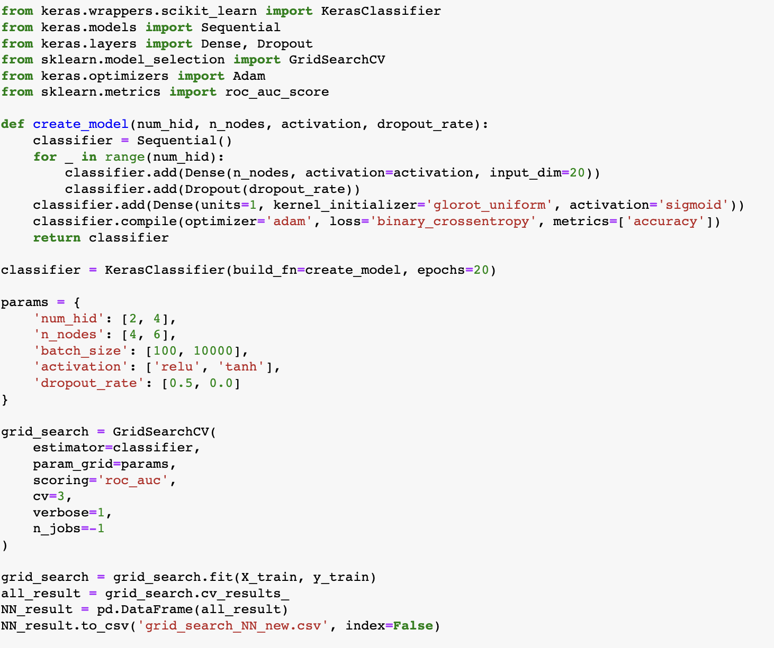
Neural Network – Grid Search
we demonstrate a crucial step in model development—hyperparameter tuning for neural networks. We utilize Keras and Scikit-Learn's GridSearchCV to systematically explore various configurations, including hidden layer count, node numbers, activation functions, dropout rates, and batch sizes. By conducting an exhaustive search for the best hyperparameters, we aim to maximize the ROC AUC score for binary classification. The results are meticulously recorded and saved, allowing us to select the most optimized neural network architecture for enhanced predictive performance. This approach significantly streamlines the model development process and contributes to better decision-making in machine learning.

Slide 17
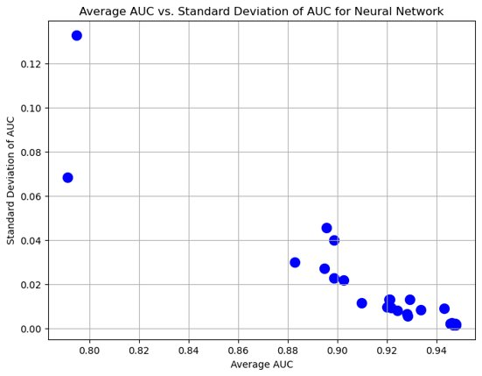
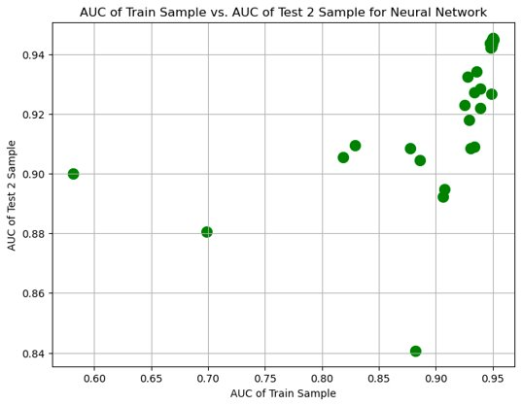
Neural Network – Grid Search
Train sample vs test 2 sample gives the highest AUC value. Thus, selecting it gives the best Neural Network model

Slide 18
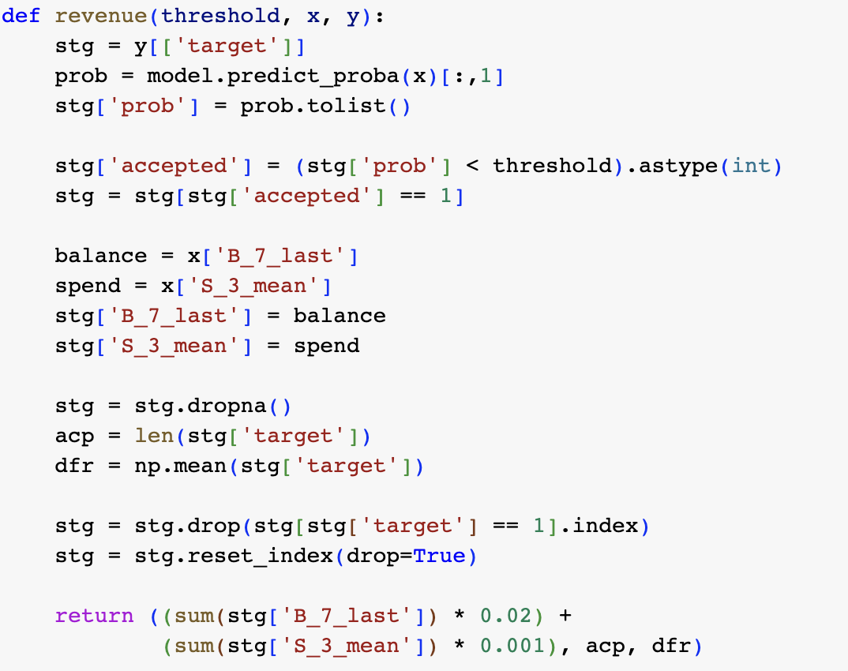
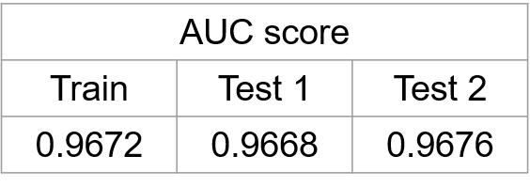
Final Model - XGBoost

Slide 19
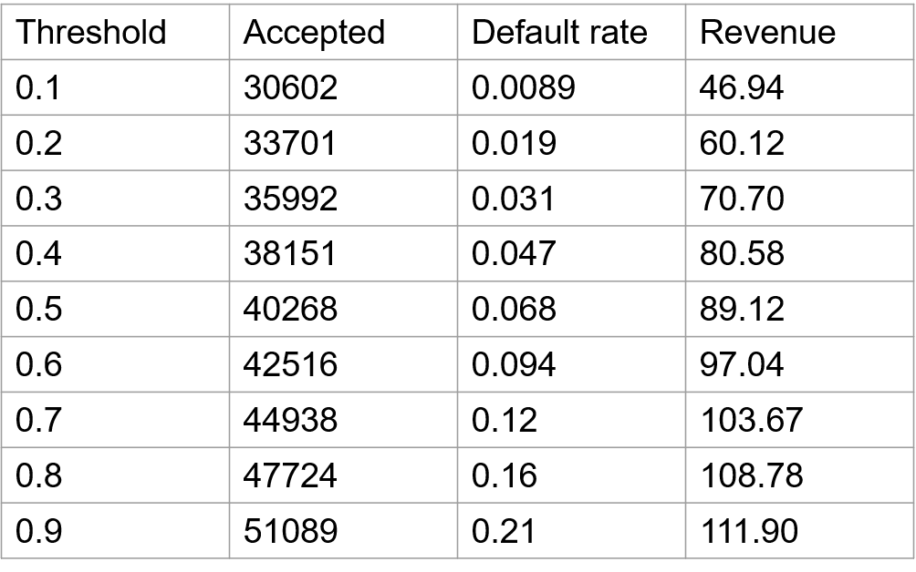
STRATEGY
We calculate Revenue using the formula: Revenue = (Balance Feature Sum * 0.02) + (Spending Feature Sum * 0.001), with chosen default rate thresholds of 30% for the Conservative strategy and 50% for the Aggressive strategy.
Conservative
Aggressive

Slide 20


Thank you

