Slide 1
AI DRIVEN DATA ANALYTICS
MUSIC PERFORMANCE & STREAMING ANALYTICS
Team : | T1_ANB19
Organization : | Entri Elevate
Batch : | FNANB19
Mentor : | Kumaran A

Slide 2
TEAM MEMBERS
Priyanka R – Team Lead
Mohammed Fasi S – Data Preparation Analyst
Nithish S - Data Analyst
Jagadishwaran R - Dashboard Developer
Ramya M - Data Storyteller

Slide 3
Agenda
Project Overview & Objectives
Problem Statement
Dataset Overview
Data Cleaning & Preprocessing
Tools Used
KPI’s
Dashboard Demonstration
Key Insights & Findings
Conclusion
Questions & Answers

Slide 4
Project Overview & Objectives
The Music Performance & Streaming Analytics project analyzes a global music streaming dataset to understand the factors influencing song popularity and audience engagement across multiple digital platforms.
The dataset includes information on songs, artists, albums, release dates, streaming counts, playlist reach, and engagement metrics from platforms such as Spotify, YouTube, TikTok, Apple Music, Deezer, Amazon Music, AirPlay, and SiriusXM.
Using Microsoft Excel for data cleaning and exploratory data analysis and Power BI for interactive dashboard development, this project transforms raw data into meaningful insights that support data-driven decision-making.

Slide 5
Problem Statement
Clean and preprocess the music streaming dataset by handling missing values, duplicates, inconsistent formats, and unwanted characters.
Analyze the performance of songs, artists, and albums using key streaming and popularity metrics.
Compare audience engagement across multiple music streaming platforms.
Identify trends in song popularity based on release year and playlist inclusion.
Explore relationships between Spotify streams, YouTube views, TikTok engagement, and playlist reach.
Develop an interactive Power BI dashboard to visualize key performance indicators (KPIs) and business insights.
Generate actionable insights to understand the key factors contributing to a song's success.

Slide 6
Dataset Overview
Music Performance dataset
Rows: 4,600
Fields: Artist, Track, Streams, Release Date,ISRC ,All time Rank, Track score , spodify streams , spodify playlist count ,spodify play list reach,spodify popularity, youtube views ,youtube likes ,tiktok post ,tiktok likes ,tiktok views , YouTube Playlist Reach , Apple Music Playlist Count , AirPlay Spins , SiriusXM Spins , Deezer Playlist Count , Deezer Playlist Reach , Amazon Playlist Count , Pandora Streams , Pandora Track Stations , Soundcloud Streams , Shazam Counts

Slide 7
Data Cleaning & Pre-processing
Corrected inconsistent text values (track names, album names, artist names).
Formula: =PROPER(TRIM(CLEAN([@[Album Name]])))
=PROPER(TRIM(CLEAN([@Artist])))
Removed records where song details could not be identified using the ISRC code.
Removed unwanted/special characters from text fields. Trimmed extra spaces and cleaned non-printable characters.
Formula: =TRIM(SUBSTITUTE(SUBSTITUTE(SUBSTITUTE(SUBSTITUTE(SUBSTIT UTE(B160,“ ï¿½",""),"Ï¿½",""),"ï",""),"¿",""),"?",""))
Handled missing values using appropriate techniques (Median/Mean where applicable).

Slide 8
Data Cleaning & Pre-processing
Standardized Release date formats for consistency.
Formula: =IF(ISNUMBER(D2),TEXT(D2,"dd-mm- yyyy"),IF(ISNUMBER(SEARCH("/",D2)),TEXT(DATE(RIGHT(D2,4),LEFT(D2,FIN D("/",D2)- 1),MID(D2,FIND("/",D2)+1,FIND("/",D2,FIND("/",D2)+1)- FIND("/",D2)-1)),"dd-mm- yyyy"),TEXT(DATE(RIGHT(D2,4),MID(D2,4,2),LEFT(D2,2)),"dd-mm-yyyy")))
Converted all the columns to the correct data types.
Validated the dataset to ensure completeness and consistency before analysis

Slide 9
Tools Used
Microsoft Excel
TRIM, CLEAN, SUBSTITUTE, PROPER
MEAN, MEDIAN
Pivot Tables
Descriptive Statistics
Charts
Power BI
Calculated Measures
KPI Card’s
Interactive Dashboard
Visualizations

Slide 10
KPI’s
Key Dataset Metrics
🎵 Total Songs: 4,585
Total_Songs = COUNTA(DA_GP_ANB19_Cleaned[Track])
The dataset contains 4,585 songs from various artists and albums across multiple music streaming platforms.
🎤 Unique Artists: 2,065
Features 2,065 unique artists, enabling analysis of artist performance, popularity, and streaming trends.
Unique_Artist = DISTINCTCOUNT(DA_GP_ANB19_Cleaned[Artist])
💿 Total Albums: 4,032
Includes 4,032 albums, allowing comparison of album popularity and overall performance.
Total_albums = DISTINCTCOUNT(DA_GP_ANB19_Cleaned[Album Name])

Slide 11
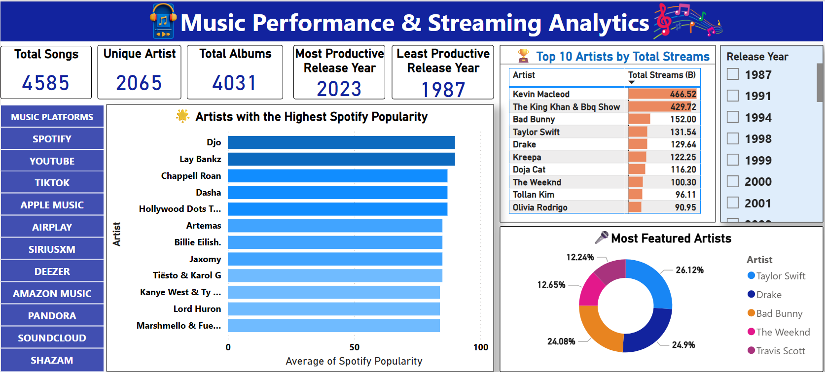
Dashboard Demonstration

Slide 12
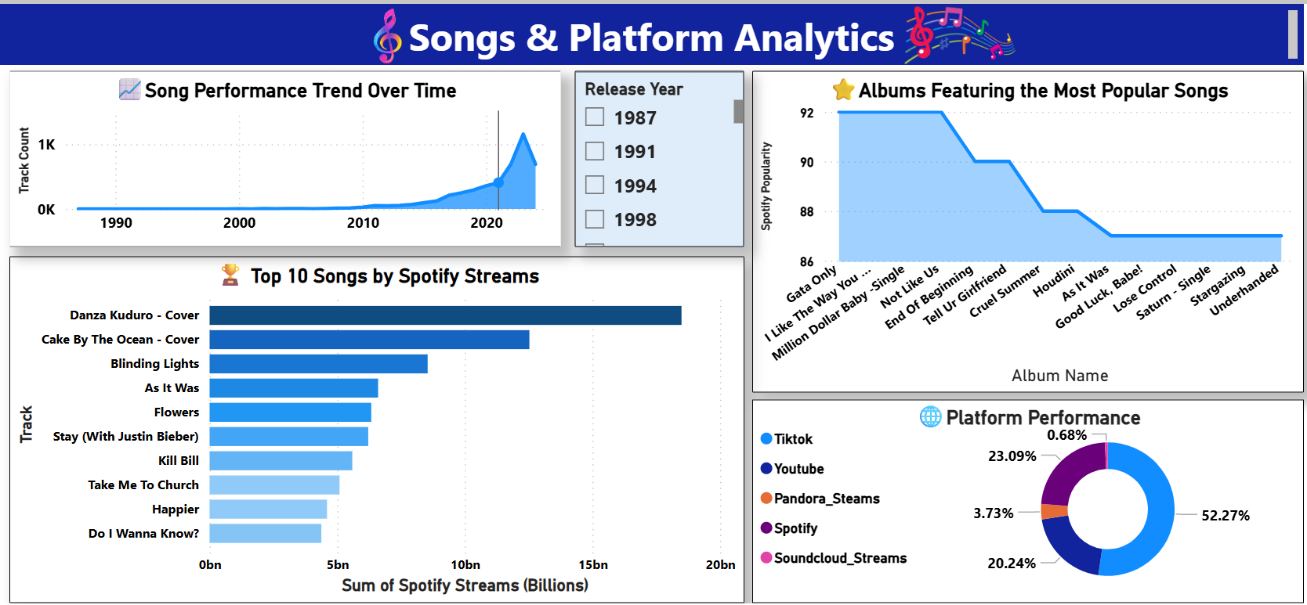
Dashboard Demonstration

Slide 13
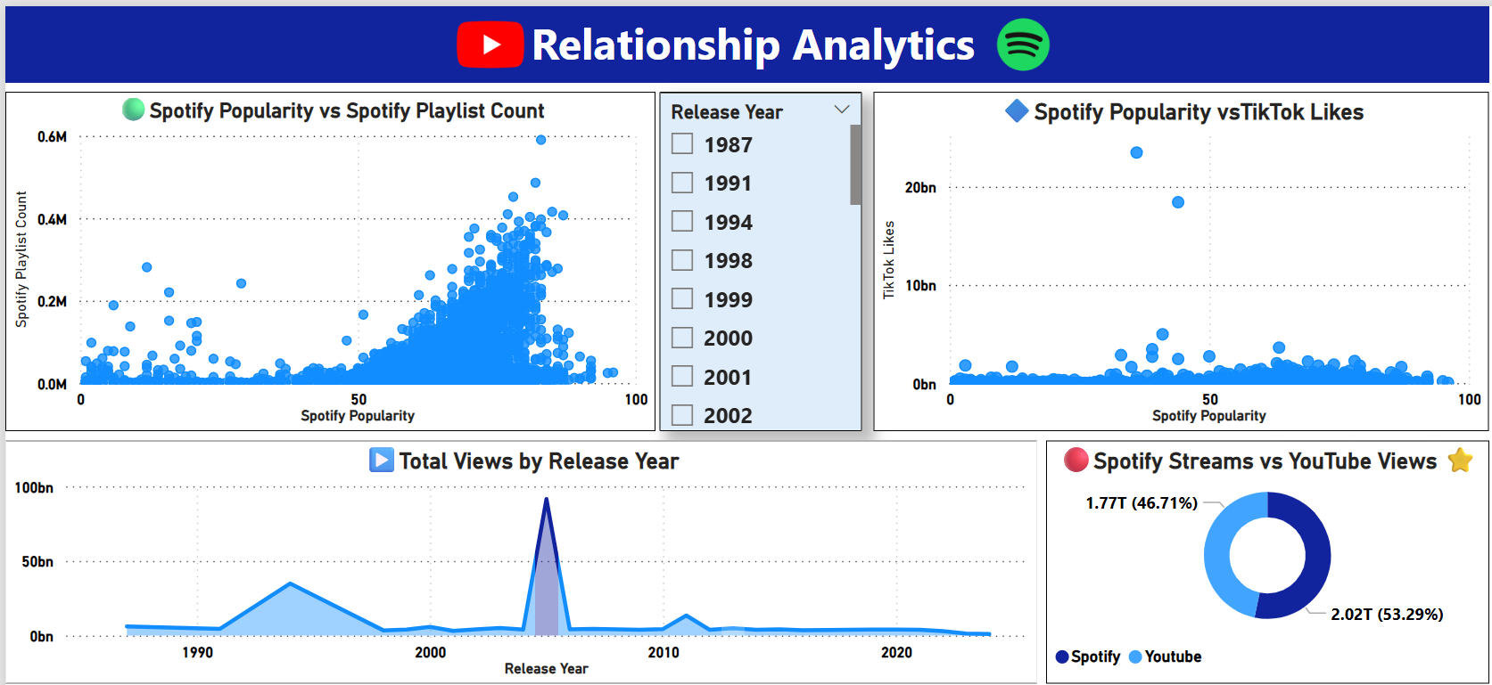
Dashboard Demonstration

Slide 14
Key Insights & Findings
Major Insights – Artist Performance
1. Audience Reach is Not Determined by the Number of Songs
Insight: Kevin MacLeod ranks first in Total Views despite having only one track in the dataset, while Taylor Swift and Drake have many more songs but hold next place in the performance.
Decision: Music companies should evaluate artists based on audience engagement and content value, not just the size of their music catalogue.
2. Larger Catalogues Support Long-Term Growth
Insight: Taylor Swift (64 songs), Drake (61 songs), and Bad Bunny (59 songs) have the largest catalogues and consistently rank among the top-performing artists.
Decision: Record labels should encourage consistent music releases to build sustainable streaming revenue over time.

Slide 15
Key Insights & Findings
3. High-Quality Content Can Outperform High Quantity
Insight: Artists with fewer songs, such as Kevin MacLeod and The Weeknd, generate exceptionally high audience reach, indicating that content quality and reuse are key success factors.
Decision: Investment should prioritize high-impact songs with strong engagement potential rather than focusing only on increasing the number of releases.
4. Spotify Popularity Reflects Current Market Trends
Insight: Artists like Lay Bankz and Djo have the highest Spotify popularity scores, showing strong current listener interest even though they are not among the highest in total views.
Decision: Marketing teams should use Spotify Popularity to identify trending artists and launch timely promotional campaigns.

Slide 16
Key Insights & Findings
Song Performance
1. Songs Generate the Majority of Streams
Insight: The Top 10 songs contribute a significantly larger share of total streams compared to the remaining songs in the dataset. This indicates that listener attention is concentrated on a few highly successful tracks.
Decision: Streaming platforms should prioritize these high-performing songs in playlists and recommendations while also promoting emerging songs to diversify listener engagement.
2. songs have the highest popularity
Insight:
"Danza Kuduro - Cover" is the most popular track with a Spotify Popularity Total of 824, significantly outperforming all other songs. The top two cover songs (Danza Kuduro - Cover and Cake By The Ocean - Cover) dominate the popularity rankings, indicating that cover versions can achieve substantial audience engagement. The remaining tracks have popularity scores ranging from 213 to 277, showing a noticeable gap between the top two songs and the rest.
Decision: Marketing teams should use Spotify Popularity to identify trending songs early and increase promotional efforts while audience interest is growing.

Slide 17
Key Insights & Findings
3. Albums contain the most popular songs
Insight: Four albums—Not Like Us, Million Dollar Baby - Single, Gata Only, and I Like The Way You Kiss Me—share the highest average Spotify popularity score of 92, making them the most popular albums in the dataset. Most of the top-performing albums have popularity scores between 87 and 92, indicating consistently high audience engagement with only a small difference among the leading albums. The narrow popularity range suggests that several albums are performing competitively rather than one album dominating the rankings.
Decision: Prioritize the top-rated albums (92 popularity score) for playlist placements, promotions, and marketing campaigns to maximize listener engagement.
Music companies should monitor social media trends and invest quickly in songs showing viral growth to maximize commercial opportunities.

Slide 18
Key Insights & Findings
Platform Analysis – Major Insights
1. Platform has the highest audience reach
Insight
TikTok has the highest audience reach with 4.58 billion views, more than double the reach of Spotify.
Spotify ranks second with 2.02 billion streams, followed by YouTube with 1.77 billion views, indicating these platforms remain major drivers of music consumption.
Pandora (327.37 million) and SoundCloud (59.38 million) contribute a comparatively smaller share of the total audience reach.
Decision
Prioritize TikTok for music promotions, viral campaigns, and influencer collaborations to maximize audience reach.
Maintain a strong presence on Spotify and YouTube to sustain streaming performance and listener engagement.
Use Pandora and SoundCloud as supporting platforms for niche audiences rather than primary marketing channels.

Slide 19
Key Insights & Findings
2. Platform contributes the most to song popularity
Insight
The dataset accumulated 290,879 Spotify popularity points and generated an impressive 2.02 billion Spotify streams, indicating strong overall audience engagement.
The high streaming volume suggests that Spotify is a major platform for music consumption across the analyzed tracks.
While popularity scores measure audience interest, the large number of streams reflects sustained listening behaviour.
Decision
Continue prioritizing Spotify as a key distribution and promotional platform due to its significant contribution to total streams.

Slide 20
Key Insights & Findings
3. Spotify, YouTube and TikTok performance
Insight: Spotify records the highest streaming activity among all platforms, making it the dominant platform for music consumption in the dataset.
YouTube generates a large number of views and likes, showing that audiences prefer consuming music through video content as well as audio streaming.
Songs with higher TikTok posts and views often experience increased popularity across other streaming platforms, indicating TikTok's influence on music discovery.
Decision: Record labels should adopt a multi-platform marketing strategy instead of relying on a single platform to maximize audience reach and reduce platform dependency.

Slide 21
Key Insights & Findings
Trend Analysis – Major Insights
1. Music Streaming Has Increased Over Time
Insight: The analysis shows an overall upward trend in music streams over the years, indicating continuous growth in digital music consumption.
Music releases have increased significantly in recent years, with 2023 being the most productive release year.
Decision: Record labels should prioritize digital streaming platforms and allocate more resources to online music distribution, as consumer preference is shifting from traditional media to streaming services.
2. Recent Releases Gain Faster Audience Attention
Insight: Recently released songs achieve high streams and popularity within a shorter period due to digital marketing, playlist recommendations, and social media exposure.
Decision: Marketing campaigns should focus on the first few weeks after a song's release, as early promotion significantly influences long-term performance.

Slide 22
Key Insights & Findings
3. Streaming Performance Fluctuates Across Time
Insight: The trend shows noticeable peaks and declines rather than continuous growth, indicating that audience engagement changes based on new releases, seasonal demand, and viral trends.
Decision: Record labels should schedule major releases during periods of higher listener activity and maintain regular promotional campaigns during low-engagement periods.

Slide 23
Key Insights & Findings
Relationship Analysis – Major Insights
1.Spotify popularity and playlist presence
There is a clear concentration of songs with Spotify popularity around 60–80. Songs with higher popularity generally appear in more playlists, suggesting that playlist inclusion is strongly associated with visibility and popularity.
A few highly playlisted songs are clear outliers and may represent major hits.
2.Spotify popularity vs. TikTok likes
The relationship is not strongly linear. Some songs with relatively moderate Spotify popularity have extremely high TikTok engagement.
This indicates that TikTok virality does not necessarily depend on Spotify popularity.
TikTok can therefore be an important channel for discovering potential breakout songs.

Slide 24
Key Insights & Findings
3.Spotify streams vs. YouTube views
YouTube accounts for approximately 53.29% (2.02T) of the combined views/streams shown.
Spotify accounts for approximately 46.71% (1.77T).
The relatively close split indicates that both platforms are important for music consumption and reach.
Decision:
Prioritize songs based on combined Spotify, TikTok, YouTube, and playlist performance, rather than relying on a single platform metric.

Slide 25
Overall Key Insights & Findings
Analyzed 4,585 songs from 2,065 unique artists across 4,031 albums. The dataset spans releases from 1987 to 2024, enabling long-term trend analysis.
Kevin MacLeod, Bad Bunny, and Taylor Swift are among the top-streamed artists.
Taylor Swift, Drake, and Bad Bunny are the most frequently featured artists.
A small number of songs account for the highest Spotify streams, indicating a skewed distribution.
Albums with top-performing tracks consistently achieve higher Spotify popularity.
Spotify and TikTok contribute the largest share of audience reach.
Recent releases generally show stronger streaming performance than older releases.
Higher Spotify streams tend to align with higher YouTube views, suggesting positive cross-platform engagement.
Playlist exposure appears to support higher song popularity and discoverability.

Slide 26
Conclusion
Prioritize promotions on Spotify and TikTok.
Increase playlist placements to improve song visibility.
Leverage collaborations with top-performing artists.
Track cross-platform performance to optimize marketing strategies.
Focus promotional campaigns on newly released songs to maximize audience engagement.

Slide 27
Thank You! Thank you for your time and attention
Questions & Answers

