Slide 1


CHATBOT
Submitted by-
Priyanka Rastogi
(2019017)
Under mentorship of-
Dr. Surender Singh Samant
Associate Professor (CSE)

Slide 2


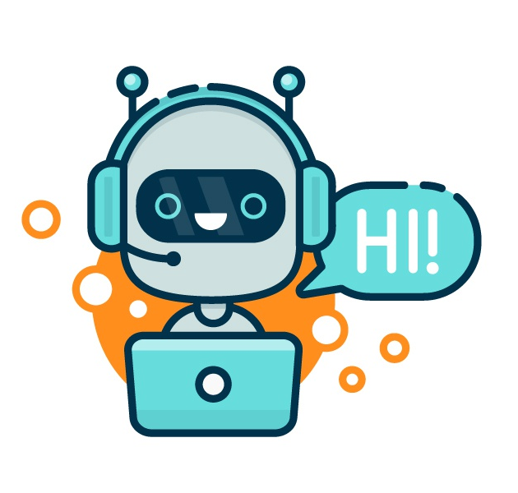
What is a Chatbot?
Chat robot, is a computer program that simulates human conversation, or chat, through artificial intelligence.
Typically, a chat bot will communicate with a real person.

Slide 3
Why Chatbot?
Chatbot is available 24/7
Bots send faster reply
Provide better user experiences
They increase customer engagement levels
Help user in resolving a complaint or problem easily

Slide 4
Using RNNs to build a Chatbot
In this Python project with source code, we are going to build a chatbot using deep learning techniques. The chatbot will be trained on the dataset which contains categories (intents), pattern and responses. We use a special recurrent neural network (LSTM) to classify which category the user’s message belongs to and then we will give a random response from the list of responses.
Let’s create a retrieval based chatbot using NLTK, Keras, Python, etc.

Slide 5
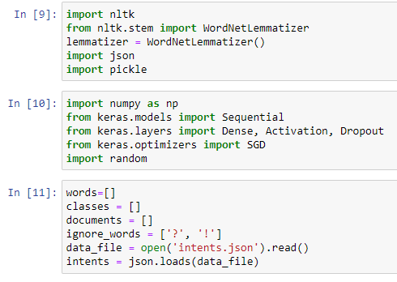
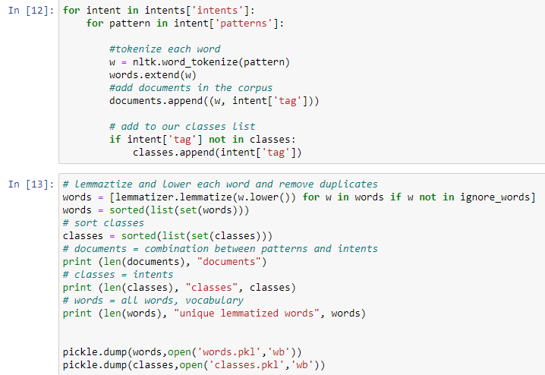
Methodology
Import and load the data file- Preprocess data-
We import all necessary packages, and use a json file. When working with text data, we need to preprocess it.

Slide 6
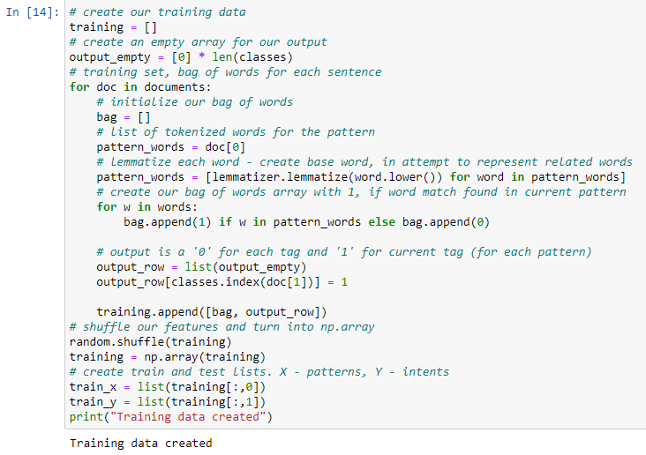
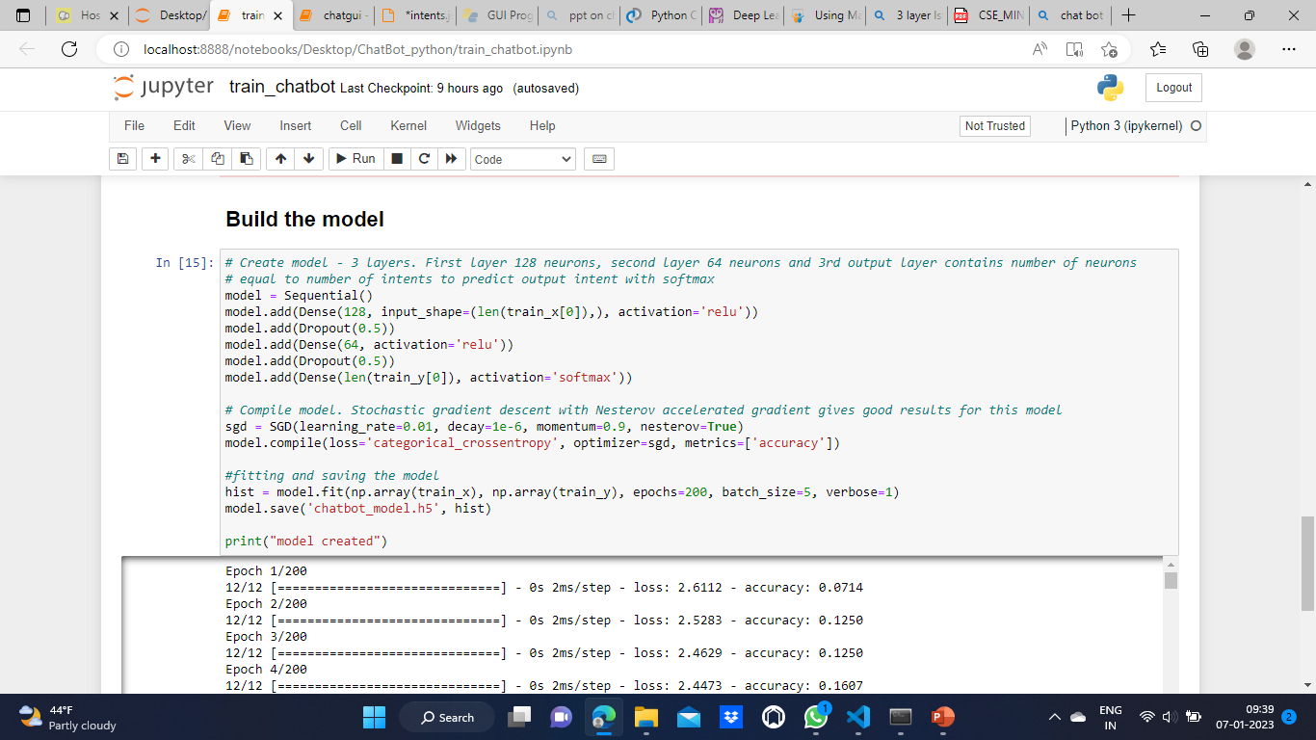
Create training and testing data- Build the model-
We create the training data We have our training data ready, now we will build a
(we will provide the input and the output) deep neural network that has 3 layers.

Slide 7
Predict the response (Graphical User Interface)-
We will load the trained model and then use a graphical user interface that will predict the response from the bot. The model will only tell us the class it belongs to, so we will implement some functions which will identify the class and then retrieve us a random response from the list of responses.
Let’s use Tkinter library which is shipped with tons of useful libraries for GUI. We will take the input message from the user and then use the helper functions we have created to get the response from the bot and display it on the GUI.

Slide 8
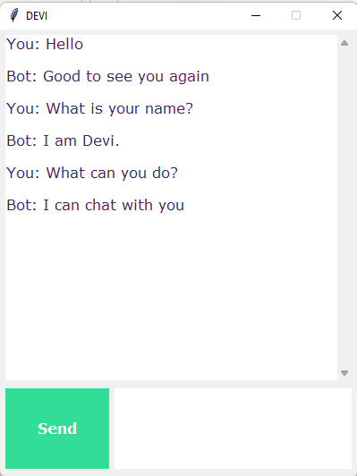
Final Chatbot

Slide 9
Conclusion and Future Work
In this Python data science project, we understood about chatbots and implemented a deep learning version of a chatbot in Python which is accurate.
We can customize the data according to business requirements and train the chatbot with great accuracy. Chatbots are used everywhere and all businesses are looking forward to implementing bot in their workflow.
Our bot was created on a very small dataset, but by increasing the dataset we can create a more accurate and user friendly chatbot.

