Slide 1
Comparison between two models

Slide 2
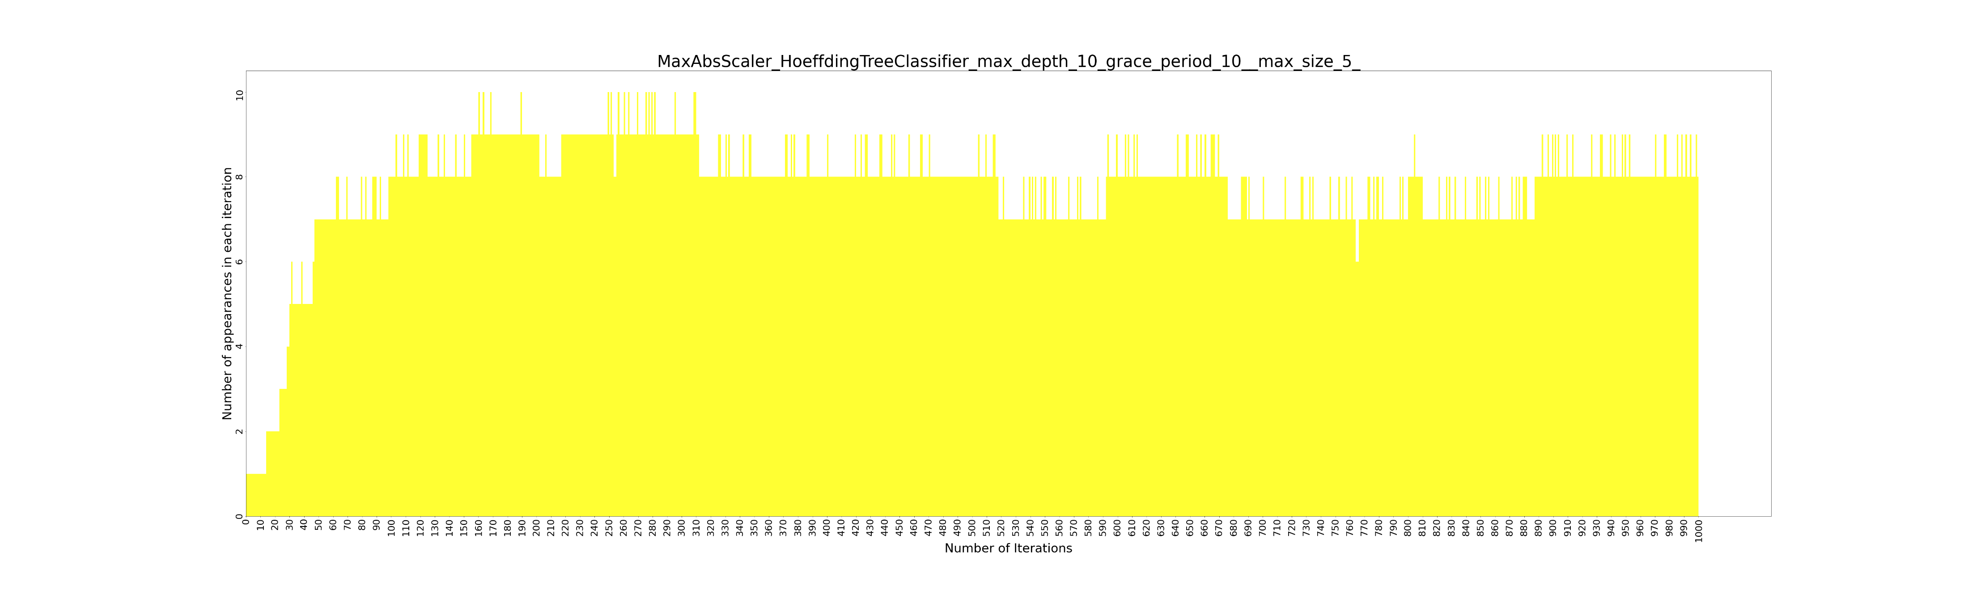
MaxAbsScaler_Hoeff_10_10_5

Slide 3
MaxAbsScalerHoeffding Tree Classifier_10_10_5 - Training 50% data, Prediction 50% data- 5 features
MaxAbsScalerHoeffding Tree Classifier_10_10_5 - Training 50% data, Prediction 50% data- 5 features
MAPE: (Training 0.009330 - HP Selection 0.024728) - Validation 0.007016
RMSE: (Training 0.018866 - HP Selection 0.024639) - Validation 0.051075
R^2 : (Training 0.660301 - HP Selection -0.056258) - Validation -294.418132
['n_estimators_5', 'criterion_mse', 'max_depth_quniform(3,6,1)', 'max_features_auto', 'min_samples_split_loguniform(0.1,1)', 'min_samples_leaf_1']
Metrics for best result:
Best Technique- Random Forest

Slide 4
MaxAbsScalerHoeffding Tree Classifier_10_10_5 - Training 50% data, Prediction 50% data- 5 features
DECISION TREE
RANDOM FOREST
XGBOOST
Training MAPE 0.009330
HP Selection MAPE
0.024728
Validation MAPE 0.007016
Training MAPE 0.024645
HP Selection MAPE
0.026301
Validation MAPE 0.004106
Training MAPE 0.025134
HP Selection MAPE
0.026346
Validation MAPE 0.003464
SVR
LRRIDGE
Training MAPE 0.148651
HP Selection MAPE
0.152538
Validation MAPE 0.130821
Training MAPE 0.027450
HP Selection MAPE
0.028034
Validation MAPE 0.005639

Slide 5
MaxAbsScalerHoeffding Tree Classifier_10_10_5 - Training 50% data, Prediction 50% data- 5 features
 | XGBoost | Decision Tree | Random Forest | SVR | LRRidge
MAPE | 0.020134 | 0.020115 | 0.020103 | 0.032071 | 0.020128
RMSE | 0.040314 | 0.040289 | 0.040222 | 0.042025 | 0.04029
R^2 | -0.00162 | -0.000355 | 0.002974 | -0.08844 | -0.00041

Slide 6
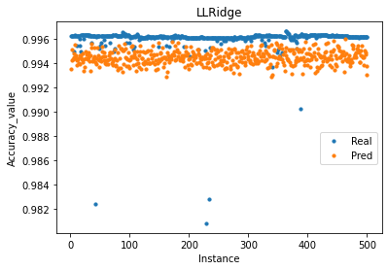

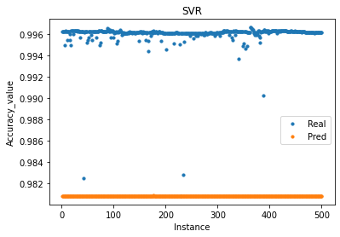
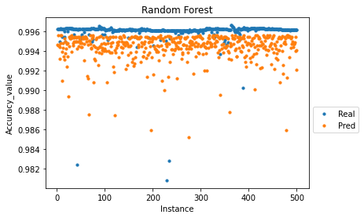
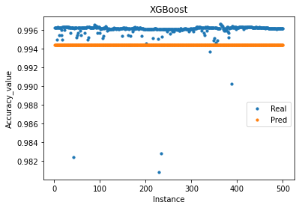
Prediction for MaxAbsScalerHoeffding Tree Classifier_10_10_5 - Training 50% data, Prediction 50% data- 5 features

Slide 7
MaxAbsScalerHoeffding Tree Classifier_10_10_5 - Training 80% data, Prediction 20% data- 5 features
MaxAbsScalerHoeffding Tree Classifier_10_10_5 - Training 80% data, Prediction 20% data- 5 features
['criterion_mse', 'max_depth_3', 'max_features_auto', 'min_samples_split_loguniform(0.01,1)', 'min_samples_leaf_loguniform(0.01,0.5)']
RMSE: (Training 0.032234 - HP Selection 0.019833) - Validation 0.005000
R^2 : (Training 0.021164 - HP Selection -0.906751) - Validation -1.630041
Metrics for best result:
MAPE: (Training 0.016473 - HP Selection 0.016620) - Validation 0.002652
Best Technique- Decision Tree

Slide 8
MaxAbsScalerHoeffding Tree Classifier_10_10_5 - Training 80% data, Prediction 20% data- 5 features
BEST RESULTS FOR EACH TECHNIQUE
XGBOOST
DECISION TREE
RANDOM FOREST
Training MAPE 0.016776
HP Selection MAPE
0.016823
Validation MAPE 0.002588
Training MAPE 0.016473
HP Selection MAPE
0.016620
Validation MAPE 0.002652
Training MAPE 0.010966
HP Selection MAPE
0.017507
Validation MAPE 0.001521
SVR
LRRIDGE
Training MAPE 0.037104
HP Selection MAPE
0.037105
Validation MAPE 0.023776
Training MAPE 0.017497
HP Selection MAPE
0.017761
Validation MAPE 0.003083

Slide 9
MaxAbsScalerHoeffding Tree Classifier_10_10_5 - Training 80% data, Prediction 20% data- 5 features
 | XGBoost | Decision Tree | Random Forest | SVR | LRRidge
MAPE | 0.01274 | 0.012742 | 0.008786 | 0.023907 | 0.012724
RMSE | 0.031913 | 0.031896 | 0.026941 | 0.03381 | 0.031898
R^2 | -0.00119 | -0.000153 | 0.286442 | -0.12379 | -0.00026

Slide 10
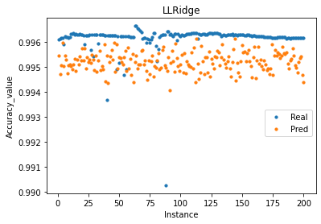
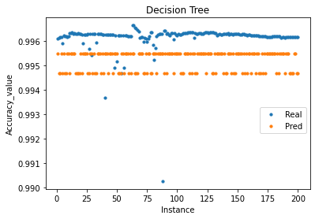
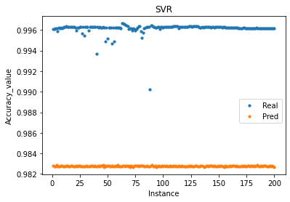
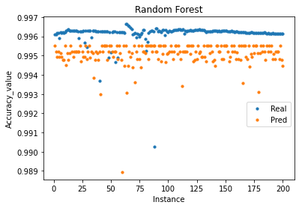
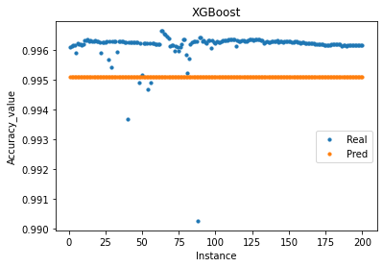
Prediction for MaxAbsScalerHoeffding Tree Classifier_10_10_5 - Training 80% data, Prediction 20% data- 5 features

Slide 11
MaxAbsScalerHoeffding Tree Classifier_10_10_5 - Training 80% data, Prediction 20% data- 5 features
['alpha_loguniform(0.01,1)']
Metrics for best result:
MAPE: (Training 0.236447 - HP Selection 0.009524) - Validation 0.008018
RMSE: (Training 0.042253 - HP Selection 0.011970) - Validation 0.010485
R^2 : (Training 0.067677 - HP Selection -4.853547) - Validation -11.045693
Best Technique- LRRidge

Slide 12
MaxAbsScalerHoeffding Tree Classifier_10_10_5 - Training 80% data, Prediction 20% data- 5 features
BEST RESULTS FOR EACH TECHNIQUE
XGBOOST
DECISION TREE
RANDOM FOREST
Training MAPE 0.222542
HP Selection MAPE
0.251024
Validation MAPE 0.004390
Training MAPE 0.235446
HP Selection MAPE
0.250511
Validation MAPE 0.004535
Training MAPE 0.076523
HP Selection MAPE
0.251248
Validation MAPE 0.006108
SVR
LRRIDGE
Training MAPE 0.301800
HP Selection MAPE
0.318344
Validation MAPE 0.079082
Training MAPE 0.014063
HP Selection MAPE
0.009524
Validation MAPE 0.008018

Slide 13
MaxAbsScalerHoeffding Tree Classifier_10_10_5 - Training 80% data, Prediction 20% data- 5 features
 | XGBoost | Decision Tree | Random Forest | SVR | LRRidge
MAPE | 0.199133 | 0.198919 | 0.199388 | 0.208695 | 0.194282
RMSE | 0.044311 | 0.044248 | 0.044248 | 0.045848 | 0.042979
R^2 | -0.00166 | 0.001178 | 0.001178 | -0.07236 | 0.05763

Slide 14
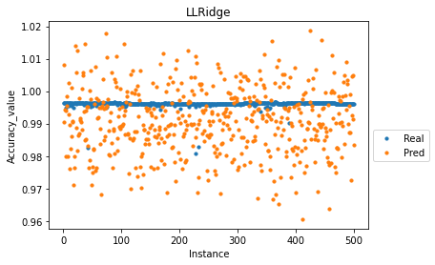
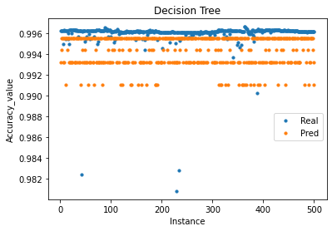
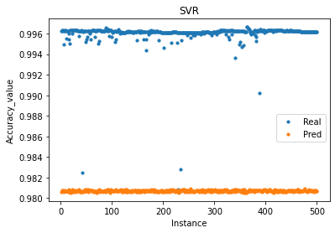
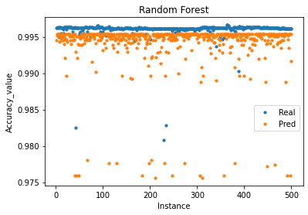
Prediction for MaxAbsScalerHoeffding Tree Classifier_10_10_5 - Training 50% data, Prediction 50% data- 10 features

Slide 15
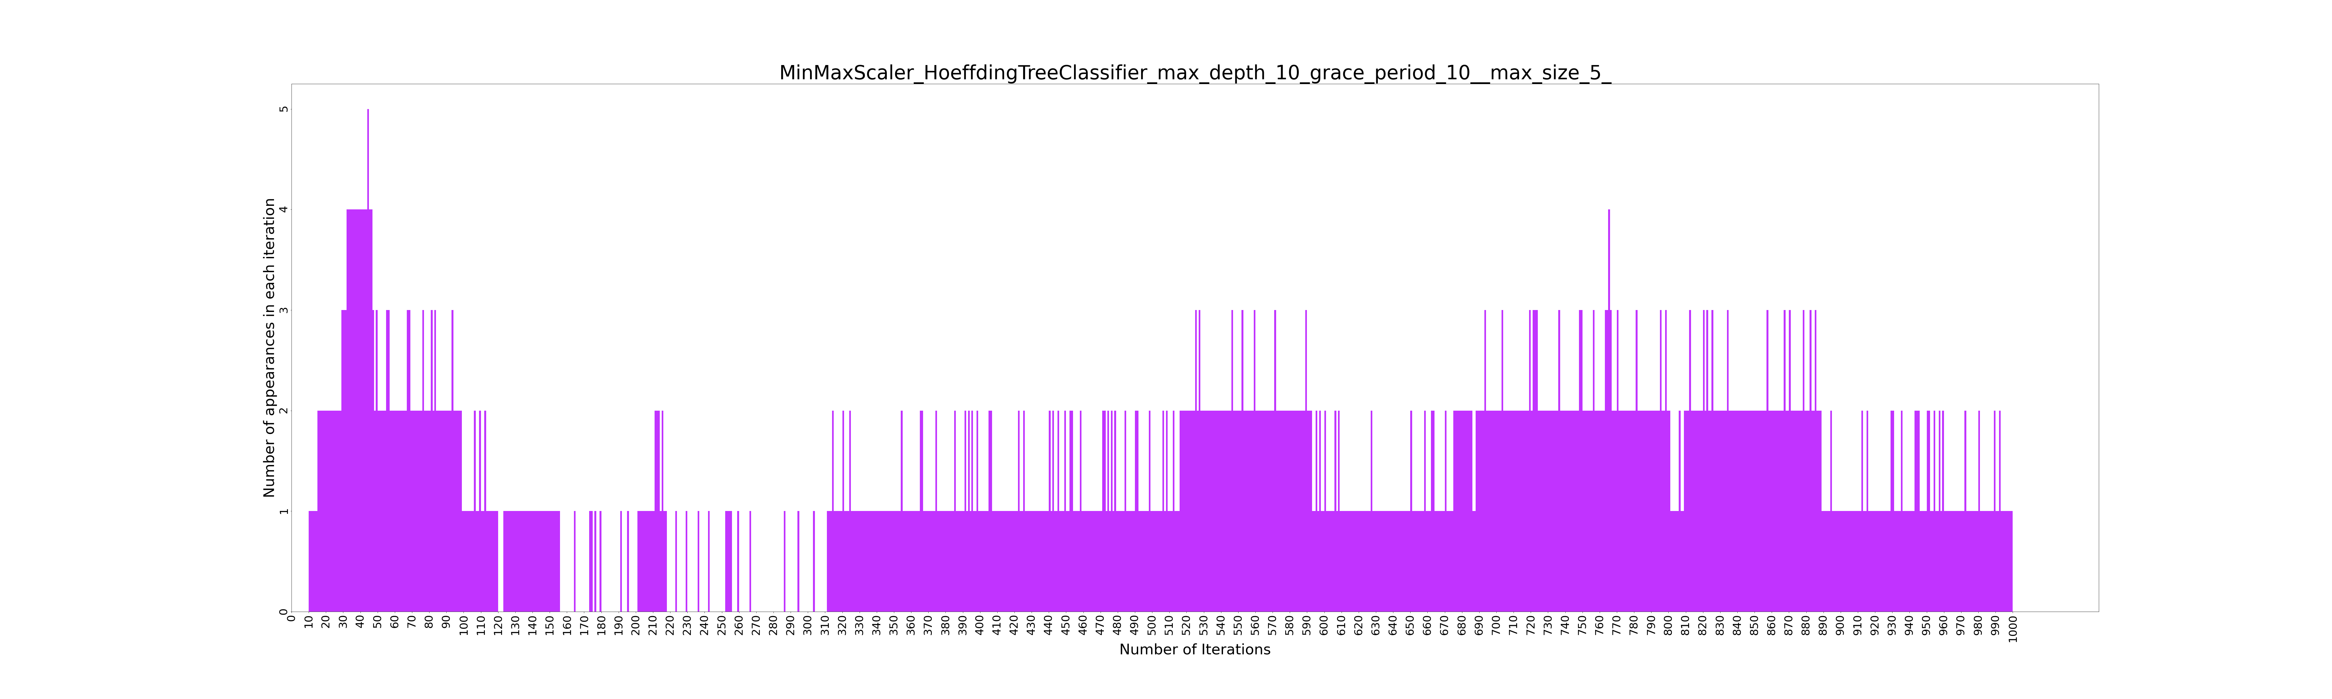

Slide 16
MinMaxScalerHoeffding Tree Classifier_10_10_5 - Training 50% data, Prediction 50% data- 5 features
MinMaxScalerHoeffding Tree Classifier_10_10_5 - Training 50% data, Prediction 50% data- 5 features
['C_loguniform(0.001,1)', 'epsilon_loguniform(0.01,1)', 'gamma_1e-07', 'kernel_linear', 'degree_2']
Metrics for best result:
MAPE: (Training 17.885168 - HP Selection 17.471476) - Validation 15.214929
RMSE: (Training 0.472918 - HP Selection 0.464132) - Validation 0.456896
R^2 : (Training -0.176795 - HP Selection -0.171973) - Validation -0.221826
Best Technique- SVR

Slide 17
MinMaxScalerHoeffding Tree Classifier_10_10_5 - Training 50% data, Prediction 50% data- 5 features
BEST RESULTS FOR EACH TECHNIQUE
LRRidge
DECISION TREE
RANDOM FOREST
Training MAPE 19.224632
HP Selection MAPE
19.659791
Validation MAPE 16.806281
Training MAPE 18.381681
HP Selection MAPE
19.632512
Validation MAPE 16.671066
Training MAPE 18.327856
HP Selection MAPE
19.605400
Validation MAPE 16.920230
SVR
XGBoost
Training MAPE 17.885168
HP Selection MAPE
17.471476
Validation MAPE 15.214929
Training MAPE 14.805710
HP Selection MAPE
19.664836
Validation MAPE 16.84099

Slide 18
MinMaxScalerHoeffding Tree Classifier_10_10_5 - Training 50% data, Prediction 50% data- 5 features
 | XGBoost | Decision Tree | Random Forest | SVR | LRRidge
MAPE | 18.00097 | 17.201945 | 18.625393 | 13.2941 | 18.52014
RMSE | 0.420199 | 0.422221 | 0.433606 | 0.491735 | 0.430463
R^2 | 0.058064 | 0.048978 | -0.003001 | -0.289949 | 0.011488

Slide 19
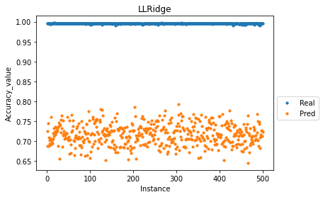
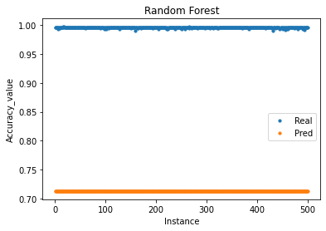
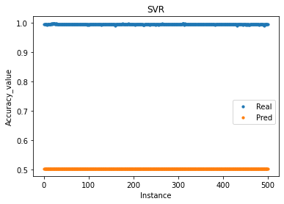
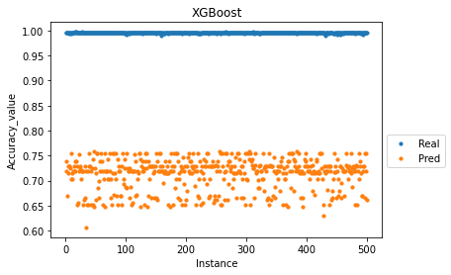
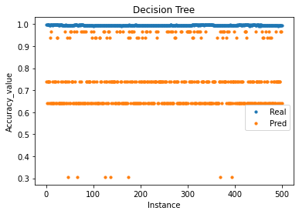
Prediction for MinMaxScalerHoeffding Tree Classifier_10_10_5 - Training 50% data, Prediction 50% data- 5 features

Slide 20
MinMaxScalerHoeffding Tree Classifier_10_10_5 - Training 50% data, Prediction 50% data- 10 features
['criterion_mse', 'max_depth_3', 'max_features_auto', 'min_samples_split_loguniform(0.01,1)', 'min_samples_leaf_loguniform(0.01,0.5)']
Metrics for best result:
MAPE: (Training 17.410961 - HP Selection 19.507689) - Validation 17.108263
RMSE: (Training 0.411706 - HP Selection 0.460758) - Validation 0.445622
R^2 : (Training 0.111004 - HP Selection -0.143800) - Validation -0.159244
Best Technique- Decision Tree

Slide 21
MinMaxScalerHoeffding Tree Classifier_10_10_5 - Training 50% data, Prediction 50% data- 10 features
BEST RESULTS FOR EACH TECHNIQUE
LRRidge
DECISION TREE
RANDOM FOREST
Training MAPE 18.840553
HP Selection MAPE
19.651864
Validation MAPE 17.004133
Training MAPE 17.410961
HP Selection MAPE
19.807689
Validation MAPE 17.108263
Training MAPE 17.831168
HP Selection MAPE
19.582777
Validation MAPE 16.804799
SVR
XGBoost
Training MAPE 19.574047
HP Selection MAPE
20.814470
Validation MAPE 16.927062
Training MAPE 15.370861
HP Selection MAPE
19.509500
Validation MAPE 16.980040

Slide 22
MinMaxScalerHoeffding Tree Classifier_10_10_5 - Training 50% data, Prediction 50% data- 10 features
 | XGBoost | Decision Tree | Random Forest | SVR | LRRidge
MAPE | 15.20838 | 16.295243 | 17.083865 | 13.2941 | 18.23117
RMSE | 0.398919 | 0.420371 | 0.408284 | 0.491735 | 0.430583
R^2 | 0.151055 | 0.057297 | 0.110726 | -0.289949 | 0.12315

Slide 23
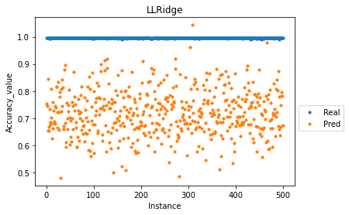
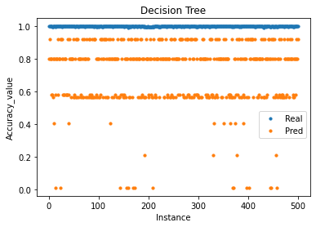
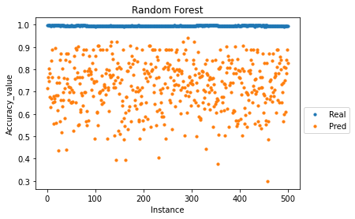
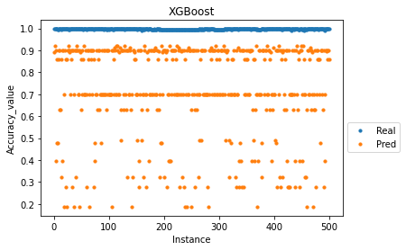
Prediction for MinMaxScalerHoeffding Tree Classifier_10_10_5 - Training 50% data, Prediction 50% data- 10 features

Slide 24
Thank You

