Slide 1

Master Thesis- Presentation1 Analysis on aMLLibrary
By
Priyanka Rajendran [10704486]

Slide 2
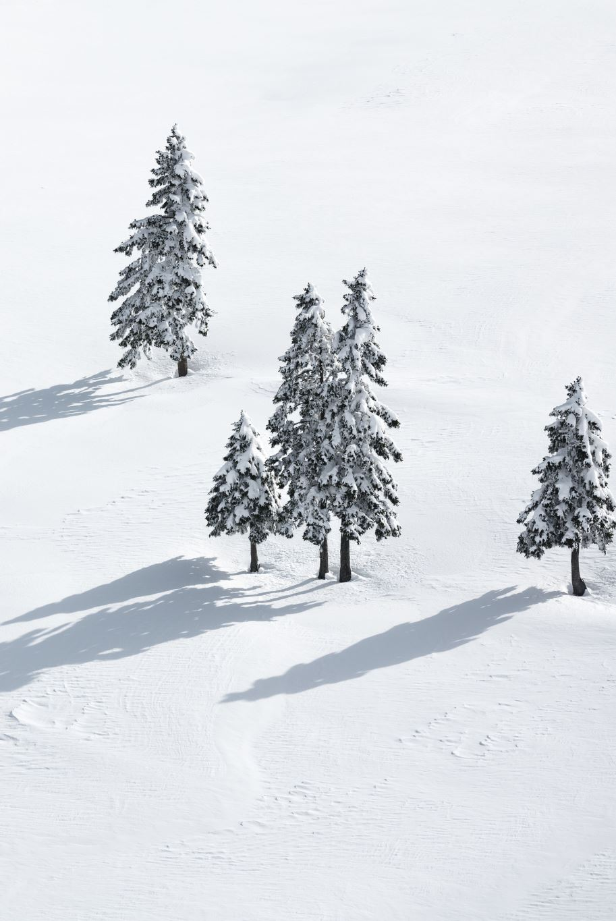
Regression models
Linear Regression (LRRidge)
Decision Tree
XGBoost
Random Forest
Stepwise
NNLS
SVR

Slide 3
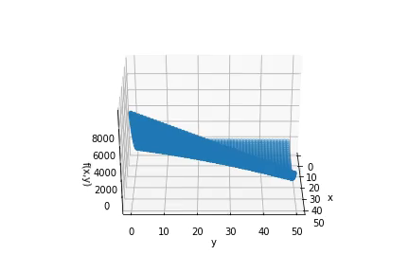
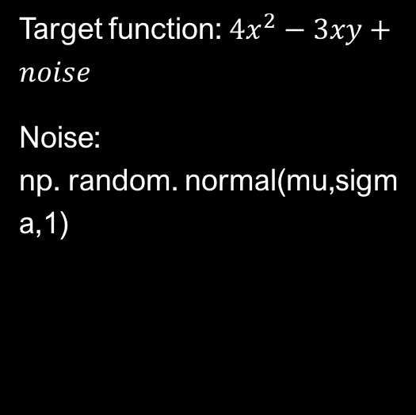
Input dataset 1
Target function: ${4x}^{2}−3xy+noise$
Noise: np. random. normal(mu,sigma,1)

Slide 4
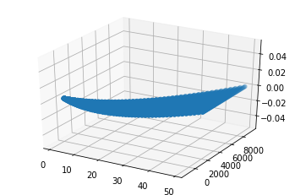
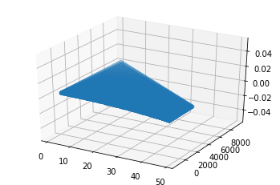
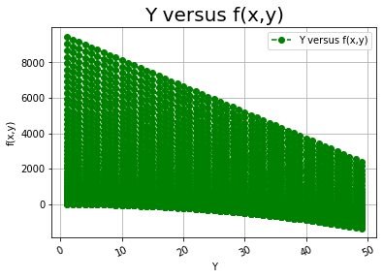
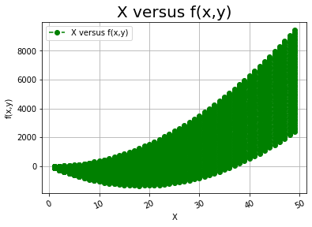

Slide 5
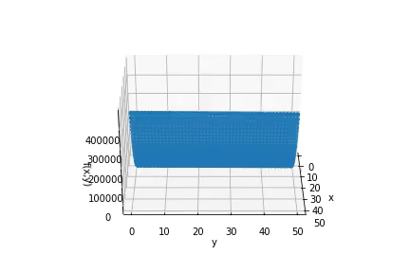
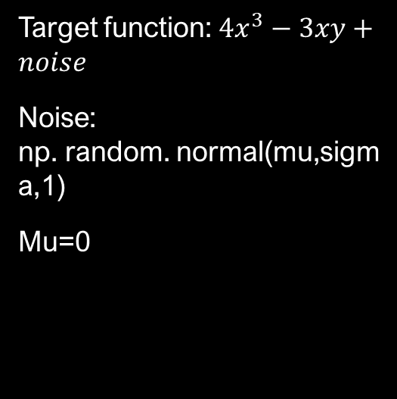
Input dataset 2
Target function: ${4x}^{3}−3xy+noise$
Noise: np. random. normal(mu,sigma,1)
Mu=0

Slide 6
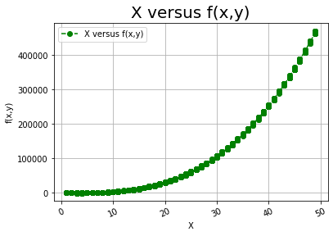
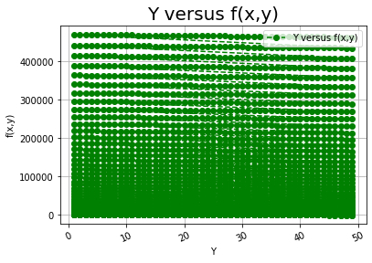
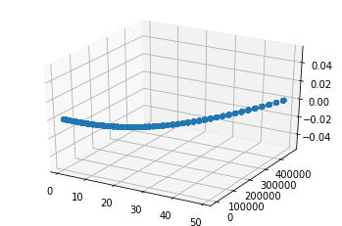
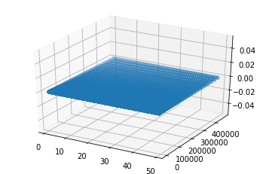

Slide 7
['LRRidge', 'DecisionTree', 'XGBoost']
hp_selection | Validation | Folds | holdout ratio | extrpolation columns | product max degree | feature selection | model selected
Kfold | HoldOut | 5 | 0.2 | - | inf | SFS | XGBoost
HoldOut | Kfold | 5 | 0.2 | - | inf | XGBoost | XGBoost
Kfold | HoldOut | 5 | 0.2 | - | 3 | SFS | LRRidge

Slide 8
['LRRidge', 'Stepwise', 'XGBoost']
hp_selection | Validation | Folds | holdout ratio | extrpolation columns | product max degree | feature selection | model selected
HoldOut | Extrapolation | - | 0.2 | {"x": 4} | inf | XGBoost | XGBoost
Kfold | HoldOut | 5 | 0.2 | - | 3 | XGBoost | XGBoost
HoldOut | Extrapolation | - | 0.2 | {"x": 4} | 3 | XGBoost | XGBoost

Slide 9
['LRRidge', 'NNLS', 'RandomForest', 'SVR', 'XGBoost']
hp_selection | Validation | Folds | holdout ratio | extrpolation columns | product max degree | feature selection | model selected
All | All | 5 | 0.2 | - | 2 | SFS | LRRidge
All | All | 5 | 0.2 | - | 2 | SFS | XGBOOST
All | All | 5 | 0.2 | - | 2 | SFS | XGBOOST
All | All | 5 | 0.2 | - | 3 | SFS | XGBOOST

Slide 10
Thank you

