Slide 1
Analysis of Agrawal Dataset
Master Thesis- Presentation 2
By
Priyanka Rajendran [10704486]

Slide 2
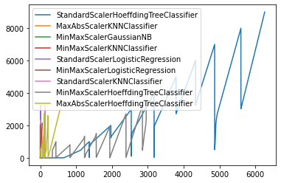

Slide 3
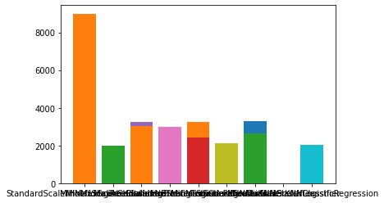
StandardScalerHoeffdingTreeClassifier
MinMaxScalerGaussianNB
MinMaxScalerHoeffdingTreeClassifier
MaxAbsScalerHoeffdingTreeClassifier
StandardScalerLogisticRegression
MinMaxScalerKNNClassifier
StandardScalerKNNClassifier
MaxAbsScalerKNNClassifier
MinMaxScalerLogisticRegression

Slide 4
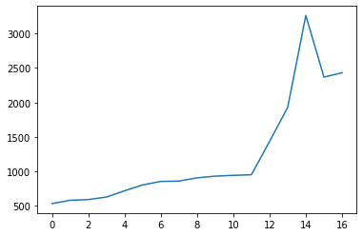
StandardScalerLogisticRegression
iterations
Total number of values for the model

Slide 5
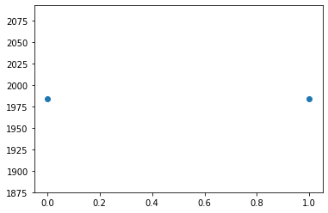
MinMaxScalerGaussianNB

Slide 6
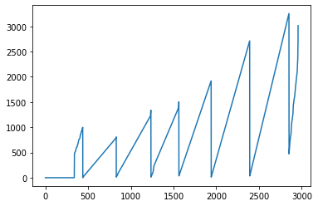
MinMaxScalerHoeffdingTreeClassifier

Slide 7
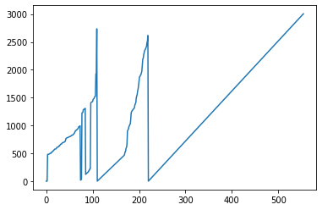
MaxAbsScalerHoeffdingTreeClassifier

Slide 8
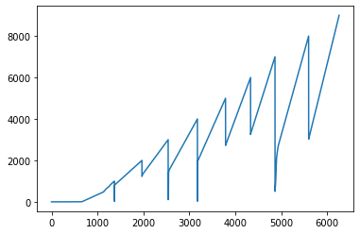
StandardScalerHoeffdingTreeClassifier

Slide 9
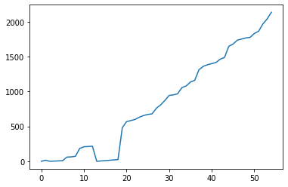
MinMaxScalerKNNClassifier

Slide 10
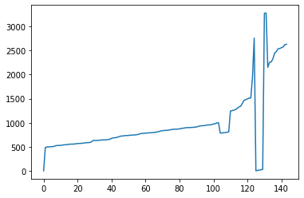
StandardScalerKNNClassifier

Slide 11
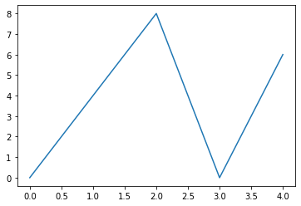
MaxAbsScalerKNNClassifier

Slide 12
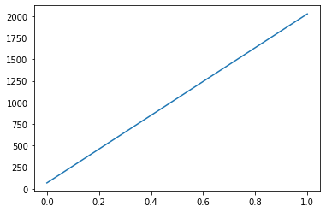
MinMaxScalerLogisticRegression

Slide 13
Thank You

Slide 14
