Slide 1
Analysis of models and parameters on Agrawal Dataset
By
Priyanka Rajendran
[10704486]

Slide 2




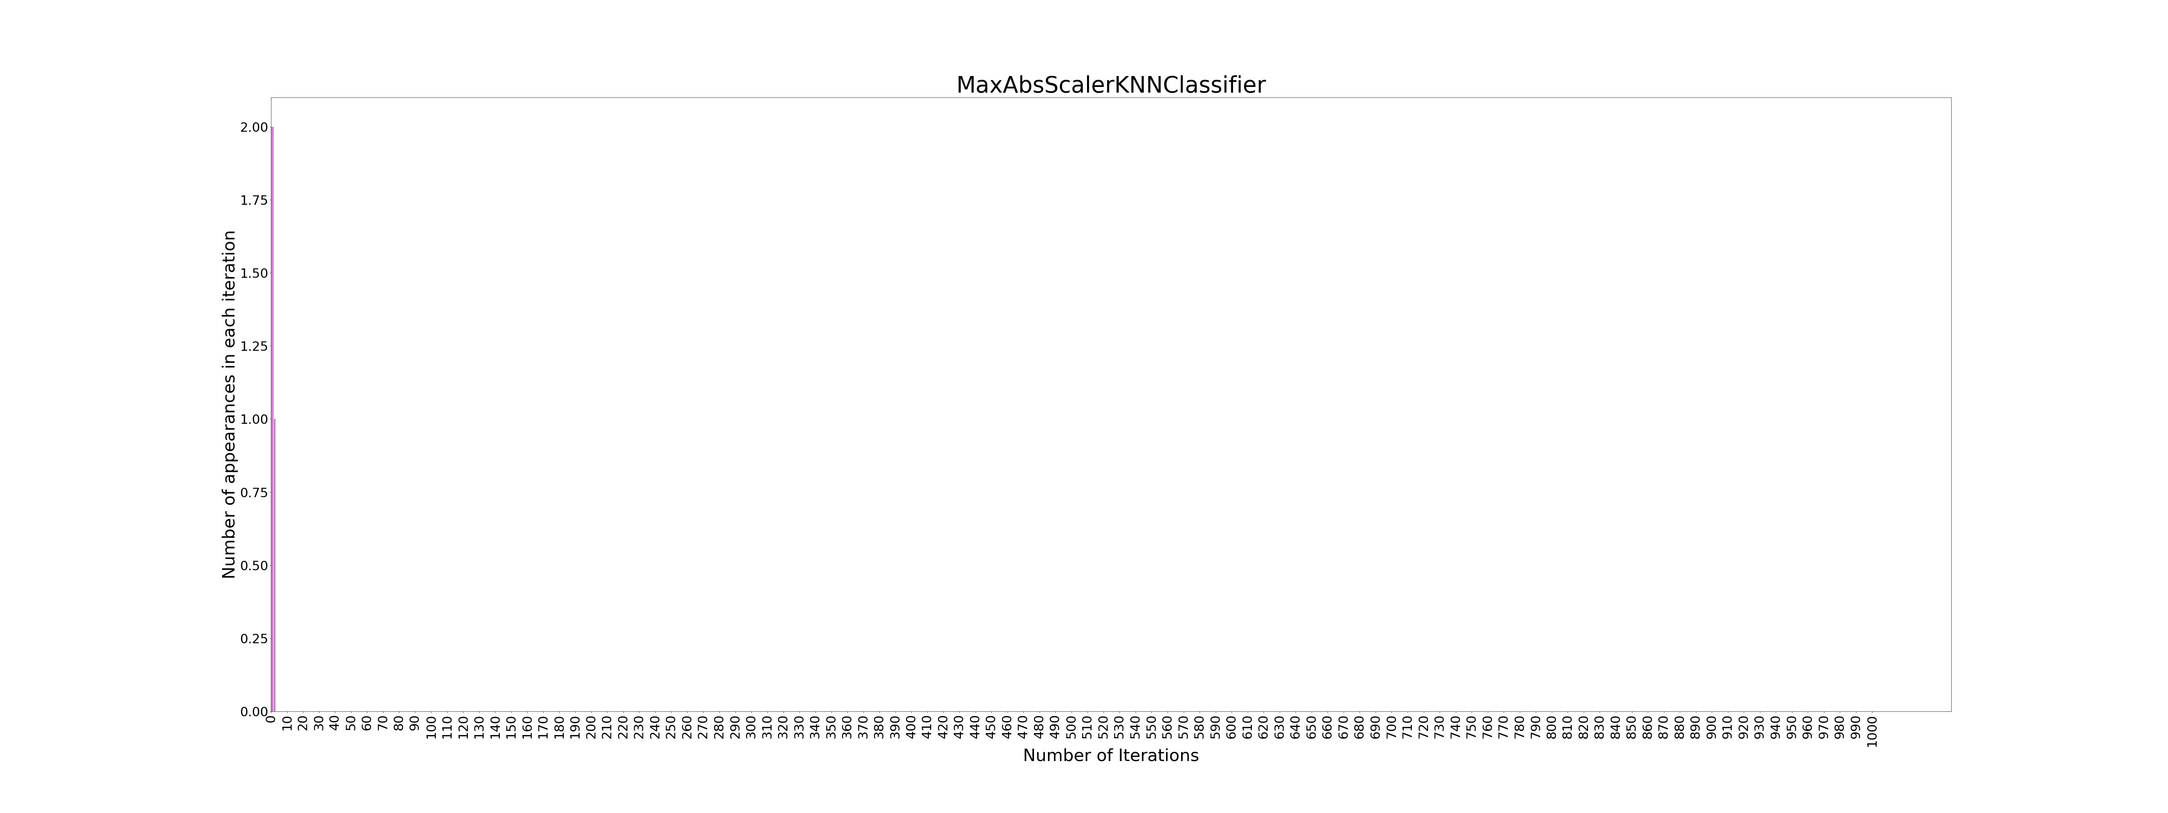





Slide 3
Hoeffding Classifier

Slide 4


Slide 5


Slide 7


Slide 8


Slide 9


Slide 10


Slide 14


Slide 15


Slide 16

0:False
1:True

Slide 17


Slide 18


Slide 19


Slide 20


Slide 22
Thank You

