Slide 1

Prediction Analysis using aMLLibrary
On Sine Dataset

Slide 2
Validation Metrics for all techniques

Slide 3
SVR (Best Technique)
Configuration:
['C_loguniform(0.001,1)', 'epsilon_loguniform(0.01,1)', 'gamma_1e-07', 'kernel_linear', 'degree_2’]
Optimal hyperparameter(s) found with Hyperopt:
{'C': 0.352, 'epsilon': 0.018, 'gamma': 0.0, 'kernel': 'linear', 'degree': 2}

Slide 4
Prediction

Slide 5
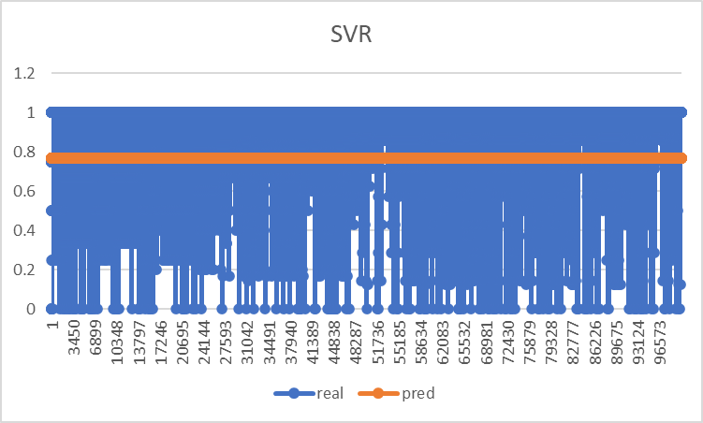

Slide 6
LRRidge
Optimal hyperparameter(s) found with Hyperopt: {'alpha': 0.82}
LRRidge coefficients:
(0.007 * feat_01) + (-0.002 * feat_02) + (0.002 * feat_11) + (0.002 * feat_12) + (0.001 * feat_13) + (0.001 * feat_03) + (0.0 * feat_05) + (0.0 * feat_15) + (-0.0 * feat_04) + (0.0 * feat_14) + (0.983)

Slide 7
Prediction

Slide 8
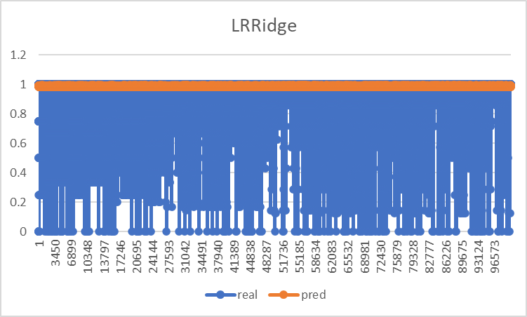

Slide 9
XGBOOST
Configuration
['min_child_weight_1', 'gamma_loguniform(0.1,10)', 'n_estimators_1000', 'learning_rate_loguniform(0.01,1)', 'max_depth_100’]
Optimal hyperparameter(s) found with Hyperopt:
{'gamma': 0.179, 'learning_rate': 0.046, 'max_depth': 100, 'min_child_weight': 1, 'n_estimators': 1000}XGBoost weights: { 0.174 feat_01 0.152 feat_11 0.096 feat_02 0.089 feat_03 0.084 feat_14 0.084 feat_12 0.082 feat_04 0.082 feat_13 0.081 feat_15 0.077 feat_05}

Slide 10
Prediction

Slide 11
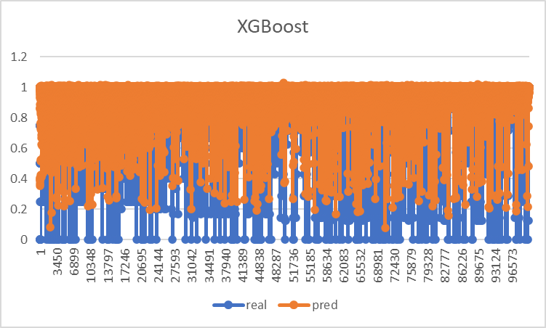

Slide 12
Decision Trees
Configuration : ['criterion_mse', 'max_depth_3', 'max_features_auto', 'min_samples_split_loguniform(0.01,1)', 'min_samples_leaf_loguniform(0.01,0.5)’]
Optimal hyperparameter(s) found with Hyperopt:
{'min_samples_leaf': 0.015, 'min_samples_split': 0.123, 'criterion': 'mse', 'max_depth': 3, 'max_features': 'auto'}

Slide 13
Prediction

Slide 14
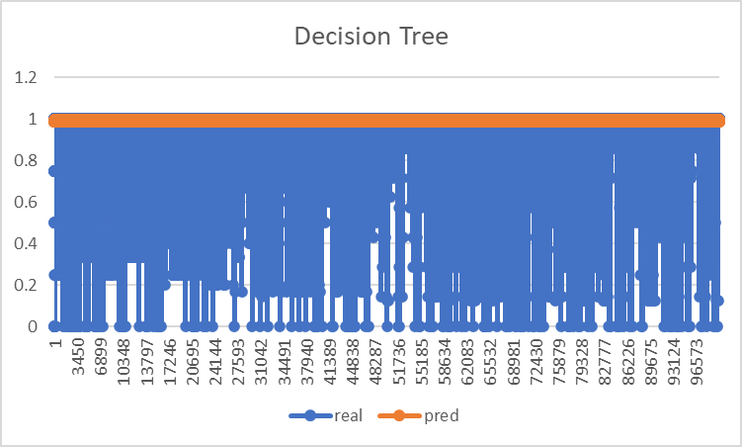

Slide 15
Random Forest
Configuration:
['n_estimators_5', 'criterion_mse', 'max_depth_quniform(3,6,1)', 'max_features_auto', 'min_samples_split_loguniform(0.1,1)', 'min_samples_leaf_1’]
Optimal hyperparameter(s) found with Hyperopt:
{'max_depth': 6.0, 'min_samples_split': 0.168, 'n_estimators': 5, 'criterion': 'mse', 'max_features': 'auto', 'min_samples_leaf': 1}

Slide 16
Prediction

Slide 17
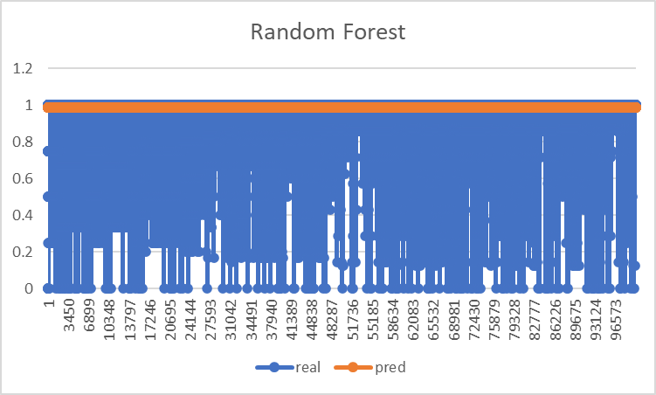

Slide 18
Thank You

