Slide 1
Prediction analysis on sine dataset

Slide 2
MinmaxScalerHoeffdingTree Classifier

Slide 3
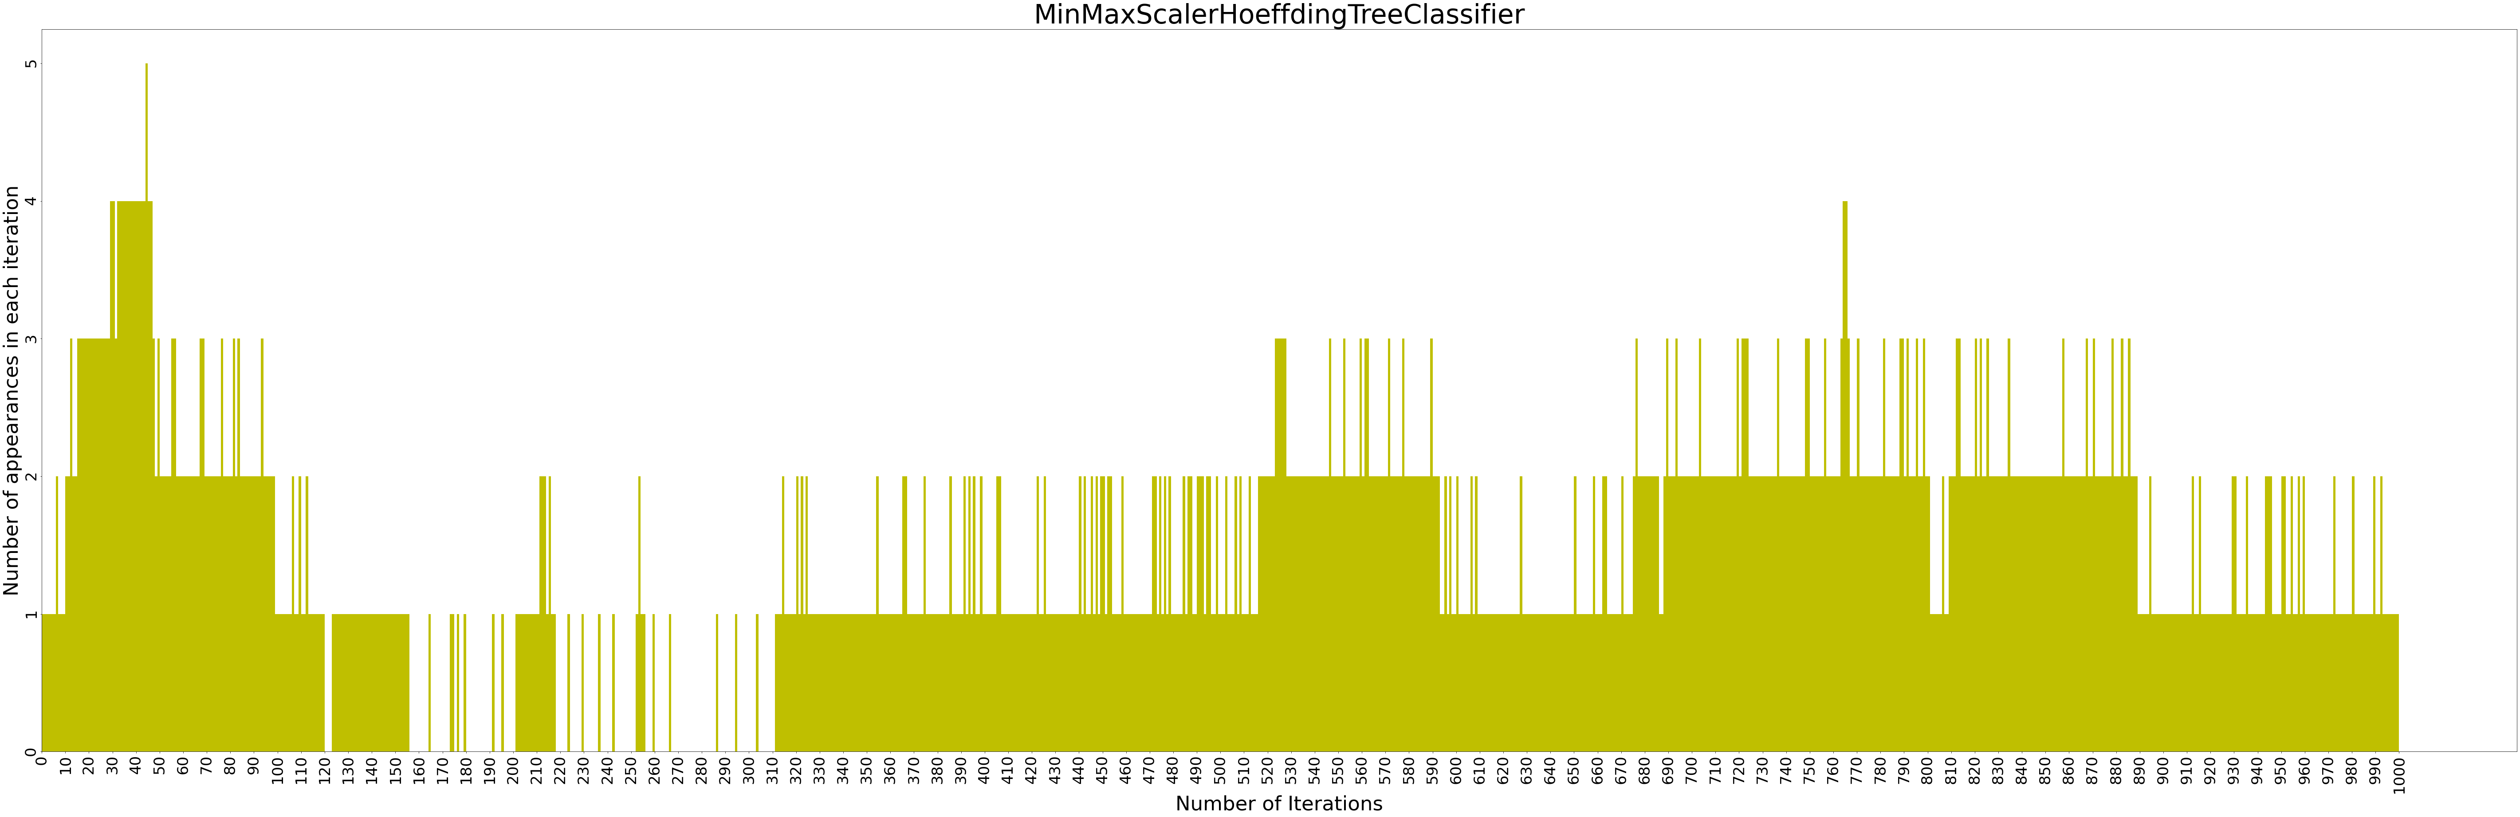

Slide 4
['criterion_mse', 'max_depth_3', 'max_features_auto', 'min_samples_split_loguniform(0.01,1)', 'min_samples_leaf_loguniform(0.01,0.5)']
MAPE: (Training 0.016317 - HP Selection 0.016324) - Validation 0.016710
RMSE: (Training 0.049001 - HP Selection 0.049005) - Validation 0.049822
R^2 : (Training 0.014484 - HP Selection 0.013450) - Validation 0.013477
Metrics for best result:
Best Technique- Decision Tree

Slide 5
BEST RESULTS FOR EACH TECHNIQUE
XGBOOST
DECISION TREE
RANDOM FOREST
Training MAPE 0.014918
HP Selection MAPE
0.016497
Validation MAPE 0.016894
Training MAPE 0.016317
HP Selection MAPE
0.016324
Validation MAPE 0.016710
Training MAPE 0.016449
HP Selection MAPE
0.016324
Validation MAPE 0.016863
SVR
LRRIDGE
Training MAPE 0.082397
HP Selection MAPE
0.082537
Validation MAPE 0.082714
Training MAPE 0.016550
HP Selection MAPE
0.016553
Validation MAPE 0.016963

Slide 7
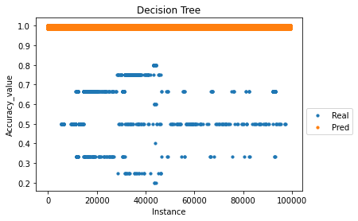
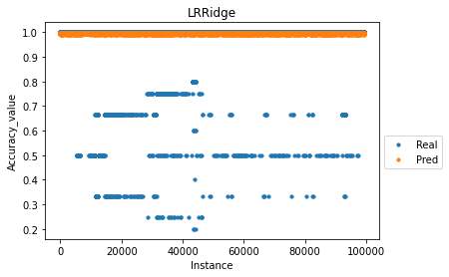
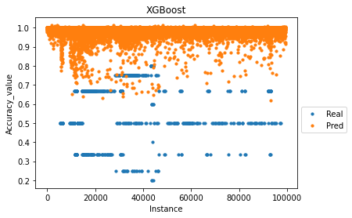
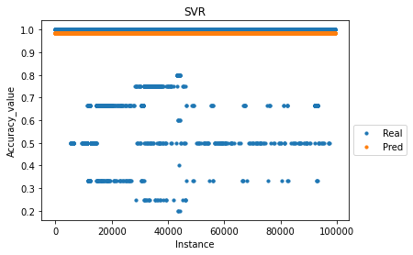
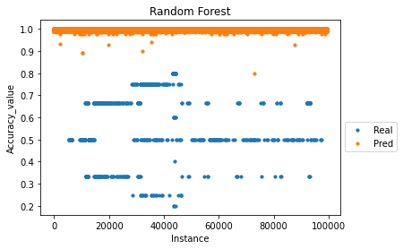
PREDICTION ANALYSIS FOR EACH TECHNIQUE

Slide 8
Standard Scaler Hoeffding Tree Classifier

Slide 9
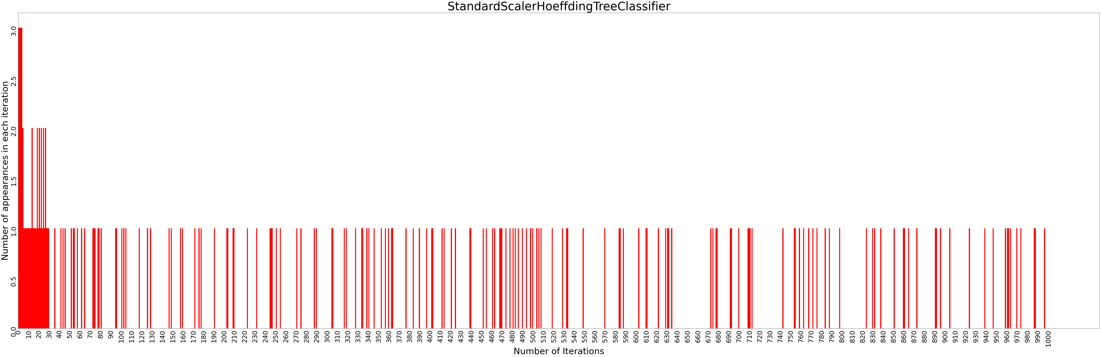

Slide 10
['criterion_mse', 'max_depth_3', 'max_features_auto', 'min_samples_split_loguniform(0.01,1)', 'min_samples_leaf_loguniform(0.01,0.5)']
MAPE: (Training 0.020006 - HP Selection 0.020024) - Validation 0.020525
RMSE: (Training 0.056594 - HP Selection 0.056537) - Validation 0.057678
R^2 : (Training 0.002974 - HP Selection 0.001907) - Validation 0.001524
Metrics for best result:
Best Technique- Decision Tree

Slide 11
BEST RESULTS FOR EACH TECHNIQUE
XGBOOST
DECISION TREE
RANDOM FOREST
Training MAPE 0.017670
HP Selection MAPE
0.020292
Validation MAPE 0.020798
Training MAPE 0.020006
HP Selection MAPE
0.020024
Validation MAPE 0.020525
Training MAPE 0.019960
HP Selection MAPE
0.020060
Validation MAPE 0.020560
SVR
LRRIDGE
Training MAPE 0.175291
HP Selection MAPE
0.175059
Validation MAPE 0.175788
Training MAPE 0.020050
HP Selection MAPE
0.020054
Validation MAPE 0.020529

Slide 13
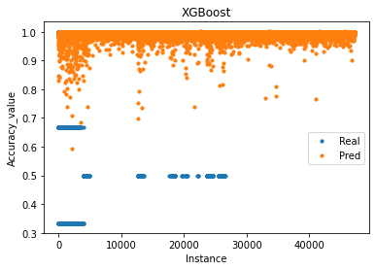
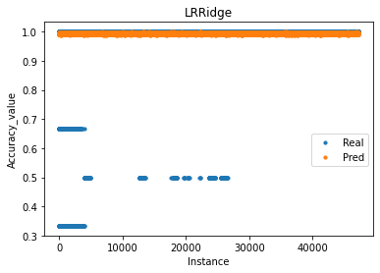
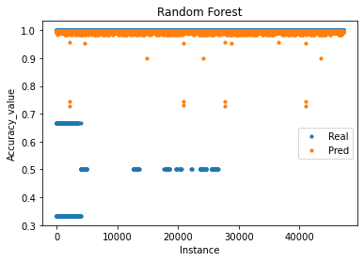
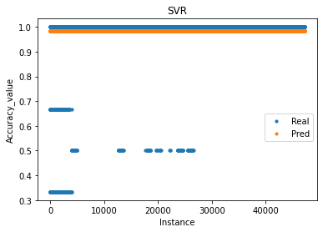
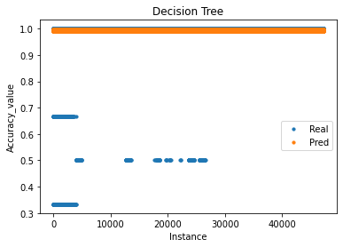
PREDICTION ANALYSIS FOR EACH TECHNIQUE

Slide 14
THANK YOU

