Slide 1
MaxAbs Scaler Hoeffding Tree Classifier of Sine Dataset

Slide 2
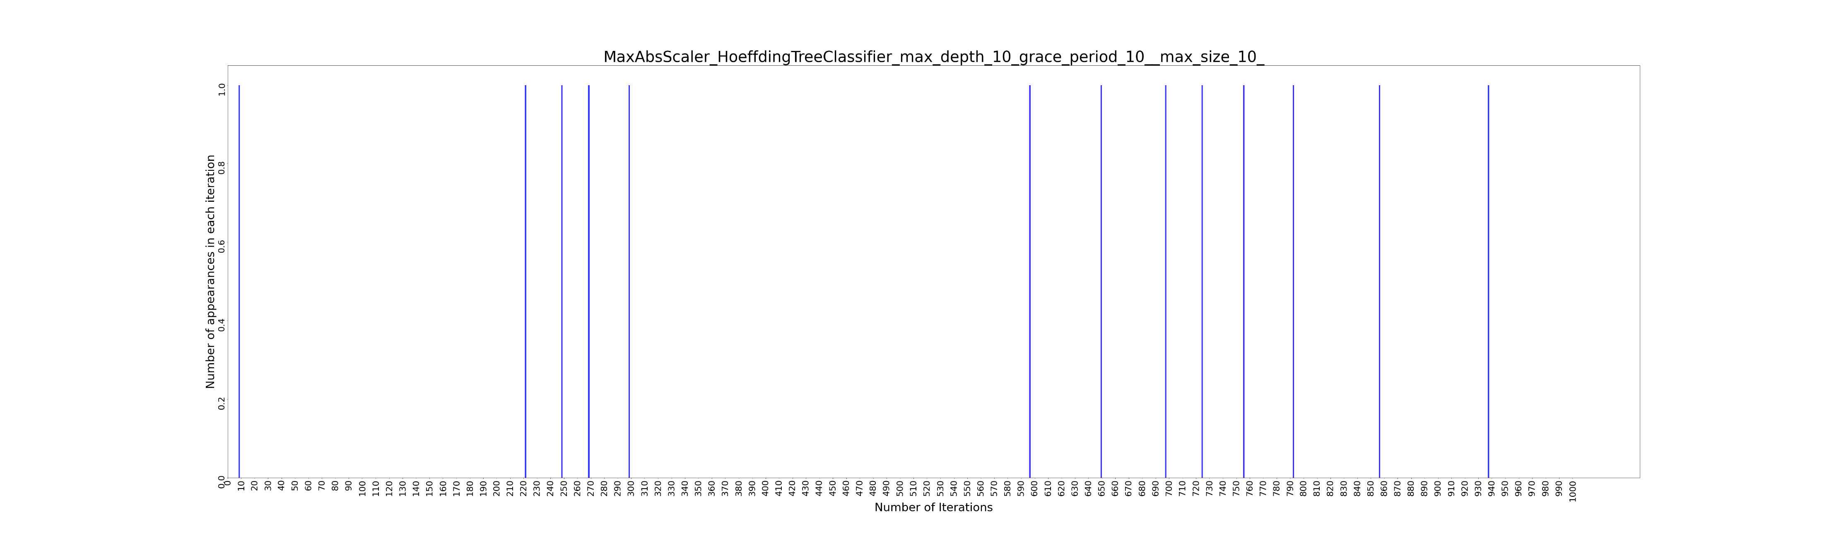
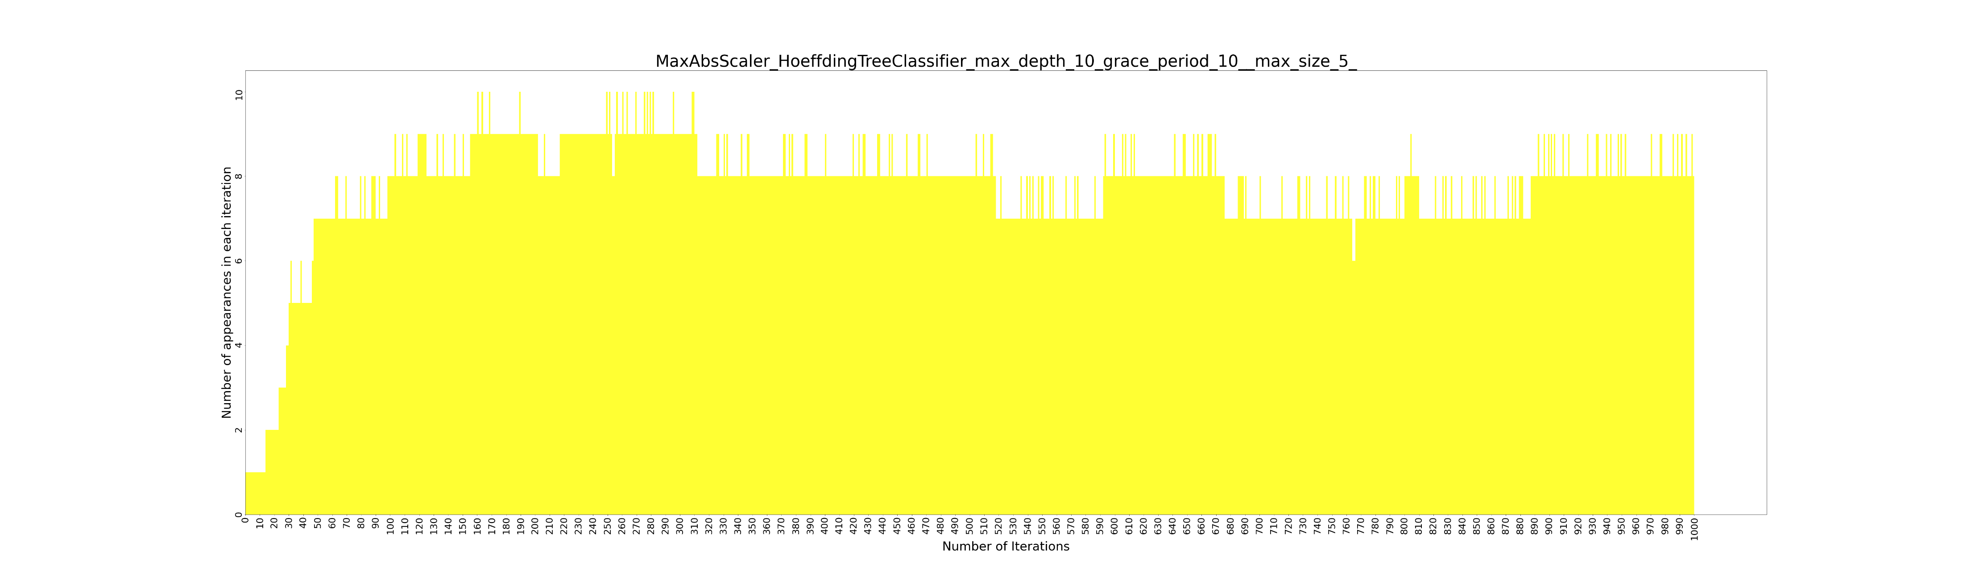

Slide 3
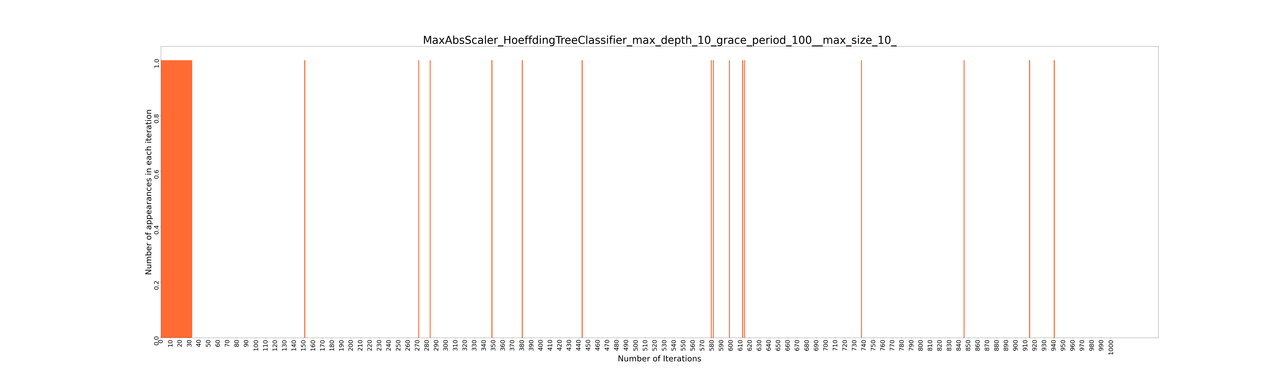
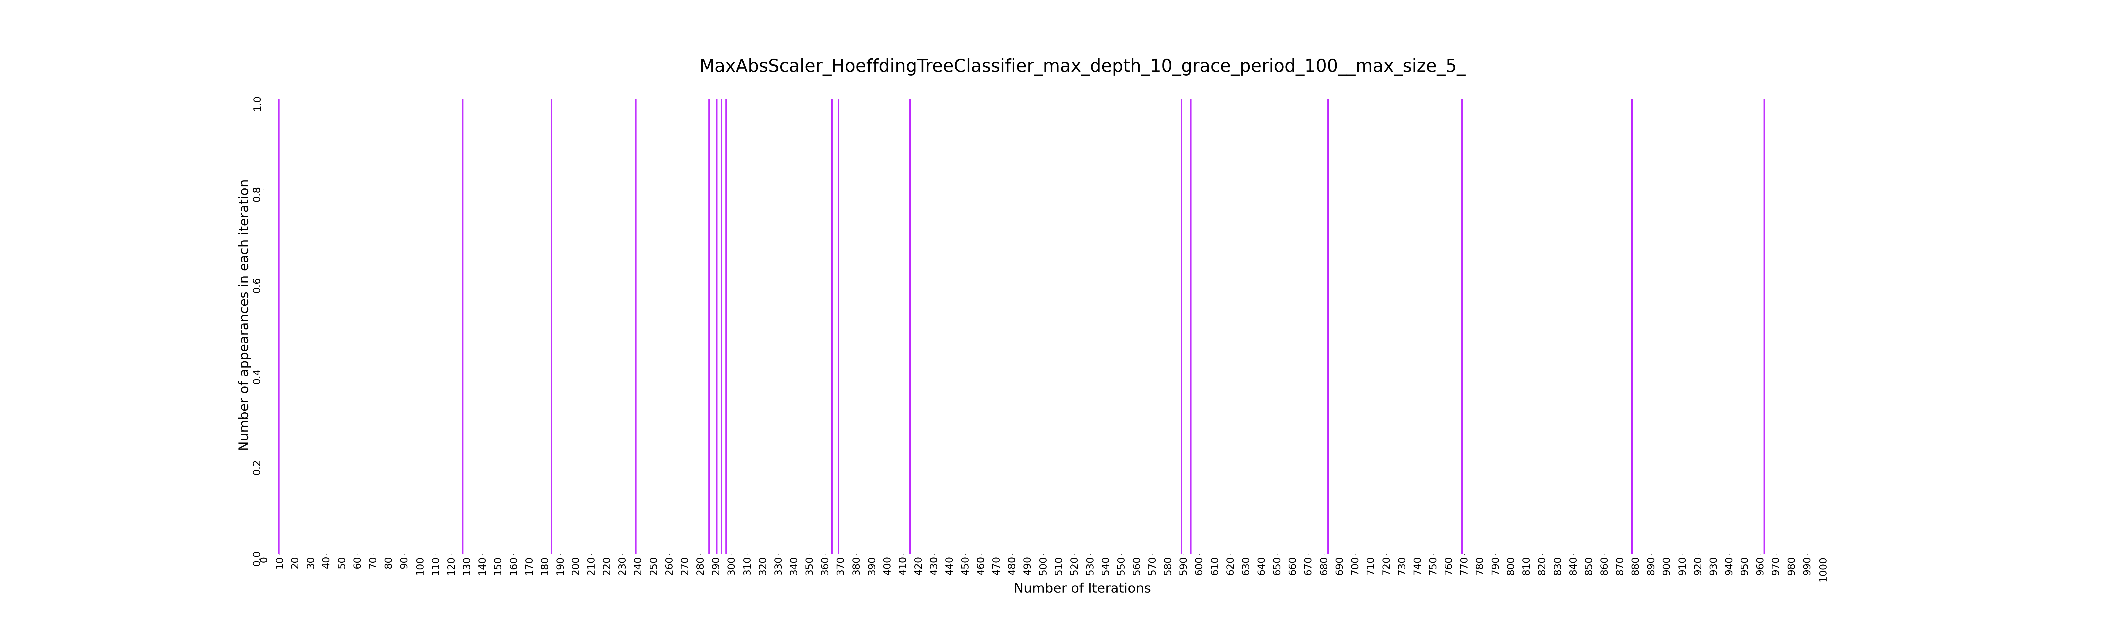

Slide 4
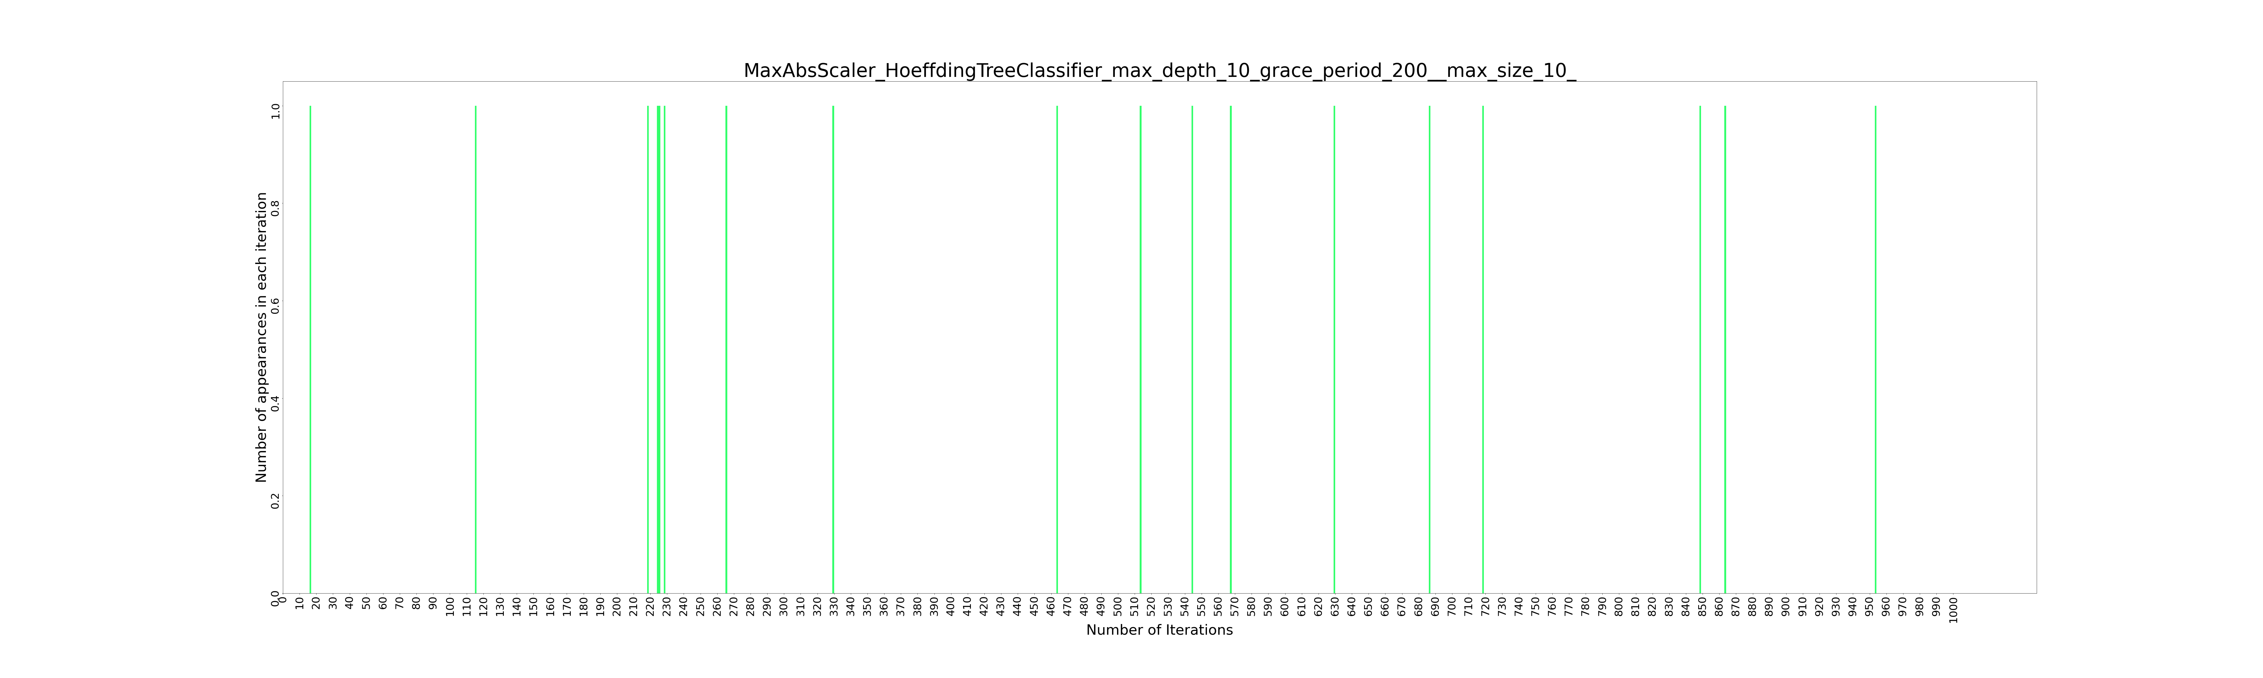
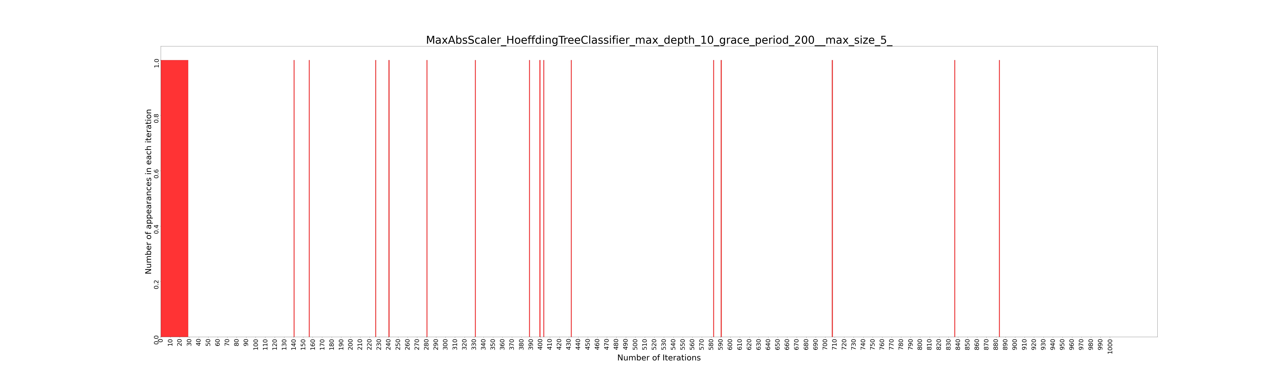

Slide 5
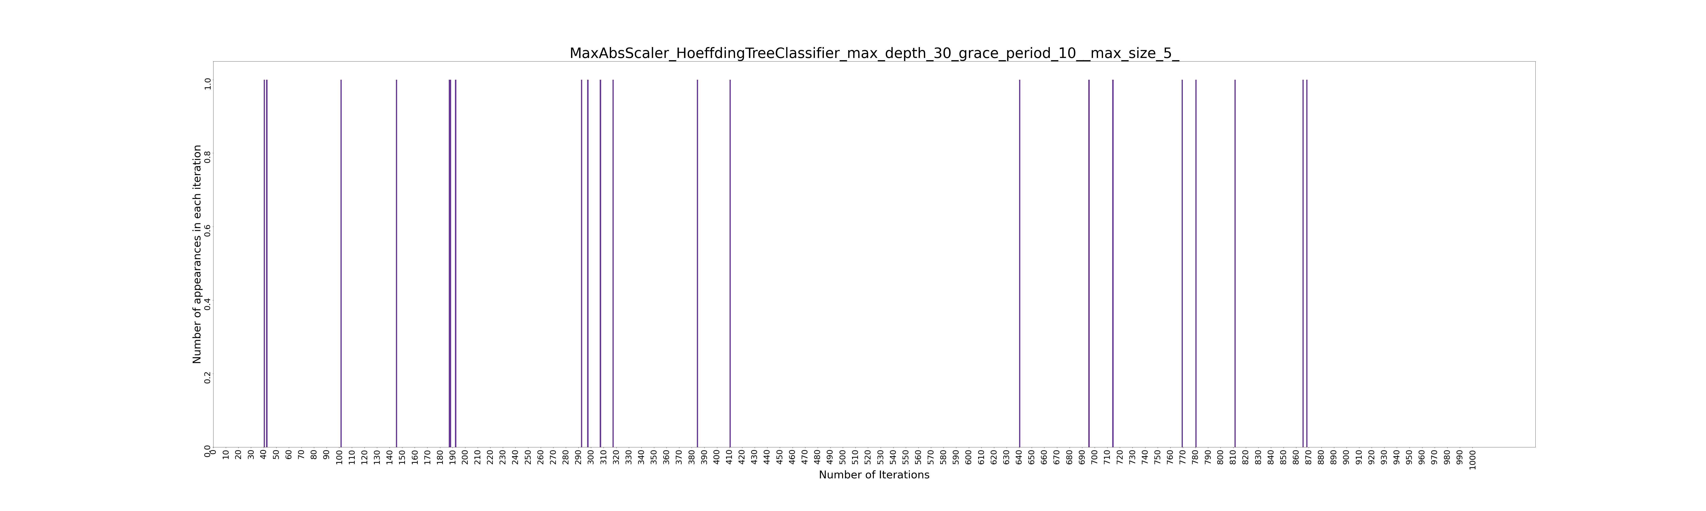
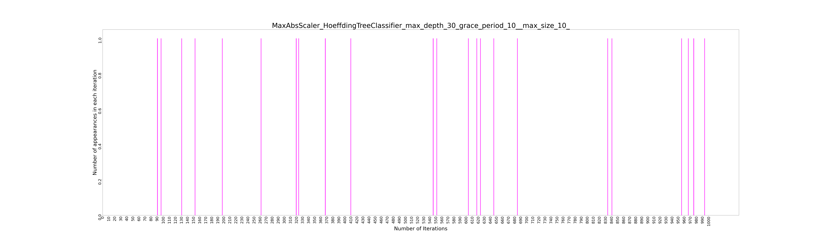

Slide 6
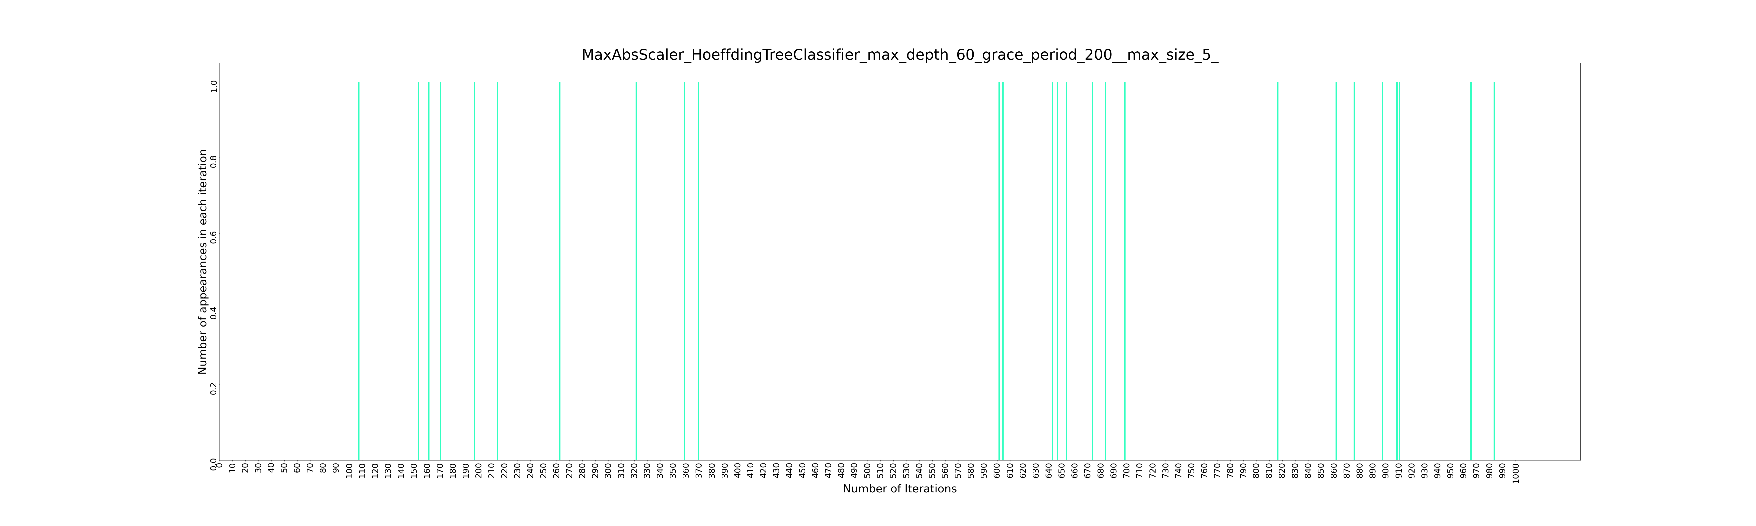
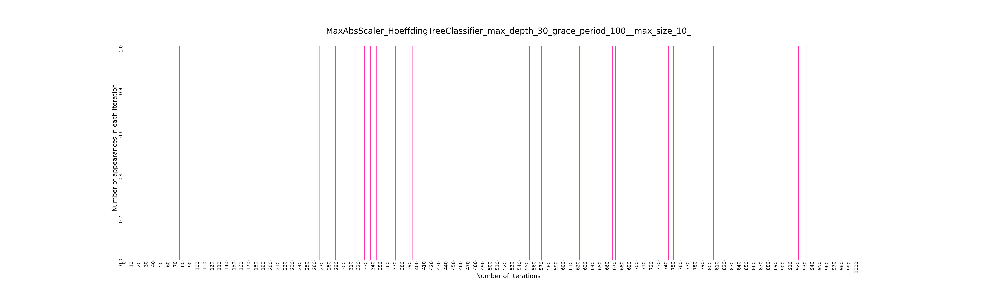

Slide 7
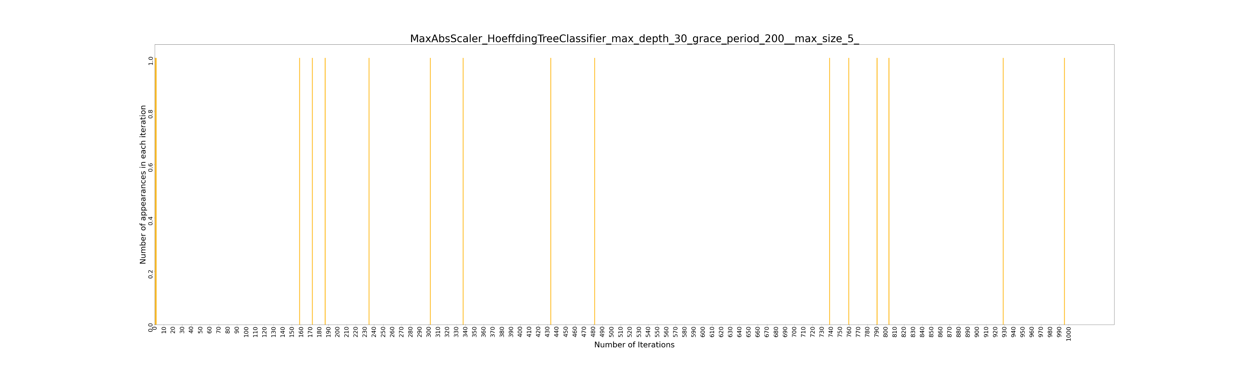
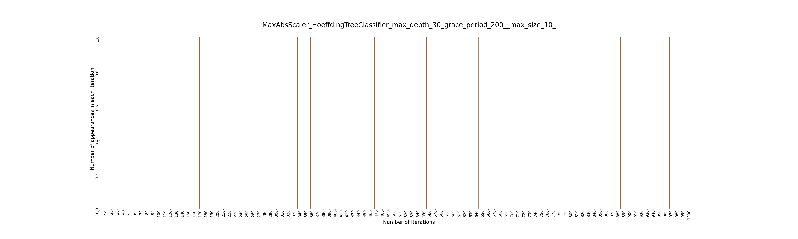

Slide 8
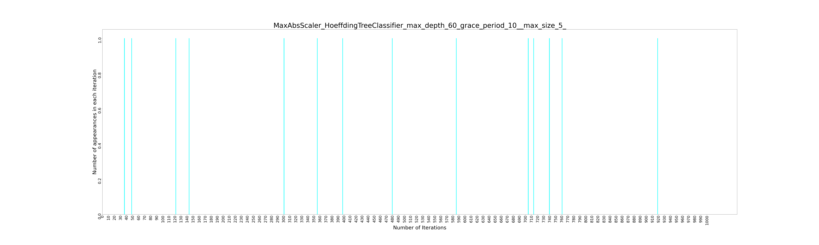
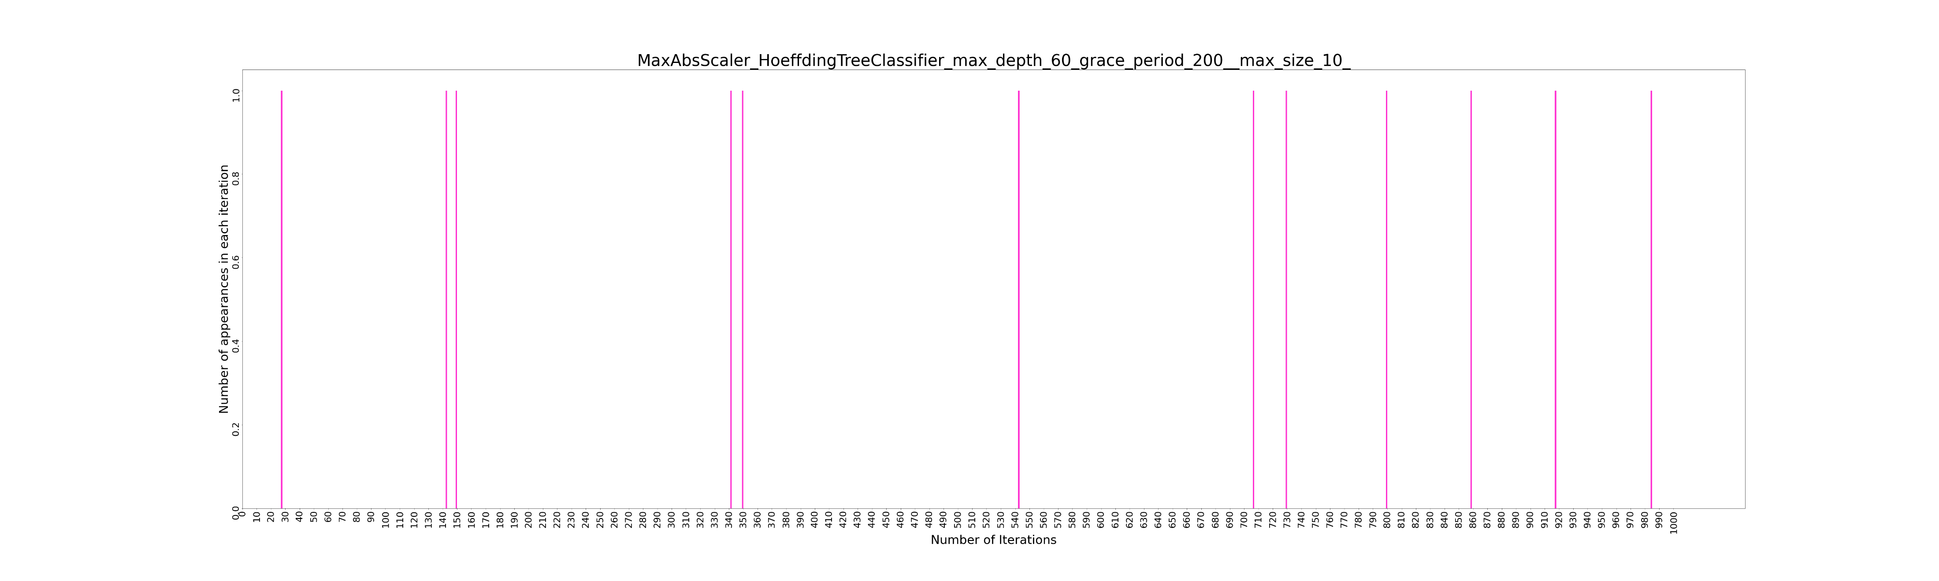

Slide 9
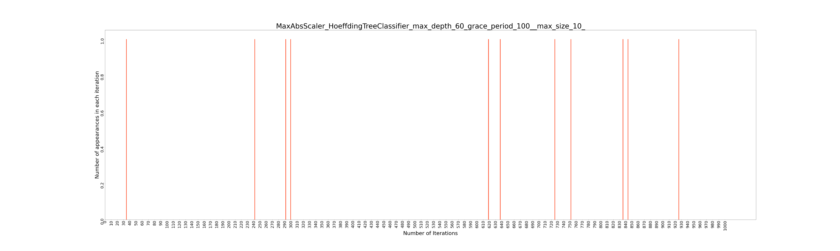
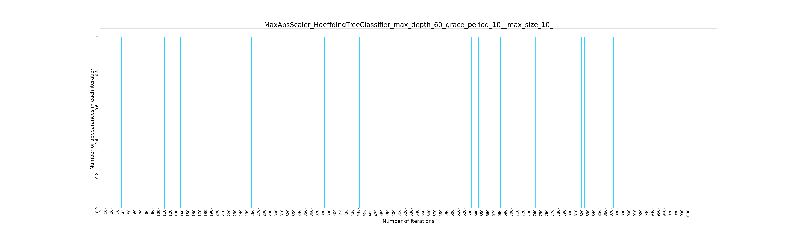

Slide 10
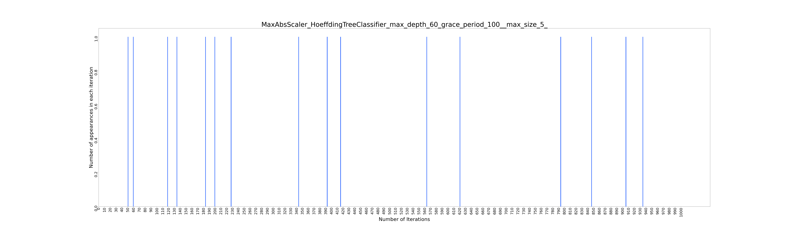
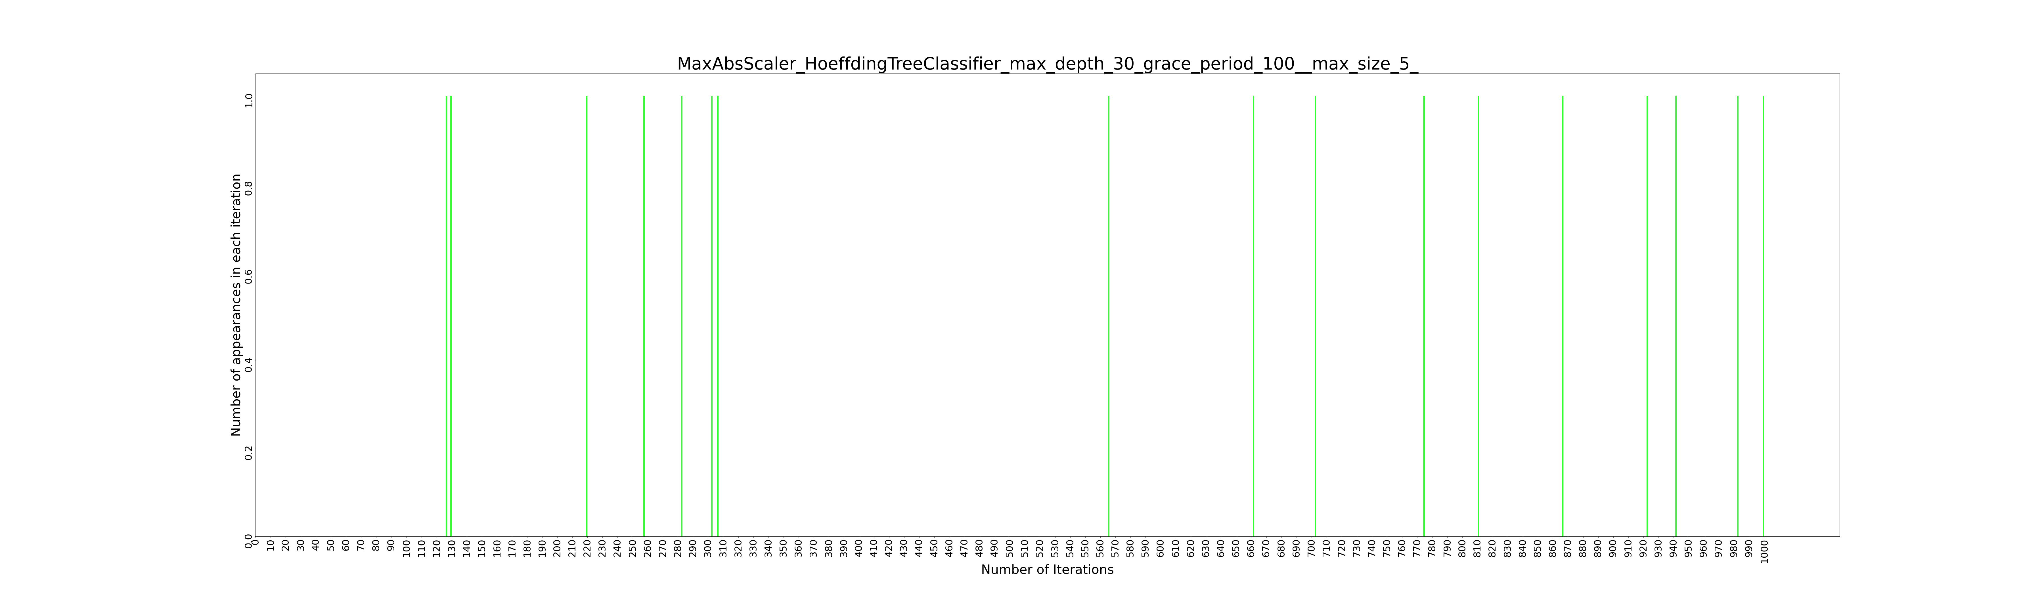

Slide 11
The Popular Model

Slide 12
['n_estimators_5', 'criterion_mse', 'max_depth_quniform(3,6,1)', 'max_features_auto', 'min_samples_split_loguniform(0.1,1)', 'min_samples_leaf_1']
Metrics for best result:
MAPE: (Training 0.009039 - HP Selection 0.012931) - Validation 0.002837
RMSE: (Training 0.022933 - HP Selection 0.018809) - Validation 0.019618
R^2 : (Training 0.304390 - HP Selection -2.936622) - Validation -61.618709
Best Technique- Random Forest

Slide 13
BEST RESULTS FOR EACH TECHNIQUE
XGBOOST
DECISION TREE
RANDOM FOREST
Training MAPE 0.013475
HP Selection MAPE
0.013483
Validation MAPE 0.002137
Training MAPE 0.012936
HP Selection MAPE
0.013972
Validation MAPE 0.002230
Training MAPE 0.009039
HP Selection MAPE
0.012931
Validation MAPE 0.002837
SVR
LRRIDGE
Training MAPE 0.134505
HP Selection MAPE
0.136318
Validation MAPE 0.125547
Training MAPE 0.014063
HP Selection MAPE
0.014212
Validation MAPE 0.002796

Slide 15
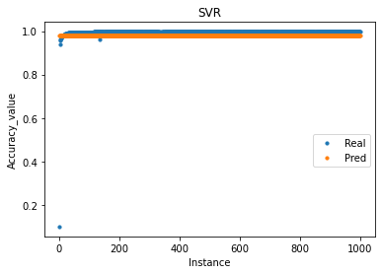
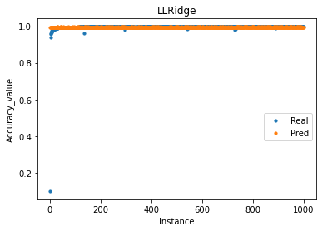
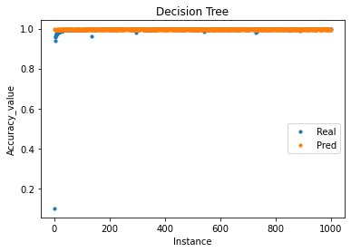
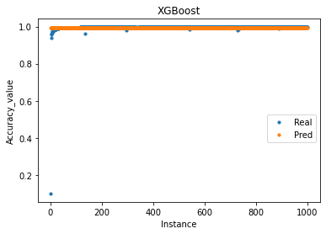

PREDICTION ANALYSIS FOR EACH TECHNIQUE

Slide 17
['criterion_mse', 'max_depth_3', 'max_features_auto', 'min_samples_split_loguniform(0.01,1)', 'min_samples_leaf_loguniform(0.01,0.5)']
MAPE: (Training 0.407619 - HP Selection 0.412988) - Validation 0.417030
RMSE: (Training 0.178660 - HP Selection 0.184858) - Validation 0.180359
R^2 : (Training 0.056100 - HP Selection -0.026886) - Validation -0.027812
Metrics for best result:
Best Technique- Decision Tree

Slide 18
BEST RESULTS FOR EACH TECHNIQUE
XGBOOST
DECISION TREE
RANDOM FOREST
Training MAPE 0.325318
HP Selection MAPE
0.466933
Validation MAPE 0.473890
Training MAPE 0.407619
HP Selection MAPE
0.412988
Validation MAPE 0.417030
Training MAPE 0.418258
HP Selection MAPE
0.434181
Validation MAPE 0.439772
SVR
LRRIDGE
Training MAPE 0.134505
HP Selection MAPE
0.136318
Validation MAPE 0.125547
Training MAPE 0.430119
HP Selection MAPE
0.431442
Validation MAPE 0.426928

Slide 20
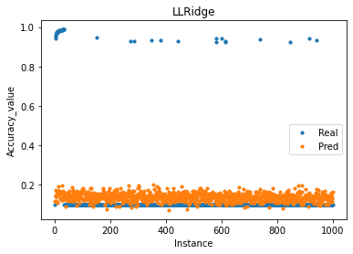
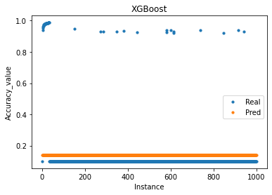
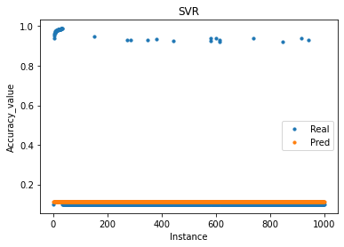
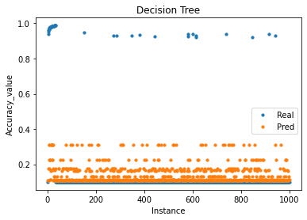
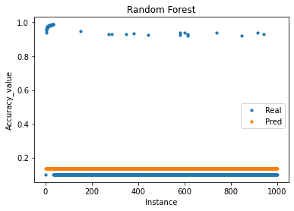
PREDICTION ANALYSIS FOR EACH TECHNIQUE

Slide 21

THANK YOU

