Slide 1


SAFE STREETS
Software Engineering- II
Mandatory Project
Priyanka Rajendran
Shara Priyanka Vakati

Slide 2
Purpose
To develop an application that helps it’s users to report the parking and traffic violations that they come across to the authorities.

Slide 3
What’s next?
Requirements Analysis and Specification
Design
Development
Testing
Implementation

Slide 4
Requirements Analysis and Specification
Basic service- Reporting violation and accessing data from Safe Streets.
Additional service- Classifying unsafe areas.

Slide 5
Goals
G1: User should be able to report the parking or traffic violation to the authorities.
G2: Authorities should be able to access the data regarding the violation.
G3: User and Authorities should be able to access data from Safe Streets with limited access to the user.
G4: User and authorities should be able to access data regarding the accidents from municipality services.
G5: Safe Streets should identify unsafe areas and provide solution.

Slide 6
Functional Requirements
Report a violation
1
View violation
2
Visualize highlighted area
3
Visualize accident information
4
View Analyzed data
5
Visualize unsafe areas
6
Log In and Sign Up
7

Slide 7
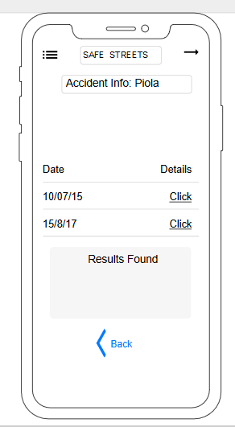
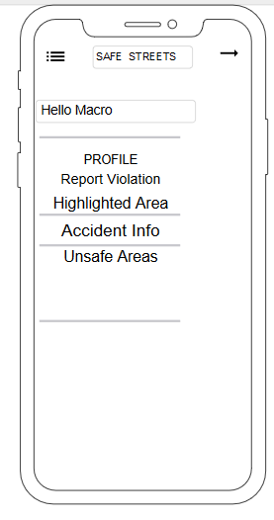
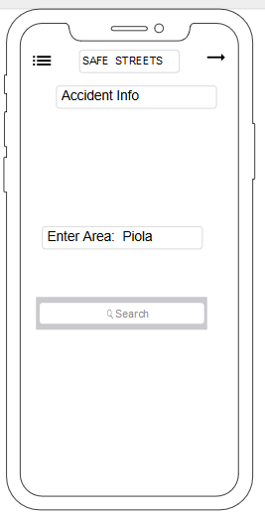
Non-functional requirements
User Interface

Slide 8
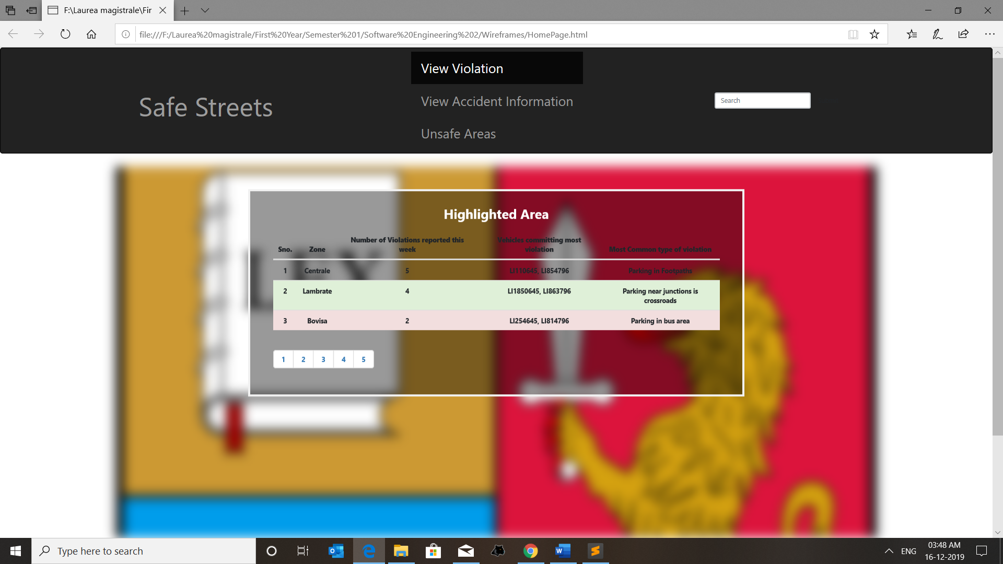
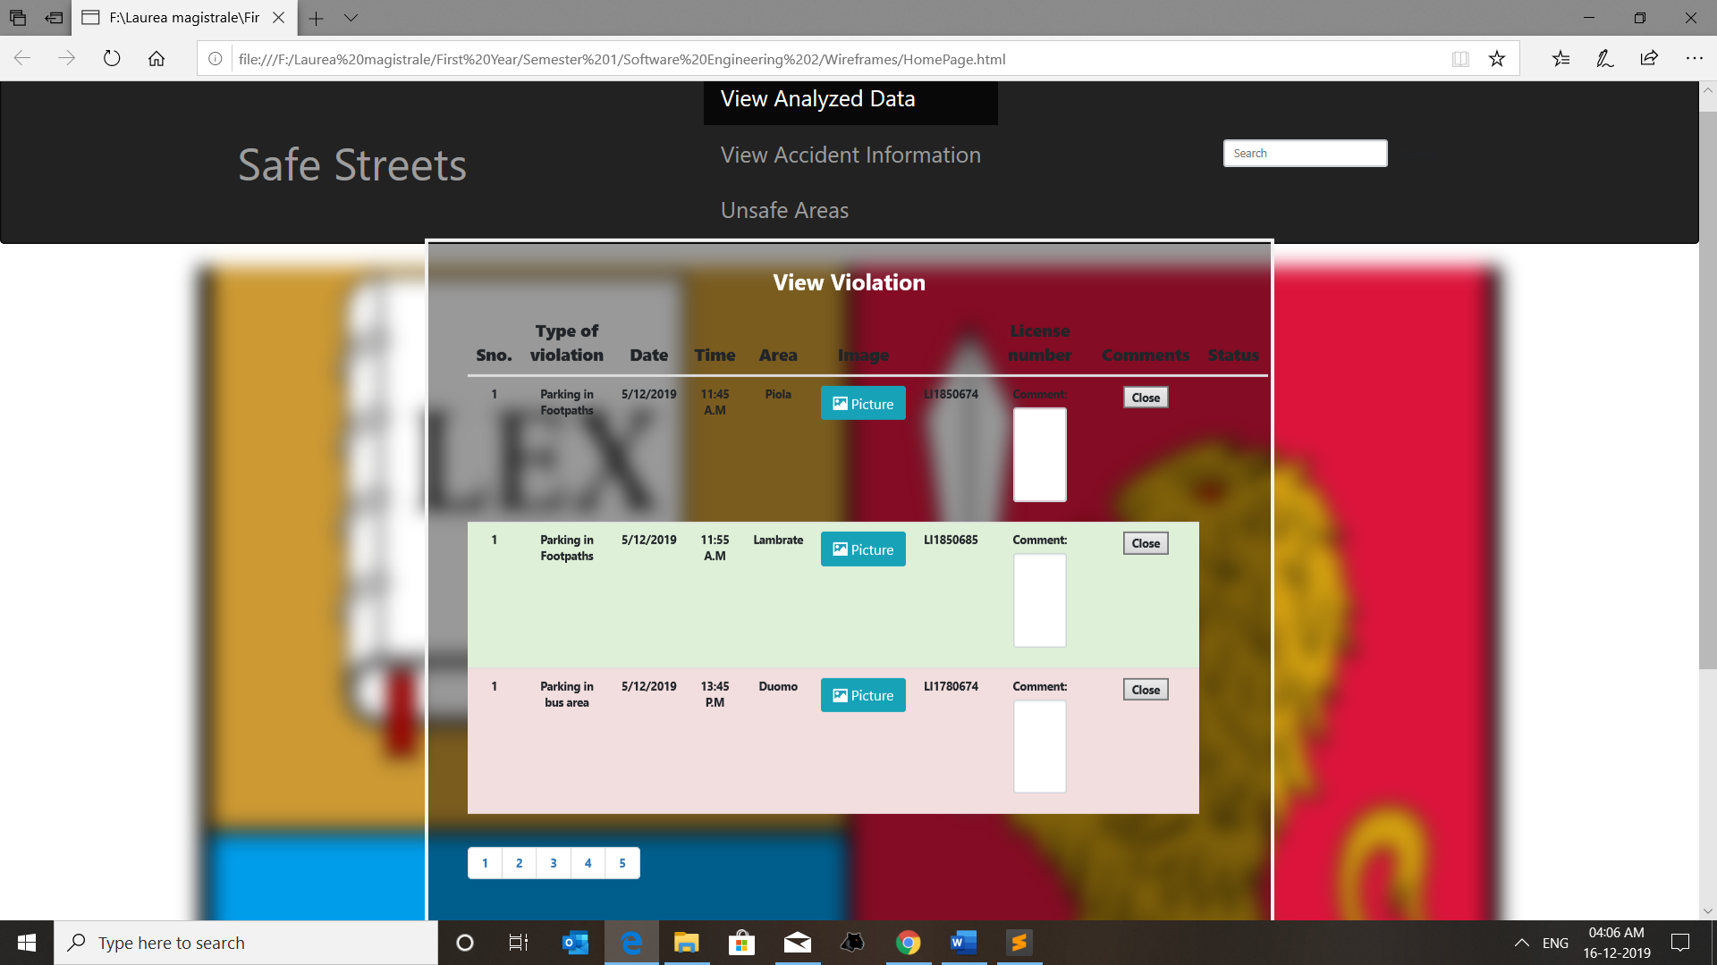
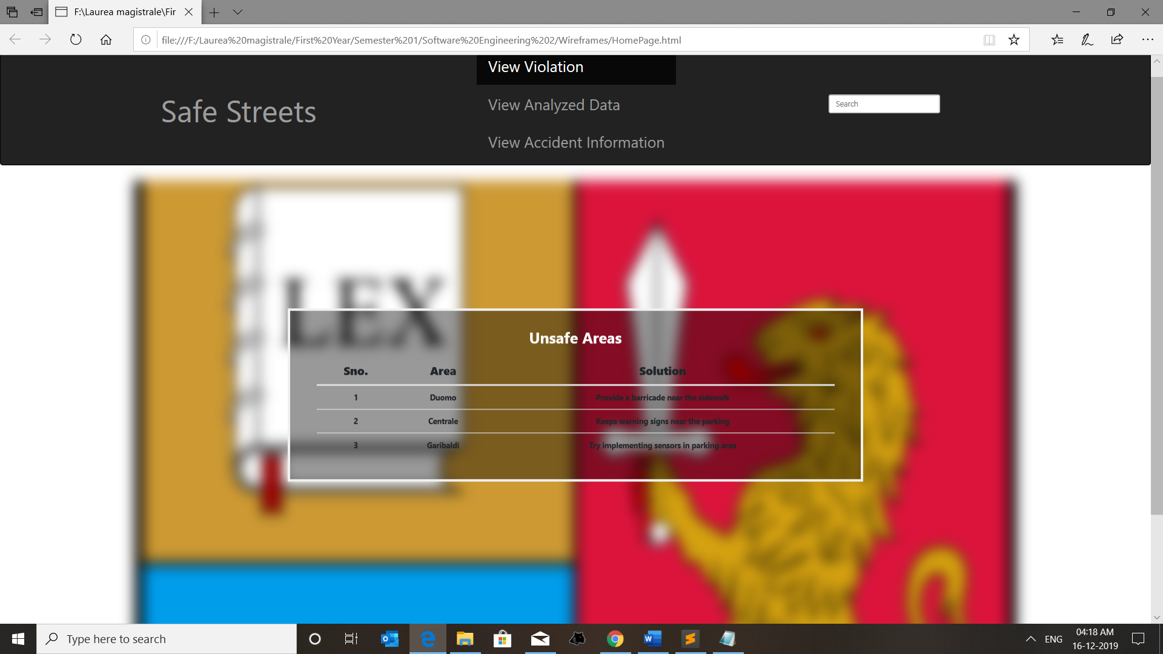

Slide 9
Hardware and Software interfaces
Mobile Phone with a GPS connection and data, a desktop with an internet connection.
System doesn’t provide API to external applications but uses municipality services and Google maps API.
No hardware interface.

Slide 10
Performance requirements
The system should be able to serve a great number of users and authorities simultaneously. It should guarantee reactive and correct responses.

Slide 11
Design Constraints and Software System Attributes
Standards Compliance- GDPR.
Hardware Limitation- resources to run the application seamlessly.
Availability- 99.9
Security.
Maintainability.
Compatibility.

Slide 12
Formal Analysis using Alloy
No two customers should have the same username or that of the same fiscal code or authority id.
Each violation should be assigned to one authority.
Highlighted areas contain the greatest number of violations.
Unsafe areas are identified using the number of accidents and the number of violations in each area.

Slide 13
Design decisions
Layered architecture – three-tier, MVC.
Relational database, Microsoft Azure.
Creational design patterns.
Structural design patterns.
RESTFul webservices.

Slide 14
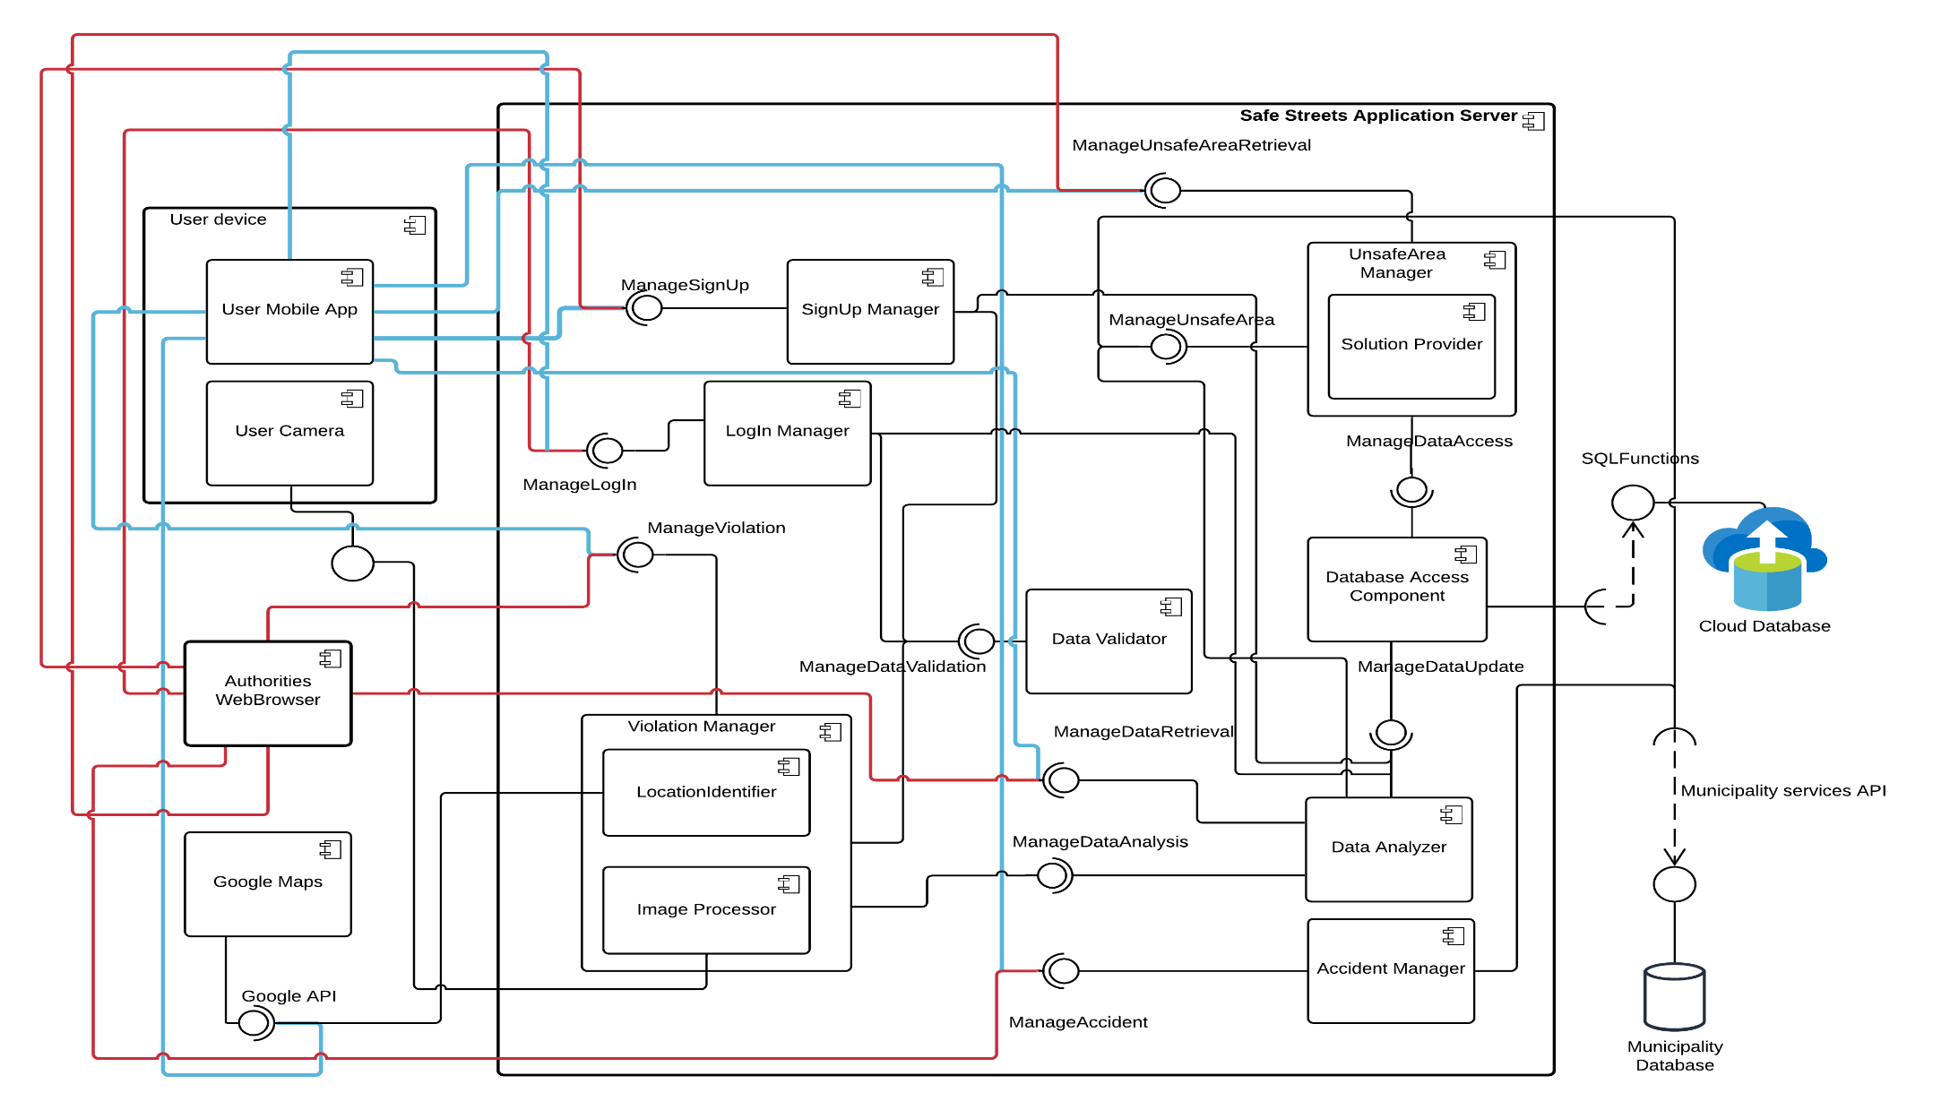
Component diagram

Slide 15
Domain assumptions
D1: Every user of the system has a fiscal code that is unique.
D2: Every authority has a unique authority ID.
D3: User has a mobile phone equipped with a GPS, camera and an internet connection.
D4: Safe Streets can access the location and date and time from the user's device automatically.
D5: Authorities should have a computer with an internet connection.
D6: The devices on which the services are exploited can provide real time information.
D7: Unsafe areas are characterized with the highest number of violations and accidents.

Slide 16
G1: User should be able to report the parking or traffic violation to the authorities.
R1: User should be able to upload the image with vehicles violating the rules. The system should not allow users to upload images from Gallery to prevent data manipulation rather it should access the device’s camera through the application.- Violation Manager
R2: The system should allow the user to select the type of violation and provide a description about the violation.- Data Validator, Image Processor.
R3: The system should be able to access the location, date and time from the user’s mobile automatically.- Location Identifier, Violation Manager.
Domain assumptions: D1, D3 and D4.

Slide 17
G2: Authorities should be able to access the data regarding the violation.
R4: Authorities should be able to access all the data regarding the violation like type of violation, location and date and time.- Violation Manager.
R5: Authorities should be able to access the processed data such as the license no. from the image submitted by the user and the area where the violation occurred. -Violation Manager, Image Processor, Location Identifier.
R6: After taking actions, authorities should close the issue. Such that investing time on the same violation that has been reported and solved already is reduced. Violation Manager.
Domain assumptions: D2, D5 and D6.

Slide 18
G3: User and Authorities should be able to access data from Safe Streets with limited access to the user.
R7: The application should allow both the users and the authorities to retrieve information regarding the area with highest violation recorded-Data Analyzer.
R8: The application should allow only the authorities to retrieve data regarding the vehicle that is committing most violation and the most common type of violation- Data Analyzer.
Domain assumptions: D6.

Slide 19
G4: User and authorities should be able to access data regarding the accidents from municipality services.
R9: The user and the authorities should be able to access the data regarding the accidents from municipality services through Safe Streets -Accident Manager.
R10: The municipality services should provide the data regarding the no. of accidents in each area -Accident Manager.
Domain assumptions- D6.

Slide 20
G5: Safe Streets should identify unsafe areas and provide solution.
R11: Safe Streets should be able to compare the data from the municipality services with its own data.
R12: An area will be characterized as an unsafe area if the frequency of accidents and the no. of violations reported in that particular area is higher than other corresponding areas.
R13: The threshold for an area to be considered safe keeps changing according to the new data.
R14: After each update of the data, it will be compared with the area labelled unsafe. If it is likely to have at least half of the parameters of the unsafe area then it will also be marked as an unsafe area.
R15: Information regarding the road in which most the violations or accidents occurred, the time in which the frequency is higher should also be provided by SS.
Component used: Unsafe Area Manager

Slide 21
Contd..
R16: Safe Streets should suggest solutions based on the analyzed data.
R17: The solutions formulated will be sent to the authorities who will be considered responsible for implementing the solutions provided.
R18: Safe Streets should also provide expected results when the solutions are implemented.
Component used: Solution Manager.
Domain assumptions: D6.

Slide 22
Implementation, Integration and Test Plan
User Mobile App.
Authority Web App.
Application Server.
External systems: Microsoft Azure Database, Google Maps, Municipality database.
Top down Integration.

Slide 23
Testing Strategy
Test coverage- conformance mapping of business requirements and test cases.
Unit testing.
Regression after each integration.
Functional testing.

Slide 24
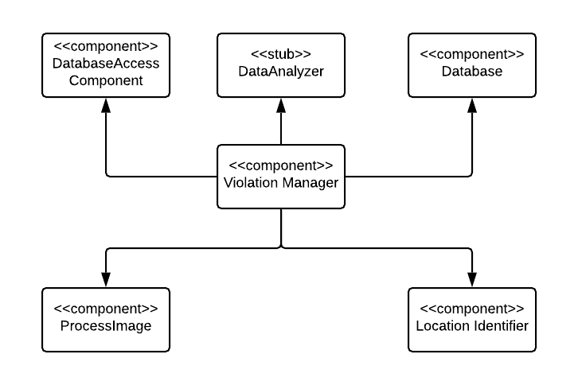
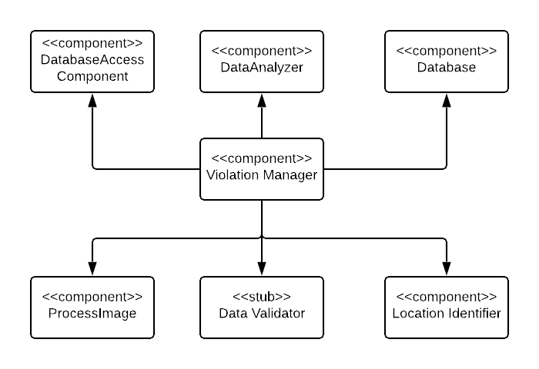
Level 2
Level 1

Slide 25
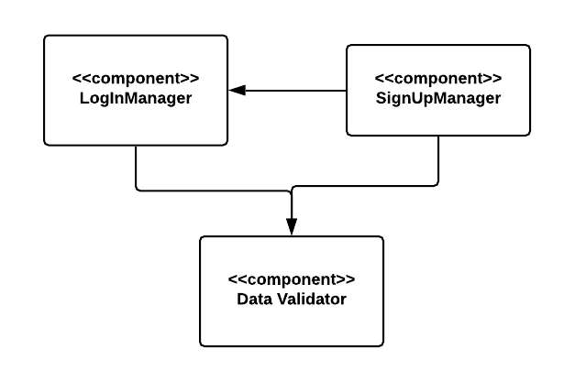
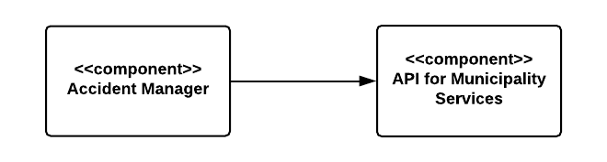
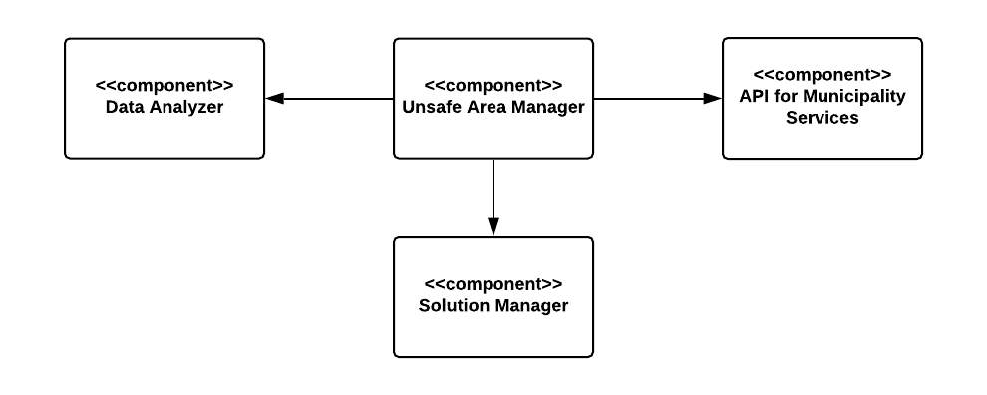
Level 3
Level 5
Level 4

Slide 26
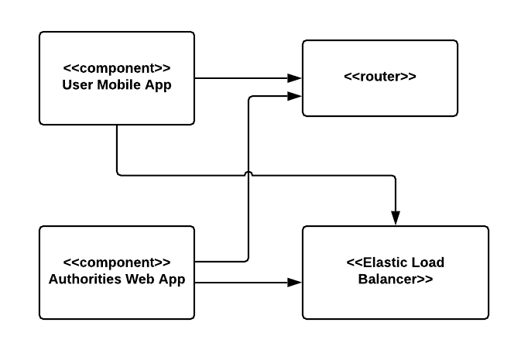
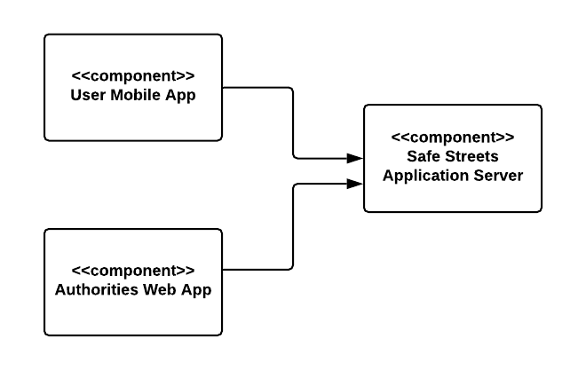
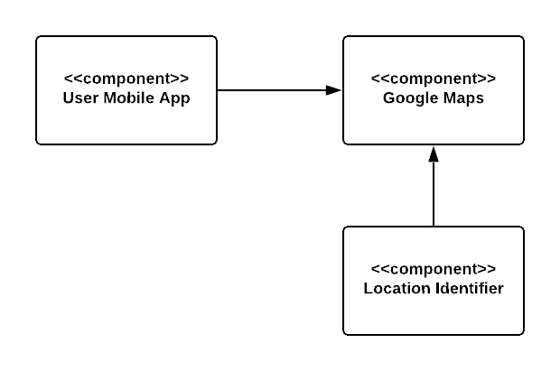
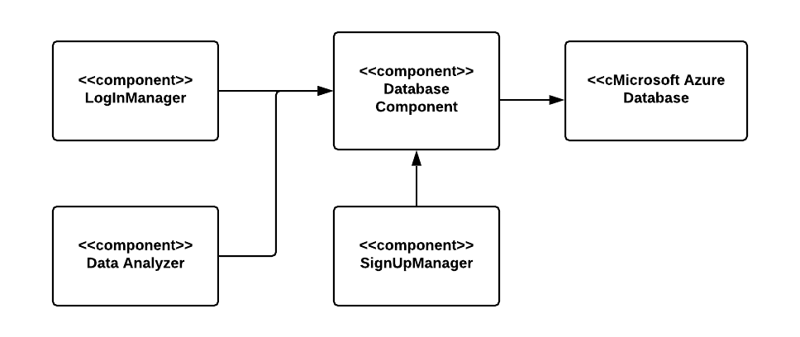
Integration of Front end and Backend
Integration of Front end with transport Layer
Integration with external services -Google Maps
Integration with external services –Database

Slide 27
Thank You
Queries?

