Slide 1

Salon Management Software For Beauty Salon

Slide 2
Salon Software Features
Online Appointments
Online Gift Certificate
Online Retails
DARCI
Salon Marketing
Appointment Book
Client Management
Inventory
Reporting
Salon POS
Analytics

Slide 3
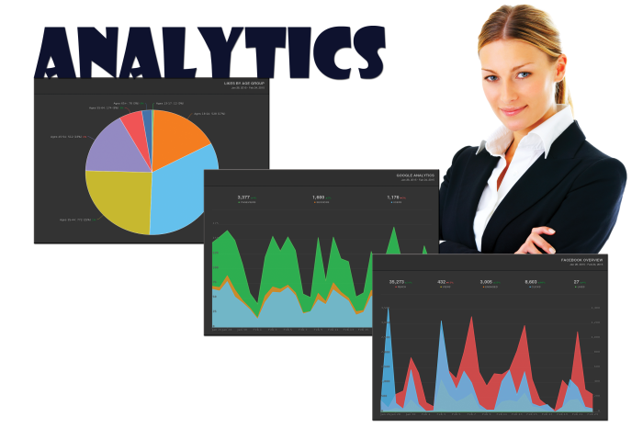
Analytics
You know that having a website and marketing your business on social media is important, but how do you know if you are doing it right? Many salon software providers can help you set up marketing campaigns, but how do you know if it’s working? We deliver real time website and social media analytics to help you learn from your online engagement. It’s one more way we help you thrive!

Slide 4
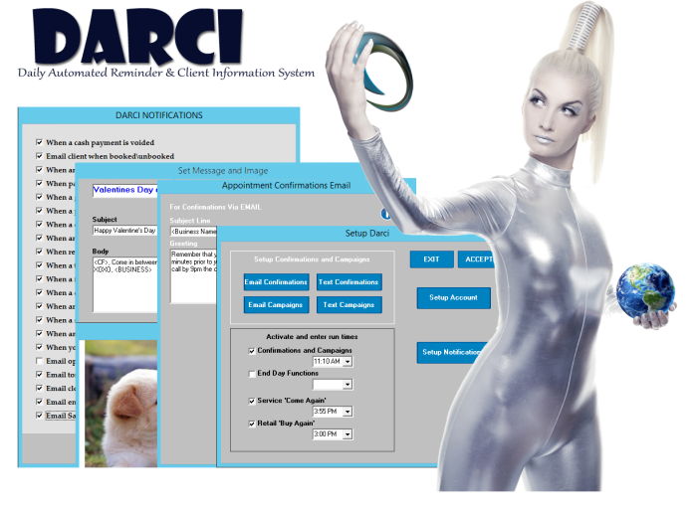
DARCI
From appointment reminders and confirmations to automated marketing and theft prevention, DARCI will help run your business and keep you informed 24/7. She’s the personal assistant you always wanted!

Slide 5
Point Of Sale
Transcend software for salons allows you to handle even the most complicated transactions with ease and our fully integrated credit card system has won the Gold Medallion Award for Excellence three years in a row!
Checkout from the Appointment Book
Multiple forms of payment
Pay with points
Refunds
Track gratuities
Gift Certificates and Cards
Modify prices on the fly
Apply coupons and discounts
Assign commissions
Create unique payment options Interfaces with cash drawer/receipt printer / barcode scanner / cc swiper.
And More

Slide 6
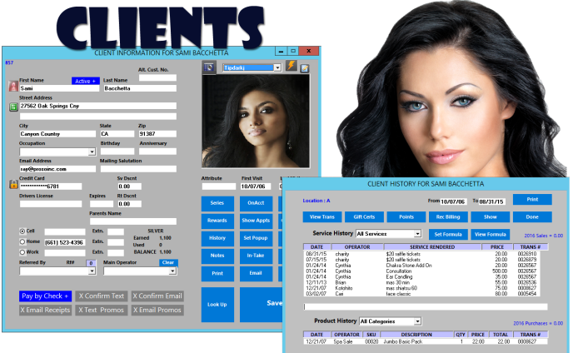
Client Management
Only our Transcend program offers a fully customizable client profile that allows you to develop the relationship with your customers that you need to succeed. No limitations.
Names, addresses and phone numbers
PA-Dss Credit Card storage in client file
Unlimited pictures
Customized tracking
History
Seamless marketing
Memberships
Loyalty Programs
Referred by

Slide 7


