Slide 1
What is virtualization
Virtualization is the "creation of a virtual (rather than actual) version of something, such as a server, a desktop, a storage device, an operating system or network resources".
Types of Virtualization:
Hardware Virtualization.
Operating system Virtualization.
Server Virtualization.
Storage Virtualization.
1) Hardware Virtualization:
When the virtual machine software or virtual machine manager (VMM) is directly installed on the hardware system is known as hardware virtualization.
The main job of hypervisor is to control and monitoring the processor, memory and other hardware resources.
2) Operating System Virtualization:
When the virtual machine software or virtual machine manager (VMM) is installed on the Host operating system instead of directly on the hardware system is known as operating system virtualization.

Slide 2
3) Server Virtualization:
When the virtual machine software or virtual machine manager (VMM) is directly installed on the Server system is known as server virtualization.
4) Storage Virtualization:
Storage virtualization is the process of grouping the physical storage from multiple network storage devices so that it looks like a single storage device.
Storage virtualization is also implemented by using software applications.

Slide 3
What is a hypervisor
A hypervisor, also known as a virtual machine monitor or VMM. The hypervisor is a piece of software that allows us to build and run virtual machines which are abbreviated as VMs.
A hypervisor allows a single host computer to support multiple virtual machines (VMs) by sharing resources including memory and processing.
There are two types of hypervisors: "Type 1" (also known as "bare metal")
"Type 2" (also known as "hosted").

Slide 4
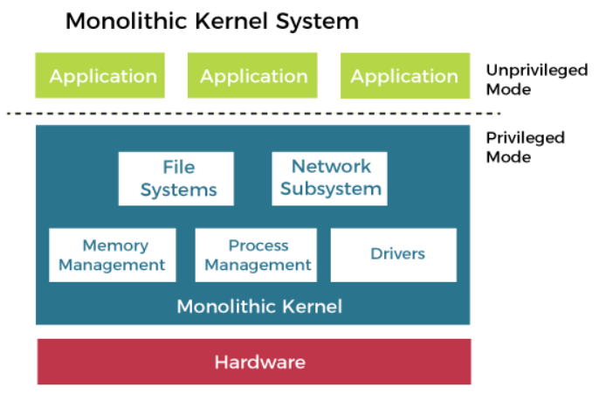
What is Monolithic architecture
A monolithic design of the operating system architecture makes no special accommodation for the special nature of the operating system.
Although the design follows the separation of concerns, no attempt is made to restrict the privileges granted to the individual parts of the operating system.
The entire operating system executes with maximum privileges.
The communication overhead inside the monolithic operating system is the same as that of any other software, considered relatively low.

Slide 5
What is Virtual Machine
Virtual Machine can be defined as an emulation of the computer systems in computing. Virtual Machine is based on computer architectures. It also gives the functionality of physical computers. The implementation of VM may consider specialized software, hardware, or a combination of both.
Advantages of VM
Virtual Machine facilitates compatibility of the software to that software which is executing on it. Hence, each software specified for a virtualized host would also execute on the VM.
It offers isolation among distinct types of processors and OSes. Hence, the processor OS executing on a single virtual machine can't change the host of any other host systems and virtual machines.
Virtual Machine facilitates encapsulation. Various software present over the VM could be controlled and modified.

Slide 6
Disadvantages. Virtual machines are
less efficient than real machines because they access hardware indirectly.
Running VM software on top of the host operating system means that it will have to request access to storage and memory from the physical device.
What are Containers?
In the traditional classical deployment scenario, we had hardware and an operating system for running multiple applications. If you want to run node.js, having certain dependencies, it will necessitate certain libraries and some specific kind of operating system

Slide 7
