Slide 1

GHANA HEALTHCARE FACILITIES
Exploratory Data Analysis

Slide 2
DATA PRE-PROCESSING
What is data pre-processing?
Pre-processing procedures followed on this dataset.
Dataset initially had 3756 records. After cleaning the dataset, the numbers of records are 3559.
Almost 200 records have been removed after refining the dataset!!
STEP 1
STEP 3
Removal of duplicates
Eliminating case mismatch
STEP 2
STEP 4
Removal of missing values
Eliminating data mismatch

Slide 3
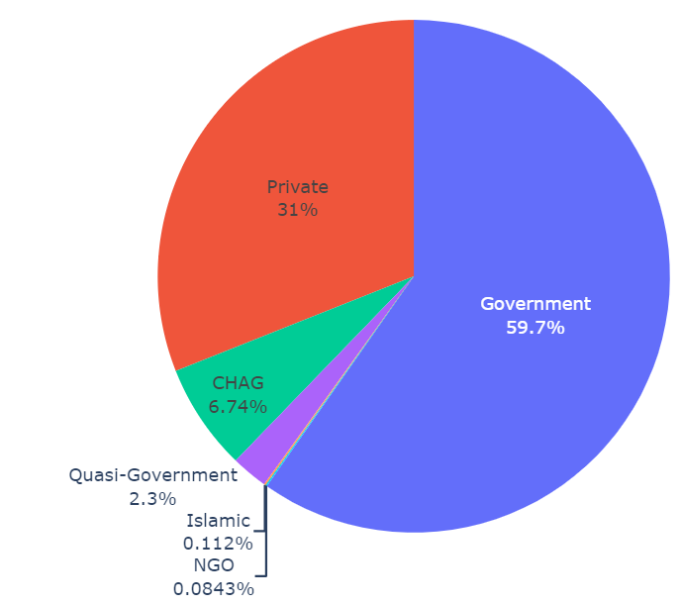
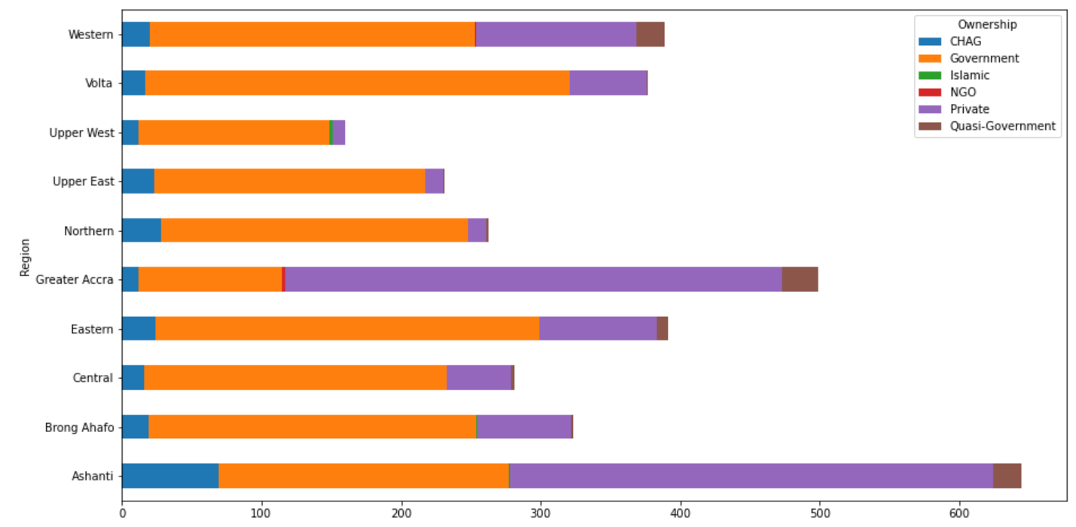
DATA ANALYSIS
Ownership percentages
Region-wise distribution of ownership

Slide 4
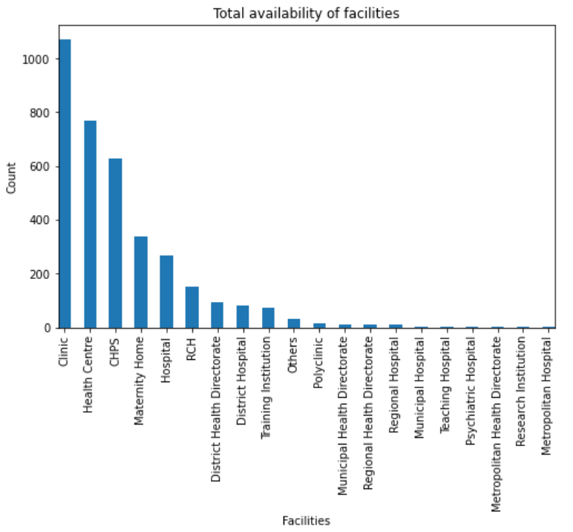
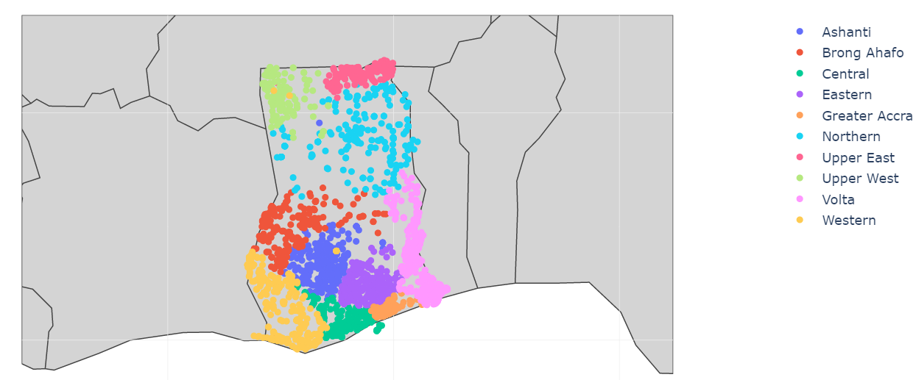
DATA ANALYSIS
Region-wise distribution of all the facilities
Total number of each facilities available

Slide 5
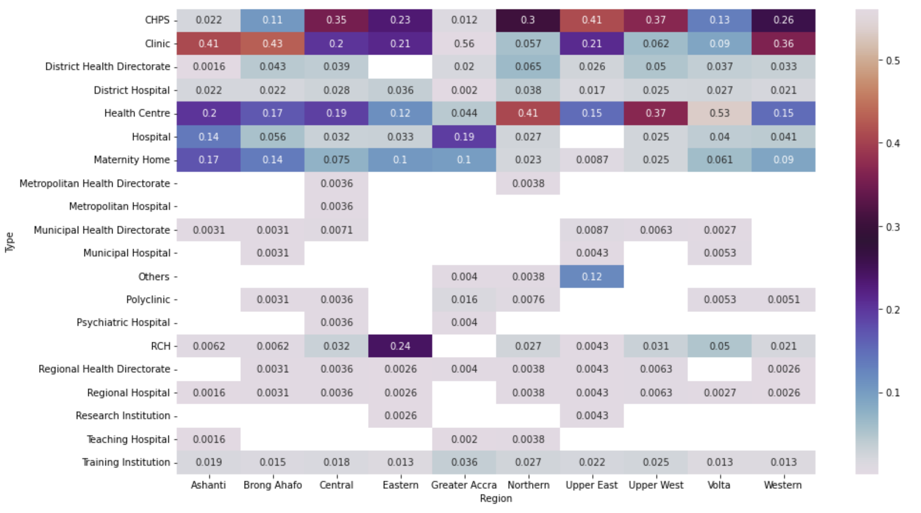
DATA ANALYSIS
Distribution of all the facilities in each region

Slide 6
CONCLUSION AND LIMITATION
Dataset is pre-processed and analysed with respect to the distribution of ownership and facilities.
Other features like measure of quality, expenses in each healthcare unit would be useful to draw deeper insights to understand how these healthcare facilities differ from one another and what is best suited for a region or its people.

