Slide 1


CRISP-DM and SMART KPIs
A comprehensive guide to structured data science methodology and effective KPI framework

Slide 2
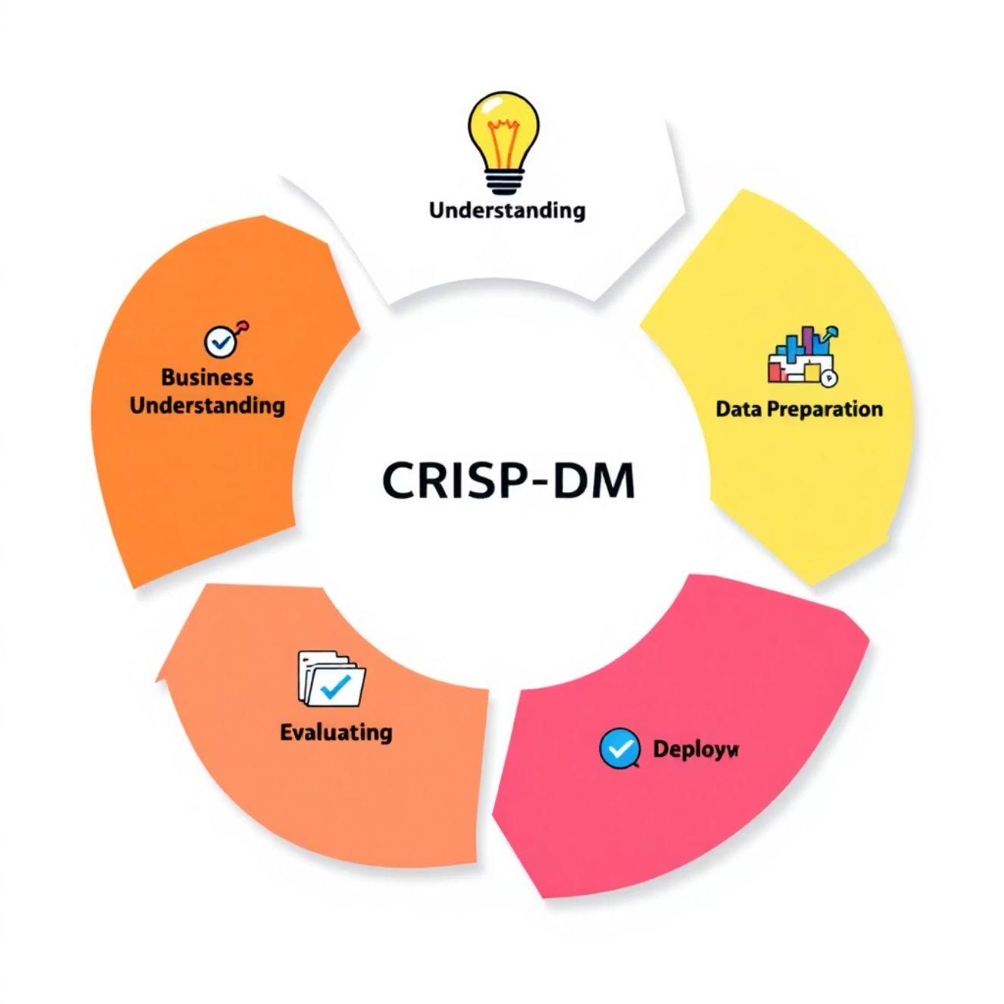
CRISP-DM Overview
Standard Methodology
Iterative Process
Proven framework for data mining and analytics projects across industries
Six interconnected phases ensuring structured, repeatable workflows
Business-Technical Bridge
Connects technical data work with clear business objectives and outcomes
CRISP-DM provides the foundation for modern data science projects, ensuring systematic approaches that deliver measurable business value.

Slide 3


Business Understanding
01
02
Define Project Objectives
Translate Business Problems
Establish clear project goals and key success criteria that align with organizational priorities
Convert business challenges into specific data mining goals and technical requirements
03
Identify Project Parameters
Document constraints, potential risks, and measurable success metrics
Example: "Reduce student inquiry response time by 30% within 6 months using predictive routing algorithms"

Slide 4


Data Understanding
Data Collection
Gather and integrate initial datasets from multiple sources and systems
Exploratory Analysis
Examine data characteristics, quality patterns, and structural relationships
Gap Assessment
Identify missing data, inconsistencies, and quality issues requiring attention
Initial Hypotheses
Develop early theories about potential drivers and outcome relationships
This phase establishes the foundation for all subsequent work by thoroughly understanding available data assets and their limitations.

Slide 5

Data Preparation
Feature Engineering Excellence
1
Data Cleaning
Handle missing values, remove outliers, and standardize formatting across datasets
2
Feature Engineering
Create meaningful variables (e.g., converting dates into age groups or seasonal indicators)
3
Encoding & Normalization
Transform categorical features and normalize numerical scales for model compatibility
4
Final Dataset
Produce clean, structured dataset ready for modeling and analysis

Slide 6





Modeling
Algorithm Selection
Choose appropriate techniques: classification, regression, clustering, or ensemble methods
Model Training
Train selected algorithms using the prepared dataset with proper validation splits
Hyperparameter Tuning
Optimize model parameters through systematic grid search or random search approaches
The modeling phase transforms prepared data into predictive insights through systematic algorithm selection and optimization.
Performance Comparison
Evaluate multiple models to identify the best performing candidate for deployment

Slide 7

Evaluation
1
Business Criteria Assessment
Measure model performance against original business success criteria and objectives
2
Technical Validation
Check for overfitting, bias detection, and ensure model interpretability for stakeholders
3
Stakeholder Review
Present findings to business stakeholders and validate results meet expectations
4
Deployment Decision
Determine readiness to move forward with production deployment or iterate further

Slide 8





Deployment
Integration
Delivery
Embed model outputs into operational systems and existing business workflows
Create reports, dashboards, or automated services for end-user consumption
Monitoring
Scalability
Establish ongoing performance tracking and schedule regular model updates
Ensure system maintainability, compliance requirements, and future growth capacity

Slide 9
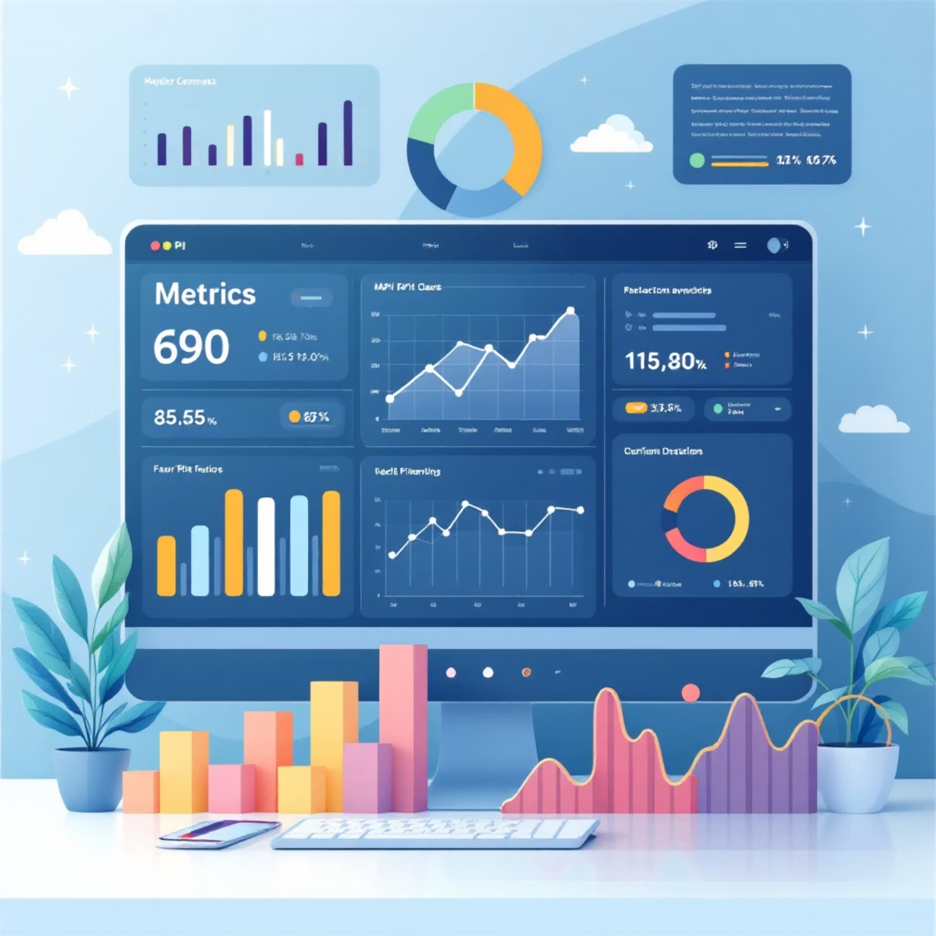
SMART KPIs Overview
Why SMART KPIs Matter
Key Performance Indicators must follow SMART principles to ensure meaningful progress tracking and accountability. Effective KPIs provide clear direction and measurable outcomes.
Measurable Progress
Track quantifiable improvements and organizational advancement
Strategic Alignment
Ensure initiatives directly support business priorities and goals

Slide 10










The SMART Framework
Measurable
Specific
Quantifiable metrics that allow progress tracking and performance assessment
Clear, well-defined objectives that eliminate ambiguity and provide focused direction
Achievable
Realistic goals within available resources, skills, and organizational constraints
Time-bound
Includes specific deadlines and timeframes for completion and milestone tracking
Relevant
Direct alignment with business priorities and strategic organizational objectives

