Slide 1

ProperTy-Hub
Jasmika Vemulapalli
Priyanka Shanker
Avinash Goli

Slide 2
Team details
https://codd.cs.gsu.edu/~jvemulapalli1/wp/Project/Pro4/homepage.html
In Codd server it is not working because of mysql database constraints and other bootstrap styles we imported doesn’t support in codd.

Slide 3
Statement of Problem & requirements
The Website let users to buy or sell the properties.
The users can register to add a listing or get details of a listing
User can pay with the card and that also validates whether the card has valid payments or not.
Admin can add, update or delete the existing properties.

Slide 4
Design & Methodology
Agile - is best suited for projects that are iterative and incremental. It’s a type of process where demands and solutions evolve through the collaborative effort of self-organizing and cross-functional teams and their customers.
We followed Agile methodology to implement our project and held meetings to finish the work based on our availability

Slide 5
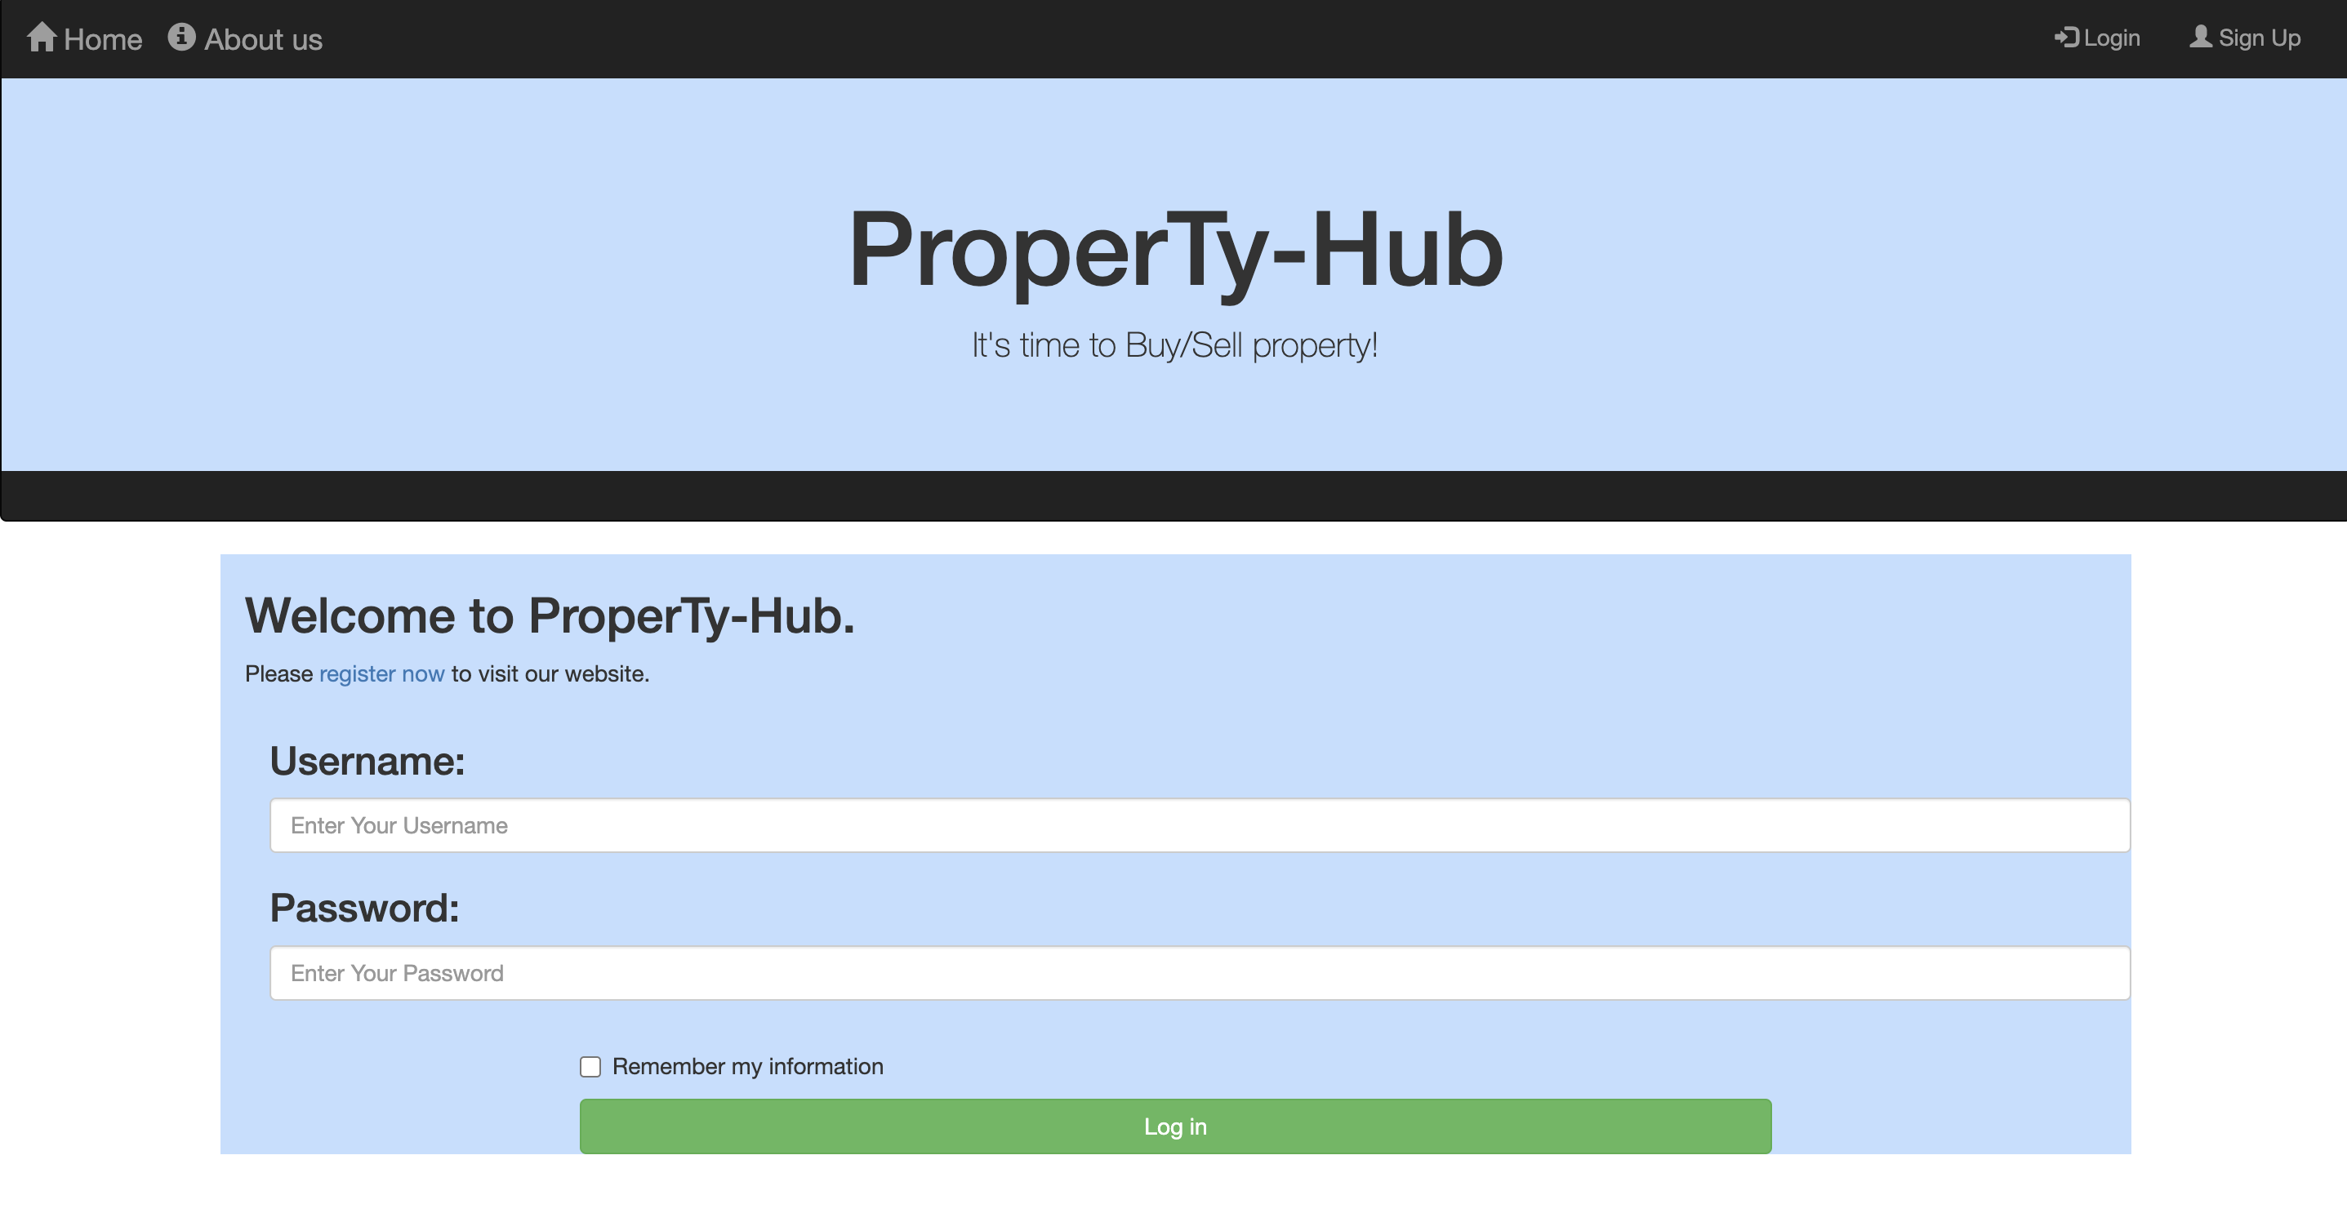
Login Page

Slide 6
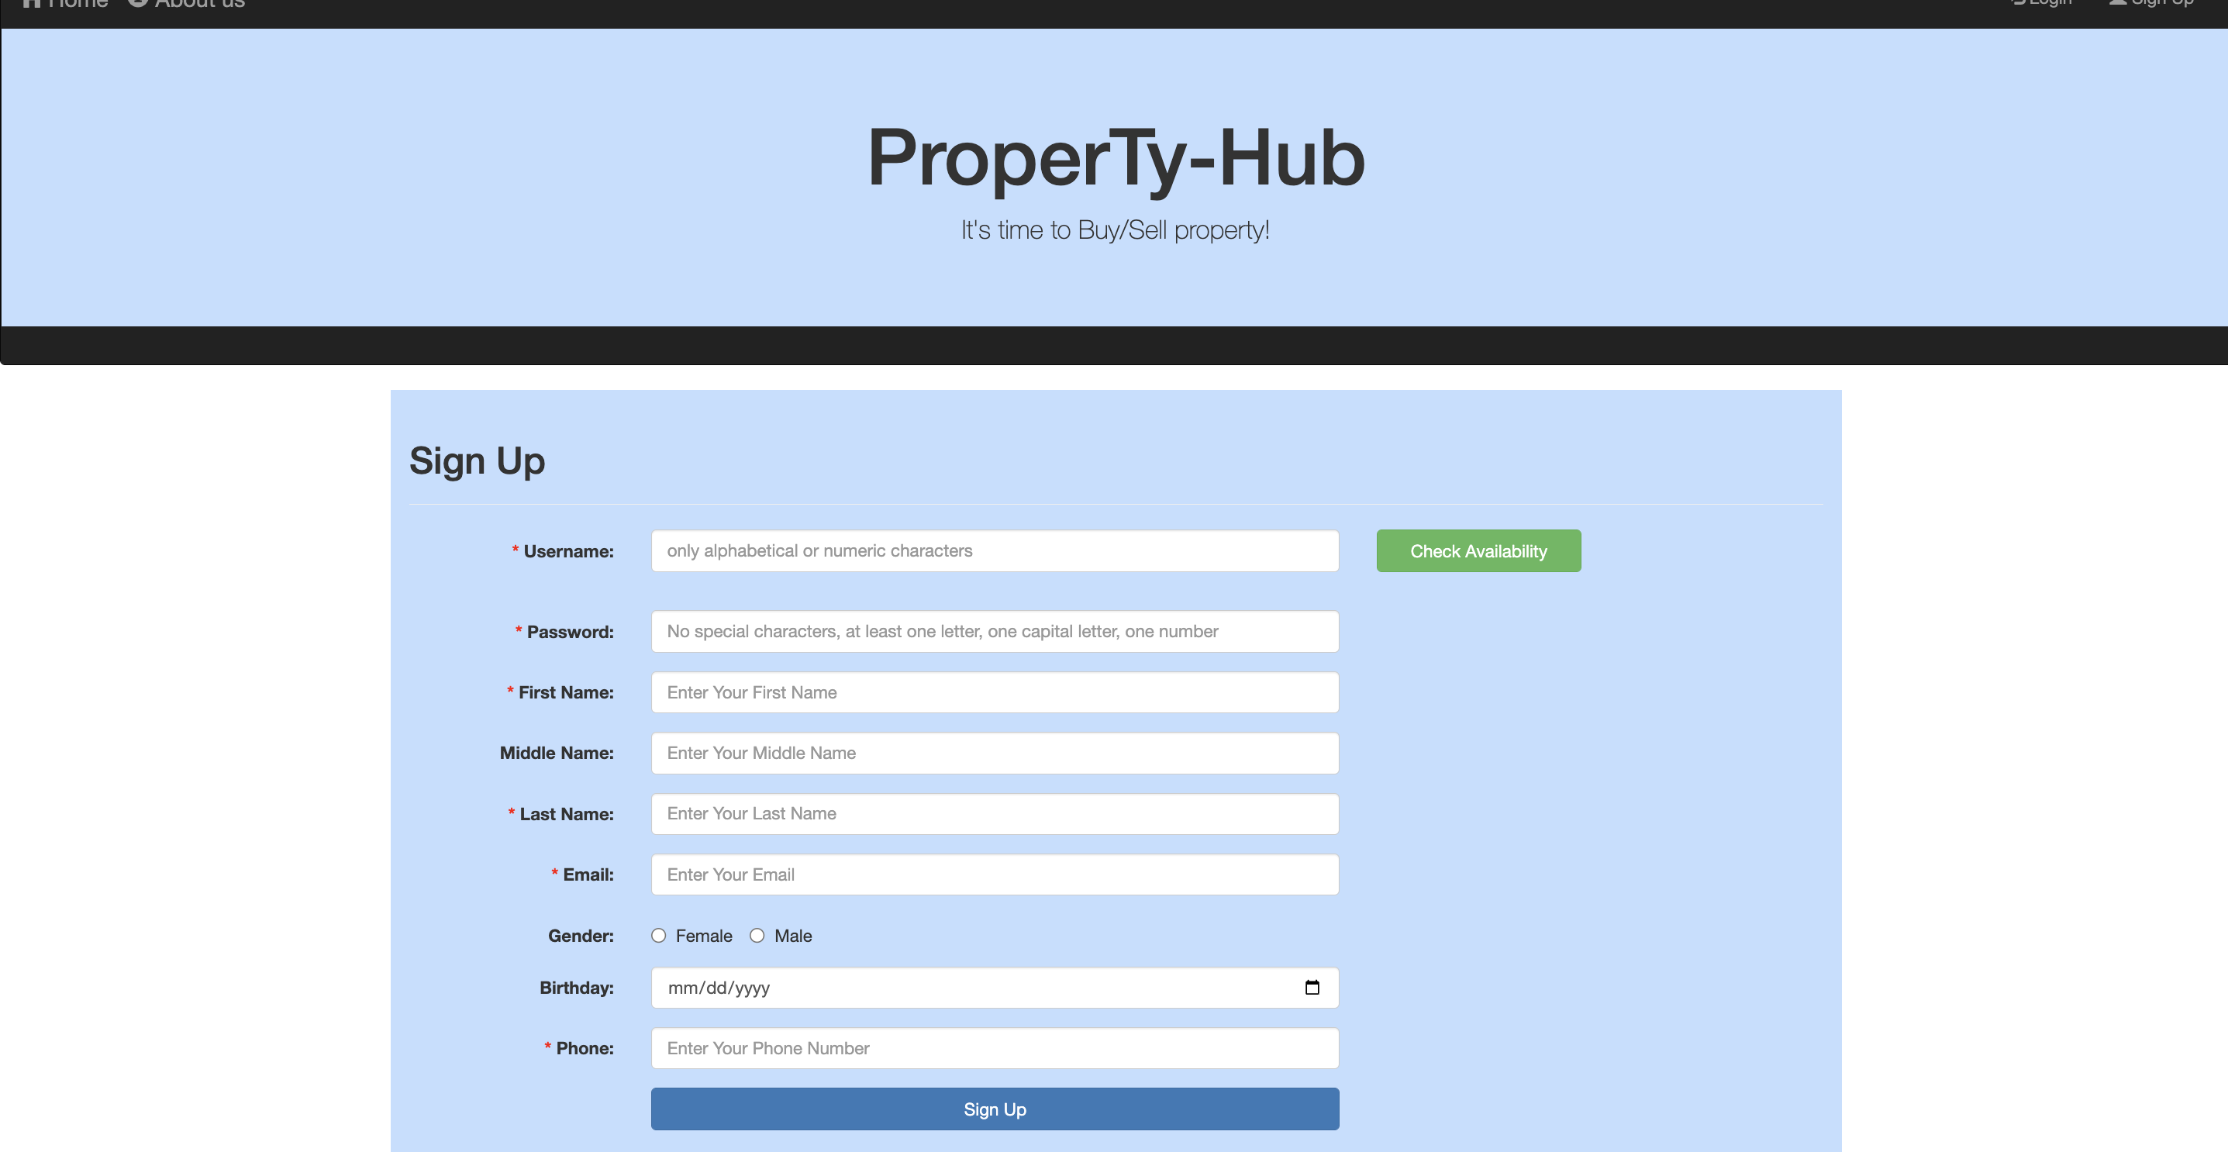
SignUp Page

Slide 7
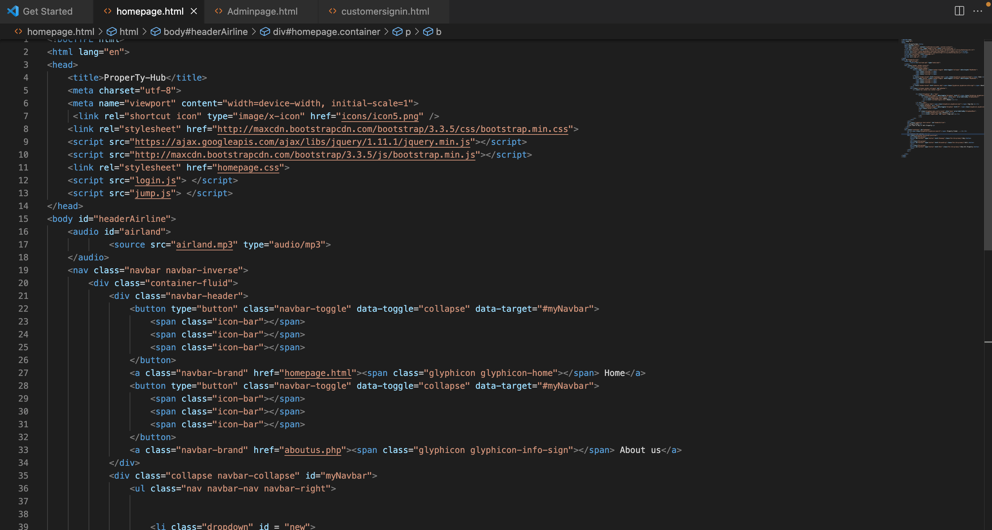
Pseudo Code

Slide 8
Testing
Chrome
Safari
Internet Explorer
Edge
Codd Server-not working

Slide 9

Thank you

