Slide 1


Department of Electronics and Communication Engineering
“Musical Source separation”
NAME | USN
Nandeesh Katakol | 02FE22BEC040
Priyanshu Porwal | 02FE22BEC056
Jamuna Pulpatli | 02FE22BEC032
Priyanka Budihal | 02FE22BEC054
Under the Guidance of
Prof/Dr.:SURESH MURGOD

Slide 2
INDEX
Sl.no | Content | Slide No.
1 | Problem Statement | 3
2 | Introduction | 4
3 | Literature review | 5
4 | Dataset | 8
5 | Block Diagram | 9
6 | Timeline of project | 10
7 | References | 11

Slide 3
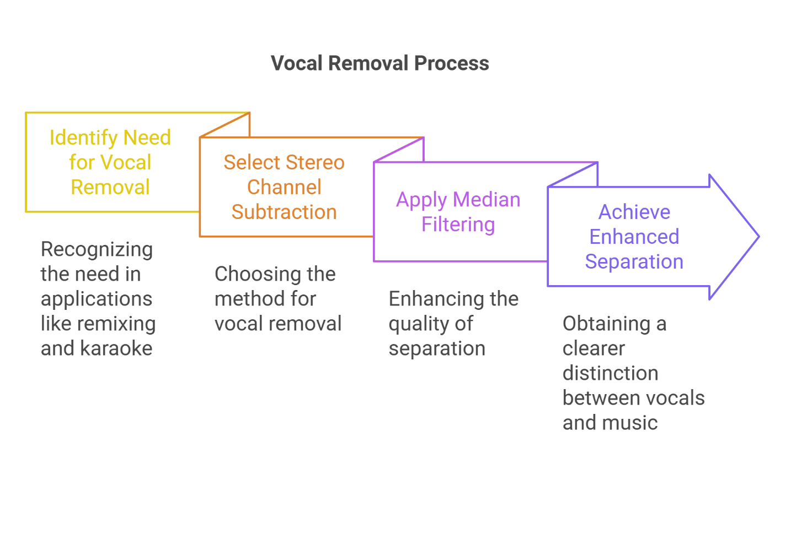
Problem Statement
To design a DSP based system that extracts vocals from an audio track. This approach aims to create an efficient and accessible method for vocal isolation suitable for real time applications such as karaoke , source separation etc.

Slide 4
Introduction
Vocal removal, or extracting vocals from music tracks, plays a vital role in applications like remixing, karaoke, and audio analysis. This process enables users to isolate vocals or background music, allowing flexibility in music production and research.
Conventional approaches relied on filters and frequency separation, which often struggled with intricate audio mixtures. However, stereo channel subtraction offers a simpler yet effective method by leveraging the natural differences between left and right channels in dual-channel audio.
In this approach, the difference between stereo channels is computed to suppress the centered vocal components while preserving the background music. Median filtering is then applied to enhance the separation quality further.
This DSP-based method avoids reliance on machine learning algorithms and focuses entirely on signal processing techniques, making it an efficient solution for vocal extraction and karaoke track creation. The approach is widely applicable in remixing, music production, and other audio engineering tasks

Slide 5
How it works?
1.Stereo Channel Subtraction
The input will be in the .wav format, if it is in MP3 format, we have a option to convert it to .wav format with a single button.
Stereo audio tracks typically have vocals placed at the center of the mix, while instruments and other elements are spread across the stereo field.
By subtracting the left channel from the right channel (or vice versa), the centered components, such as vocals, are significantly attenuated, leaving behind primarily the stereo elements of the background music.
2.Band-Stop IIR filter:
The bandstop IIR ((Infinite Impulse Response) filter suppresses frequencies within a specific band, such as the vocal range (300 Hz to 3000 Hz).
It attenuates unwanted frequencies while allowing other frequencies to pass through unaffected.
The filter is designed with a specified filter order to control the sharpness of the cutoff and improve vocal suppression.

Slide 6
3.Advantages of This Approach
No Machine Learning Dependency: This technique relies solely on signal processing principles, making it computationally efficient and suitable for standalone applications.
Real-Time Processing: The simplicity of the algorithm allows for near real-time processing of audio signals.
Wide Applicability: This method is effective for creating karaoke tracks, remixing songs, and other music production tasks.
4.Limitations
The method assumes vocals are perfectly centered, which may not be true for all audio tracks.
Some instruments or effects that are also centered in the stereo mix may get attenuated along with the vocals.
Highly complex audio mixtures may still leave residual artifacts after processing.

Slide 7
Filter Specifications:
The filter used is BandstopIIR filter of the order 4 and frequency range 300Hz to 3000Hz.
4th Order: Provides good attenuation without overly distorting the music. Higher orders (e.g., 8) might introduce unwanted phase artifacts.
Frequency range:
300 Hz is chosen because most male vocals start around 300 Hz.
3000 Hz is chosen to suppress harmonics and sibilance that can extend up to this frequency.
Frequencies below 300 Hz and above 3000 Hz are preserved to keep the instrumental and percussive elements intact.

Slide 8
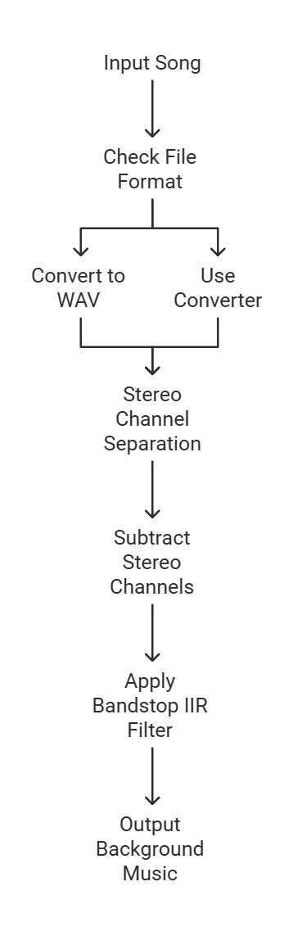
Block Diagram:

Slide 9
INPUT DATA:
1.The input data should be in the .wav format.
2.If the audio file is in Mp3 format , we can convert it to desired fie format using a single button.
3.The program will sample the Mp3 format then the MATLAB has a feature to convert it to any file format once it is sampled.
9

Slide 10
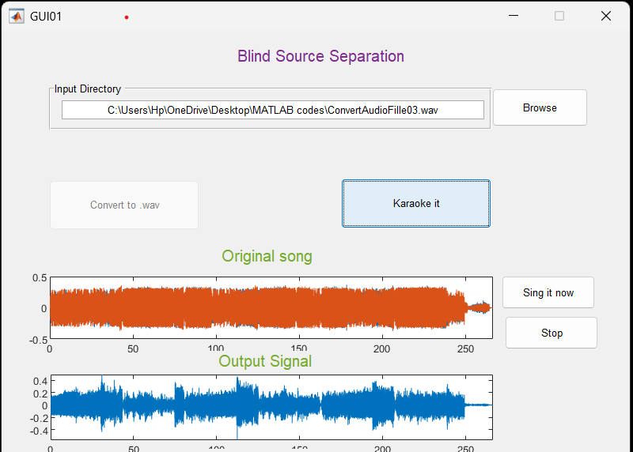
Results:
Signal Visualization
The audio signal before and after processing can be visualized to highlight the differences and demonstrate the effectiveness of the method.
The left and right channels, the resulting signal after subtraction, and the filtered output can be plotted to provide insights into the transformation of the audio signal.

Slide 11
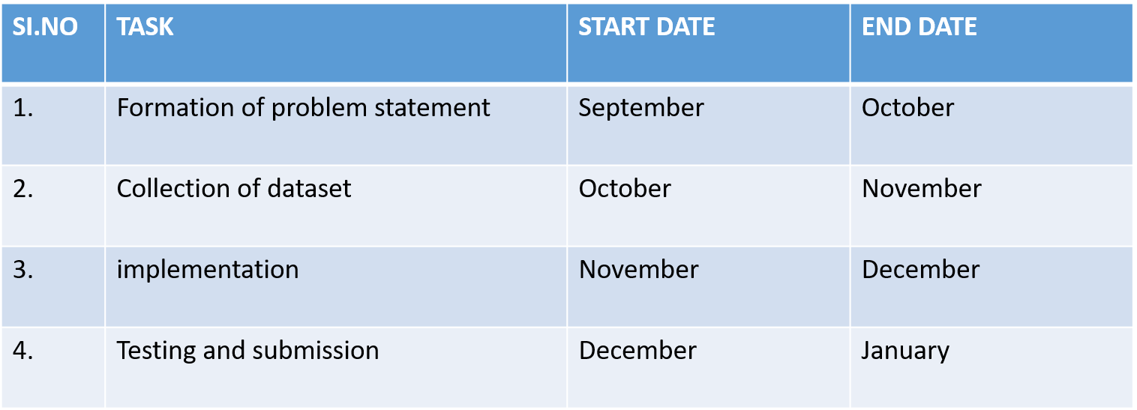
Timeline of project

Slide 12
Conclusion
This project demonstrates how DSP techniques can isolate vocals from audio tracks by focusing on harmonic features, without relying on machine learning.
The approach is useful for applications like remixing and music analysis and can be adapted for real-time use.
With further optimization, the system could handle more complex audio mixtures

Slide 13
References
I] S. Rieck, "Singing Voice Extraction from 2‐Channel Polyphonic Musical Recordings," Diploma, Institute of Electronic Music and Acoustics, Graz University of Technology, Graz, Austria, 2012.
II] W. Liu, S. Cao, and Y. Chen, “time–frequency analysis via empirical wavelet transform,” IEEE Geosci. Remote Sens. Lett., vol. 13, no. 1, pp. 28–32, Jan. 2016.
III]D. FitzGerald, E. Coyle, and M. Cranitch, “Using tensor factorisation models to separate drums from polyphonic music,” in Proc. Digital Audio Effects (DAFx-09), Como, Italy, 2009.
IV]G. Poliner, D. Ellis, A. Ehmann, E. Gomez, S. Streich, and ´ B. Ong. Melody transcription from music audio: approaches and evaluation. IEEE Trans. on ASLP, 14:1247–1256,

Slide 14
THANK YOU.

