Slide 1

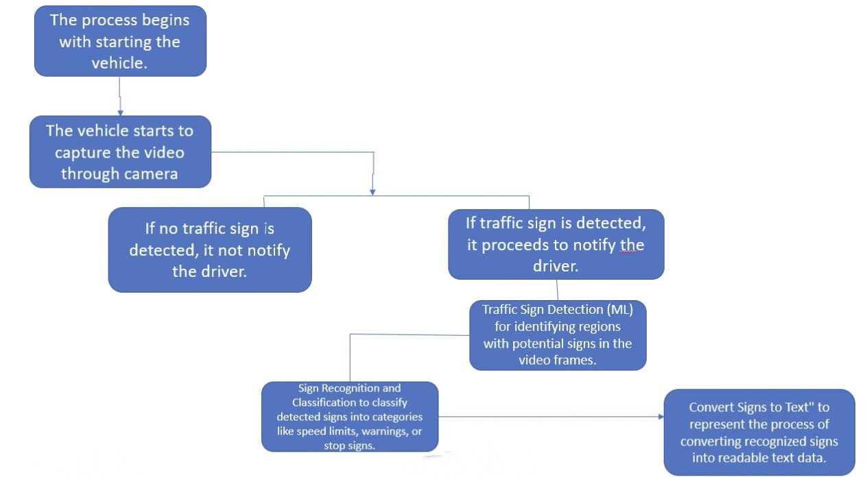
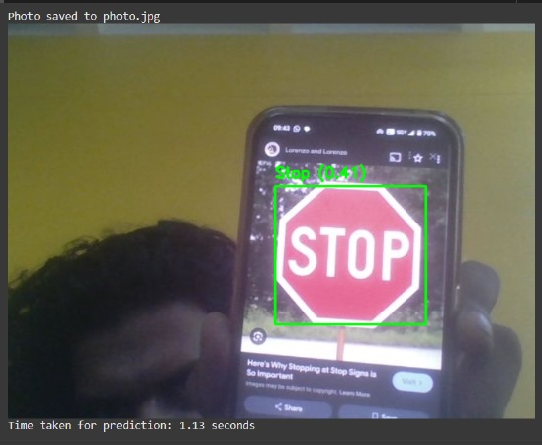
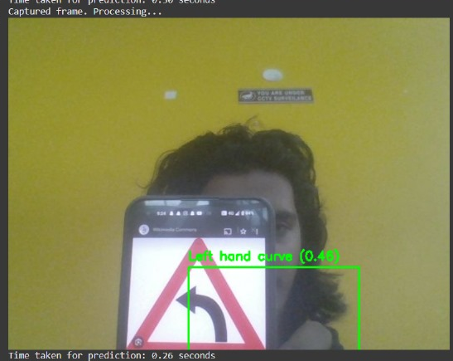
Traffic Sign Auto Assistant
Names of students: Nandeesh , Priyanshu , Priyanka , Jamuna
Under guidance of : Prof. Shridhar Iyer
Department of Electronics and Communication Engineering
Problem statement
Methodology
Input Image:
A road scene image containing traffic signs is directly fed into the model for analysis.
Feature Extraction & Detection:
The model processes the image to identify features and detects traffic signs, generating bounding boxes with confidence scores and class labels.
Filtering:
Detections with confidence scores below a set threshold are discarded, ensuring only the most likely results are retained.
Output:
The final output is an image annotated with bounding boxes and labels for the detected traffic signs
(e.g., "Speed Limit 60km/h")
Results
We aim to develop a smart system capable of detecting and interpreting road signs in real time, converting detected text into voice alerts using a compact machine learning model. The system is optimized for portable devices, enabling it to function independently on small, low-power hardware without the need for extensive computational resources.
Objectives
Real-time road sign detection, adaptable to large-scale road networks.
Reduction of false positives and improved classification accuracy for traffic signs.
Enhanced accuracy for distant signs and complex backgrounds in autonomous driving.
Accurate multi-class sign detection with minimized false positives.
Optimization details
Contributions
To optimize the traffic sign detection model, several improvements were made. The dataset was carefully curated and enhanced through data augmentation, ensuring the model could recognize signs in various conditions. The architecture was fine-tuned to balance accuracy and efficiency, reducing computational requirements while maintaining reliable detection.
Development of a real-time traffic sign detection system for improved road safety.
Enhancement of real-time processing capabilities for seamless driver assistance.
Contribution to the evolution of smart transportation systems and autonomous driving technologies.
Conclusions
Literature survey
The Traffic Rule Auto Assistance project effectively uses a laptop camera and machine learning to detect traffic signs and convert them into audio text, providing real-time guidance to drivers. This system enhances road safety and offers a practical solution for improving driver awareness. Future improvements can focus on optimizing accuracy and usability.
Automated traffic sign recognition systems enhance road safety and support intelligent transportation systems.
Recent advancements focus on improving detection speed, accuracy, and robustness in real-world conditions.
These systems are vital for developing autonomous vehicles and advanced driver-assistance technologies.
Mini Project-2024-25

